Slide 1
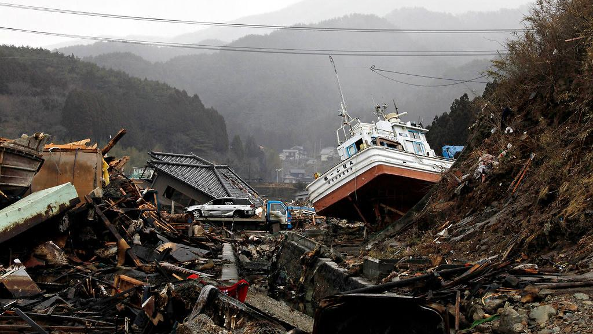
TRIPLE DISASTER OF TOHOKU EARTHQUAKE, TSUNAMI, AND FUKUSHIMA REACTOR FAILURE MARCH 2011
By: Amanda Park, Ashley Molina, Erica Galdamez, Leslie Lira, Zulia Linares
This Photo by Unknown Author is licensed under CC BY-NC

Slide 2
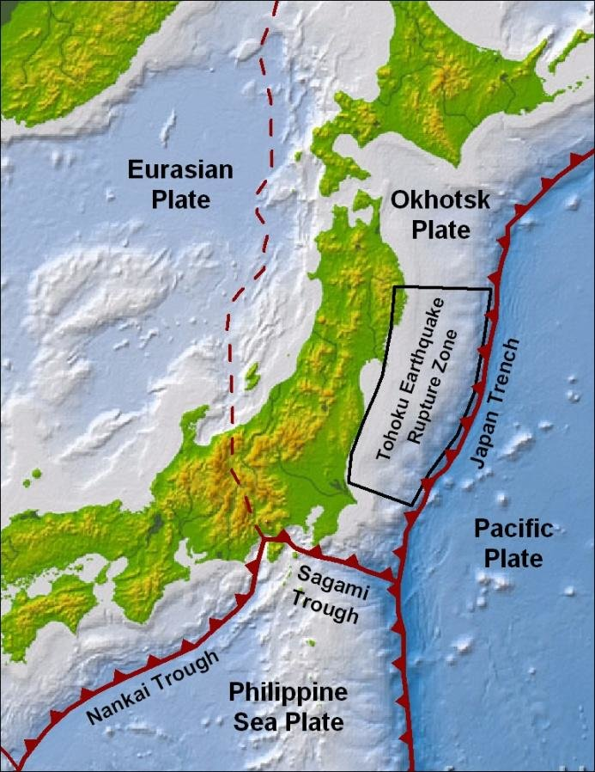
Geological Factors
Japan archipelago lies on the Pacific Ring of Fire
Pacific, Philippine, Eurasian (Amurian), and North American (Okhotsk) Plates Converge
Destructive Zone, Compressional Stress
Older, more dense oceanic plates are subducted beneath younger, lighter continental plates
Suffers 1/5 of the most powerful earthquakes recorded

Slide 3
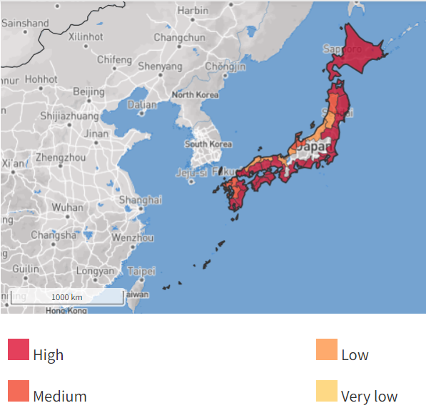
Geophysical Factors
Earthquakes generate over 80% of tsunamis
Long waves are created from a sudden massive displacement of water, typical of earthquakes below or near the ocean floor
18,480 miles of coastline in Japan, nearly all at high risk of tsunami hazard
500 mph, wavelengths hundreds of miles long, become hazardous as they approach land
As tsunamis reach land their speed and wavelength decrease increasing their amplitude and height (can be up to 30m)
Choropleth map of Japan identifying the different levels of tsunami risks of each coastal region (ThinkHazard, 2017)

Slide 4
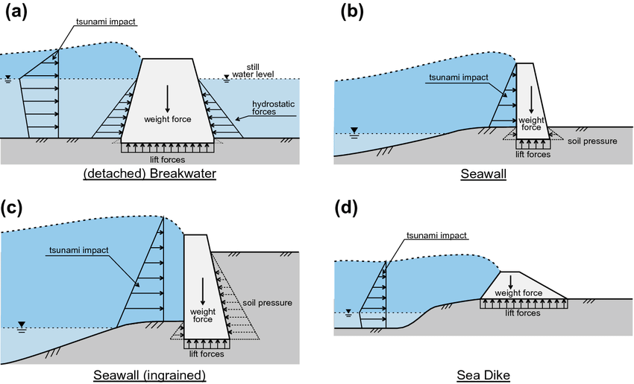
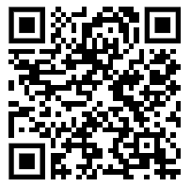
Risk & Hazard Mitigation 2011
Earthquake Early Warning (EEW)
‘Quake-resistant’ building construction
4.5-10m high seawalls and dykes
Breakwaters up to 63m depth
Vertical evacuation buildings
Disaster preparedness information

Slide 5
Risk & Hazard Mitigation 2011
Automatic power shut down once earthquake is detected
Grid & backup diesel generators to keep cooling system running
10m breakwater
Daiichi plant built 10m above sea level
Daini plant built 13m above sea level

Slide 6
11 March 2011, 2:46pm
15,899 deaths
2,527 missing, presumed dead
6,157 injuries
123,000 destroyed homes
$220 billion USD in destruction and damage

Slide 7
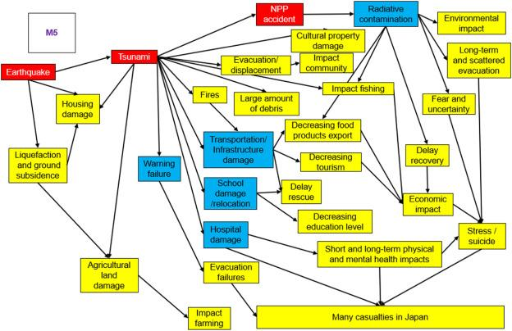
Cascading Events
Figure 3 A schematic process and cascading impacts of the 2011 Great East Japan Earthquake and Tsunami (Suppasri et al., 2021).

Slide 8
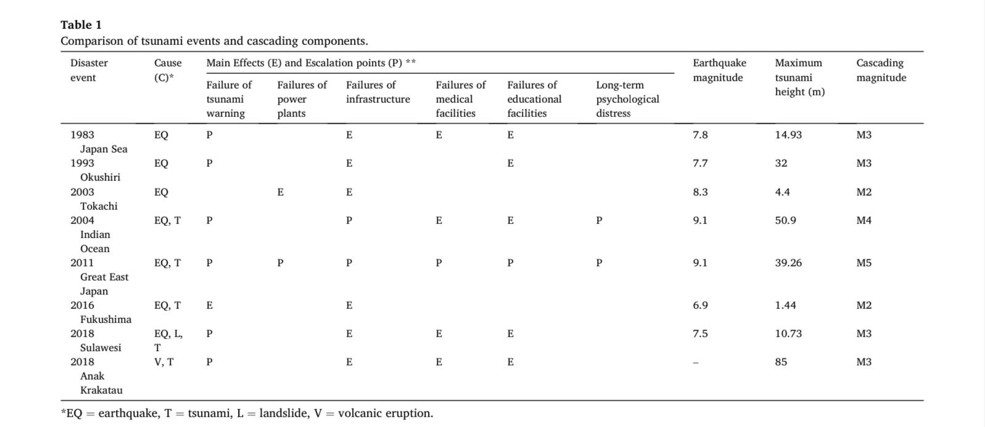
Cascading Events
Table 1 Comparison of tsunami events and cascading components (Suppasri et al., 2021)

Slide 9
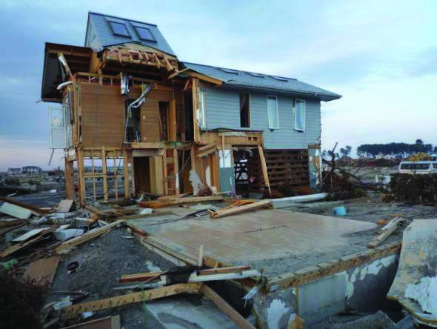
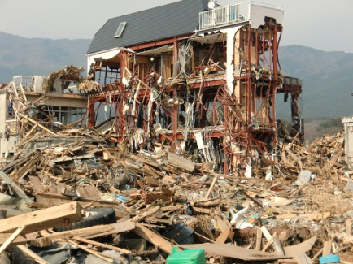
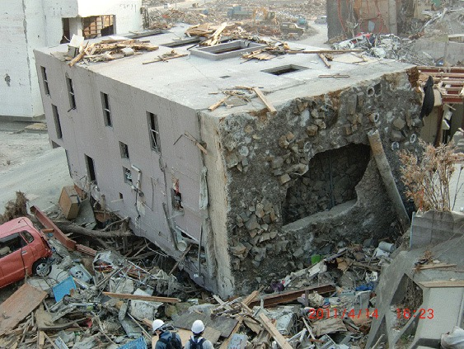
Architectural/Infrastructural Failures
(a) Overturned RC building (b) Damaged steel building (c) Wood building foundation
Major damage patterns of buildings

Slide 10
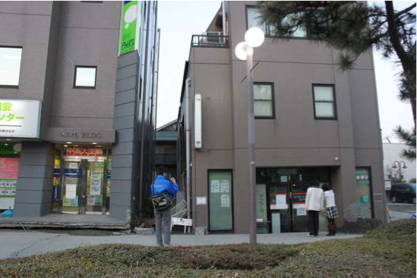
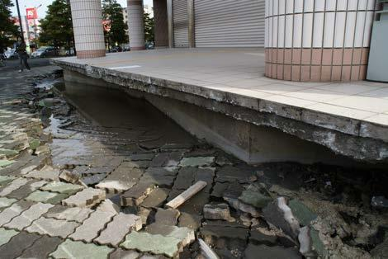
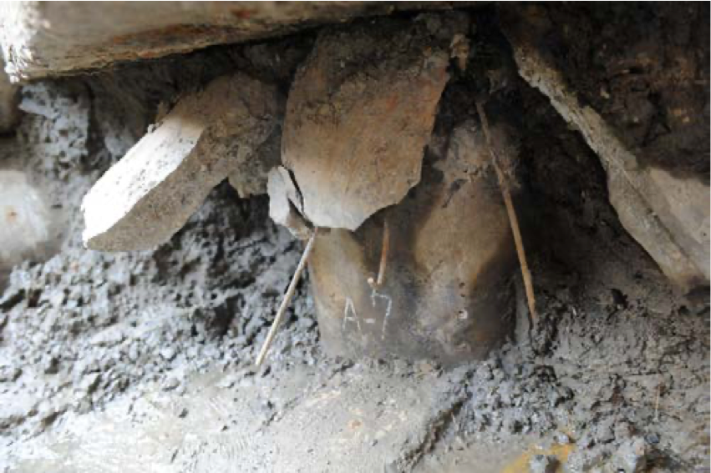
Architectural/Infrastructural Failures
Pile-supported building and settled building (Tokimatsu et al., 2011) Pile-supporting building suffering large settlement (Tokimatsu & Katsumata, 2012)
Damage to pile head

Slide 11
Architectural/Infrastructural Failures

Slide 12
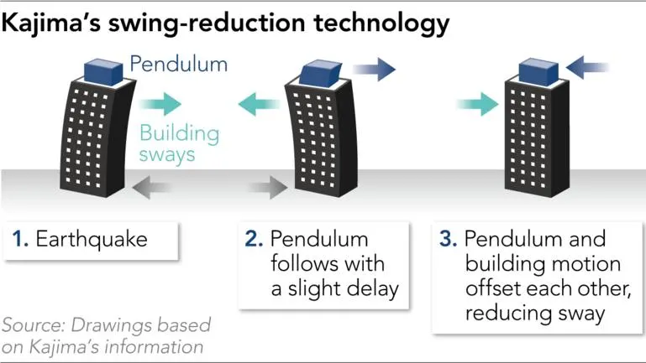
Architectural/Infrastructural Advancements

Slide 13
Architectural/Infrastructural Advancements

Slide 14
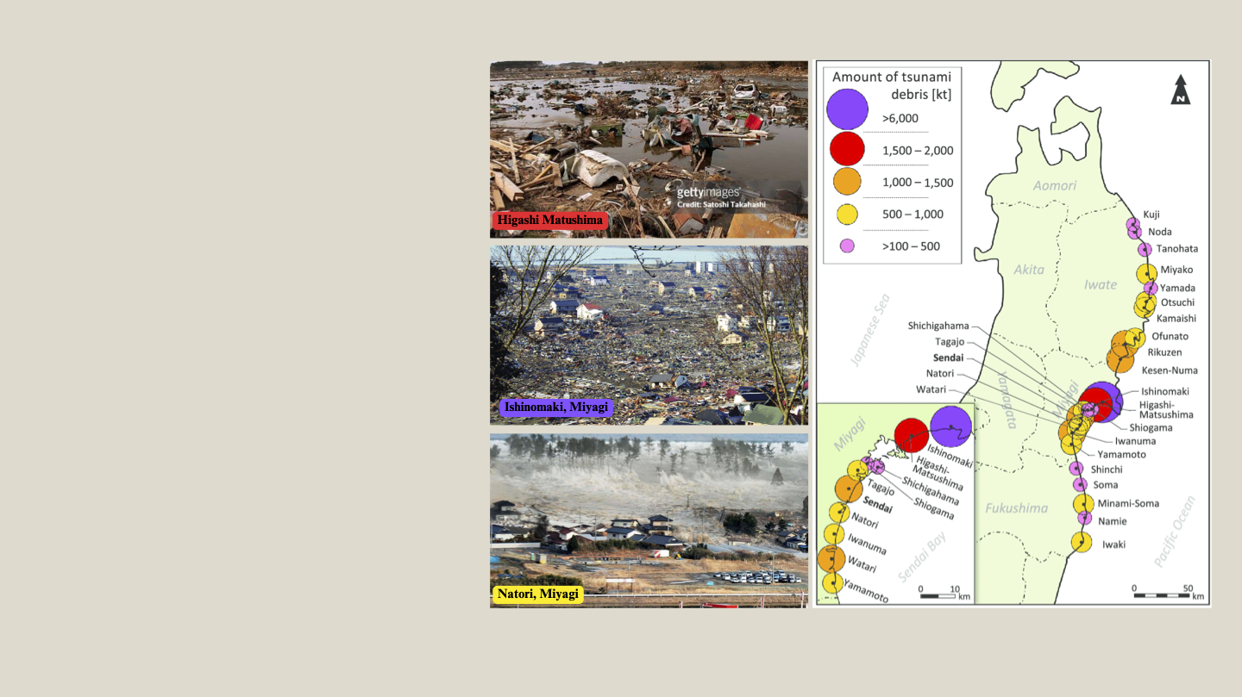
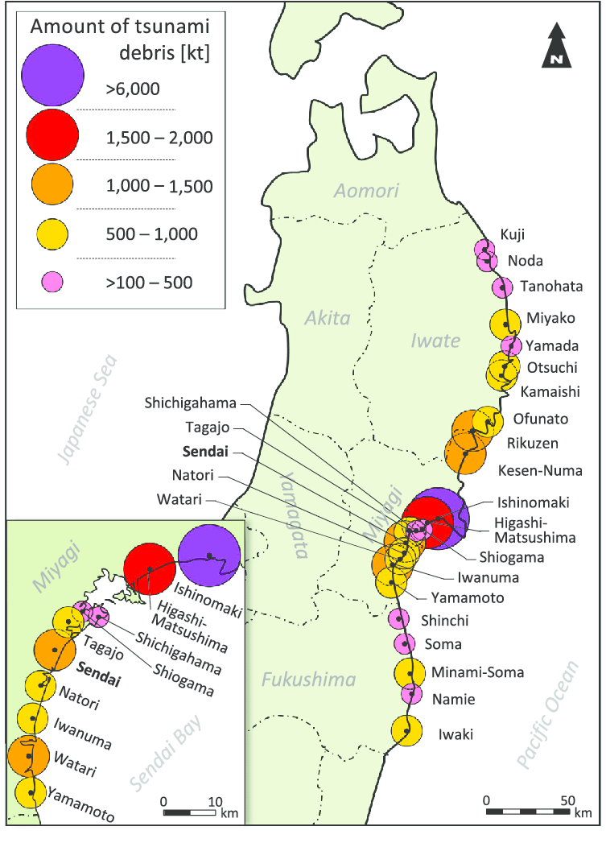
Social Vulnerability
Most casualties and vulnerability reside in coastal areas of Fukushima, Iwate & Miyagi prefectures.
Age is a significant determinant with 57% of total fatalities being individuals 65 years and older.
Child mortality is disaster, contrasting with previous events, accounted for only 4% of total death toll.
Historical context, ethno-cultural traits, minority status, immigration standing, age, gender, and education intensify vulnerability.
Fig. (4) Map of the Tohoku region in Northeastern Japan showing the amounts of tsunami debris in the most affected cities along the Pacific Coast.
Notes:
Impact on Vulnerability:
Civilian victims faced disruptions affecting physical conditions and social vulnerability.
Marginalized people of various nationalities (Filipinos, Chinese, Vietnamese, Koreans, Thais) affected.
Concept of Vulnerability:
Originated from early works on famine and food security in the eighties.
Significance in multidisciplinary thought as global disasters persist.
Encompasses external exposure, internal dimensions, and active roles in developing coping strategies.
Critical Factors in Social Vulnerability:
Historical context, ethno-cultural traits, minority status, immigration standing, age, gender, and education intensify vulnerability.
Marginalization of Thai Migrant Women:
Three dimensions: legal, social, and economic.
Victims of ethnic image perpetuated by international tourism industry.
Negative Perceptions and Marginalization:
Thai women face unfavorable perceptions tied to ethnicity and gender.
Marginalization exacerbated by international tourism sector.
Conclusion:
Vulnerability is a multidimensional concept influenced by historical, social, economic, and cultural factors.
Holistic understanding crucial for effective disaster resilience and migrant support strategies.

Slide 15
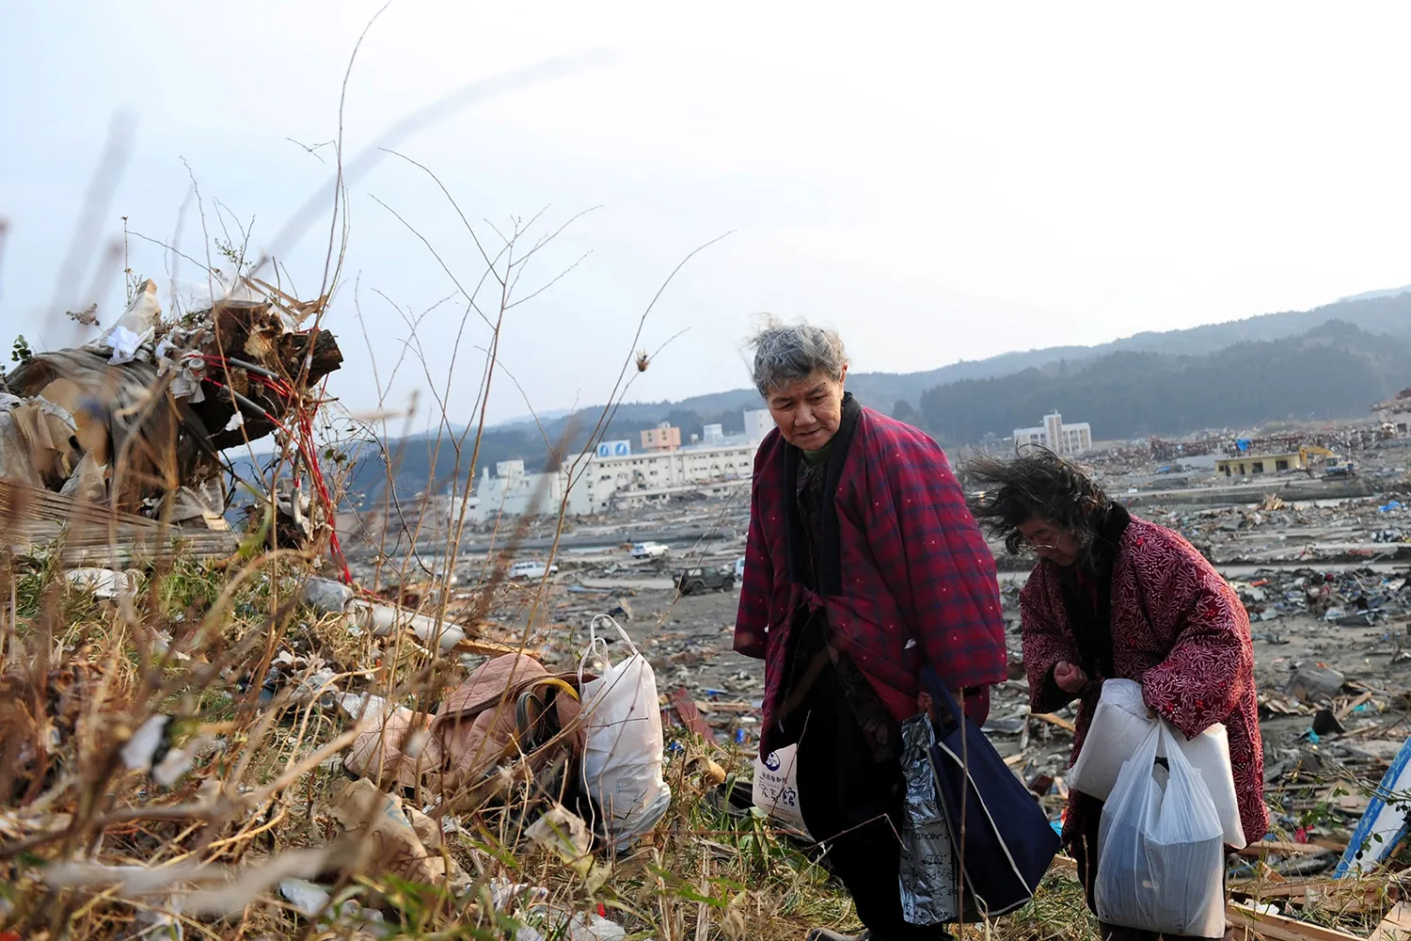
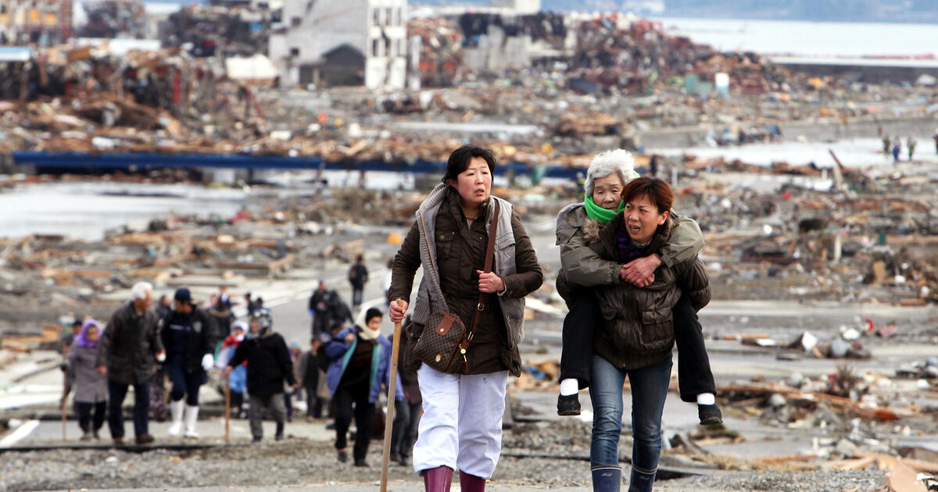
Social Vulnerability
Marginalized people of various nationalities: (Filipinos, Chinese, Vietnamese, Koreans, Thais) affected.
Marginalization of Thai Migrant Women:
Three dimensions: legal, social, and economic.
Victims of ethnic image perpetuated by international tourism industry.
Negative Perceptions and Marginalization:
Thai women face unfavorable perceptions tied to ethnicity and gender.
Marginalization exacerbated by international tourism sector.
Japanese communities faced the serious health risks due to environmental contamination with the radioactive release in the country and worldwide.
unhealthy conditions at temporary housing, waiting for permanent housing which are under construction.
Notes:
Impact on Vulnerability:
Civilian victims faced disruptions affecting physical conditions and social vulnerability.
Marginalized people of various nationalities (Filipinos, Chinese, Vietnamese, Koreans, Thais) affected.
Concept of Vulnerability:
Originated from early works on famine and food security in the eighties.
Significance in multidisciplinary thought as global disasters persist.
Encompasses external exposure, internal dimensions, and active roles in developing coping strategies.
Critical Factors in Social Vulnerability:
Historical context, ethno-cultural traits, minority status, immigration standing, age, gender, and education intensify vulnerability.
Marginalization of Thai Migrant Women:
Three dimensions: legal, social, and economic.
Victims of ethnic image perpetuated by international tourism industry.
Negative Perceptions and Marginalization:
Thai women face unfavorable perceptions tied to ethnicity and gender.
Marginalization exacerbated by international tourism sector.
Conclusion:
Vulnerability is a multidimensional concept influenced by historical, social, economic, and cultural factors.
Holistic understanding crucial for effective disaster resilience and migrant support strategies.

Slide 16
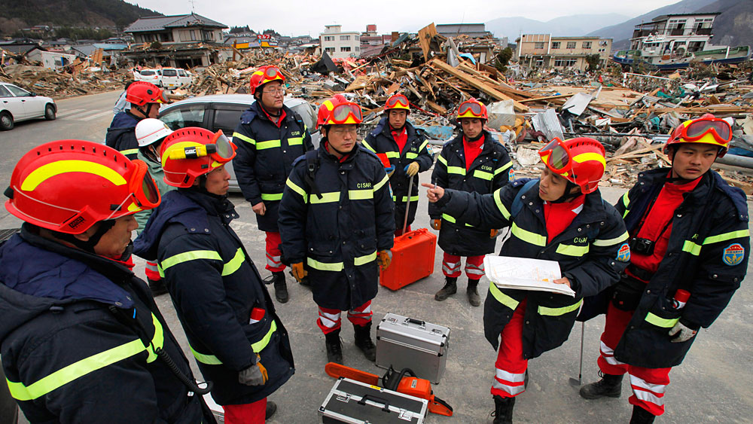
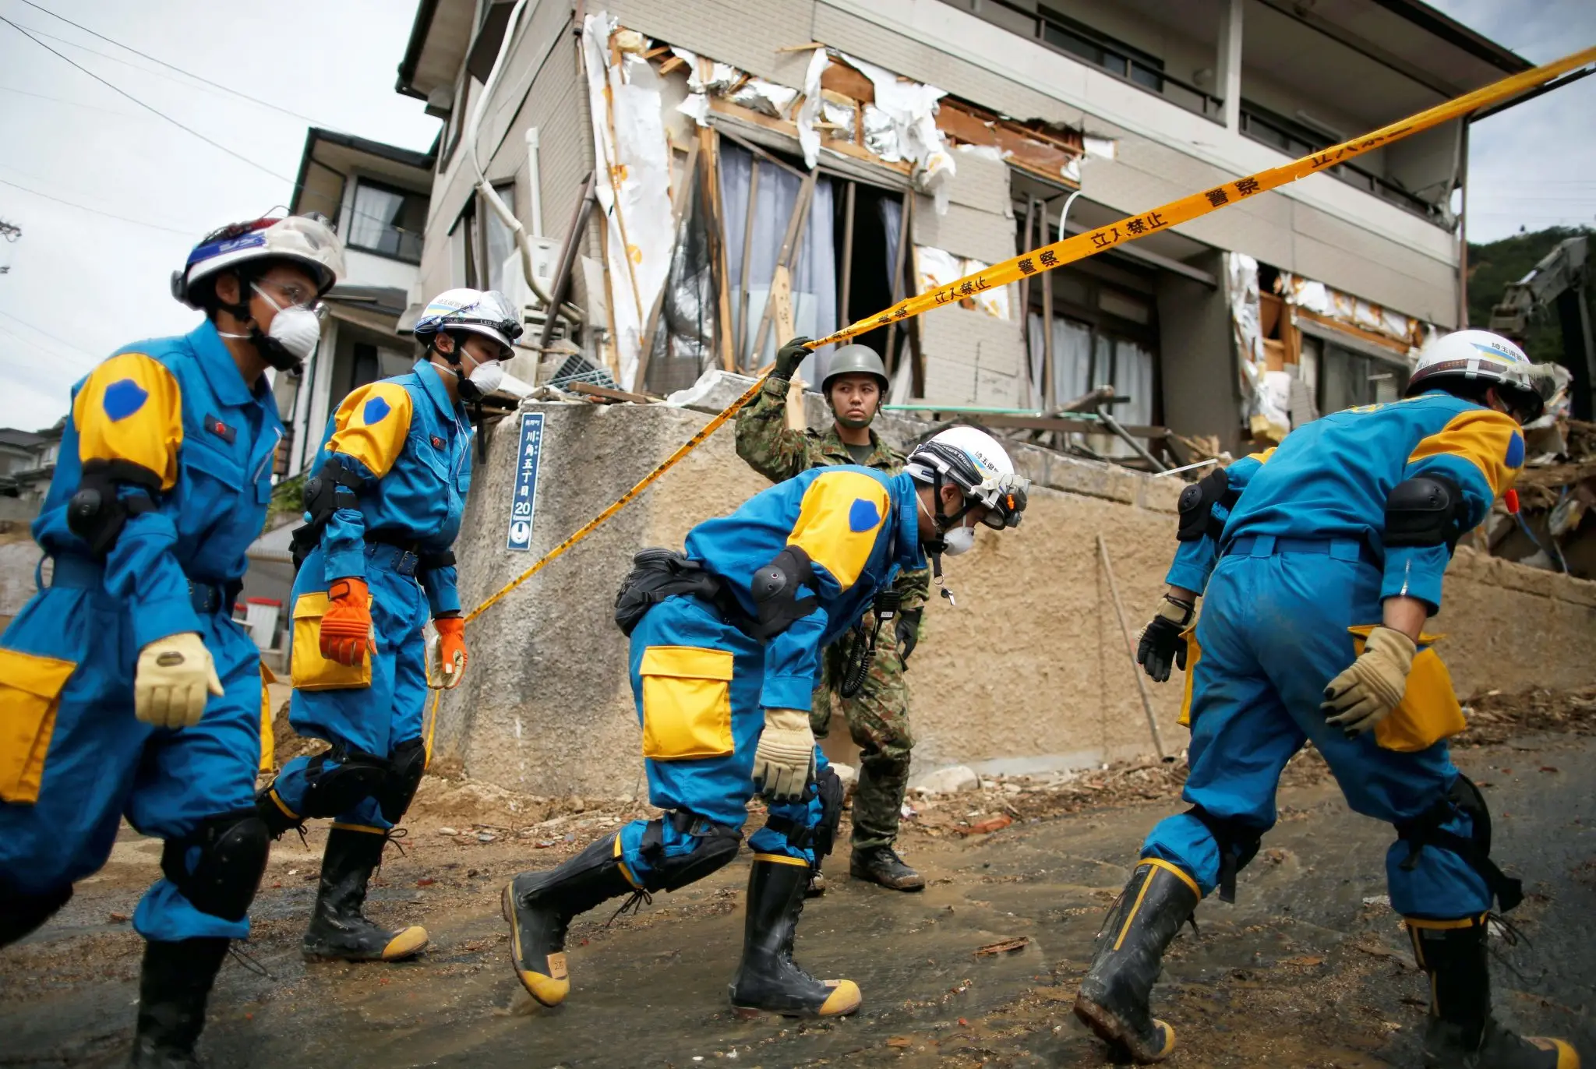
Social Resources
Disaster Headquarters
Local prefectures
Prime minister’s office
First Responders
Firefighters (FDMA)
Self-Defense Forces (SDF)
Government Action
National Police Agency
Ministry of Land, Infrastructure, Transport and Tourism (MLIT)
Coast Guard
United States Support
Operation Tomodachi

Slide 17
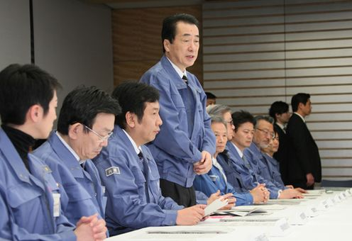
Emergency Management Flaws
Disorganization, especially in the first days following the disaster
Insufficient preparation
Lack of Unity of Effort
Disruption of communications and transportation
Reliance on Community Self-Help
“Team in Charge of Assisting the Lives of Disaster Victims” set up one week after disaster

Slide 18
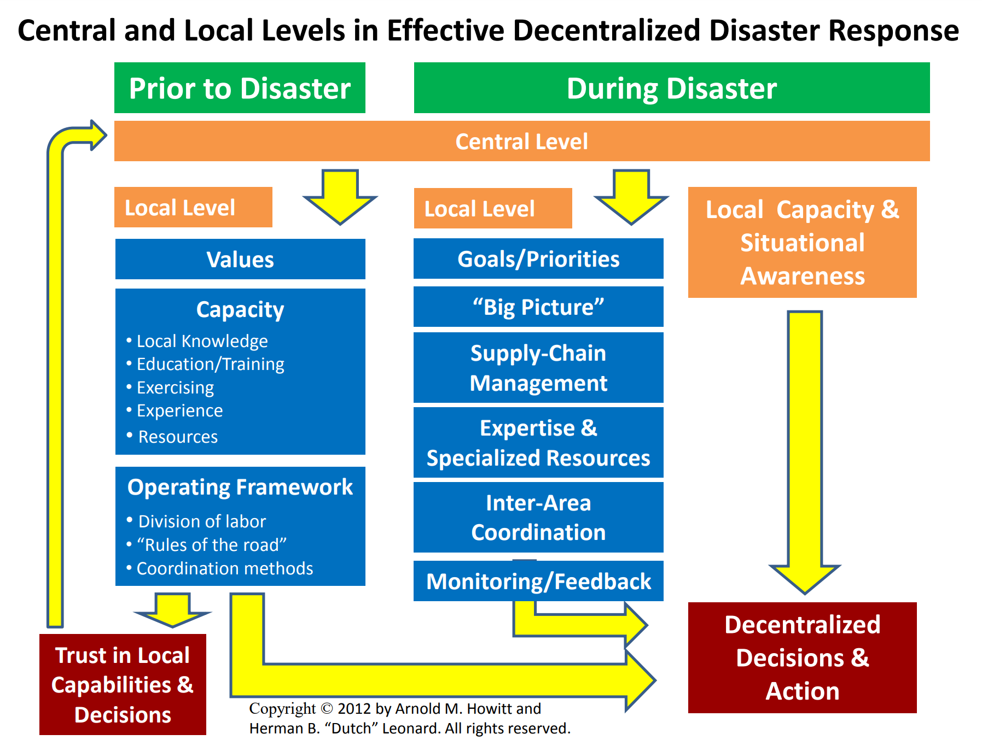
Future Recommendations

Slide 19
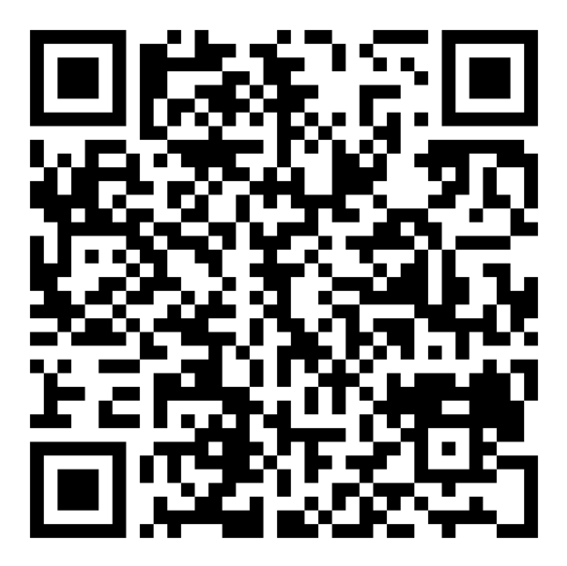
Thank You!

