Slide 1
Portuguese Bend Reserve
Adina Bakos, Godofredo Galsim, Vincent Ibarra, Ulysses Sandoval

Slide 2
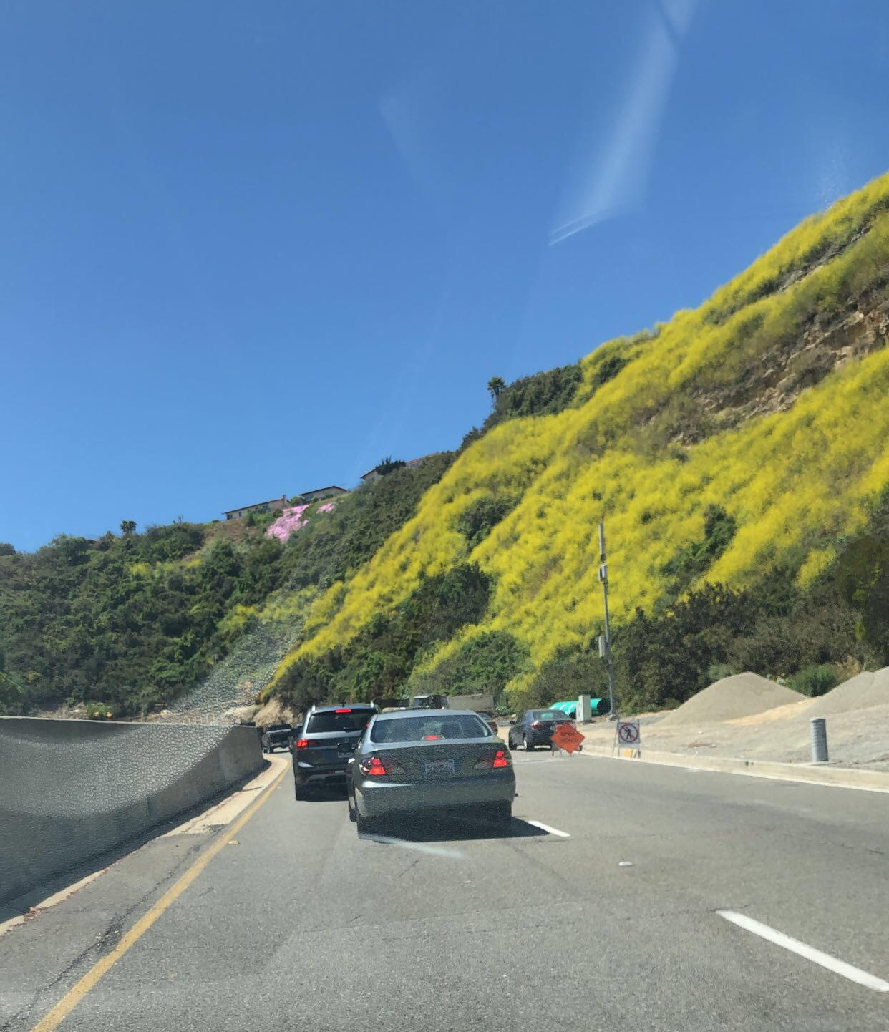
Introduction
Coastal Sage Scrub is a critically endangered habitat which faces threats of habitat fragmentation, development, and invasion from non-native grasses and forbs.
Portuguese Bend Reserve has seen extensive loss of CSS habitat and has faced multiple challenges in successful recovery.
These regions provide varying states of CSS health so the data provided by this project leads to a statistical analyses of the recovery of CSS,

Slide 3
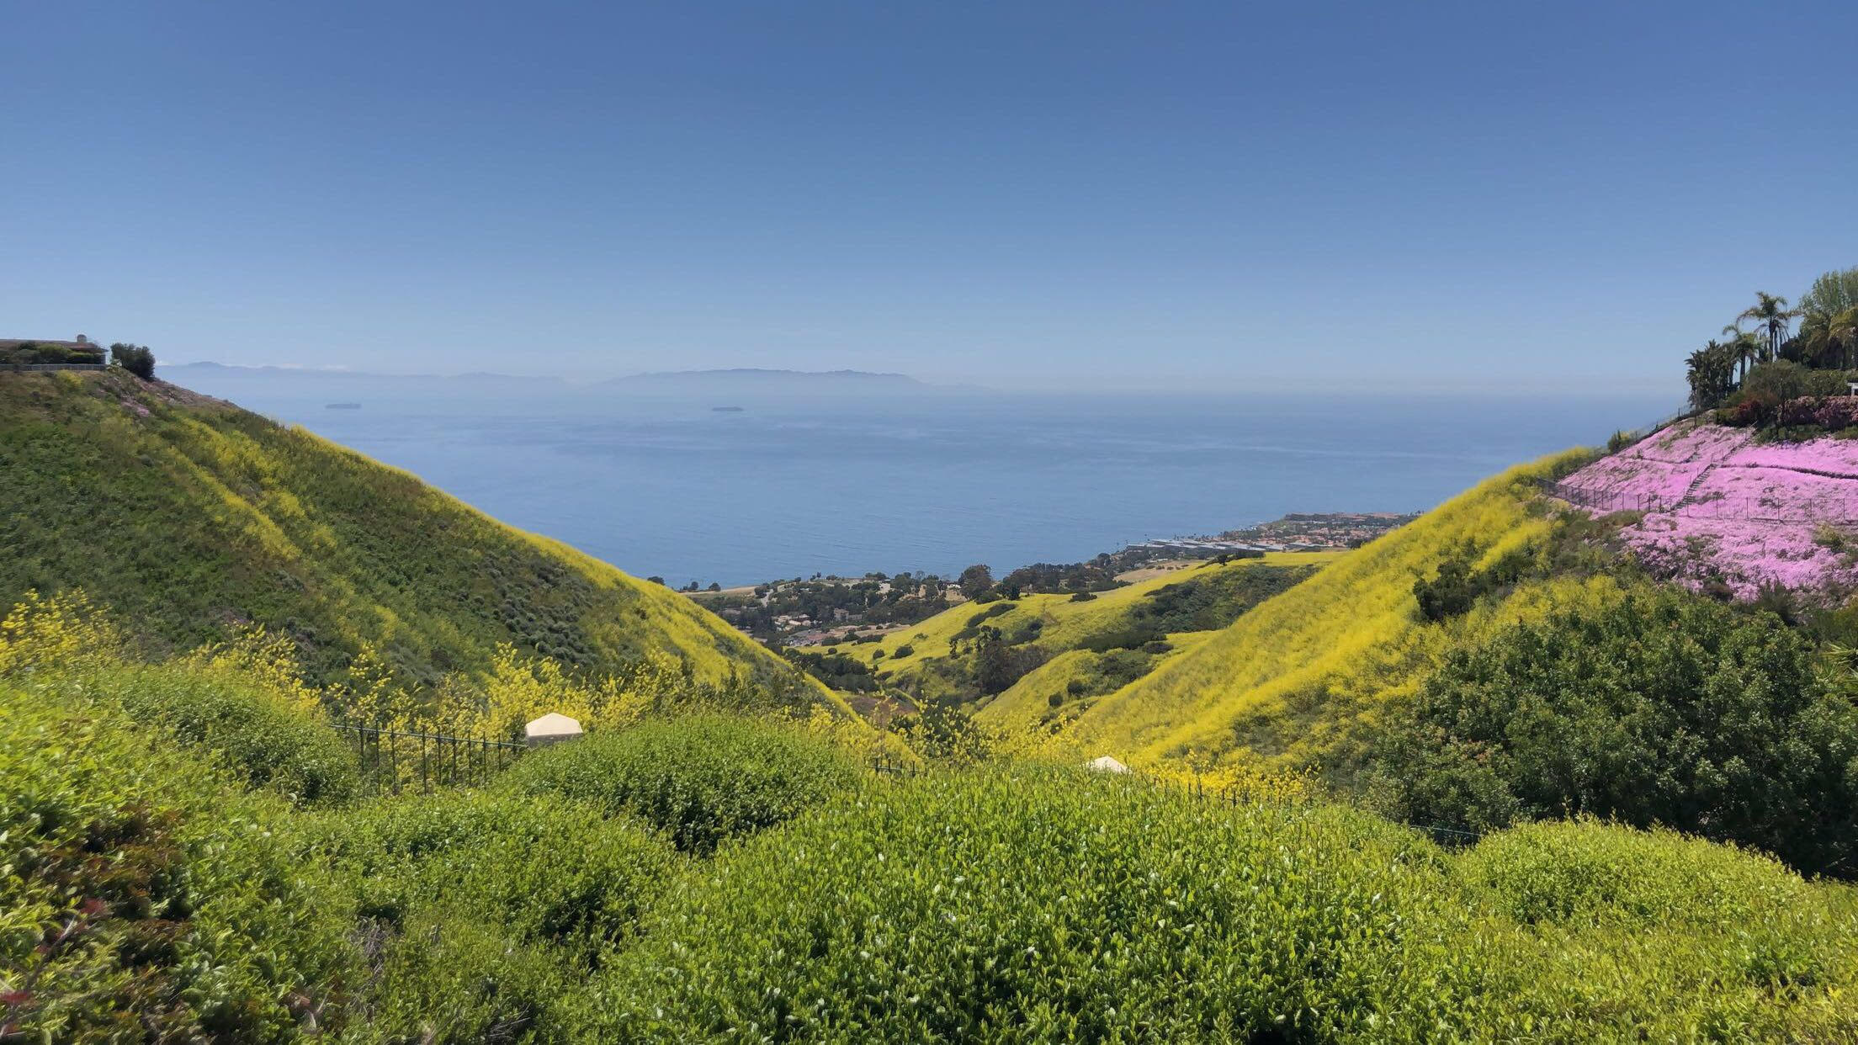

Slide 4
Hypotheses
Our Portuguese Bend Data vs Past Portuguese Bend Data
H₁:There is a significant seasonal difference between our data and previous data.
H₀ : There is no significant seasonal difference between our data and previous data.
Our Portuguese Bend Data vs Previous Forrestal Data
H₁:There is a significant difference between disturbed and undisturbed areas of CSS.
H₀ : There is no significant difference between disturbed and undisturbed areas of CSS.
Our Portuguese Bend Data vs Spring Forrestal East Data
H₁:There is a significant difference between disturbed and undisturbed areas in the same season of CSS.
H₀ : There is no significant difference between disturbed and undisturbed areas in the same season of CSS.

Slide 5
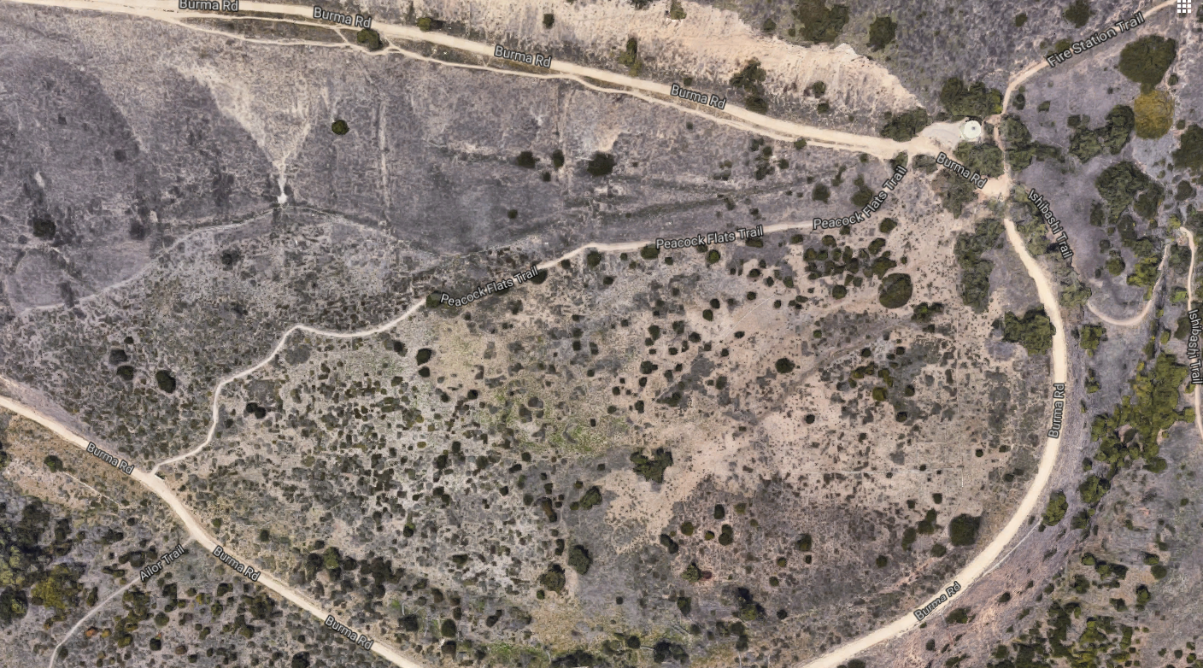

Slide 6
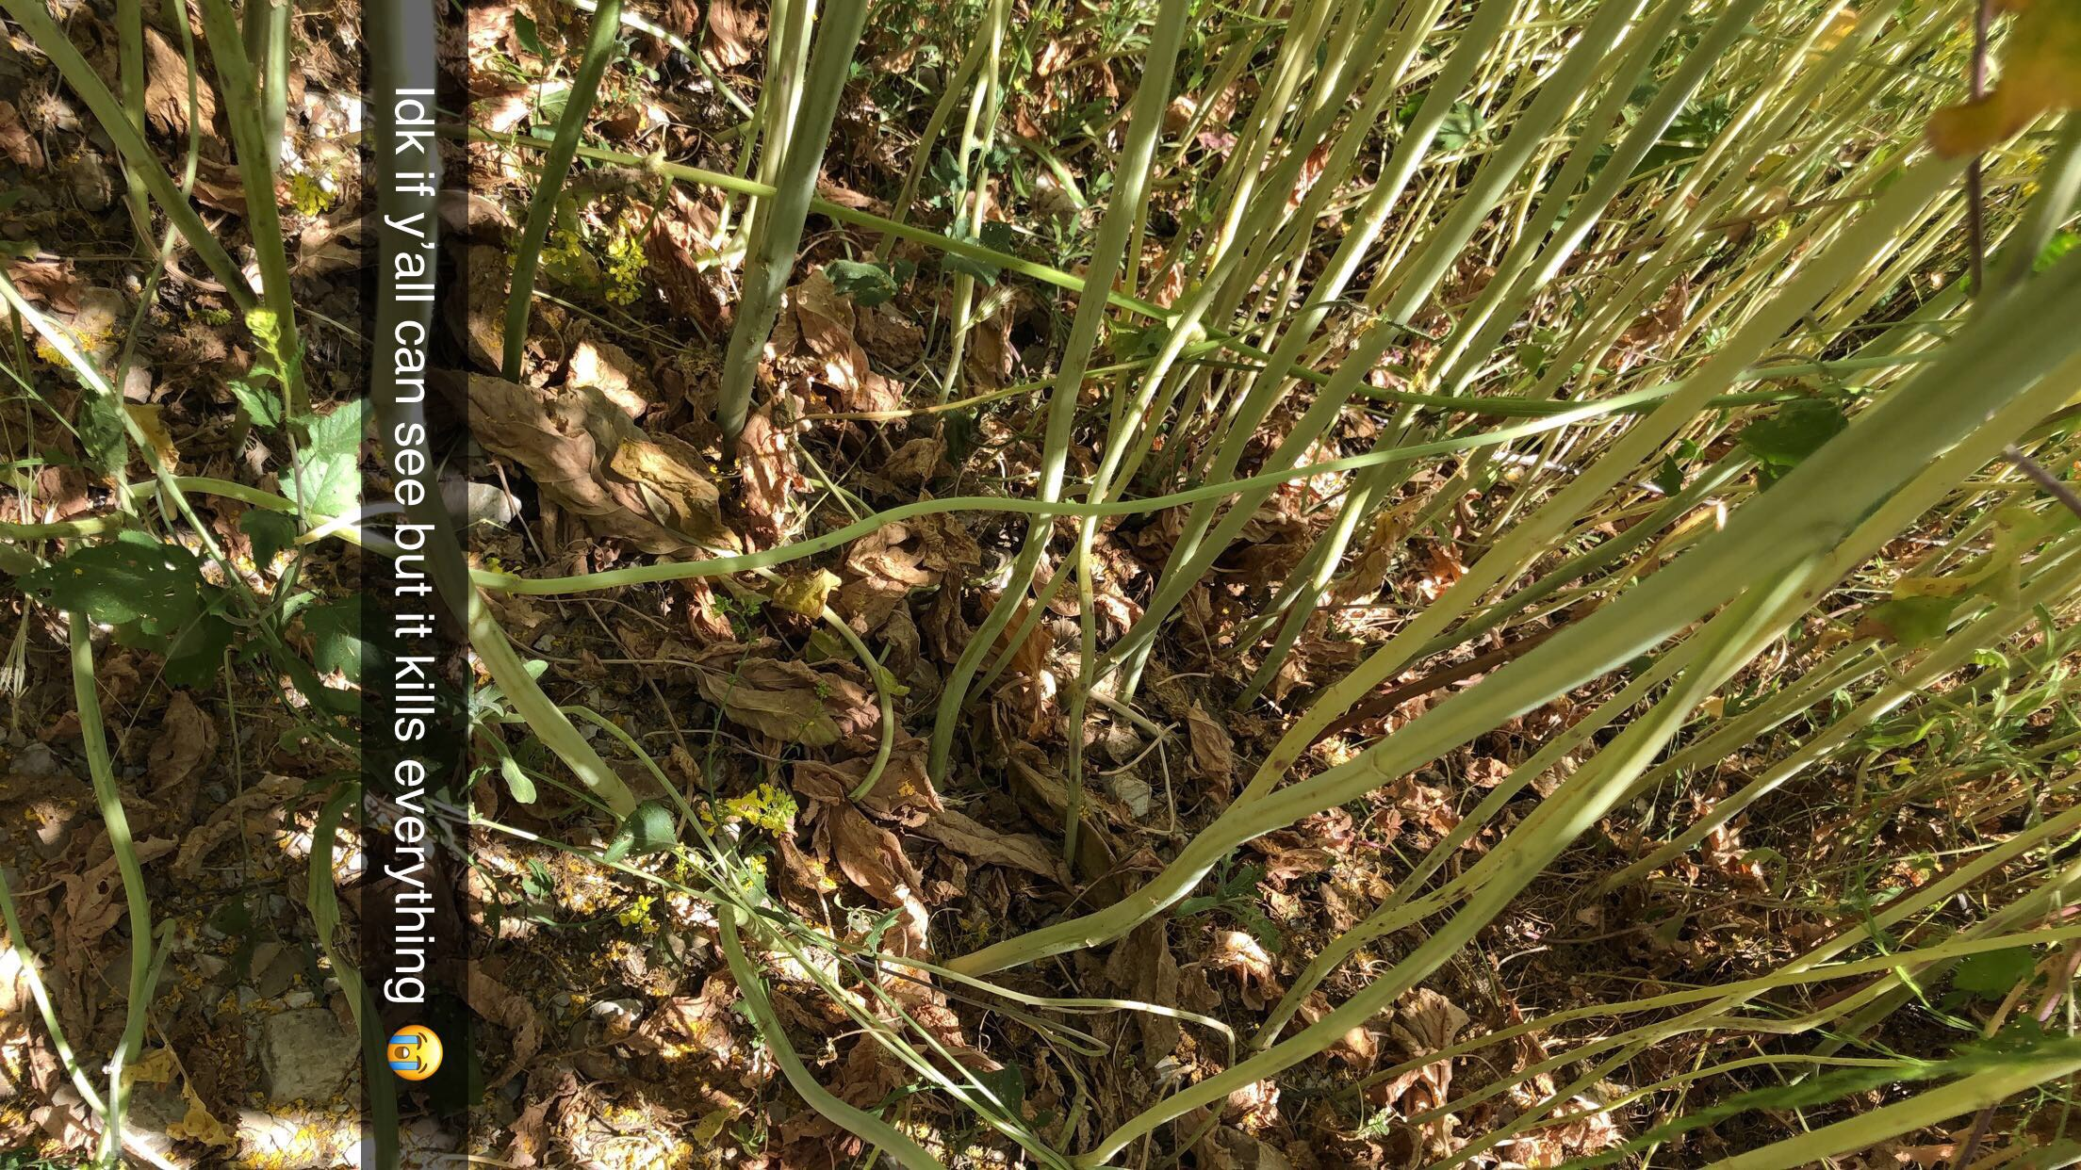

Slide 7
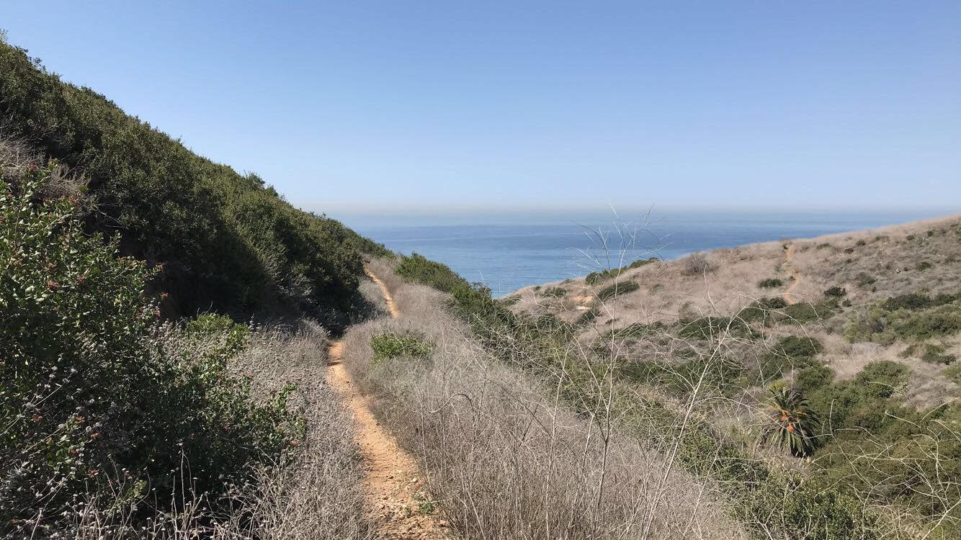
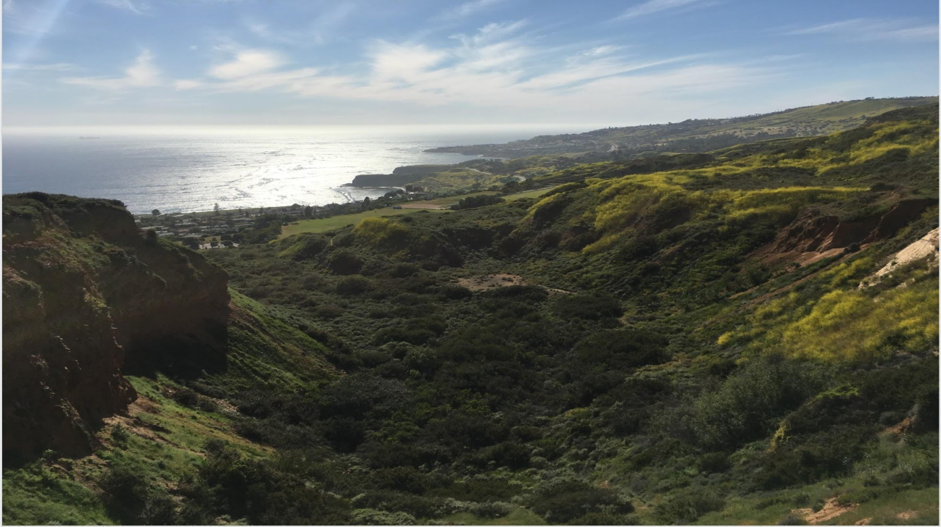
Forrestal Reserve
-Regarded as a curiously healthy region of CSS
- adjacent to Portuguese Bend which emphasizes contrast of health.
April 2018
April 2019

Slide 8
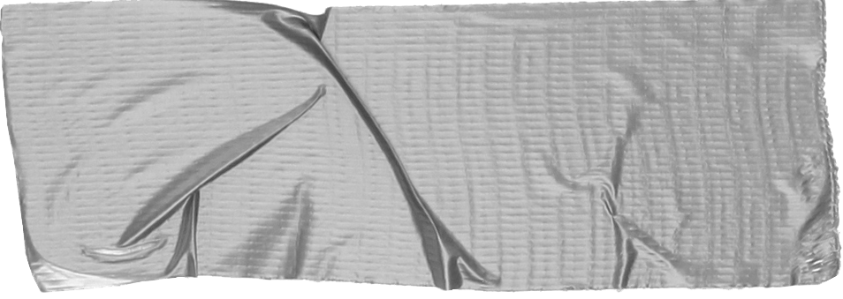
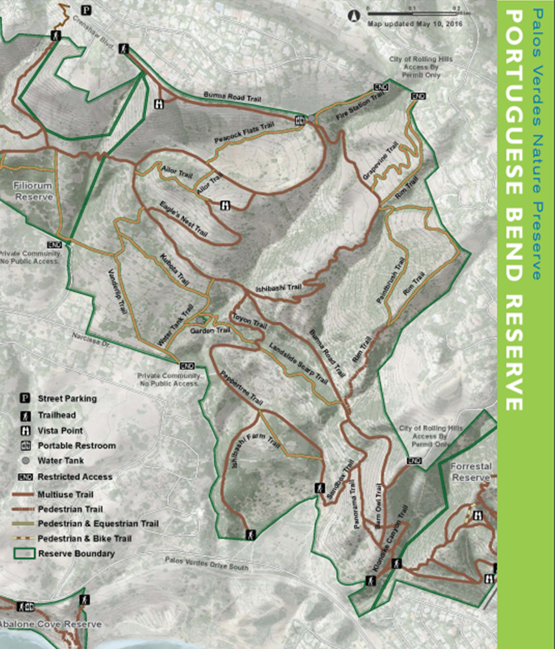
Data and Methods
We used transecting tape and two GPS units to take fifteen ten meter transects.
We gathered coordinate data at both ends of each transect.
We used Chi Square to calculate the significance of the data that we accumulated during our transecting.
We compared predecessor’s Portuguese Bend data to ours, as well as our data compared to predecessor’s Forrestal Reserve data. We also compared our Portuguese data to Spring 2019 Forrestal data.

Slide 9
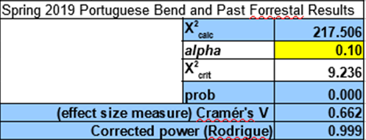
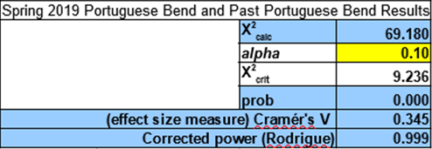
Results

Slide 10
Discussion
Portuguese Bend Spring 2019 data vs Past Portuguese Bend Data:
X² calc (69.180) > (9.236) X² crit (significance)
Seasonal difference at the same site.
Portuguese Bend Spring 2019 data vs Past Forrestal Data:
X² calc (217.506) > (9.236) X² crit (significance)
Significant difference between more pristine Forrestal versus the more disturbed Portuguese Bend
Portuguese Bend Spring 2019 data vs Spring 2019 Forrestal Data:
X² calc (20.472) > (9.236) X² crit (significance)
Significant difference between more pristine Forrestal versus the more disturbed Portuguese Bend in the same season.

Slide 11
Conclusion
Both Portuguese Bend and Forrestal Reserve exhibit seasonal changes in the dominant species -Significant variability between Fall and Spring
-Dominant species vary from year to year
-In Spring 2019, Brassica nigra dominated disturbed areas
Recommendations
Future classes should conduct more transects
Better for statistics
Emphasizes importance of this research
Gather seasonal changes in dominant species

