Slide 1
Portuguese Bend Transecting Project Spring 2019
“Lemonade Berry Forest”
By Cameron Mayer, Ellis Armendariz,Sam Wellsfry, Trevor Stangle

Slide 2
Introduction
Working Hypothesis: the data gathered in this study exhibits a significant difference when compared with the data gathered by predecessors in the Portuguese Bend “Lemonade Berry forest”.
Null Hypothesis: there is no significant difference between the data collected for this study and previously collected data.
Importance - Gives insight into species diversity in Palos Verdes Peninsula as well as native habitat integrity, or lack thereof.
Purpose - The collection and assessment of field data involving species frequency counts for comparison with data collected by predecessors.

Slide 3
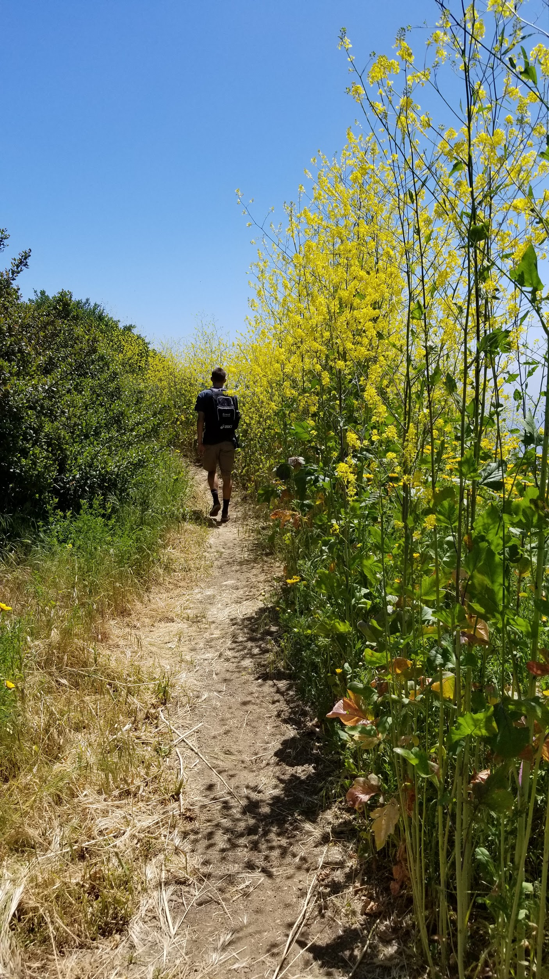
Data and Methods
20 meter transects (9 total)
Paintbrush Trail: 4
Ishibashi Trail: 3
Rim Trail (informal): 2
Mostly parallel transects, 2 at right angles to the trail
Chi- Square statistical analysis performed on data gathered.

Slide 4
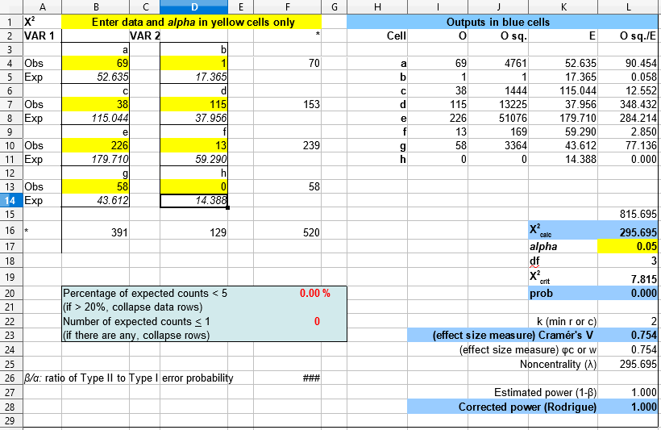
Results
When analyzing the data between Lemonade berry forest in Spring 2019 and Lemonade berry forest in the Summer of 2009 we got a chi squared calculated of 295.695 which is larger than the chi squared critical of 7.815. We got a p-value of 0 which is less than the alpha standard 0.05 meaning we can reject the null hypothesis. We also got an effect size of 0.754 and a power of 1.000 .

Slide 5
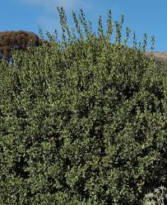
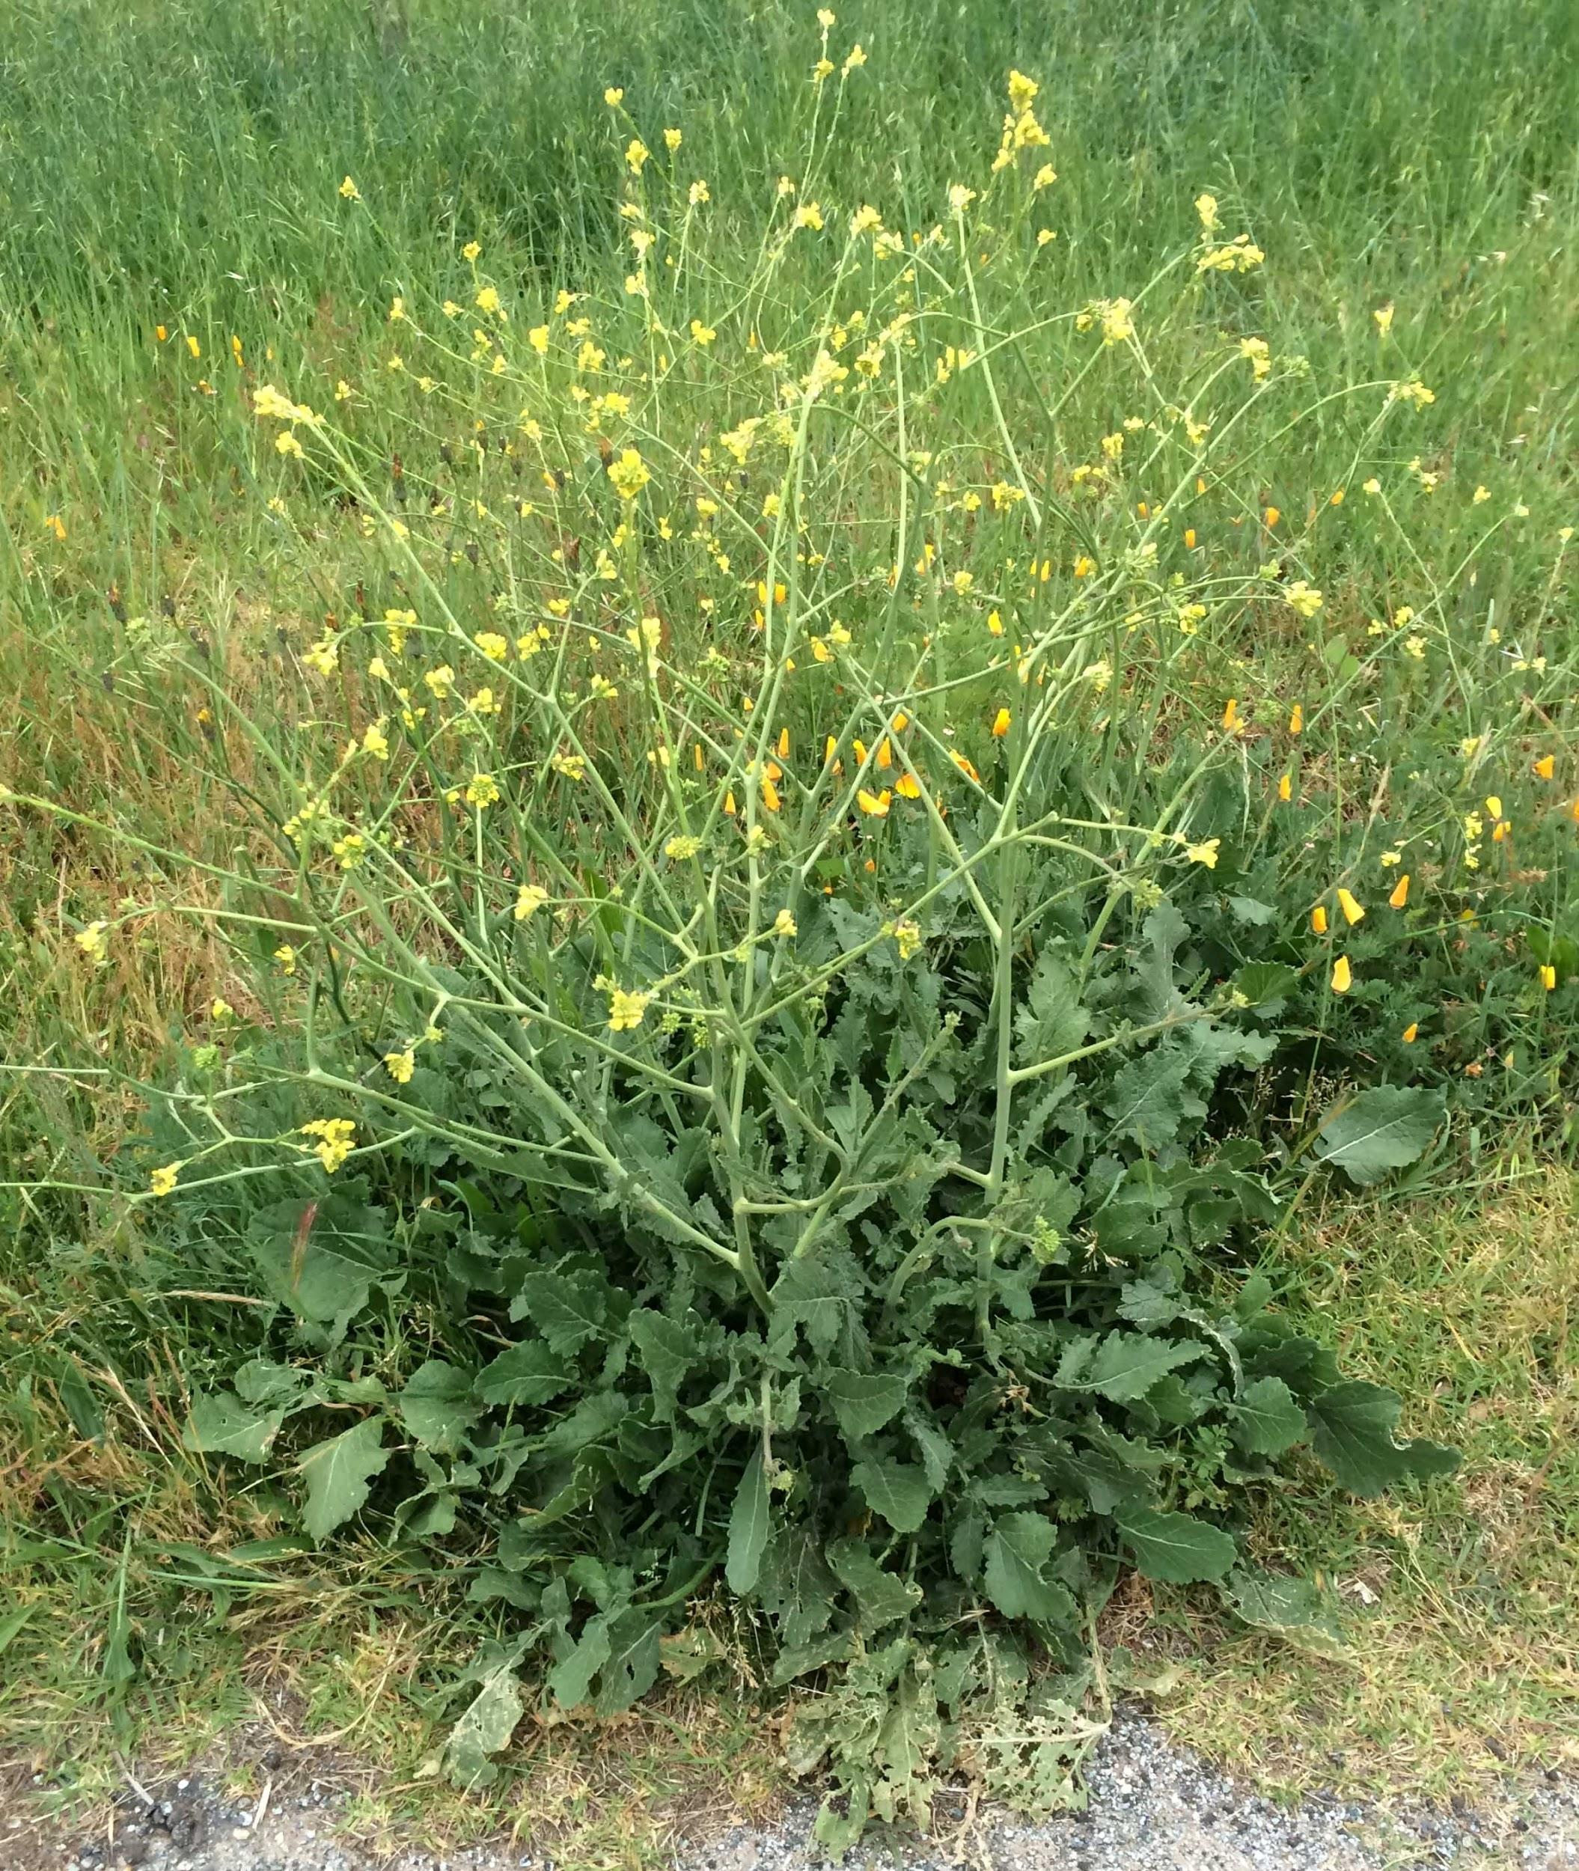
Discussion
A fire cleared out the old growth in this region in 2009, leaving much of the ground bare for newcomers.
Due to the heavy rainfall received in Southern California in the early portion of 2019, the excess water provided resources for new critters to grow like “Black Mustard.”
Lemonade Berry has been replaced by Black Mustard in almost every area in the Portuguese Bend area of the Palos Verdes reserve.

Slide 6
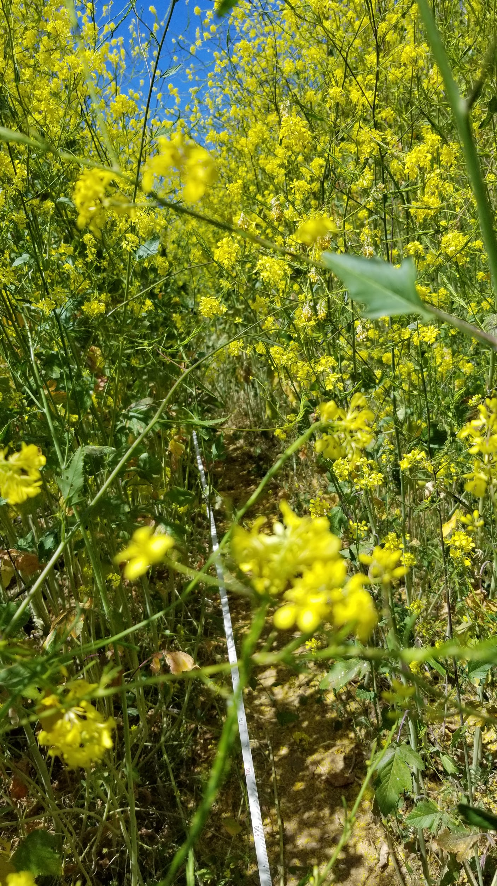
Conclusion
Further Research
Not many surviving natives
Lemonade Berry has now been overrun with mustard.
Our group could not see the edges of the cliff.

Slide 7
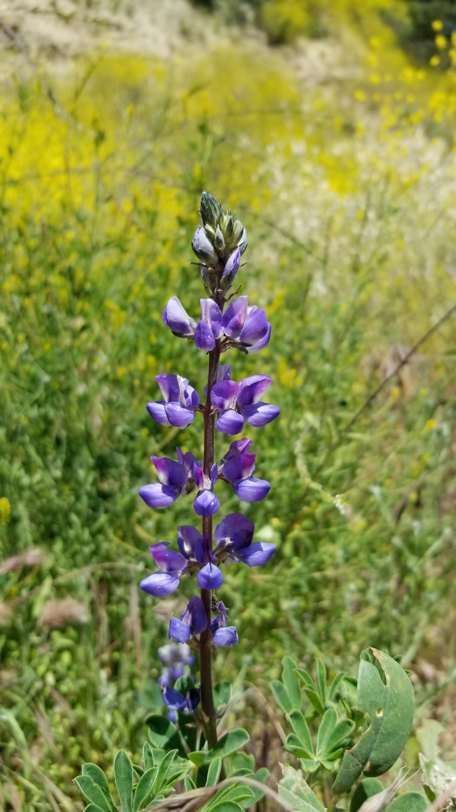
References
Data collected in Summer 2009 by: Karyssa Fenderson, Victoria Zamora, Marilyn Roun, Jade Dean

