Slide 1
CSS Distribution in
Cheseboro Canyon
Megan Honey, Brian Maka, &
Lisa Mouren-Laurens
GEOG 442
Spring 2019

Slide 2
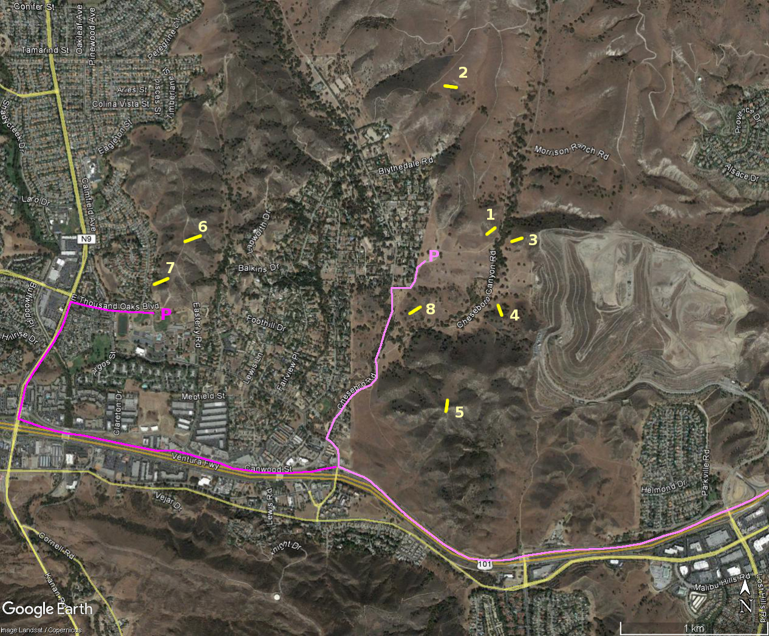
Introduction
Study of California sage scrub community in Cheseboro Canyon
Northern portion of Santa Monica Mountains
East of Agoura Hills
Monitor vegetation cover
Recommendations for restoration efforts
Use chi squared analysis
Alpha=0.10
http://web.csulb.edu/~rodrigue/geog330/maps/CheseboroCanyon2016.png

Slide 3
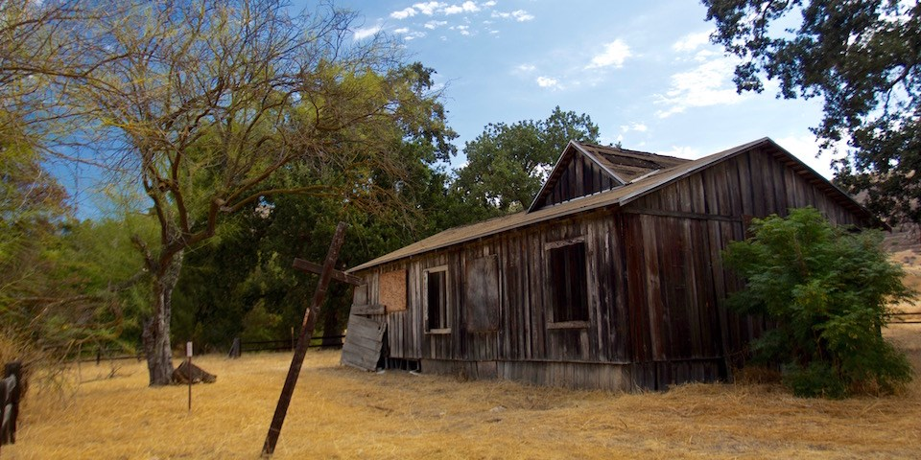
History
Morrison Ranch House
Cheseboro Canyon
Chumash occupied for 1000’s of years
Ranchers came into area in 1800’s
Managed as Open Space by the National Park Service
Loss of CSS from:
Cattle grazing
Fires
Fragmentation
Invasive/ Non-Native Species
Source: https://www.nps.gov/samo/planyourvisit/cheeseboropalocomado.htm

Slide 4
Background
2005 - Scott Eckhardt’s thesis
Wanted to identify loss of CSS in the Canyon
Collected data by looking at aerial photos
Found CSS expanding in areas although no restoration efforts had been done
Species mix of 95% native species in 8 areas observed
2017-2018: Student-collected data
Collected transects at Eckhardt’s sites
Compared data to Scott Eckhardt’s data
Decrease in species mix - 70% native
Further research needed

Slide 5
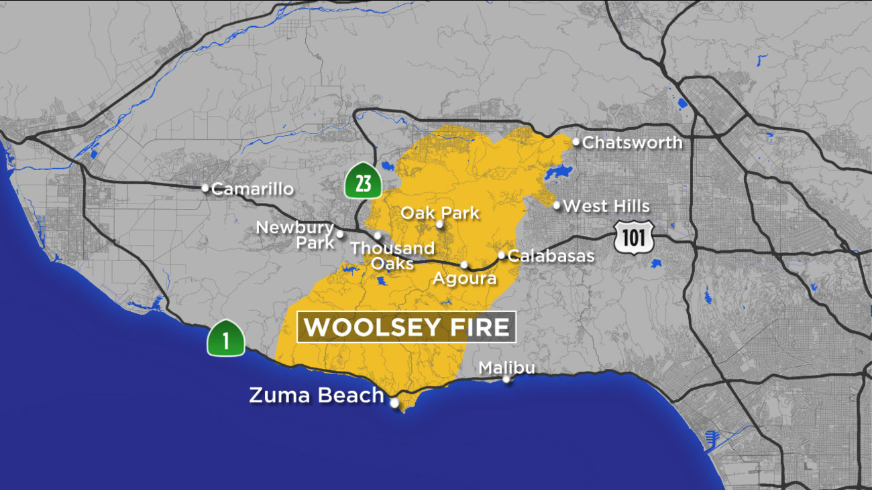
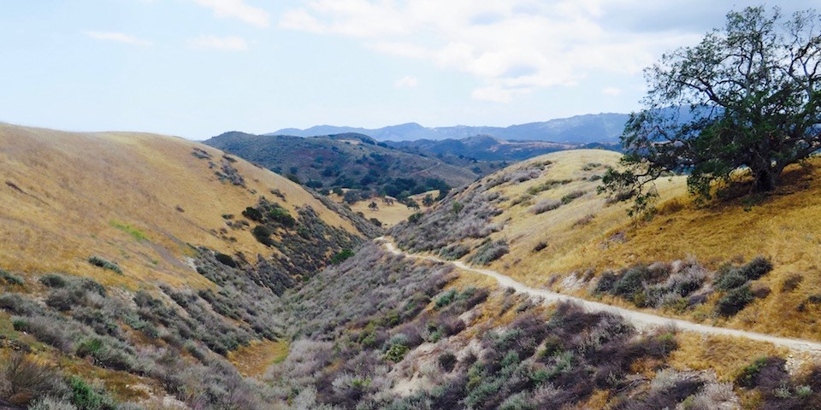
Our Goal
Compare plant succession communities between pre and post-fire periods
Woolsey Fire in 2018
Using Scott Eckhardt’s data from 2005
Compare to our data
Compare the species found during the drought to species found after the drought
Using data from 2017-2018 collected by previous students
Compare to our data
Source: https://abc7.com/fire-map-woolsey-fire-headed-to-the-ocean/4654421/
Source: https://www.nps.gov/samo/planyourvisit/cheeseboropalocomado.htm

Slide 6
Methods
Visited 4 of Eckardt’s 8 locations
T1,T3,T4, and T8
8 continuous 1x1 meter quadrats per transect
Documented species richness and percent coverage
Identified native vs. Non-native
Source:web.csulb.edu/~rodrigue/geog330/maps/CheseboroCanyon2016.png

Slide 7
Hypothesis
Working: There is a significant difference in plant communities prior to and following the fire in Fall of 2018.
Null: There is no significant difference in the make up of plant communities between the pre-fire and post-fire succession.
Working: There is a significant difference in plant communities during and after the drought.
Null: There is no significant difference in plant communities during and and after the drought.

Slide 8
Results - Post Fire: Comparing 2019 and 2005
Alpha | 0.10
X2 Calc | 11.952
X2 Critical | 4.605
Probability Value | 0.003
Effect size | 0.358
Corrected Power | 0.935

Slide 9
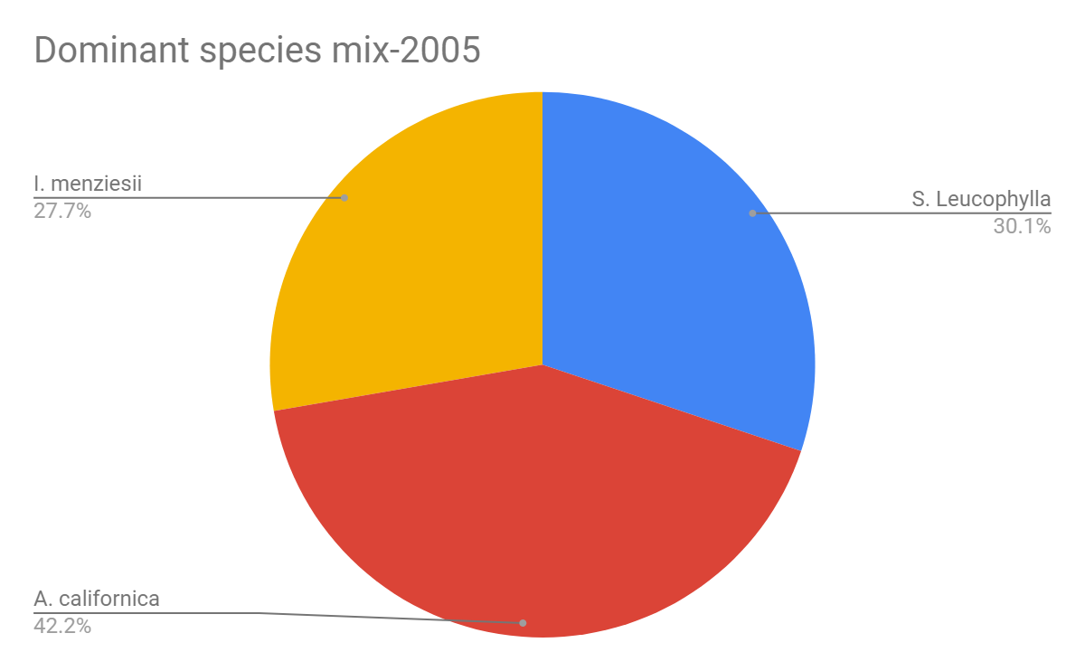
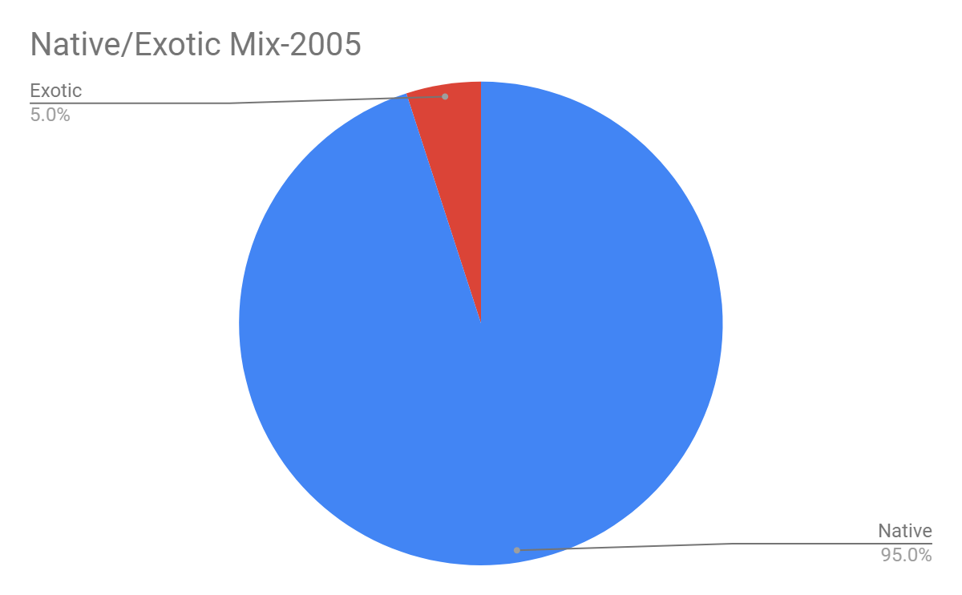
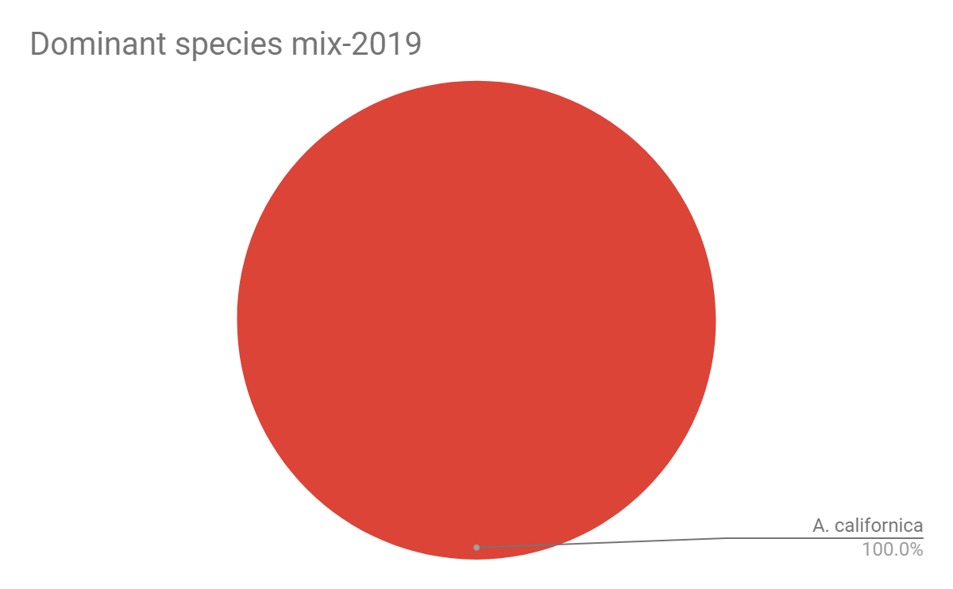
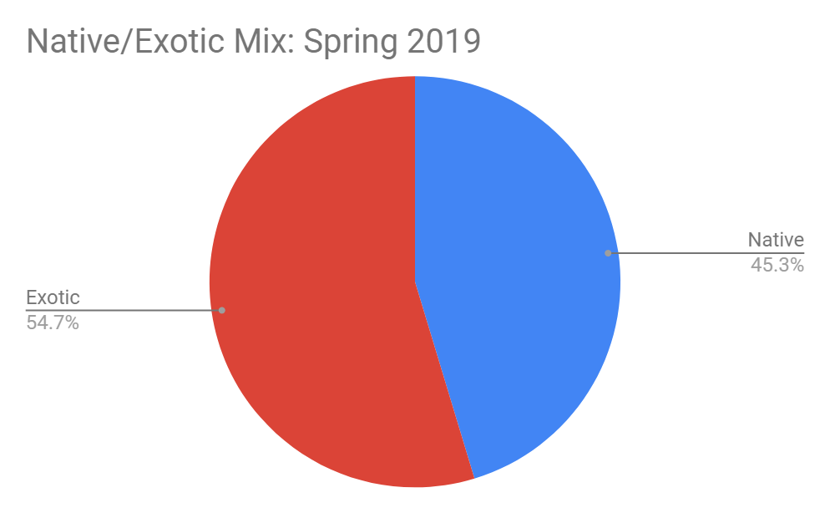
Results - Post Fire: Comparing 2019 and 2005

Slide 10
Results - Post Drought: 2017/18 - Present
X2 Calc | 95.058
X2 Critical | 9.236
Alpha | 0.1
Probability Value | 0.000
Effect Size (Cramer’s V) | 0.469
Corrected Power | 0.999

Slide 11
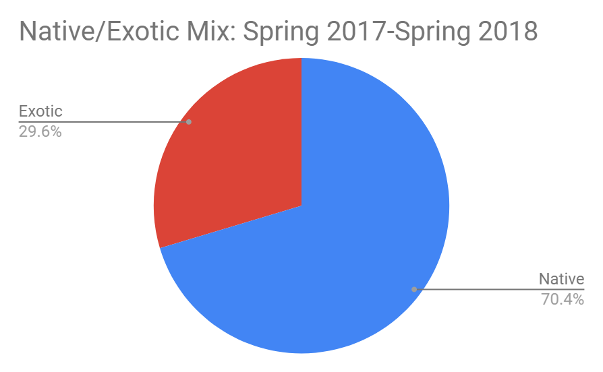
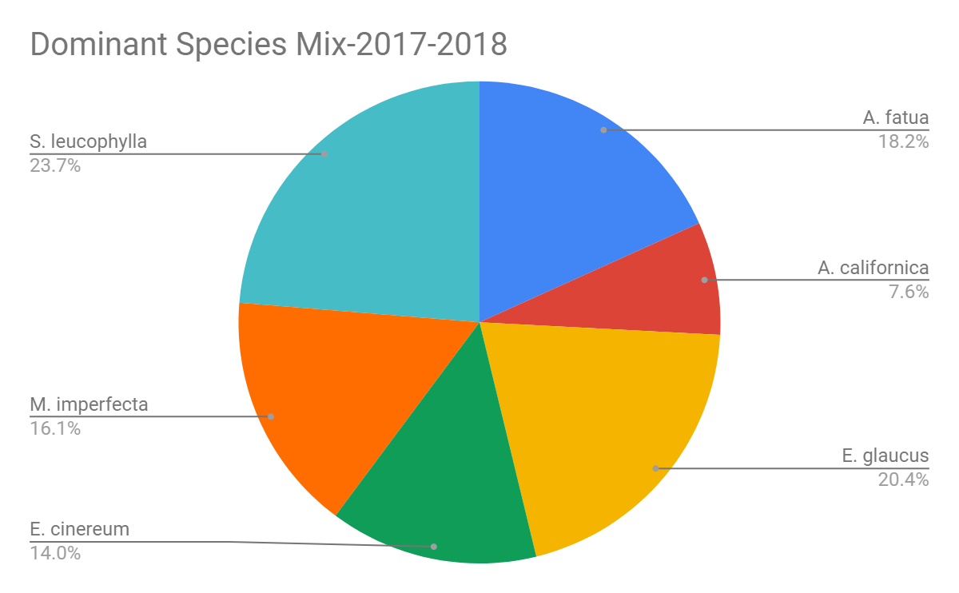
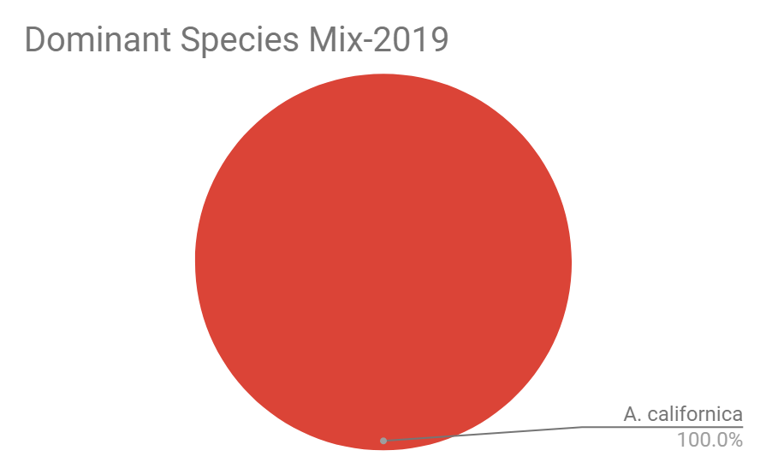
Results - Post Drought: 2017/18 - Present

Slide 12
Discussion
Hypothesis 1: Reject the null at 90% confidence level
Post-fire survey: lower coverage of native shrubs, dominated by grasses
Natives seen were largely small seedlings
Hypothesis 2: Reject the null at 90% confidence level
Post-drought survey: larger proportion of exotic species
Likely due to wet season that ended the drought
Combination of fire followed by heavy rains:
Made room for exotic annual growth
Different methods of data collection pose as potential source of bias
Quadratting versus transecting

Slide 13
Conclusion
Interaction of influences on CSS coverage is unclear
Which factor had greater effect on increased proportion of exotics?
Natives species largely observed as seedlings
May establish successful stands after exotic annuals finish life cycle
Limitations exist due to exploratory nature of this survey
Valuable contribution of data to the body of research.
Recommendation for further surveys
Monitor during both times of year
Complete transects at all 8 sites
Consistency in data collection methods

Slide 14
Thank You

