Slide 1
Coastal Sage Scrub in the Forrestal Reserve
By Jillian Malone, Samantha Ishak, Elijah Purtee, & Vincent Ibarra

Slide 2
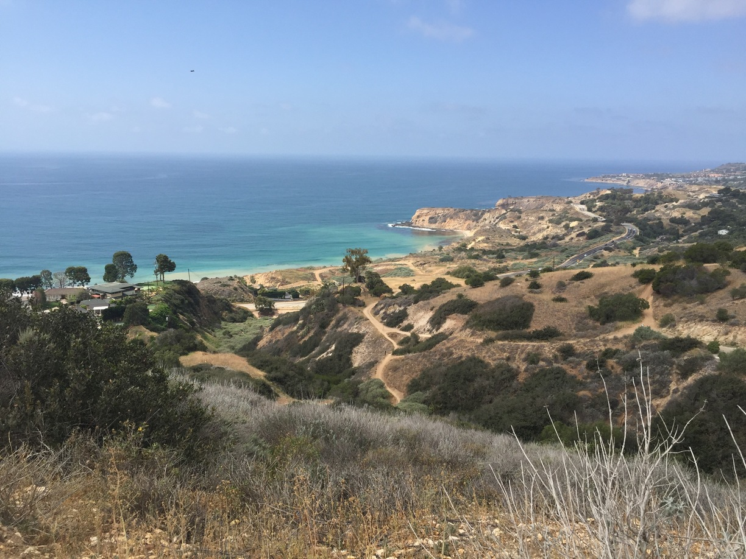
Forrestal Reserve
One of the few areas with healthy, undisturbed CSS
Compared to other areas in Palos Verdes, Forrestal Reserve has the most intact CSS
Major threats to CSS include development and invasive species
Serves as a safe haven for CSS species
Notes:
Forrestal Nature Reserve, Rancho Palos Verdes, California - Short...

Slide 3
Our Hypothesis
Alternate hypothesis: The trails censused at the Forrestal Reserve are significantly different from other transects in Palos Verdes
Null hypothesis: The trails censused at the Forrestal Reserve are not significantly different from the other transects in Palos Verdes.

Slide 4
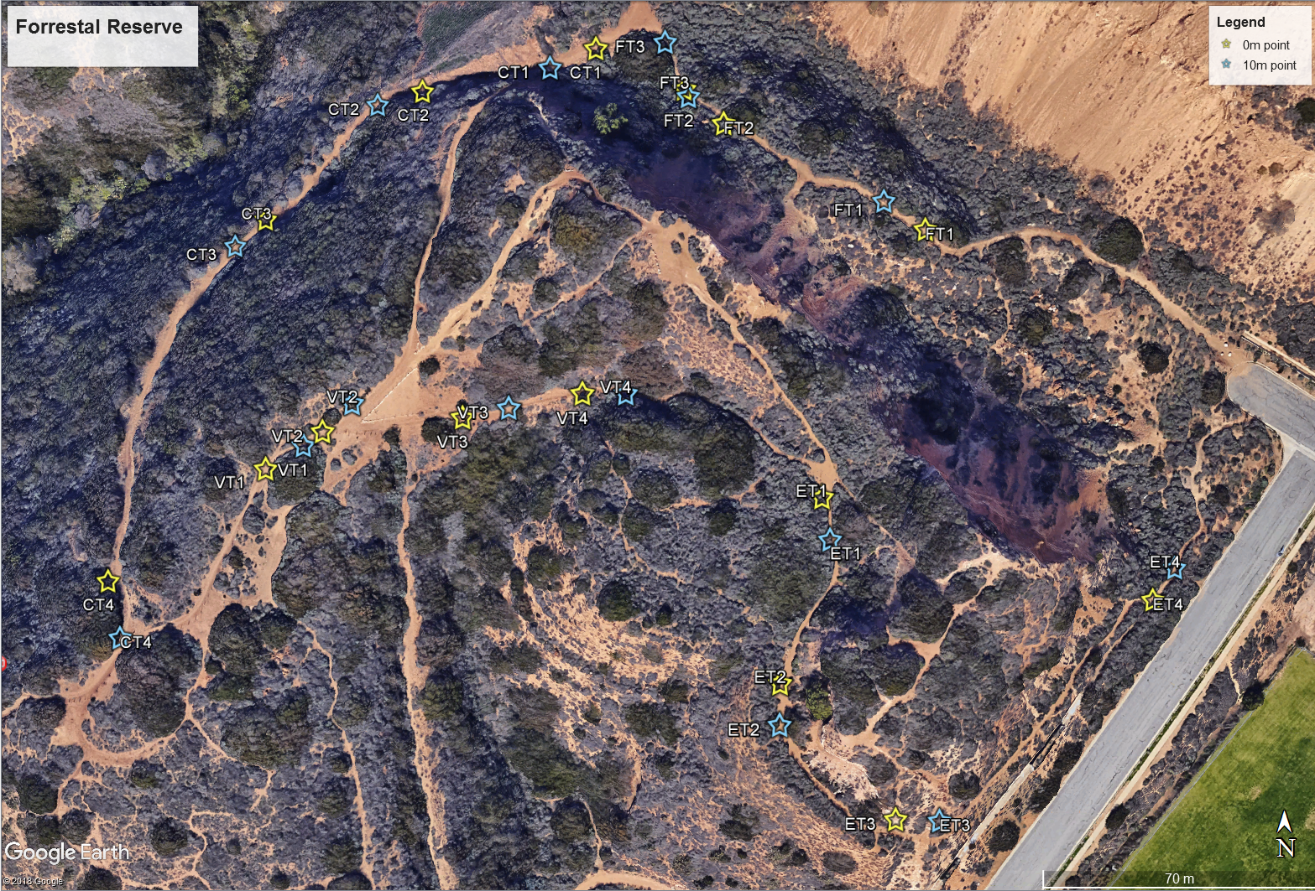
Data Collection
4 different trails:
Fossil Trail
Canyon View Trail
Vista Trail
Exultant Trail
Instruments used:
10 m transect tape
GPS to measure coordinates and elevation
Field notebook
Species list for reference

Slide 5
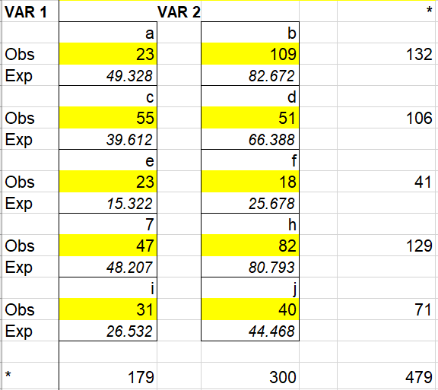
Data Processing and Analysis
Listed the sum of species and species richness in Palos Verdes
Used trails we censused
Historical data from previous classes
Used Chi Square comparing the 5 most abundant species within Forrestal Reserve and Portuguese Bend in Palos Verdes
Alpha standard: 0.05
Notes:
Var 1 → Forrestal Reserve
Var 2 → Portuguese Bend

Slide 6
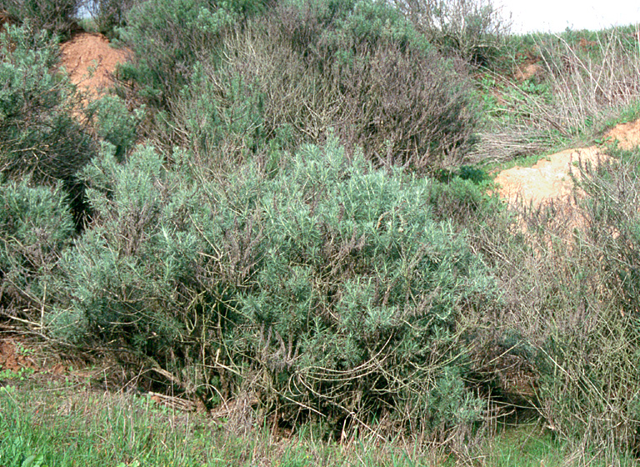
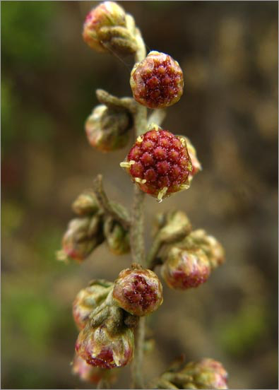
Artemisia californica (California Sagebrush)
Notes:
https://calphotos.berkeley.edu/cgi/img_query?enlarge=0000+0000+0103+0419
https://calphotos.berkeley.edu/cgi/img_query?enlarge=0000+0000+1108+1063

Slide 7
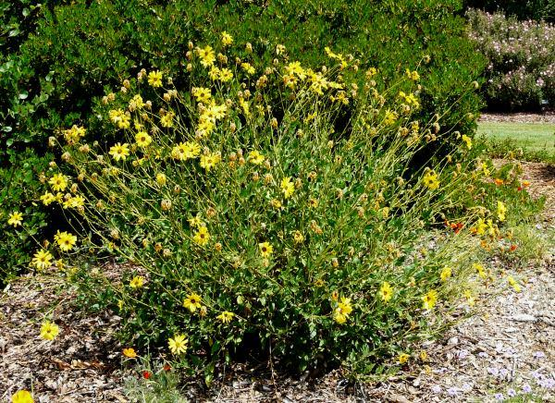
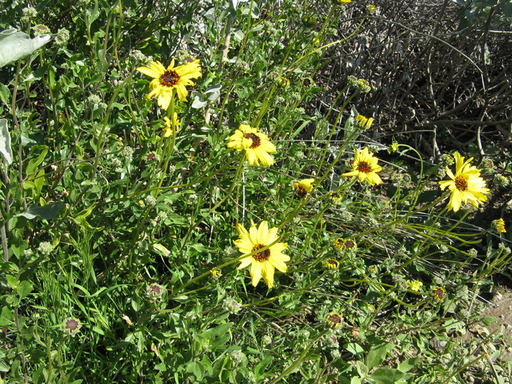
Encelia californica (California Brittlebush)
Notes:
https://www.laspilitas.com/images/grid24_24/3401/s/images/plants/260/Encelia_californica-2.jpg
https://calphotos.berkeley.edu/cgi/img_query?enlarge=0000+0000+0310+0676

Slide 8
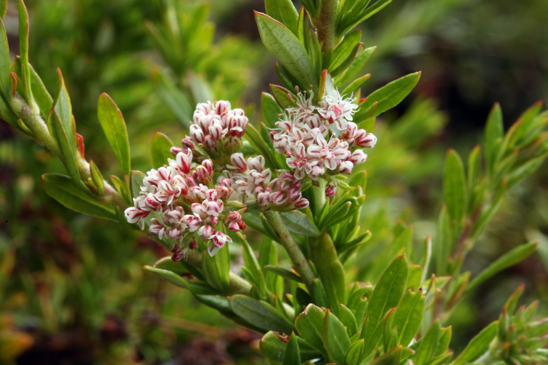
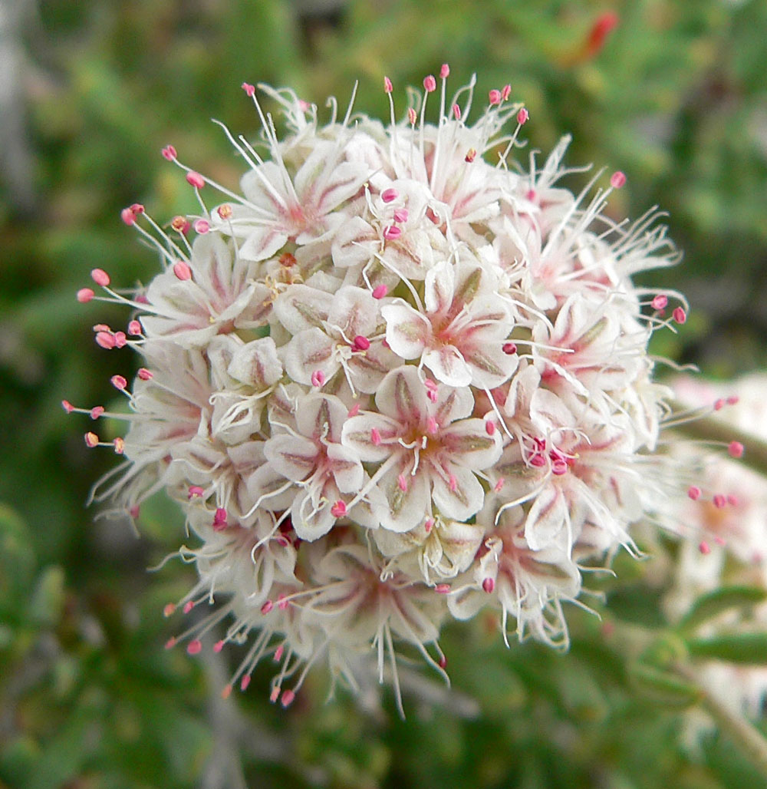
Eriogonum cinereum (California Buckwheat)
Notes:
https://calphotos.berkeley.edu/cgi/img_query?rel-taxon=begins+with&where-taxon=Eriogonum+fasciculatum

Slide 9
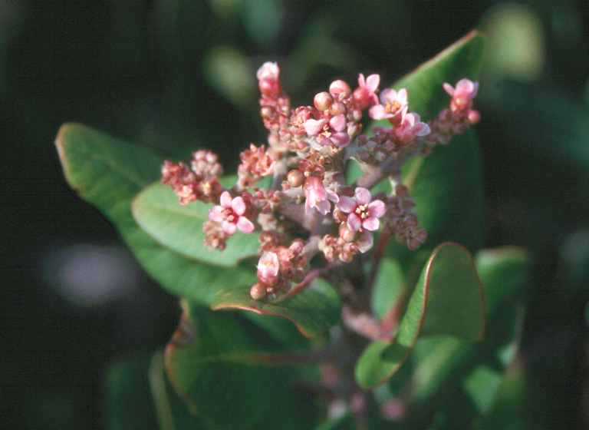
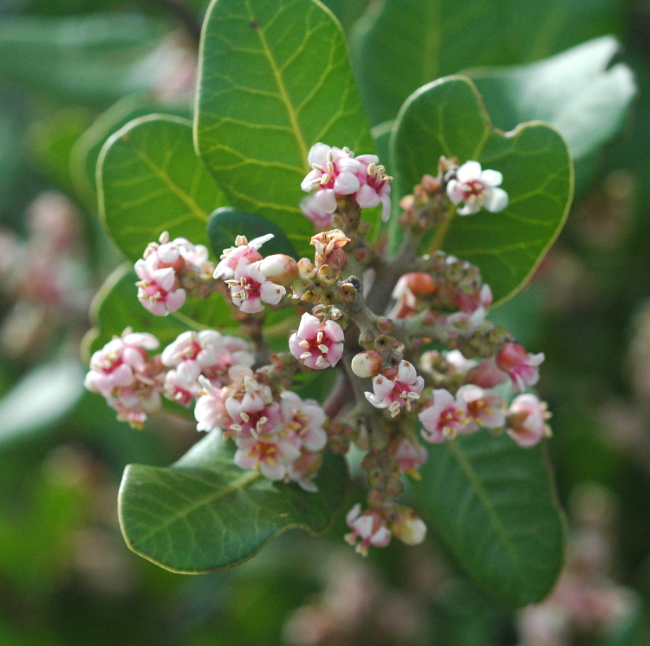
Rhus integrifolia (Lemonade Berry)
Notes:
https://calphotos.berkeley.edu/cgi/img_query?rel-taxon=begins+with&where-taxon=Rhus+integrifolia

Slide 10
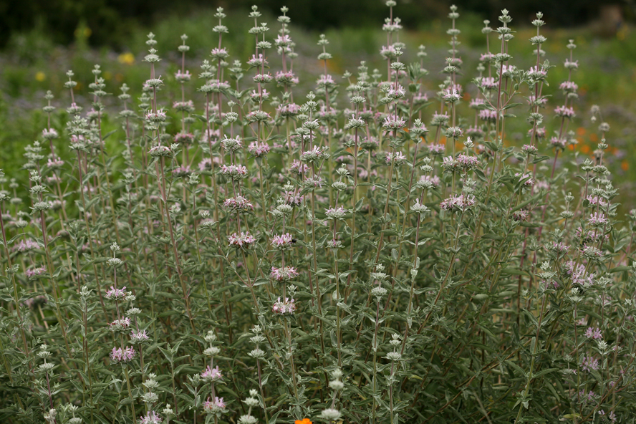
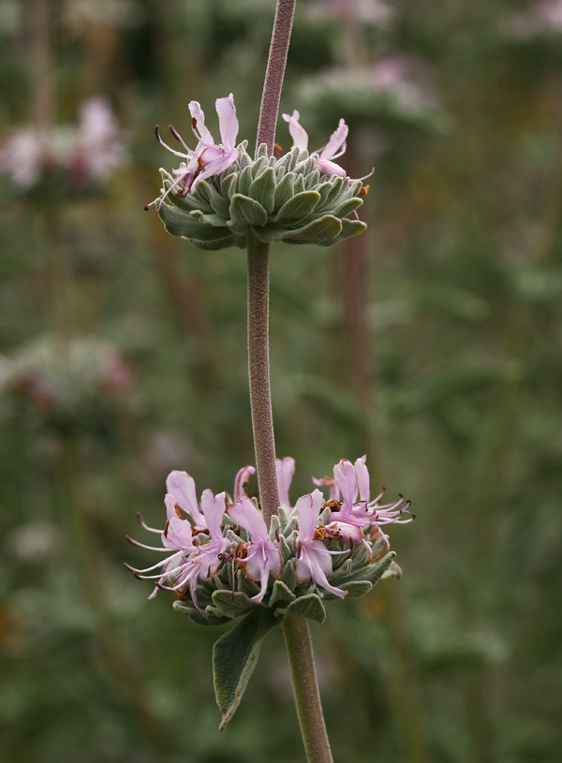
Salvia leucophylla (Purple Sage)
Notes:
https://calphotos.berkeley.edu/cgi/img_query?rel-taxon=begins+with&where-taxon=Salvia+leucophylla

Slide 11
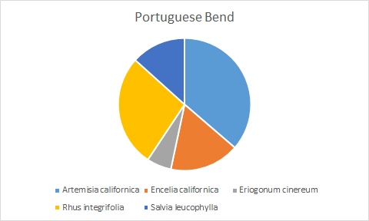
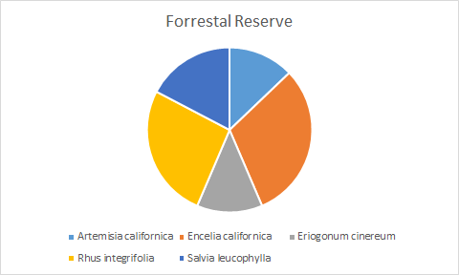
Forrestal Reserve v Portuguese Bend
Compared the 5 most abundant species between the 2 areas: Artemisia californica, Encelia californica, Eriogonum cinereum, Rhus integrifolia, Salvia leucophylla
Large difference in distribution between the two areas even though they are adjacent to each other

Slide 12
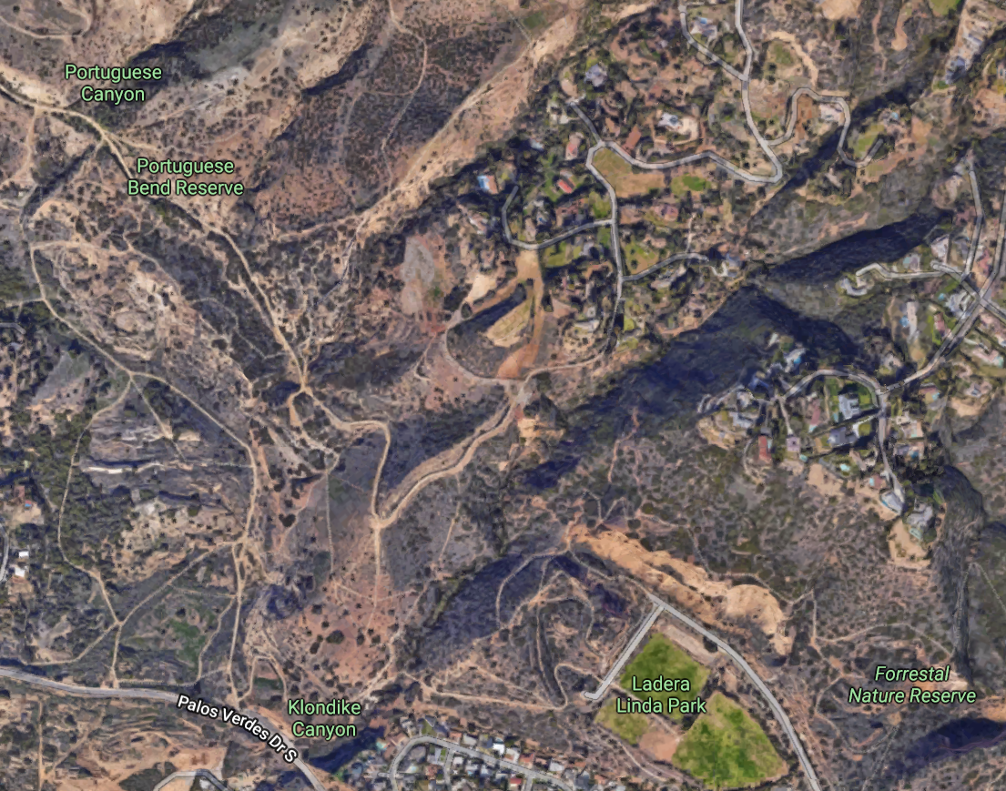
Notes:
They are adjacent to each other with a short two mile hike between the two spots. The difference in vegetation is noticeable in tis picture.

Slide 13
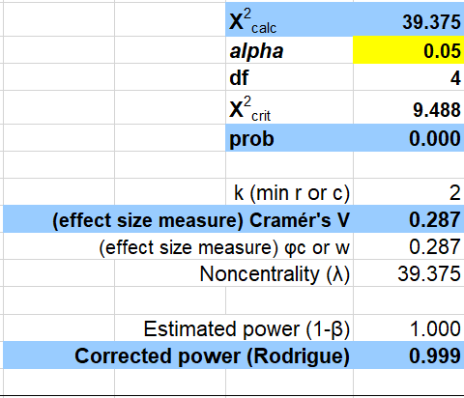
Chi-Square Analysis
X²calc is greater than X²crit
Reject the null
P value → 0.000
Strong evidence against the null hypothesis
Power → 0.999
Strong
Notes:
P

Slide 14
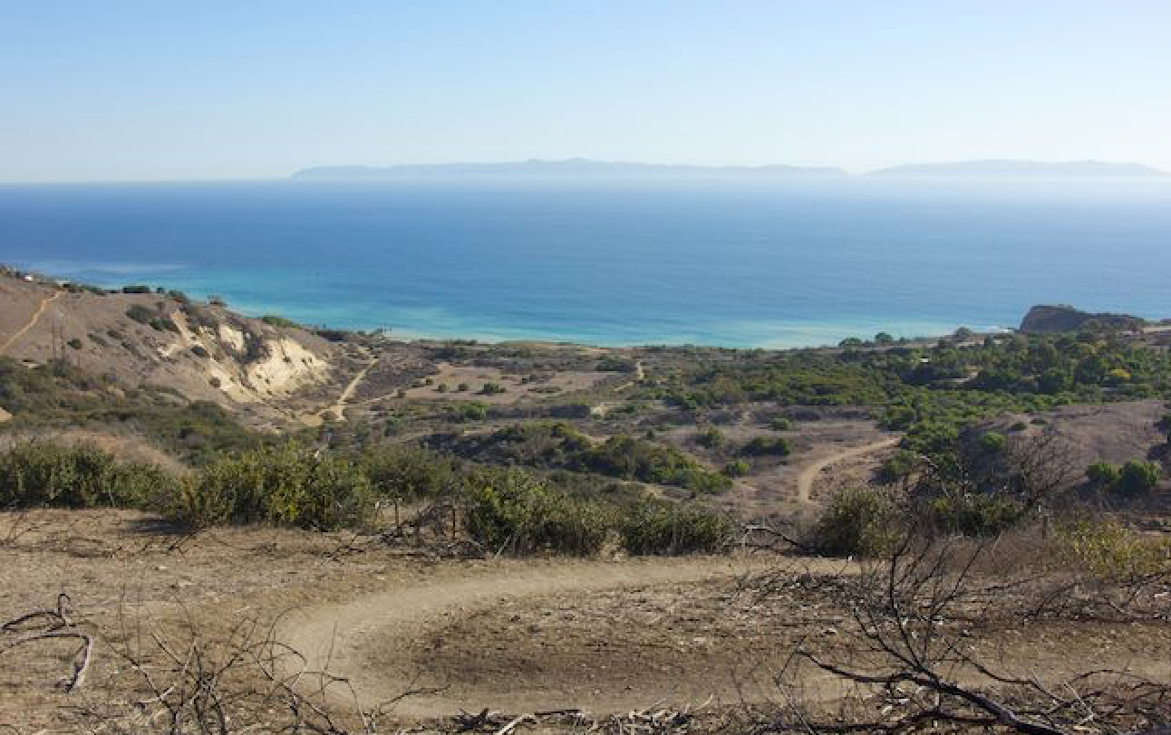
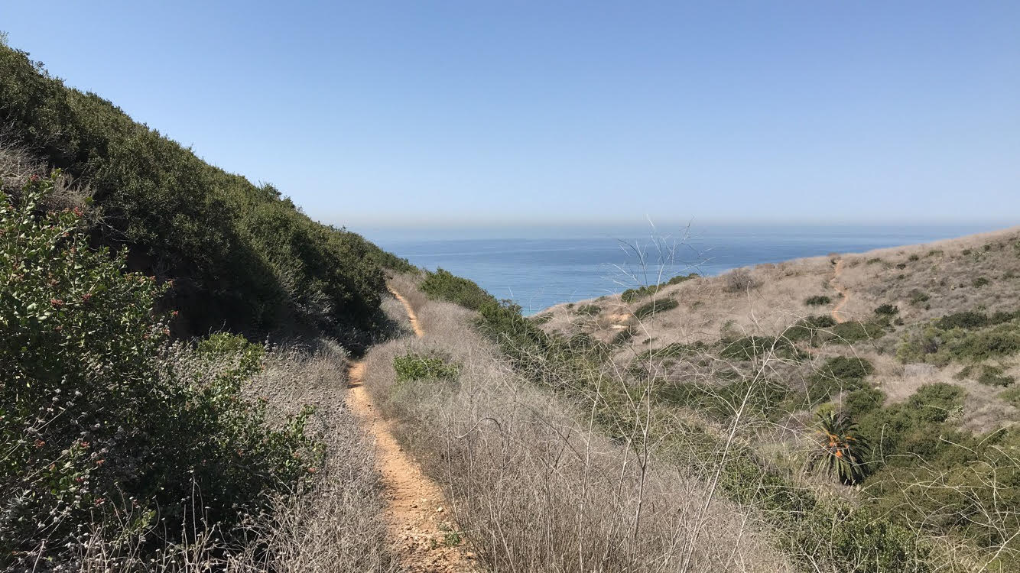
Conclusions
REJECT the null hypothesis.
There is a HIGHLY significant difference between species between the two areas.
Notes:
Portuguese Bend Reserve | Palos Verdes Peninsula | Los Angeles …
Quarry Loop in Forrestal Nature Reserve | Palos Verdes Peninsula ...

Slide 15
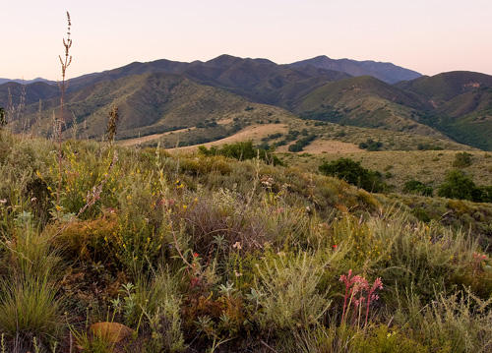
Future Implications of Our Research
Important to track the species within the Forrestal Reserve to see the overall health of CSS in the area
Can track to see if other areas in Palos Verdes are losing CSS species or becoming more like Forrestal Reserve
Weak effect size so more samples are recommended.

