Slide 1
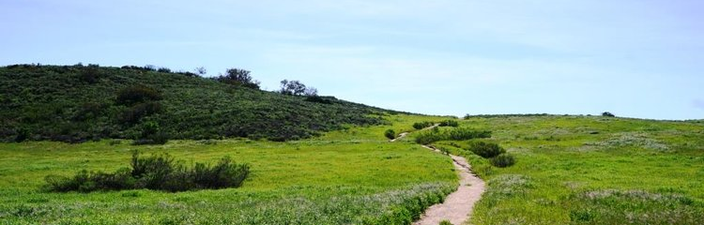
Charmlee Park- Clyde Canyon
Mellanie Hidalgo
Sawyer Marks
Cristin Hansen
Kristen Way

Slide 2
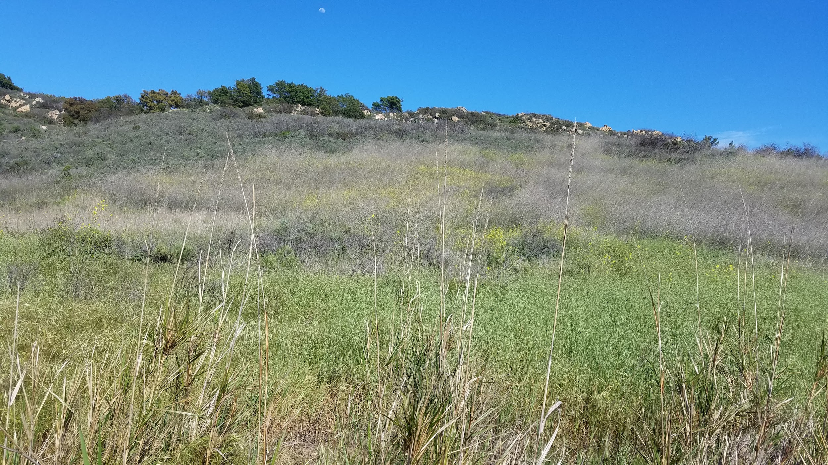
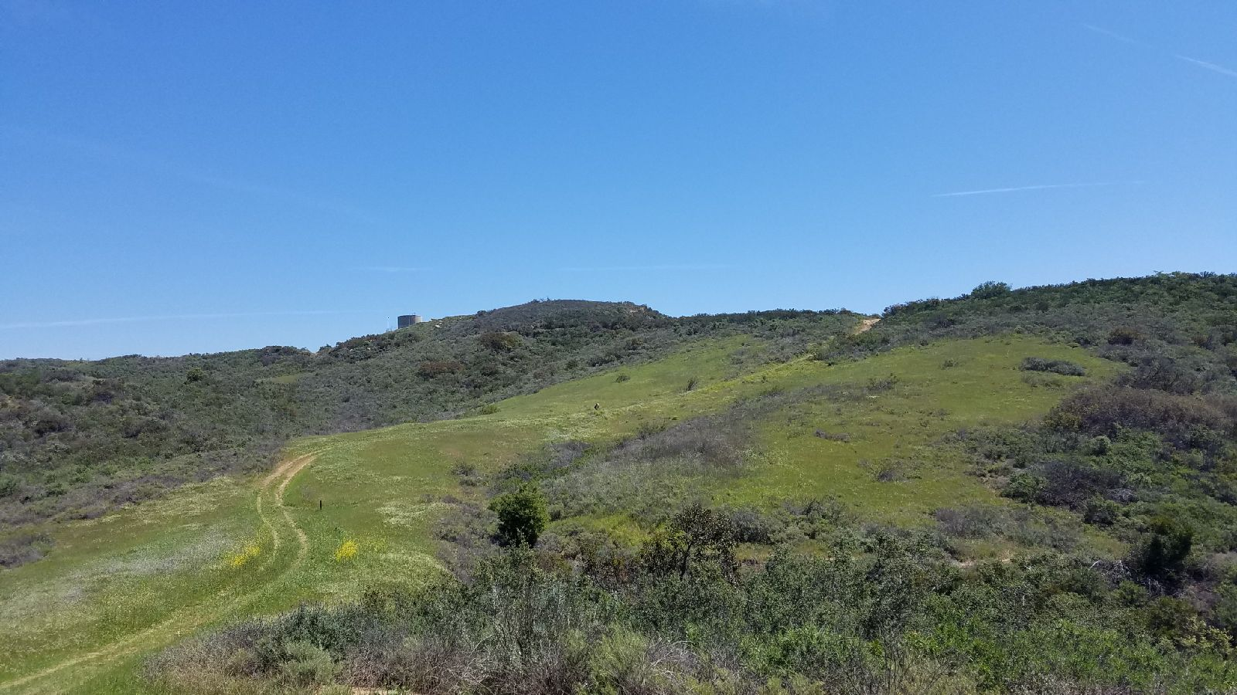
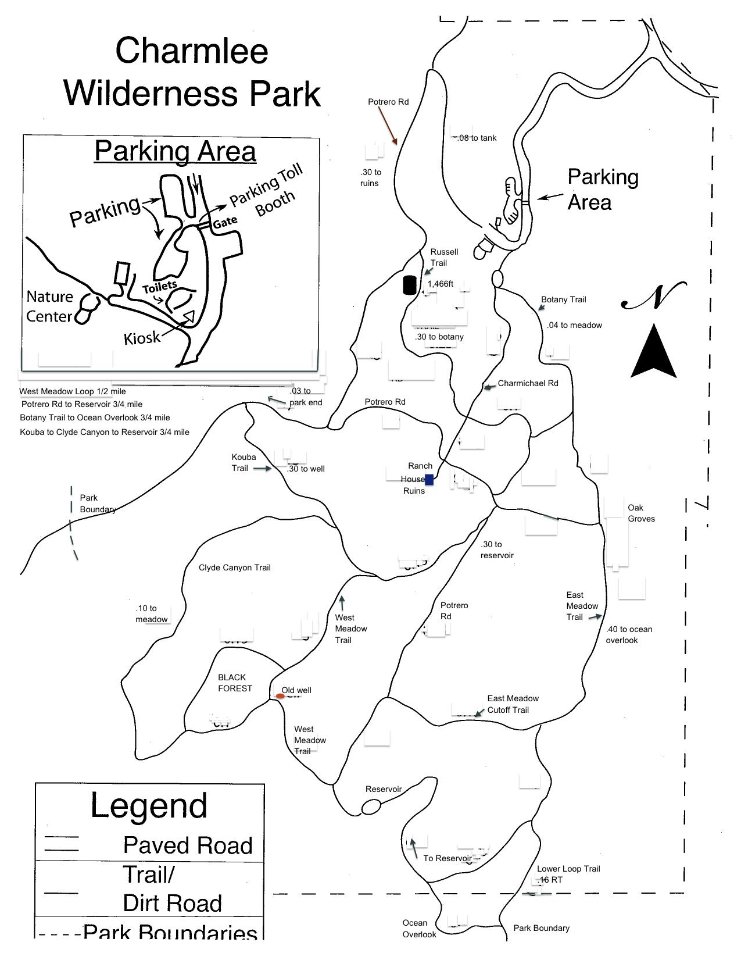
Introduction
Charmlee Wilderness Park is 590 acres of the best of the Santa Monica Mountains Coastal Slope environment. The park includes shady picnic areas, majestic ocean views, eight miles of hiking trails, and an amphitheater.
Notes:
Cristin

Slide 3
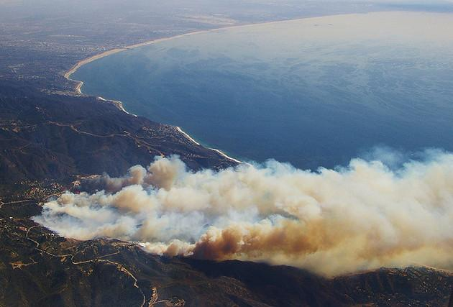
Clyde Canyon Background
Charmlee Park, by Clyde Canyon Trail, in 2003 suffered a fire
The soil was bulldozed into the soil down to the mineral matter in order to create a fire break
As the fire break clearing began to recover we being to see CSS
CSS began to grow and recover in this area
The clearing next to Clyde Canyon Trail was an area primarily dominated by black mustard.
Notes:
Cristin

Slide 4
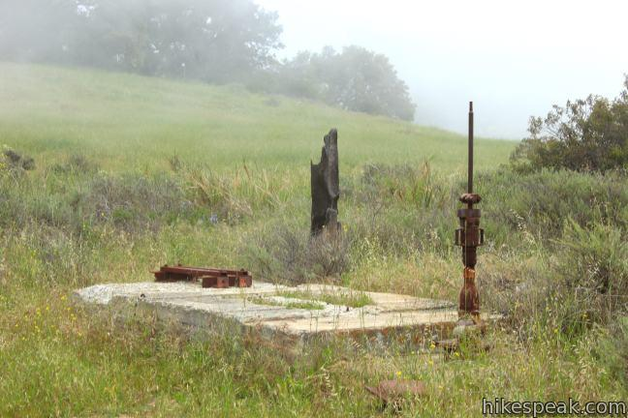
Background for CSS Recovery
Although soil disruption usually inhibits the growth of CSS, CSS began to grow and recover in this area. This was probably due to the fact that black mustard chemicals were removed from the soil. The clearing next to Clyde Canyon Trail was an area primarily dominated by black mustard.
Notes:
Mellanie

Slide 5
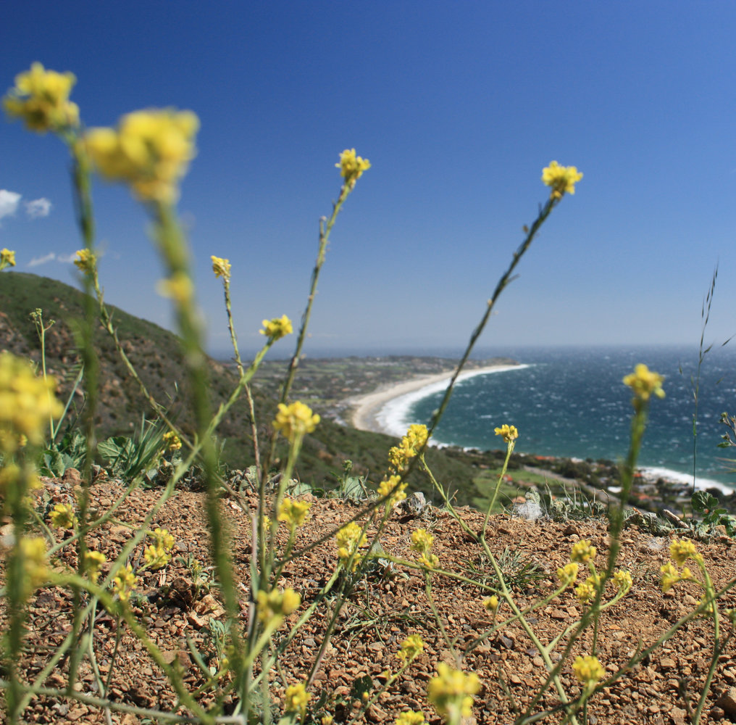
Methods
Black mustard has the characteristic of allelopathy and is the reason for its domination. At our site, black mustard continues to dominate the area, but a few CSS shrubs
Compare our data with the CSS that is next to and expanding into grasslands in a different part of Charmlee park to see if the composition of plants is
Compare the transect lines we got from field work with the secondary data from past students who did transect lines along the stable and expanding boundaries.
Notes:
Mellanie

Slide 6
Hypothesis : The composition of CSS to grasslands at Clyde Canyon is significantly different compared to stable and expanding boundaries of CSS in Charmlee Park.
Null Hypothesis: The composition of CSS to grasslands at Clyde Canyon is similar to the stable and expanding boundaries of CSS in Charmlee Park.
Notes:
Sawyer

Slide 7
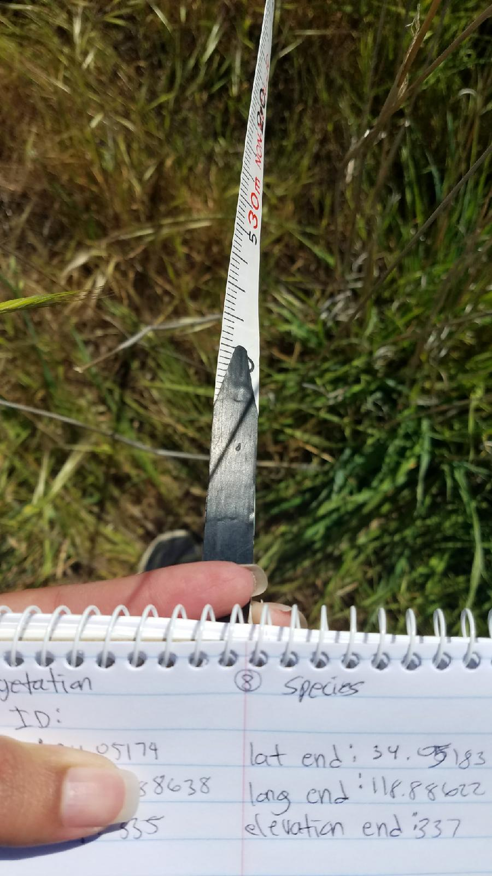
Gathering Data at Clyde Canyon
We collected data through 8, 20 meter transect lines centered on the strip of CSS vegetation
This area is 10 meters wide and grows through 5 meters into the grasslands on both sides
Notes:
Sawyer

Slide 8
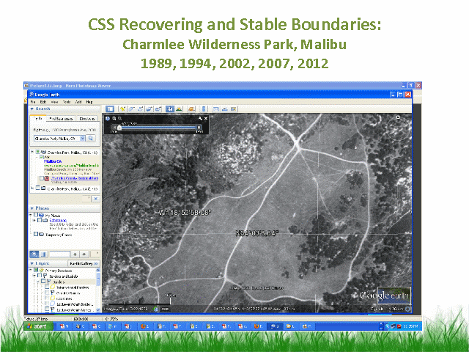
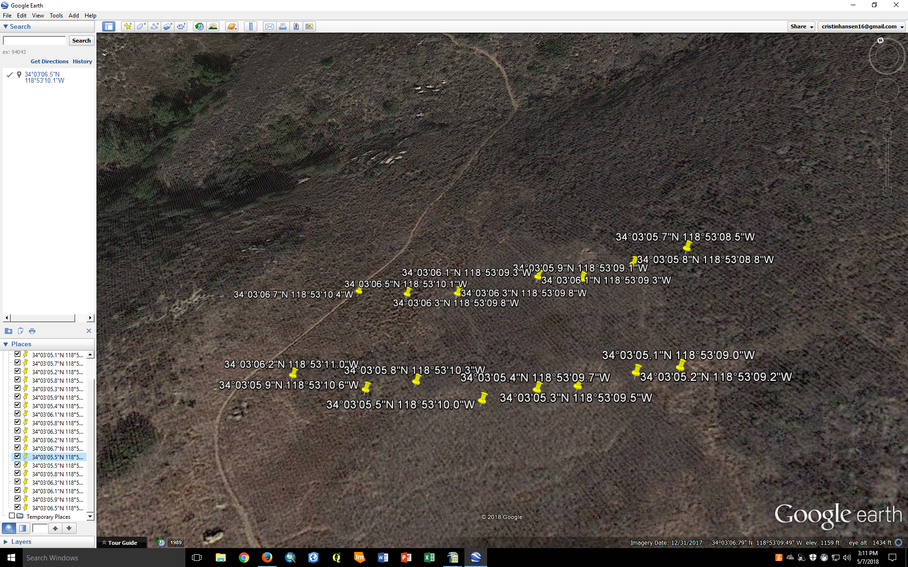
Gathering Data at Clyde Canyon
Notes:
Sawyer

Slide 9
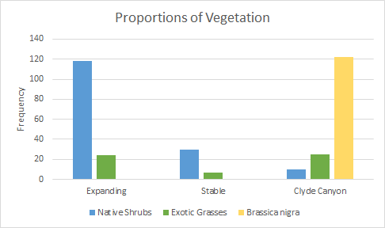
Data
For the interpretation of our data we combined all exotic and native shrubs that were found in Clyde Canyon and in Charmlee Park
Black Mustard is in its own category because it is responsible for interrupting the growth of CSS
The stable and expanding data was collected in Spring 2013 in Charmlee Park between CSS and grasslands
Notes:
Sawyer

Slide 10
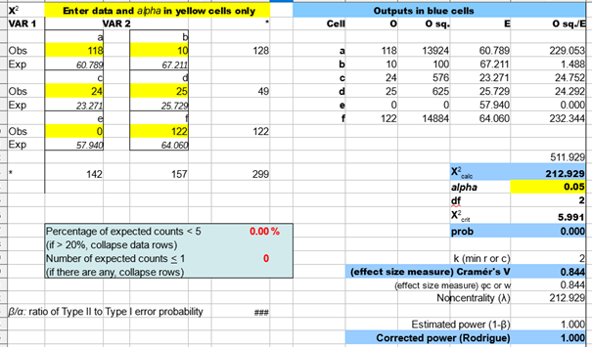
Results- Expanding Comparison
2 x 3 Chi Square Test
x²_{calc}= 212.929
x²_{crit}= 5.991
p= 0.000
Effect size= 0.844
Power= 1.000
Expanding v. Clyde Canyon
Notes:
Kristen

Slide 11
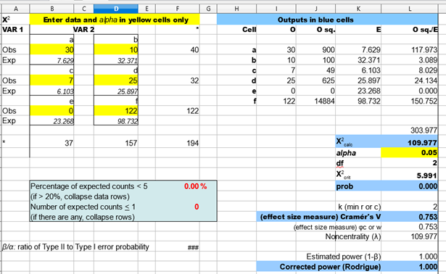
Results- Stable Comparison
Stable v. Clyde Canyon
2 x 3 Chi Square Test
x²_{calc}= 109.977
x²_{crit}= 5.991
p= 0.000
Effect size= 0.753
Power= 1.000
Notes:
Kristen

Slide 12
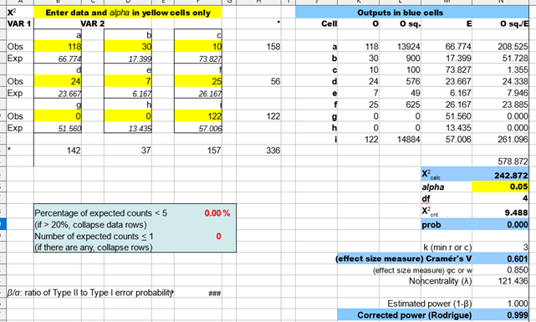
Results- Expanding v Stable v Clyde Canyon
3 x 3 Chi Square Test
x²_{calc}= 242.872
x²_{crit}= 9.488
p= 0.000
Effect size= 0.601
Power= 0.999
Expanding v. Stable v. Clyde Canyon
Notes:
Kristen

Slide 13
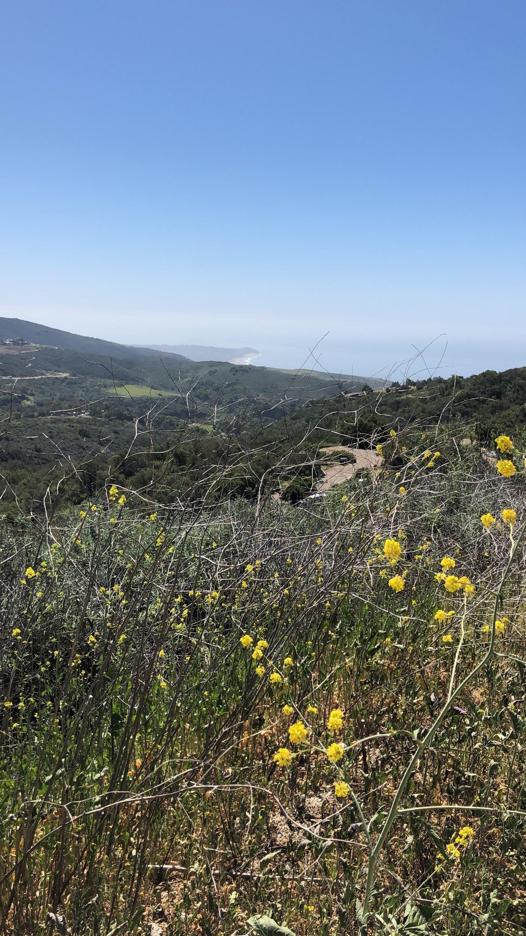
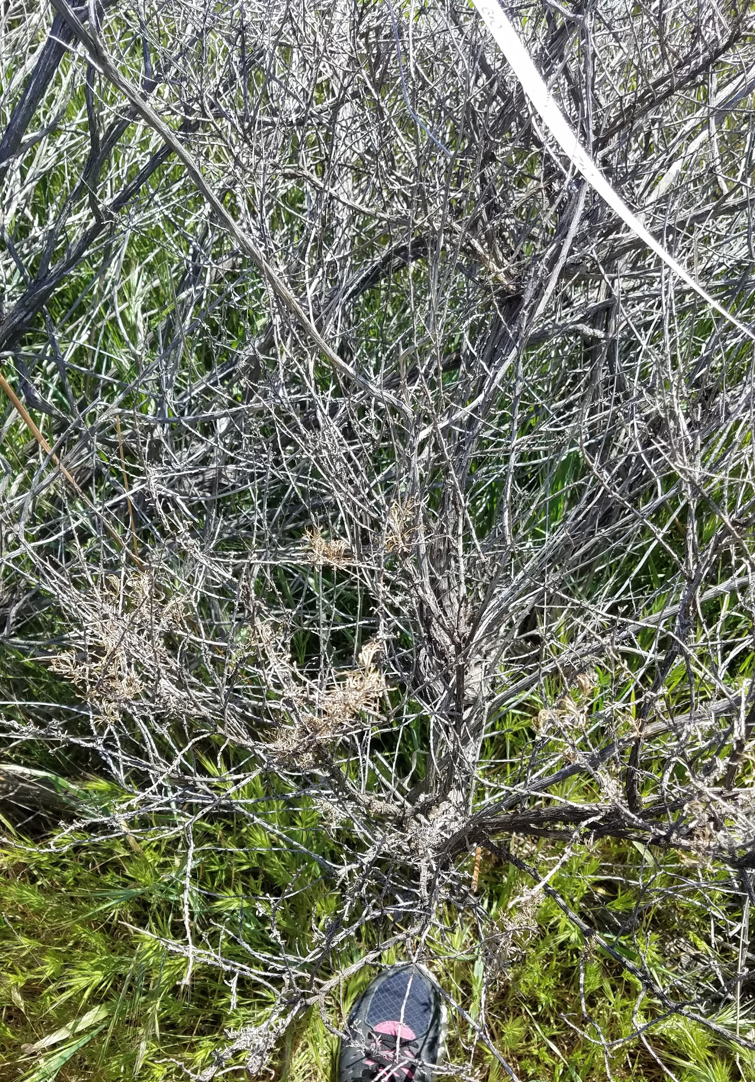
Conclusion
Reject the null hypothesis.
We believe the presence of black mustard significantly impacted the growth and recovery of CSS in the area.
Moderate effect sizes
Notes:
Kristen

Slide 14
Resources
“Differences in California Sage Scrub composition behind stable and recovering boundaries with annual grassland”
“Preliminary Report: Effects of black mustard allelopathy on the fitness and life history strategies of buffalo gourd in southern California”

Slide 15
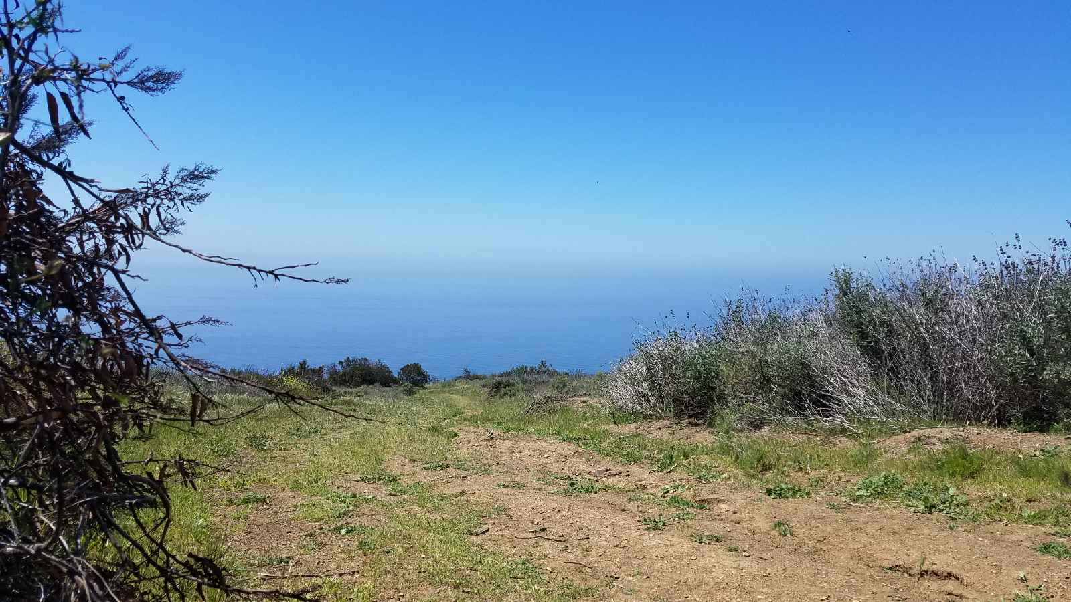
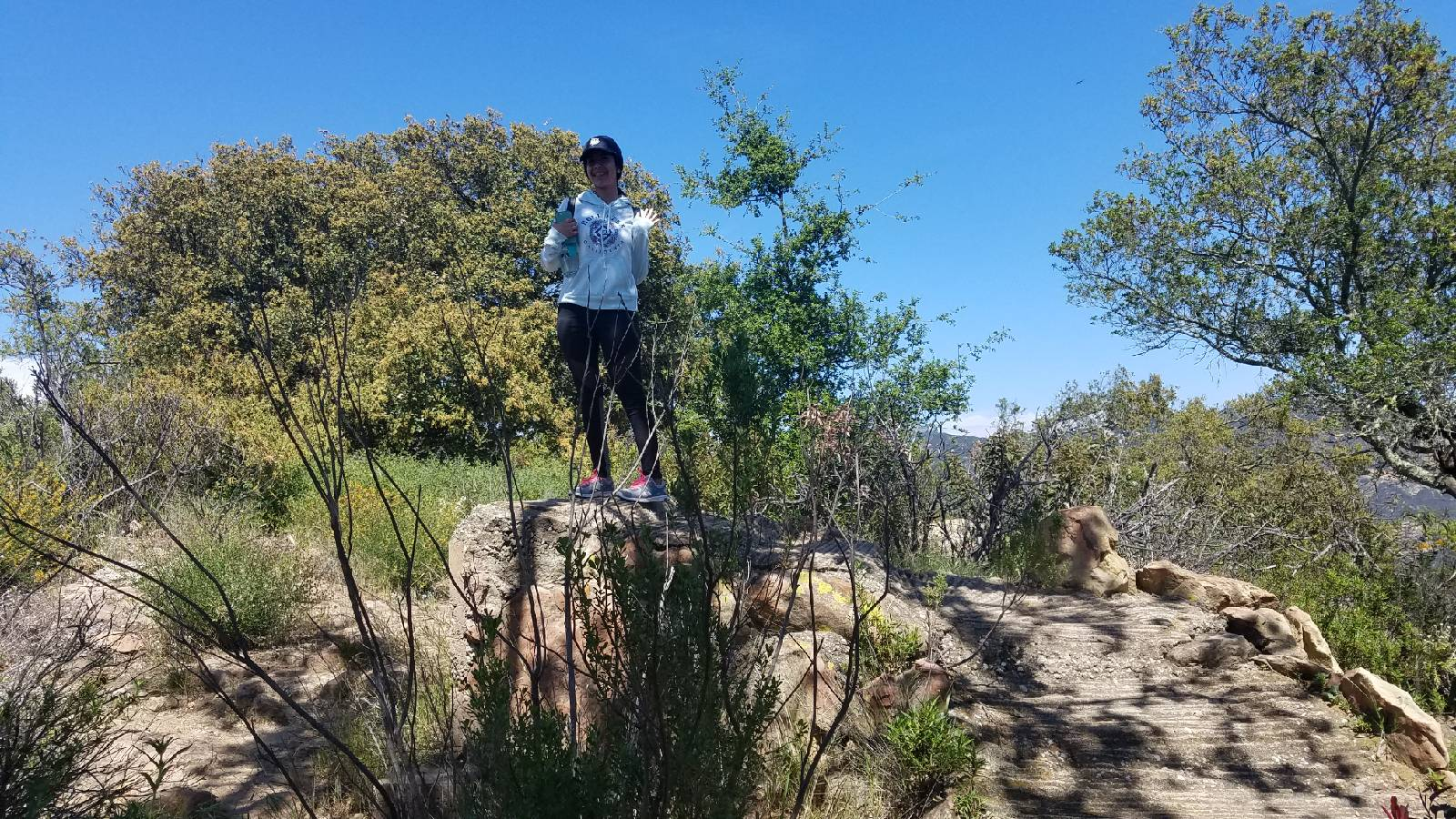
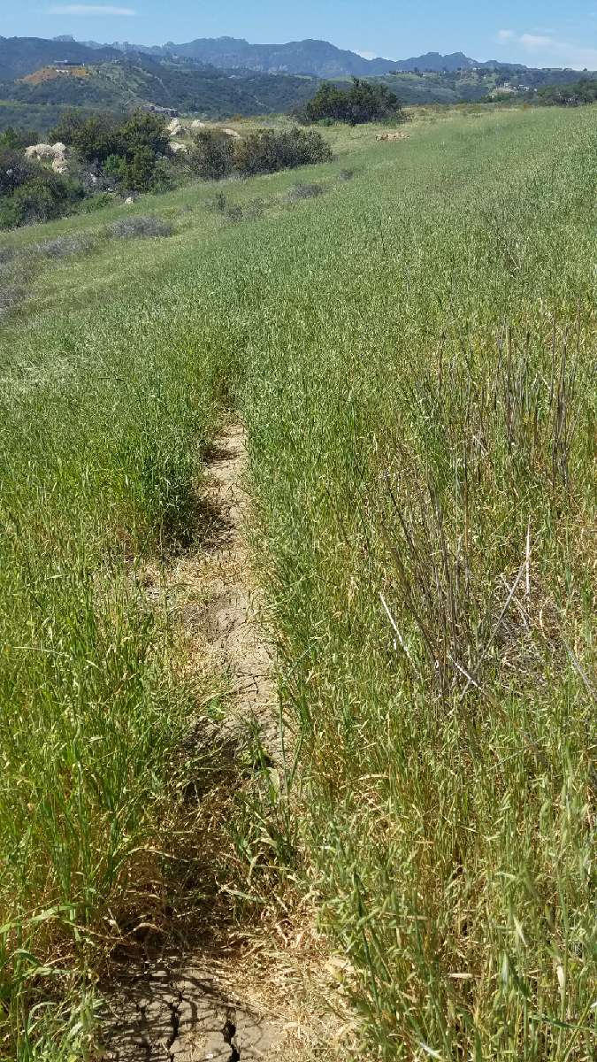
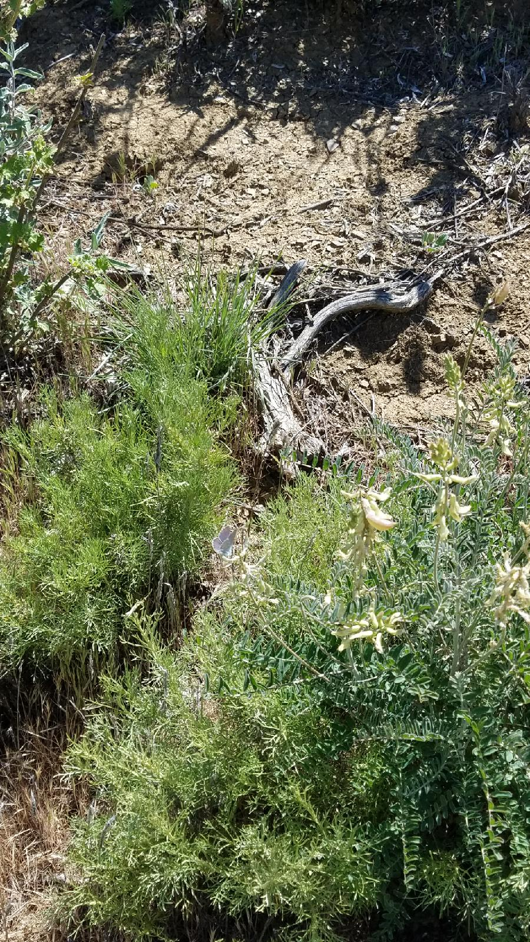
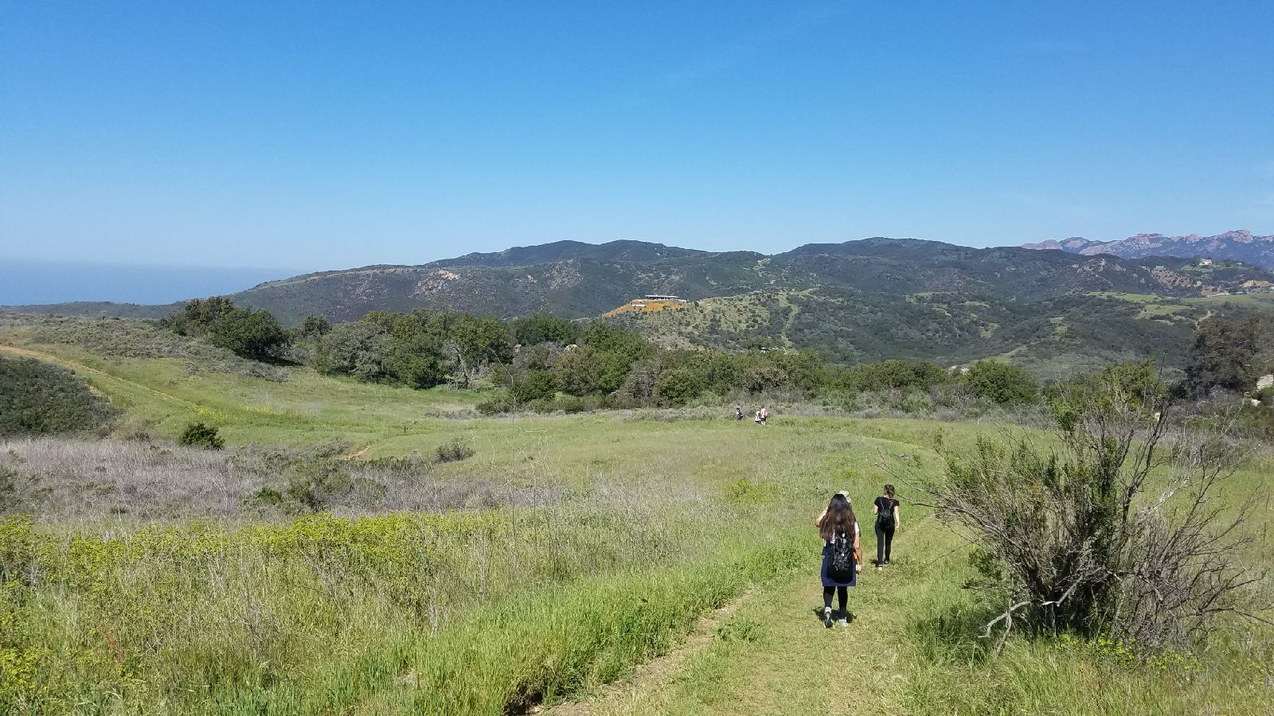
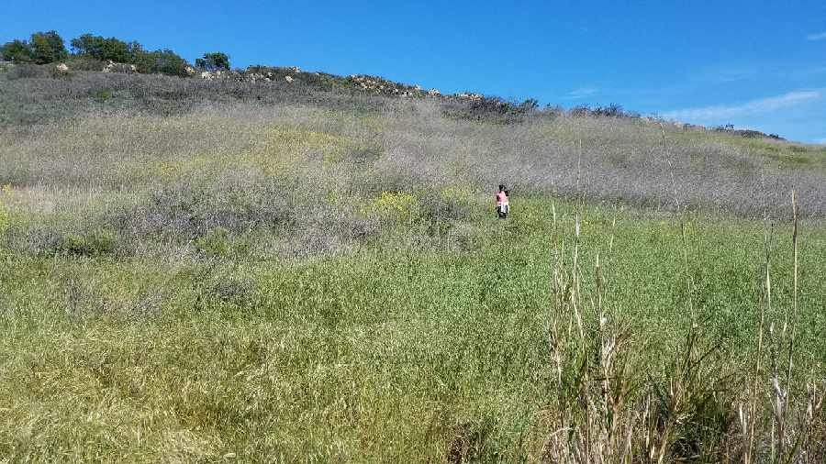
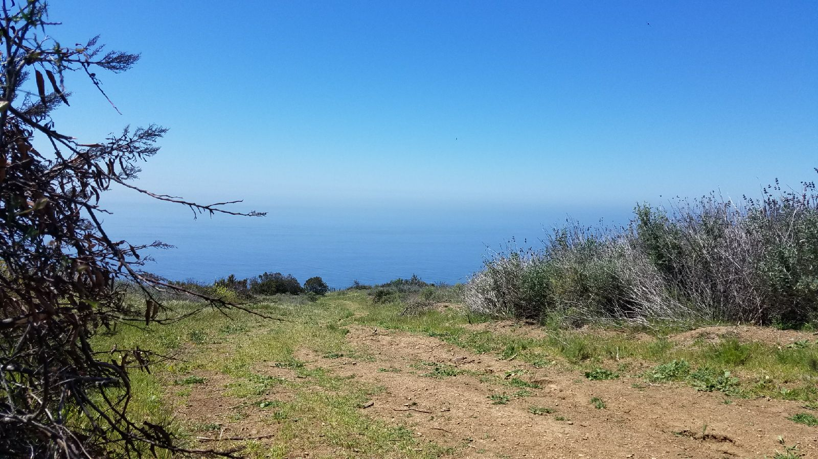

Slide 16
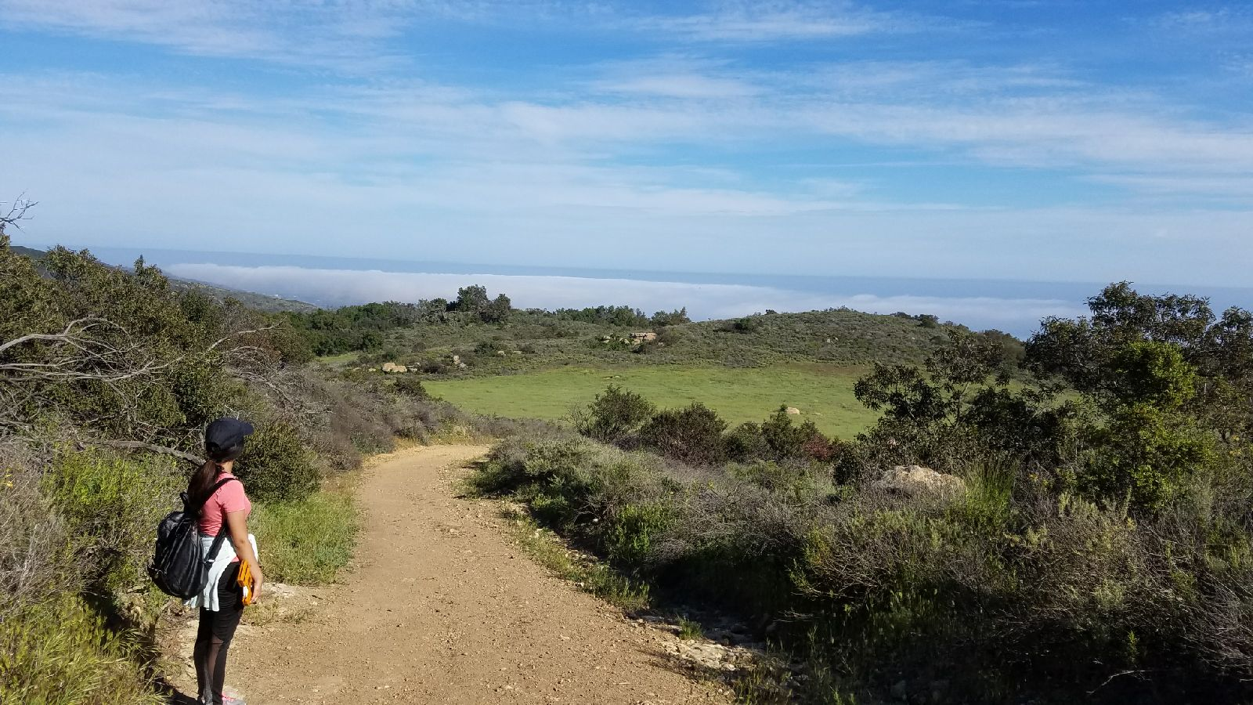
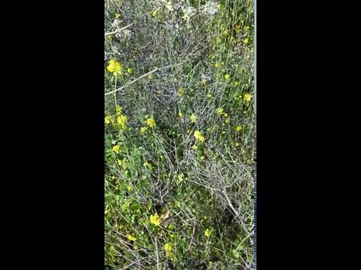
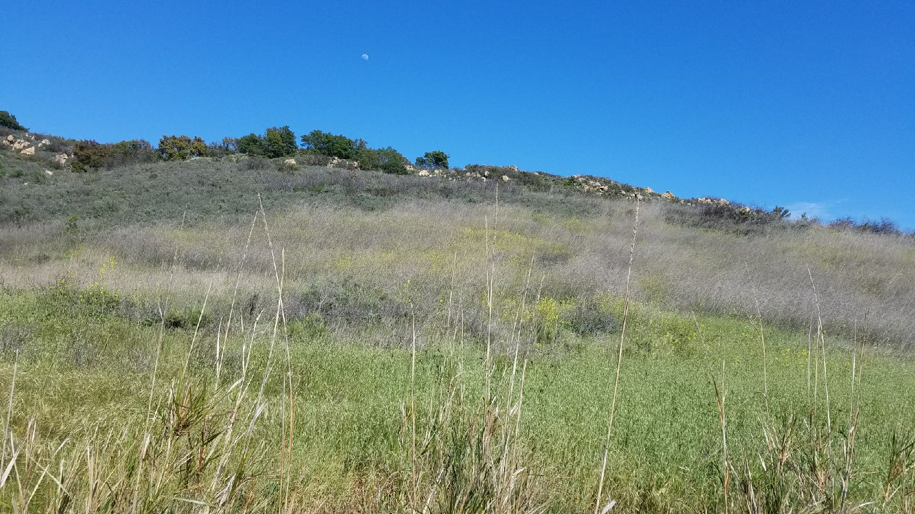
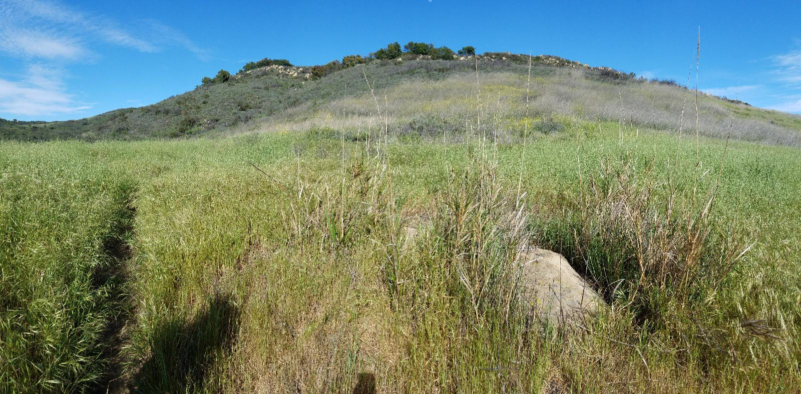

Slide 17
