Slide 1
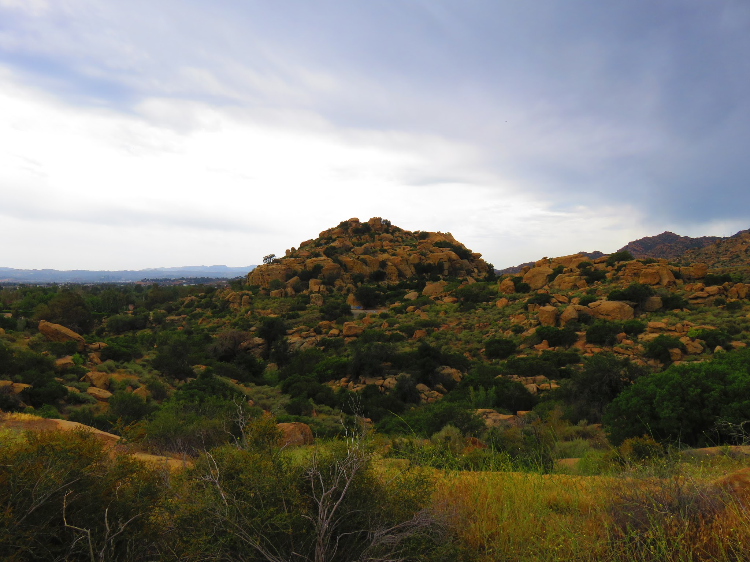
Stoney Point
Matt Billinghurst
Matt Kelly
Toria Denofrio
Joanne Tran
Maria C. Parra Aya

Slide 2
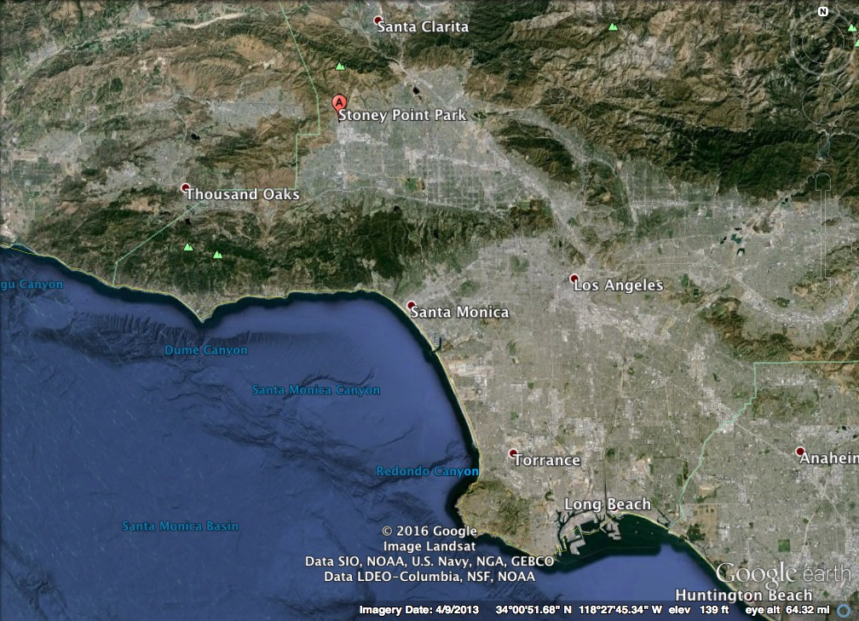
Background
55 miles north of Long Beach
Western San Fernando Valley
Chatsworth Formation
Los Angeles Parks and Recreation
Hiking Trails
Caves
Rock Climbing
Equestrian Center
Excellent Views

Slide 3
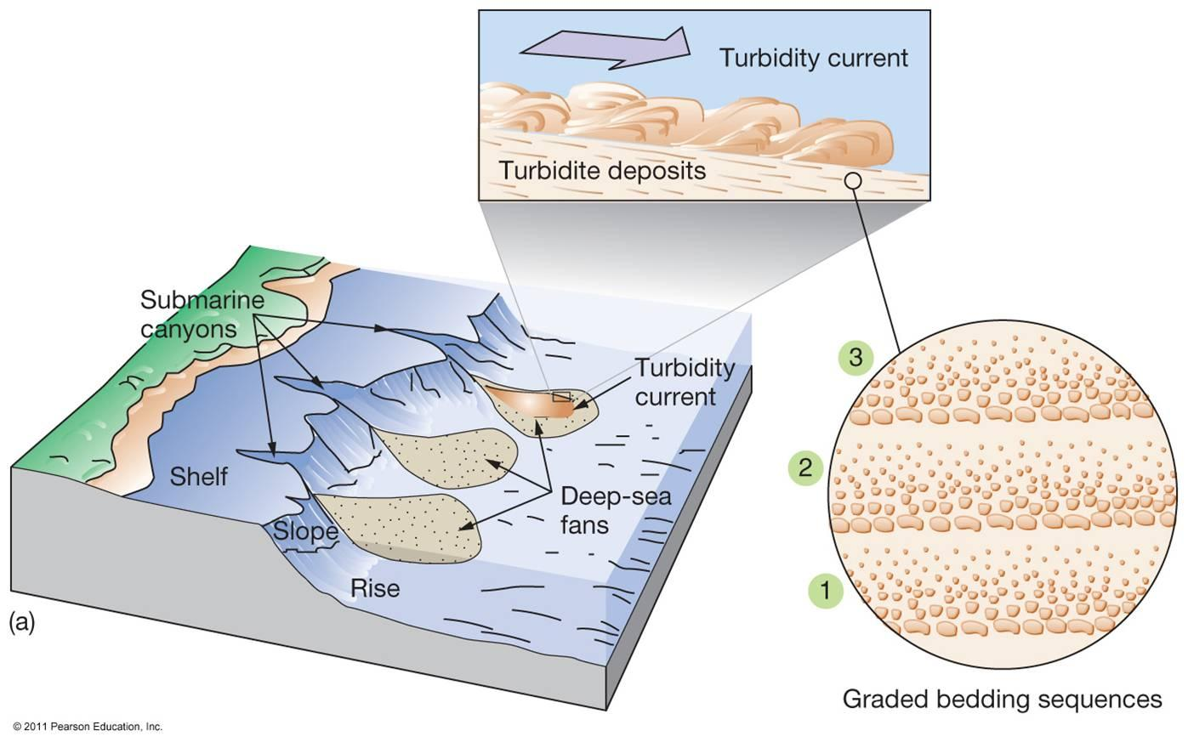
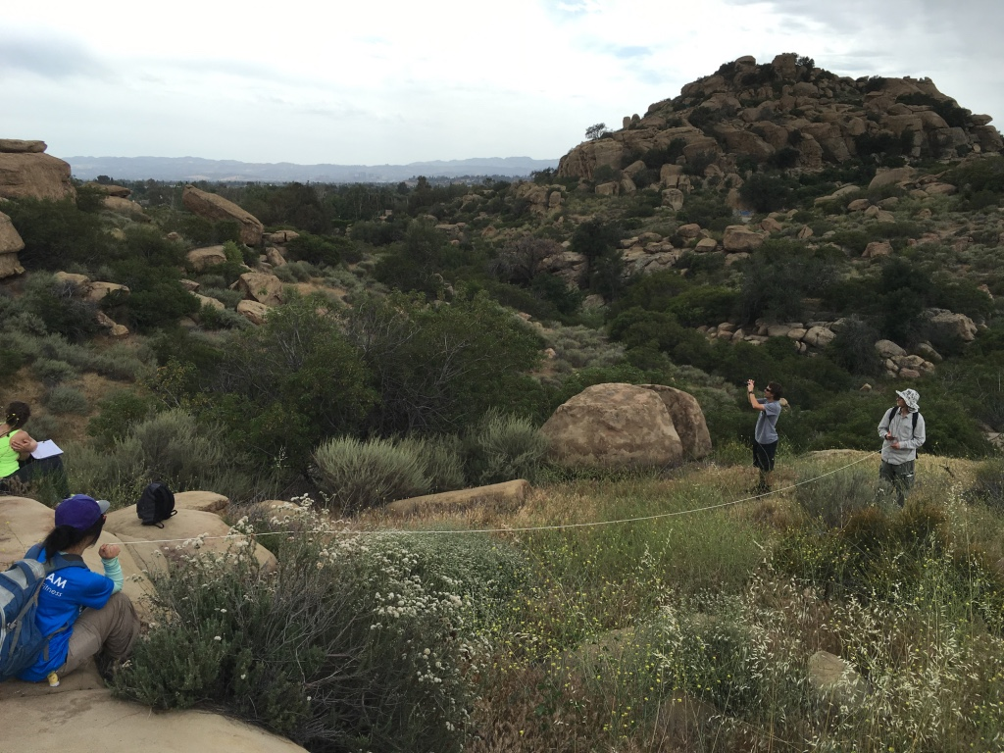
Geology
Turbidites: formed by turbidity currents or large, underwater landslides
Deposited in deep ocean canyons
Pacific and North American plates
Moving 2.5 inches NW a year
Different thicknesses throughout the formation
Soil consisted of sand, gravel, and clay

Slide 4
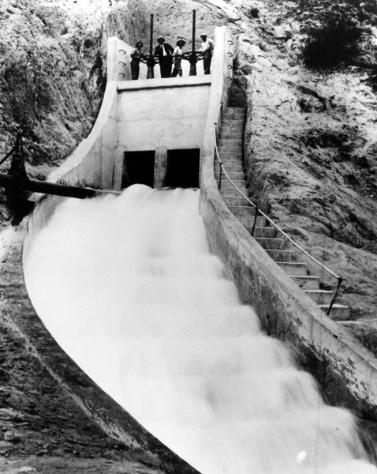
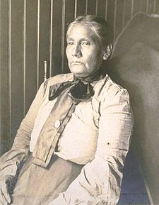
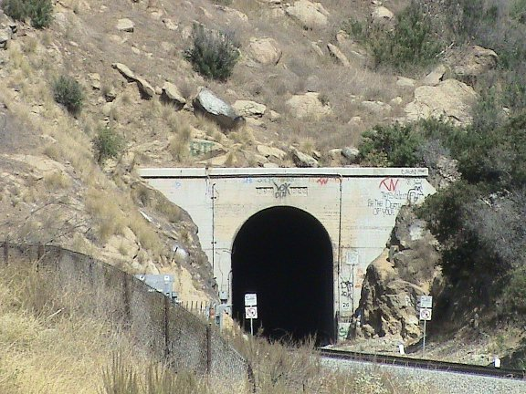
Site History
Was home to the native Gabrielino-tongva Indians for thousands of years
Gathering, hunting, and some agriculture
Different plant, animal, and mineral resources
Mid-1800s: Southern Pacific Railroad
In the 20th century the construction of LA aqueduct and the reservoir facilitated large scale agricultural development by providing this semi-arid section of the Valley with a reliable and abundant water supply.
Filming site for movies and television shows
It was designated Los Angeles Historic and Cultural Monument in 1974, because of its historic and cultural value.

Slide 5
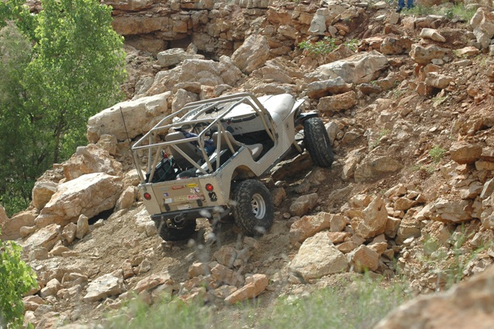
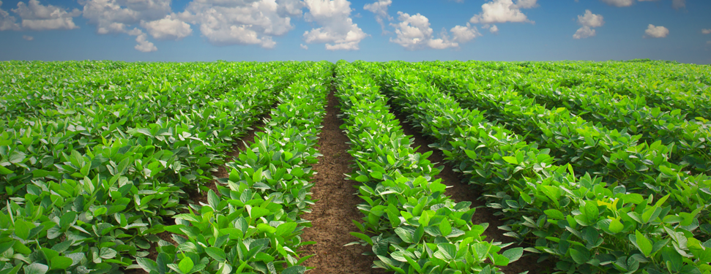
Area Disturbances
Railroad construction
Significant land alteration
Native people, plants and animals displaced
Economic/Recreation
Mining
Agriculture: oranges, lemons, walnuts, melons, and Kadota figs.
Filming equipment
Rock climbing and hiking
Off-highway Vehicle use
Equestrian activities

Slide 6
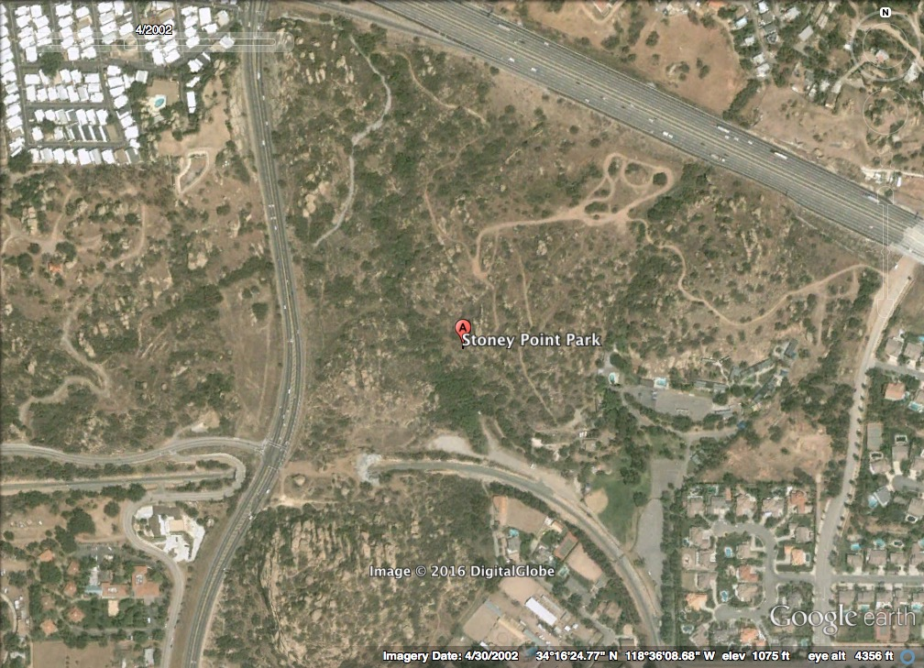

Slide 7
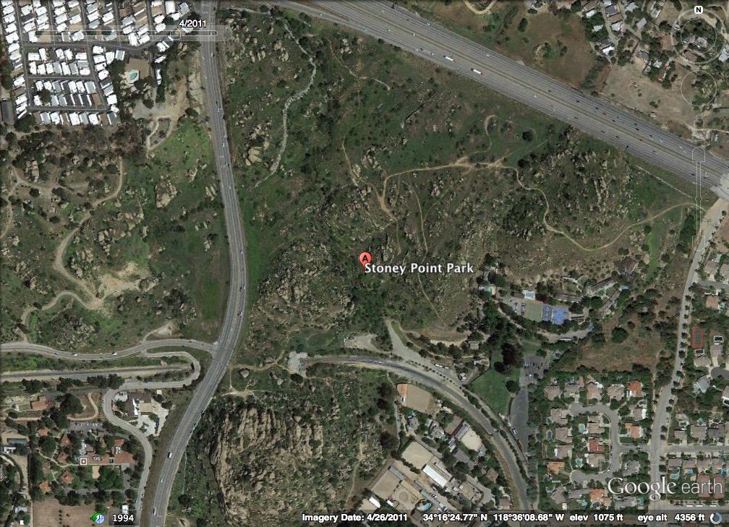
Null Hypothesis: There is a significant difference between the land cover in recovering and stable boundaries.
Alternative Hypothesis: There is no significant difference between the land cover in recovering and stable boundaries.

Slide 8
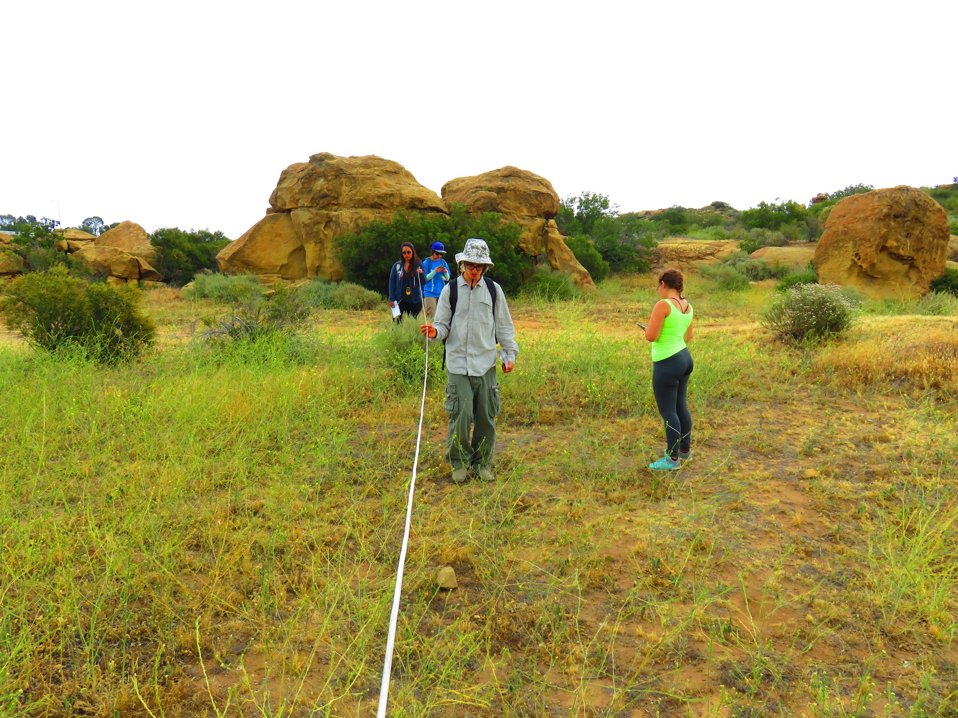
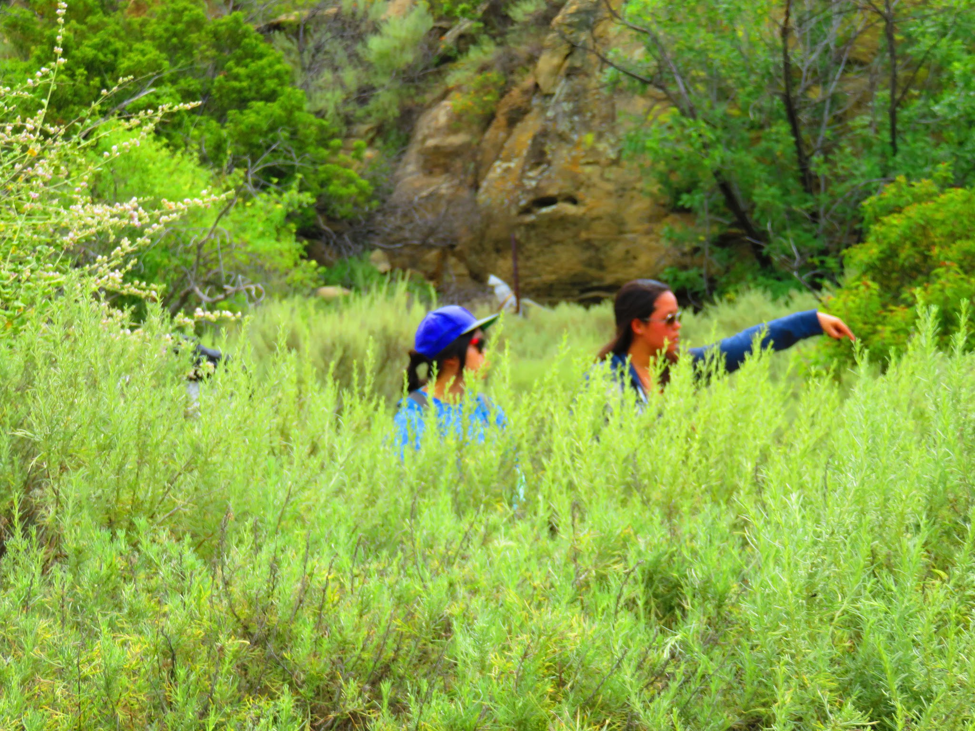
Data collection
Google Earth to find recovering and stable areas
Time-slider feature
Ten transects over two sites, recovering and stable
10 meter transect line
sampling every meter
#0 sample at trail edge
Garmin unit and cell phone application (GPS Map+)
CalFlora for identification

Slide 9
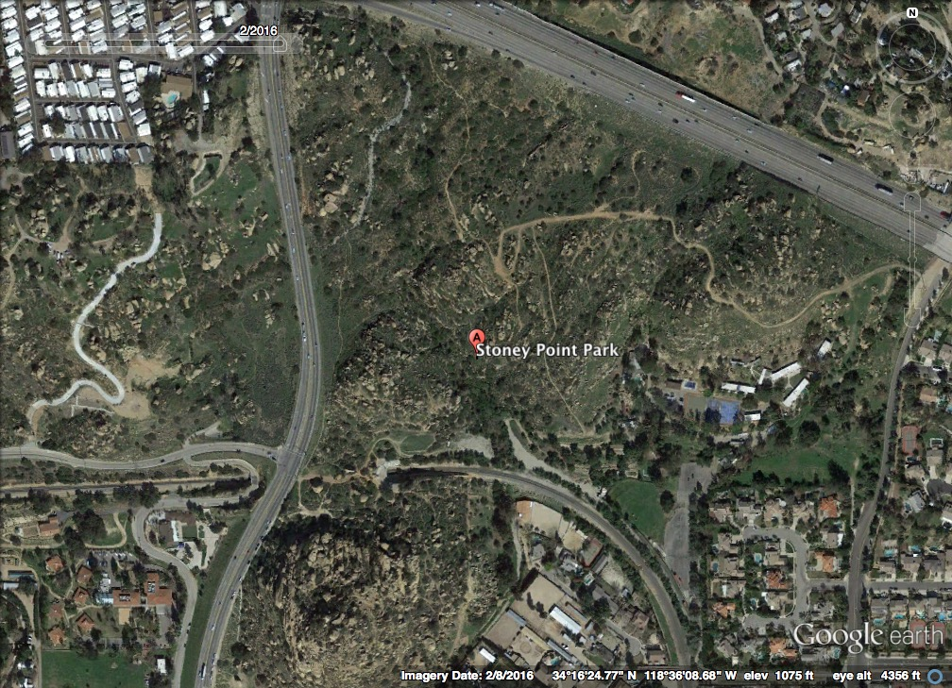

Slide 10
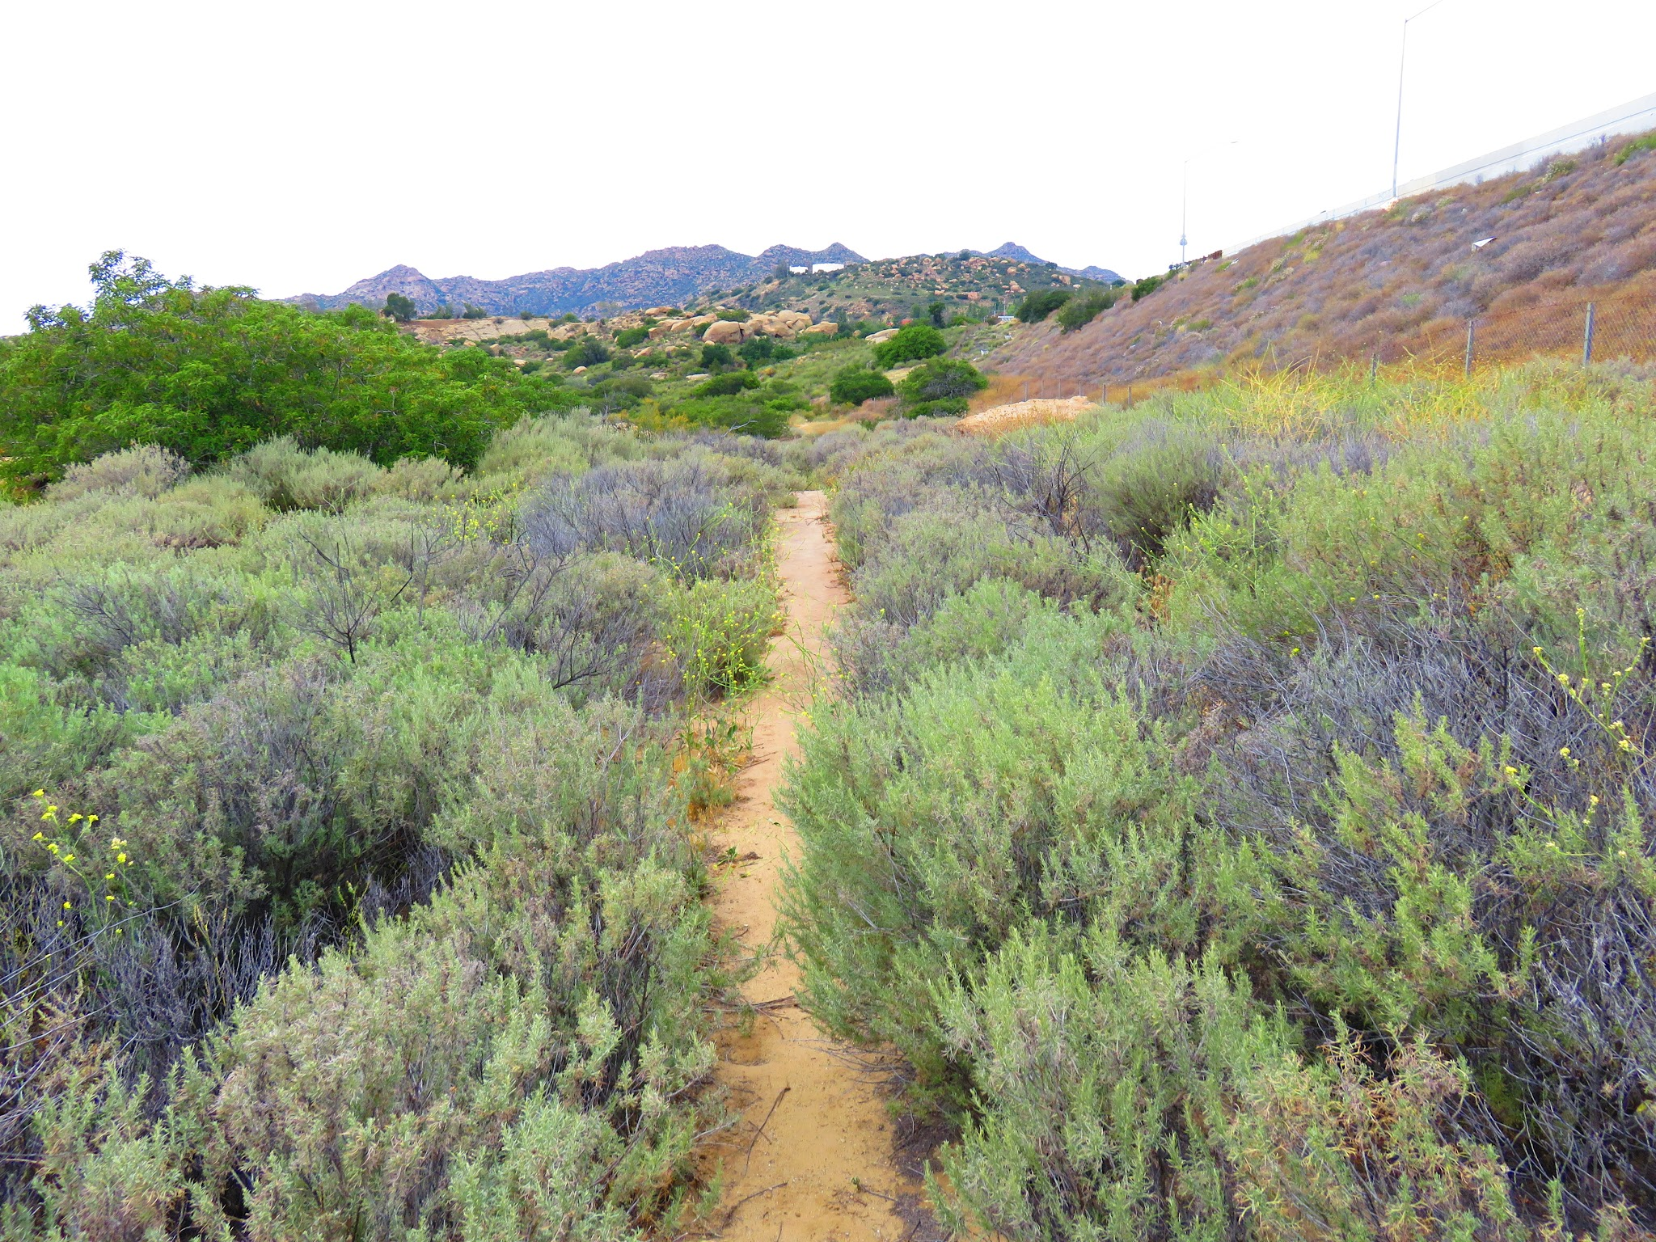
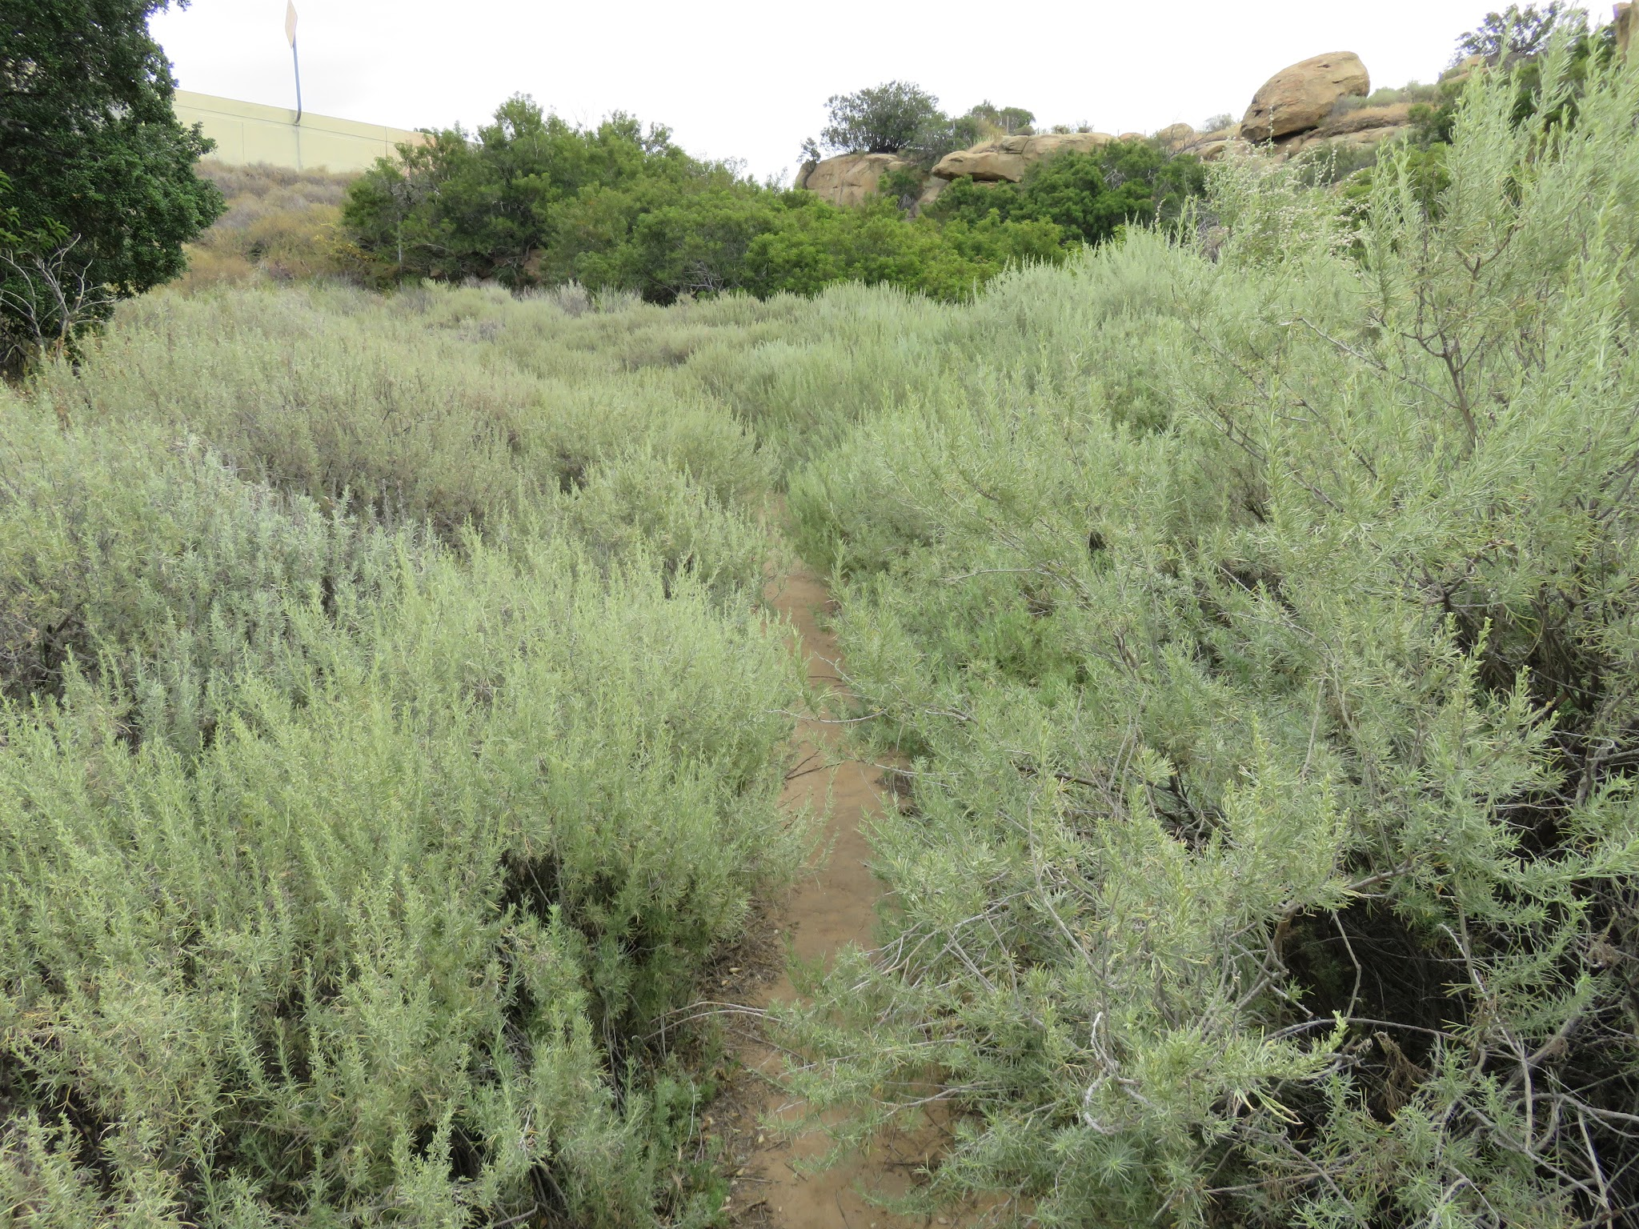

Slide 12
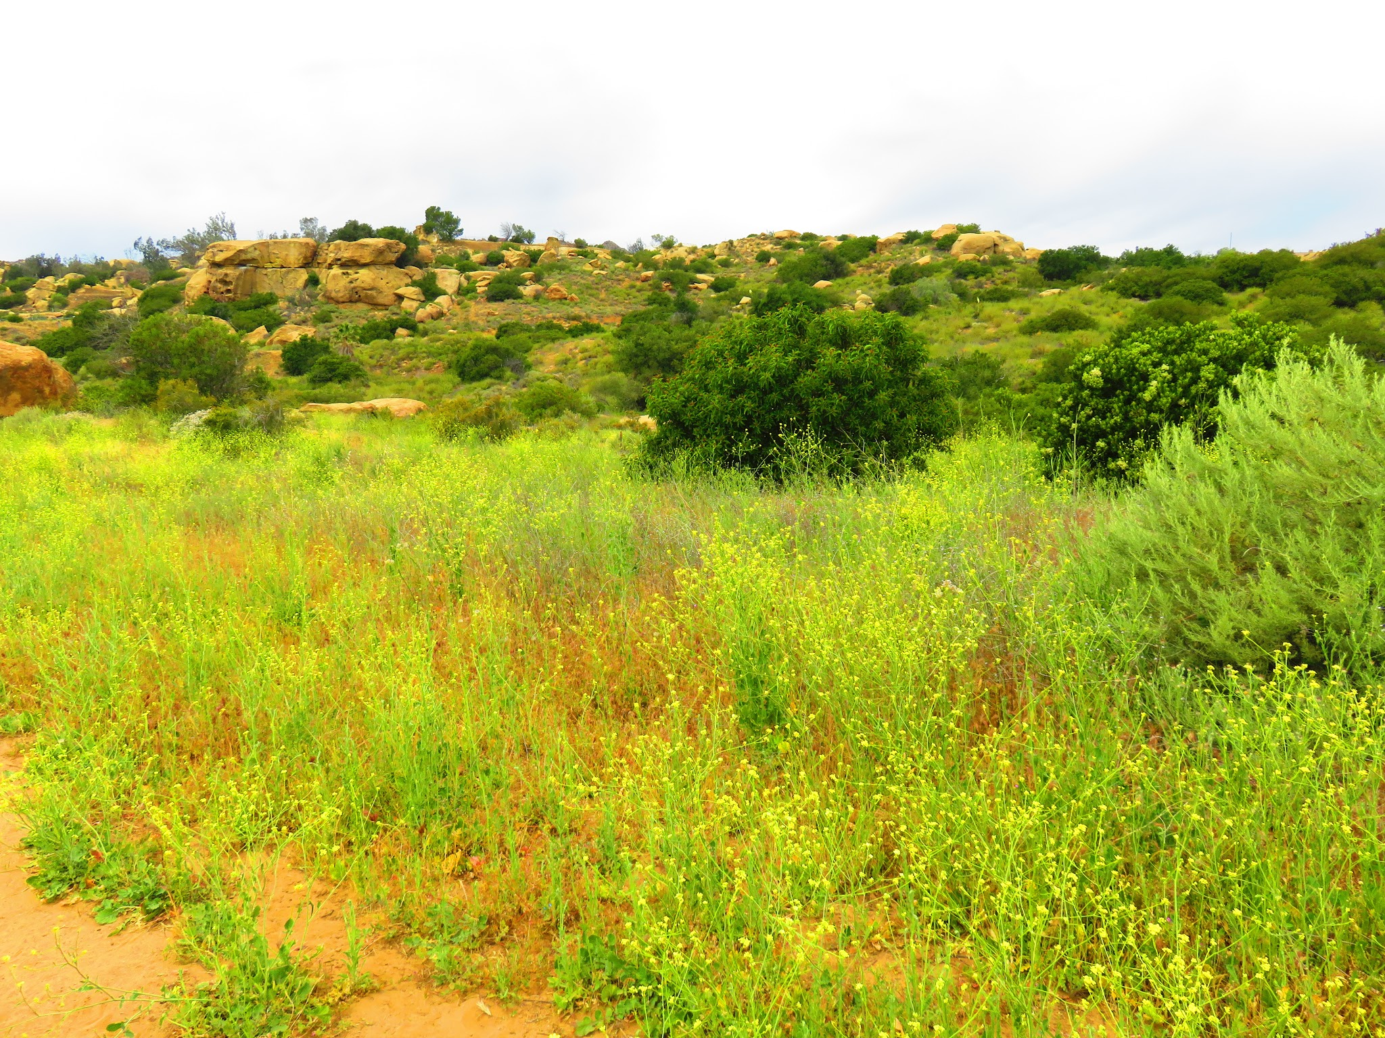
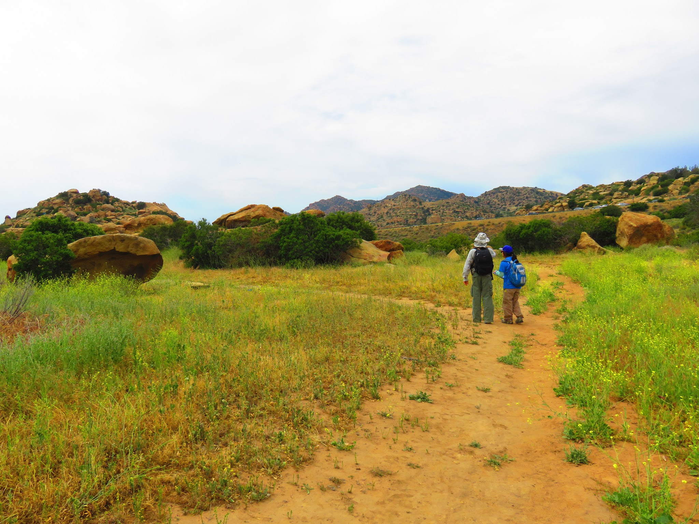

Slide 13
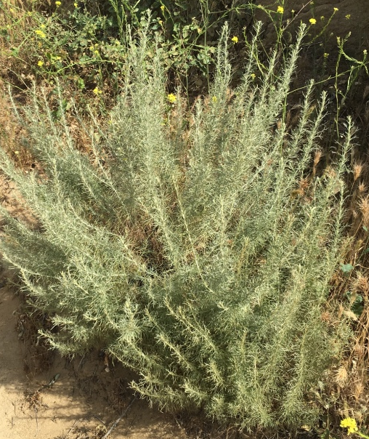
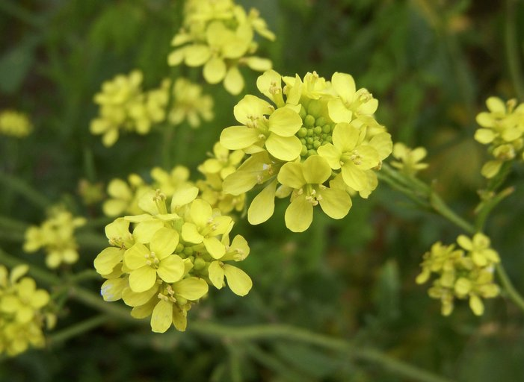
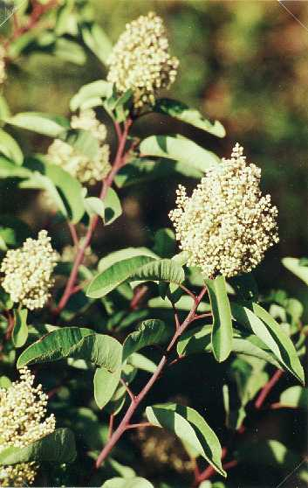
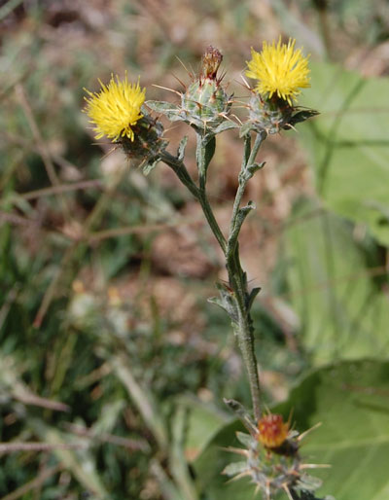
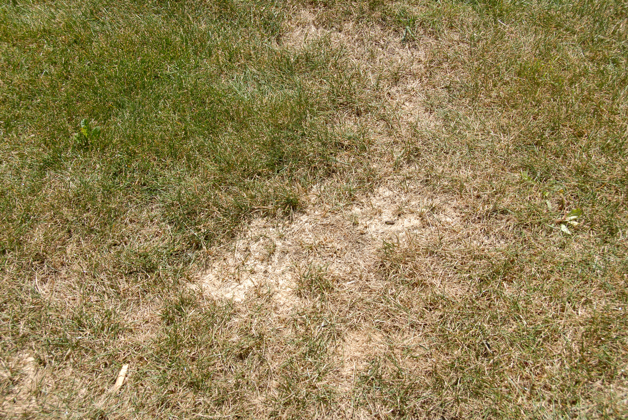
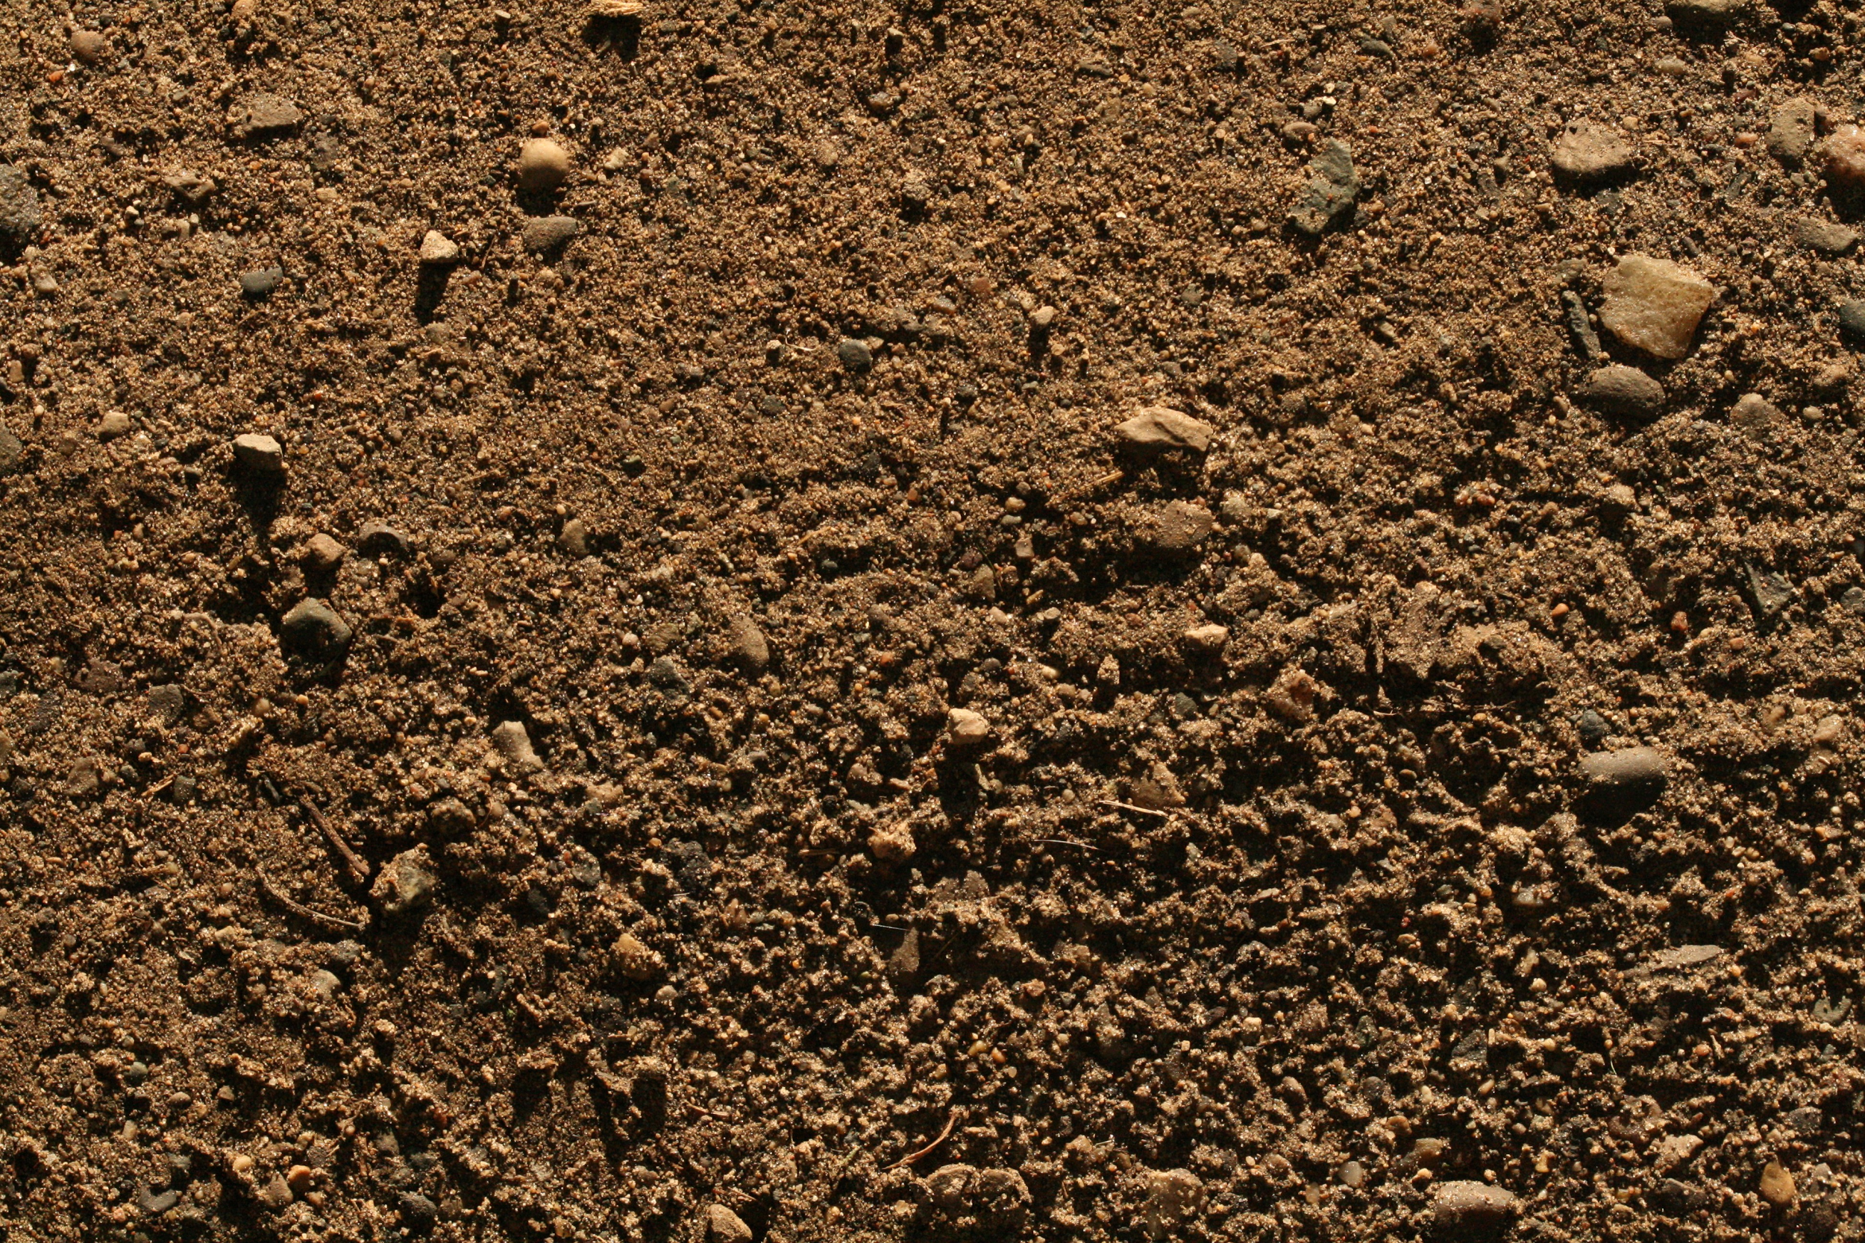
Species In Focus
Other Species In Both Boundaries
Artemisia californica
Hirschfeldia incana
Exotic/Dead Grass
Dirt
Centaurea melitensis
Malosma laurina

Slide 14
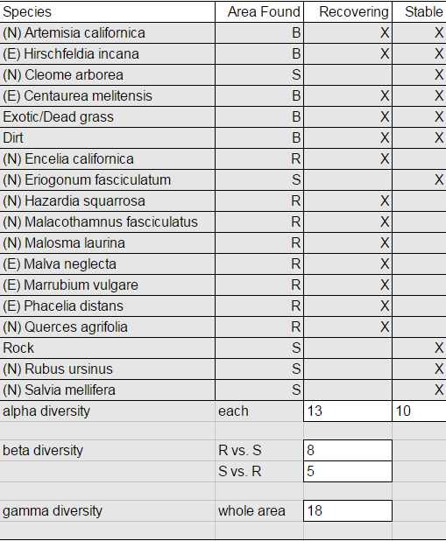
Results
Alpha: Recovering= 13 Stable= 10
Beta: R vs. S S vs. R
8 5
Gamma: 18
Greater ß in R vs. S
Recovering boundary is more unique and distinct in species compared to Stable boundary

Slide 15
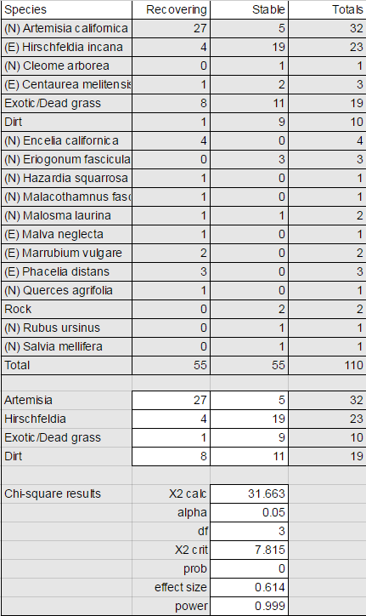
Results
Chi-square analysis
X2calc: 31.663 > X2crit: 7.815
Significant findings
Alpha: 0.05 > P-value: 0.000
Significant findings
Effect Size: 0.614
Moderate (0.5 < 0.614 < 0.8)
Power: 0.999
> 0.8 = strong
Confirms our Null hypothesis that there is a significant difference between the land cover in recovering and stable boundaries

Slide 16
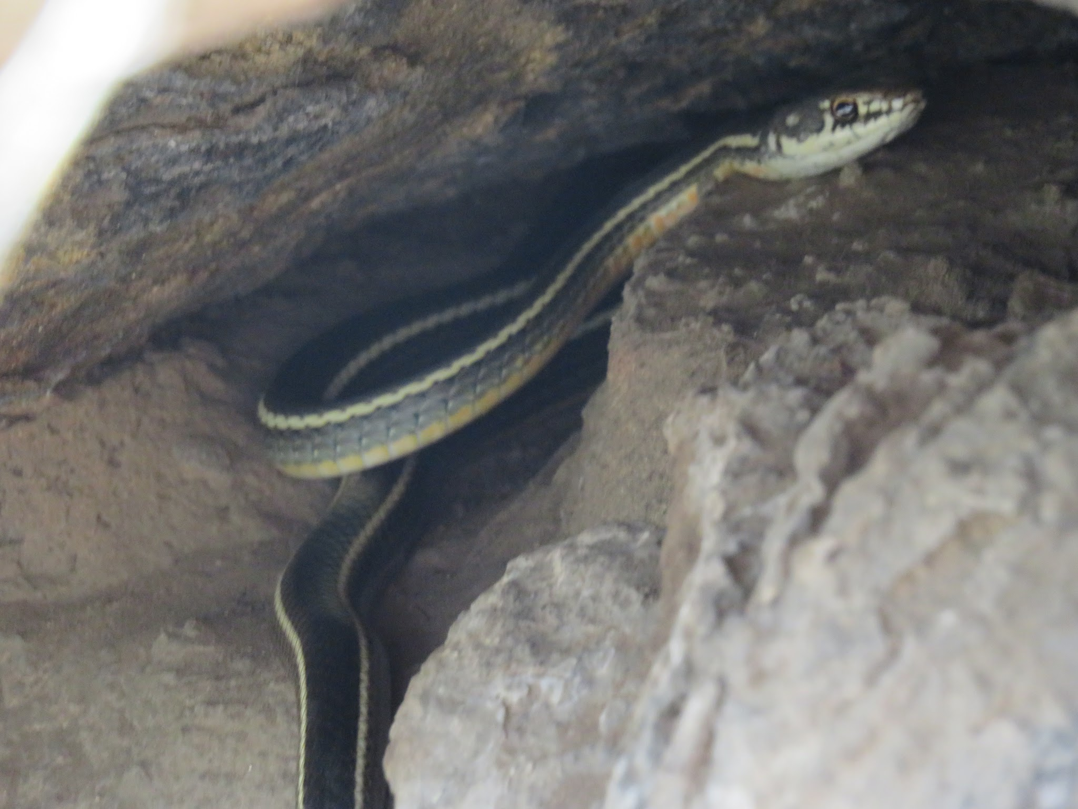

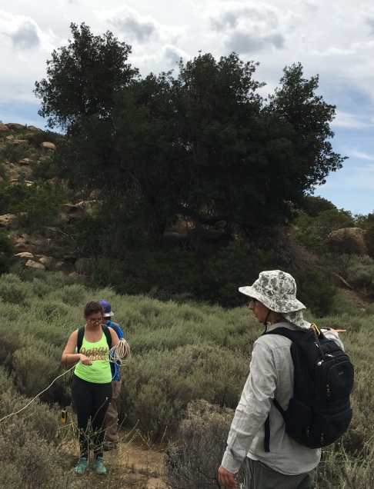
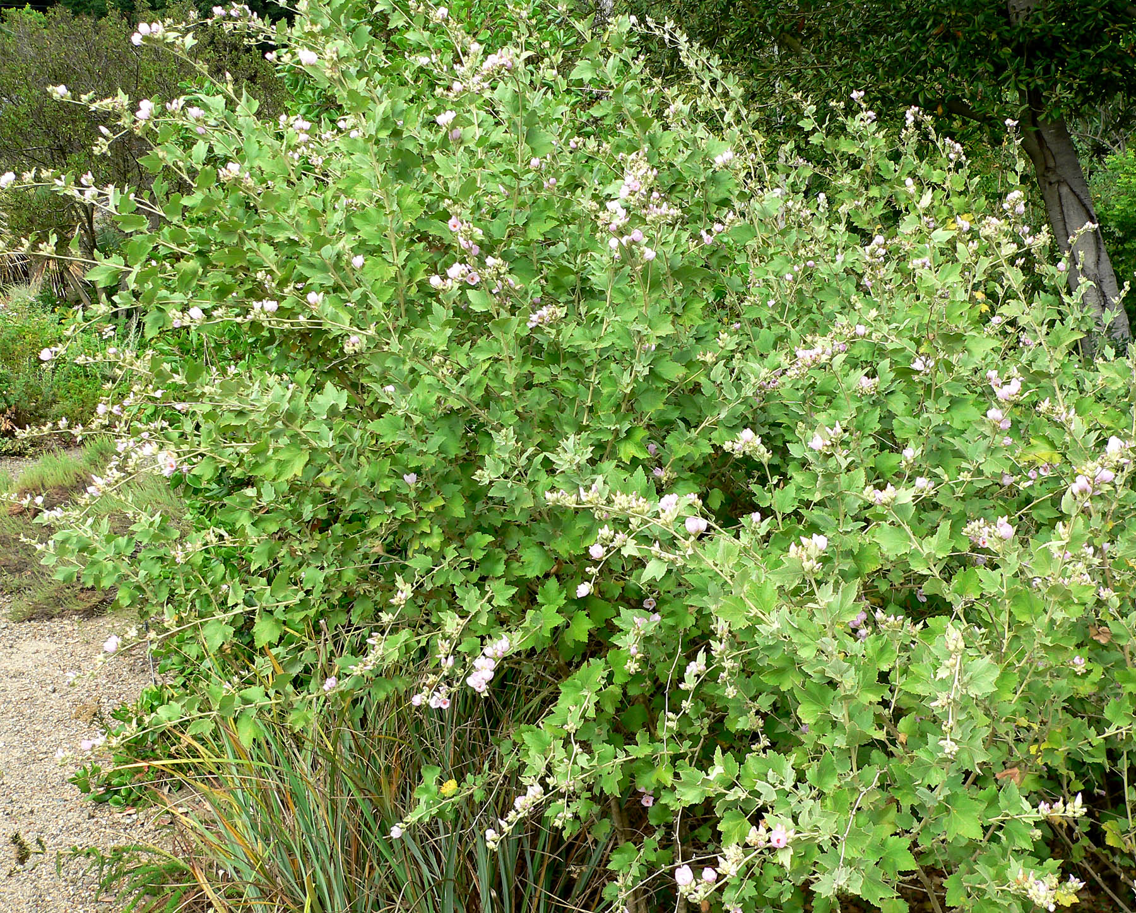
Biases
GPS inaccuracy
One was Garmin and another was an unprofessional GPS cell phone app
The coordinates were slightly off but the most concerning reading was the great differences in elevation
Selective transects
Personal preferences to have unique critters into our transects
CSS preferences in Artemisia californica
SAFETY

Slide 17
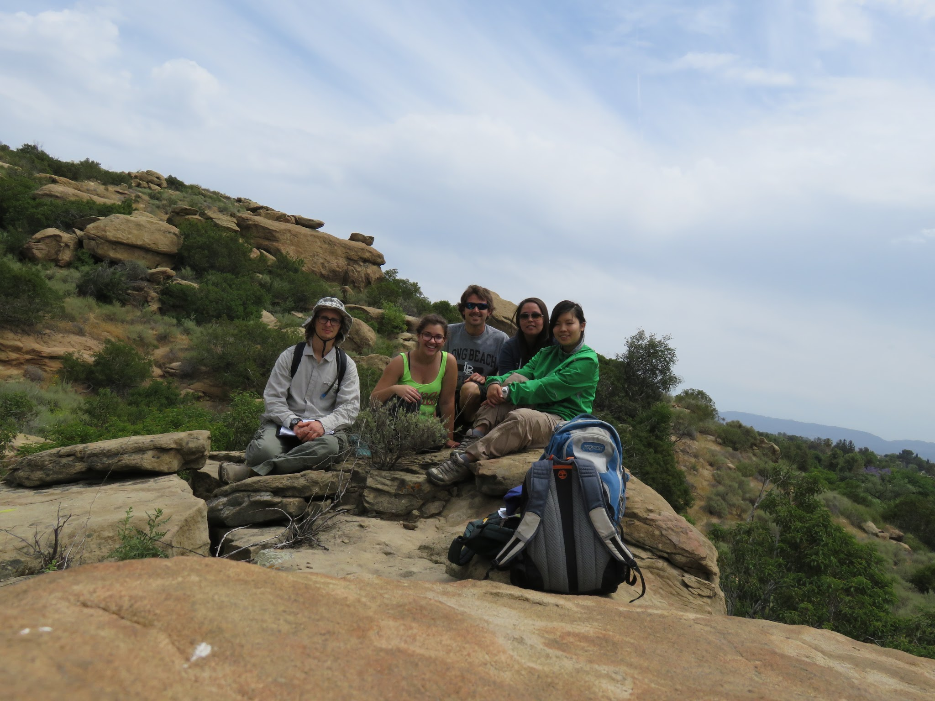
Conclusion
More samples should be collected to have more data for better results
Transect in other areas
Wearing long pants
Beware of animals
SNAKES!
Be prepared for rain
Obtain other data such as soil compaction, fire frequencies, presences of high soil nitrogen and compare the dominations of exotic species for further research

