Slide 1
Analysis of CSS and Chaparral Population in Placerita Canyon State Park
Vincent Faria ~ Narith Voeun ~ Matt Briley ~ Joshua Monsanto

Slide 2
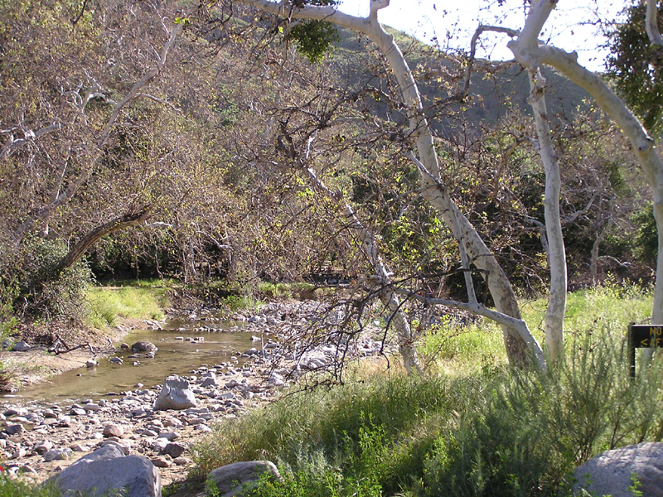
Placerita Canyon State Park Study Area
State Park established in 1950
The park encompasses:
Oak woodland
Chaparral
Riparian Plant Communities
Transecting conducted on
CSS/grassland boundaries
Chaparral/grassland boundaries

Slide 3
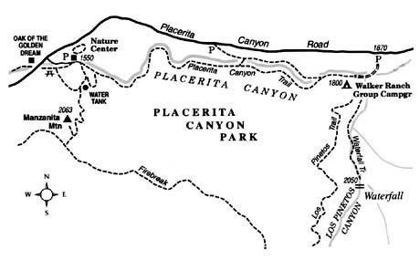
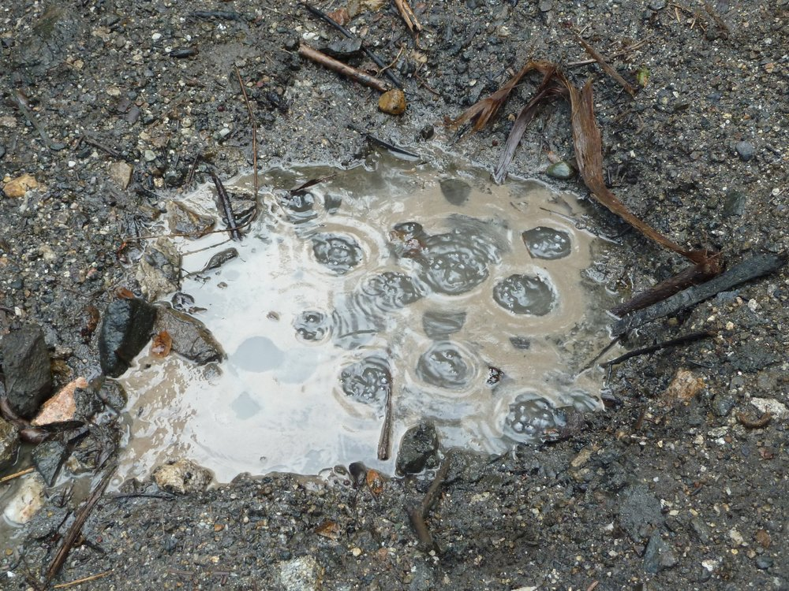
Placerita Canyon State Park Study Area

Slide 4
Questions Adressed
How diverse are CSS and Chaparral plant communities in Placerita State Park?
Are CSS and Chaparral plant communities in recovery In Placerita State Park?
How have these plant communities changed since 2009?

Slide 5
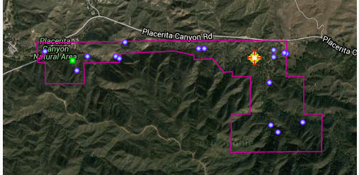

Methods and Tools of Evaluation
Tools:
Tape measure
Garmin GPS unit
Camera
Google Earth Imagery
Calflora website
Excel spreadsheet
Historical Google Earth photos of Placerita Canyon Park
Indicating plant species boundaries & density

Slide 6
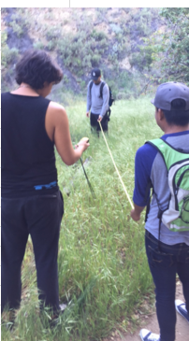
Data Collection Process
Visited Placerita Canyon Park in Newhall, CA
San Gabriel Mountains
Selected areas for testing based on Google Earth Research
10 meter transects
1 meter increments
Recorded/photographed Plant life at each increment
Tabulated data in spreadsheet
Used Calflora website to identify specific species
Compared results to historical photos

Slide 7
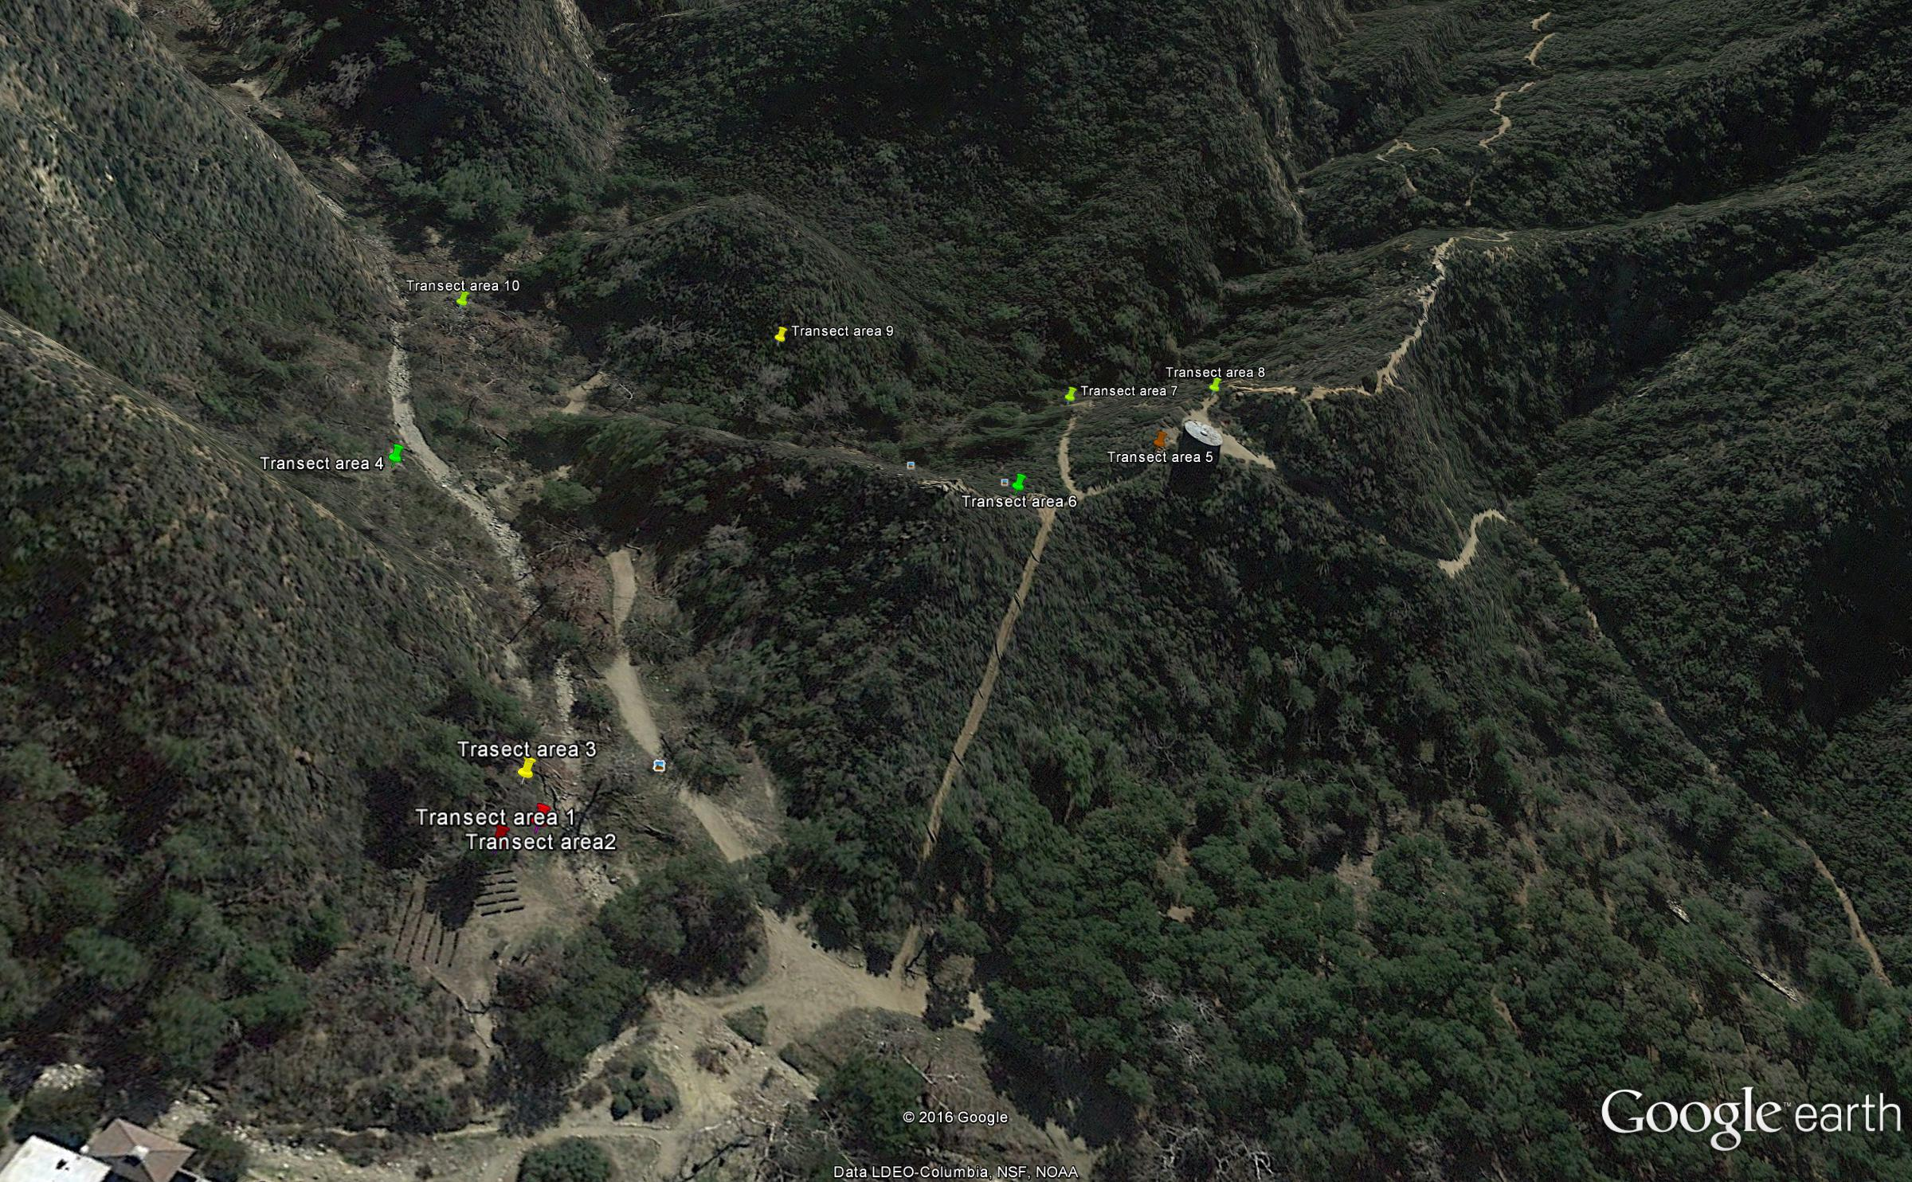
Transect Sites
2016

Slide 8
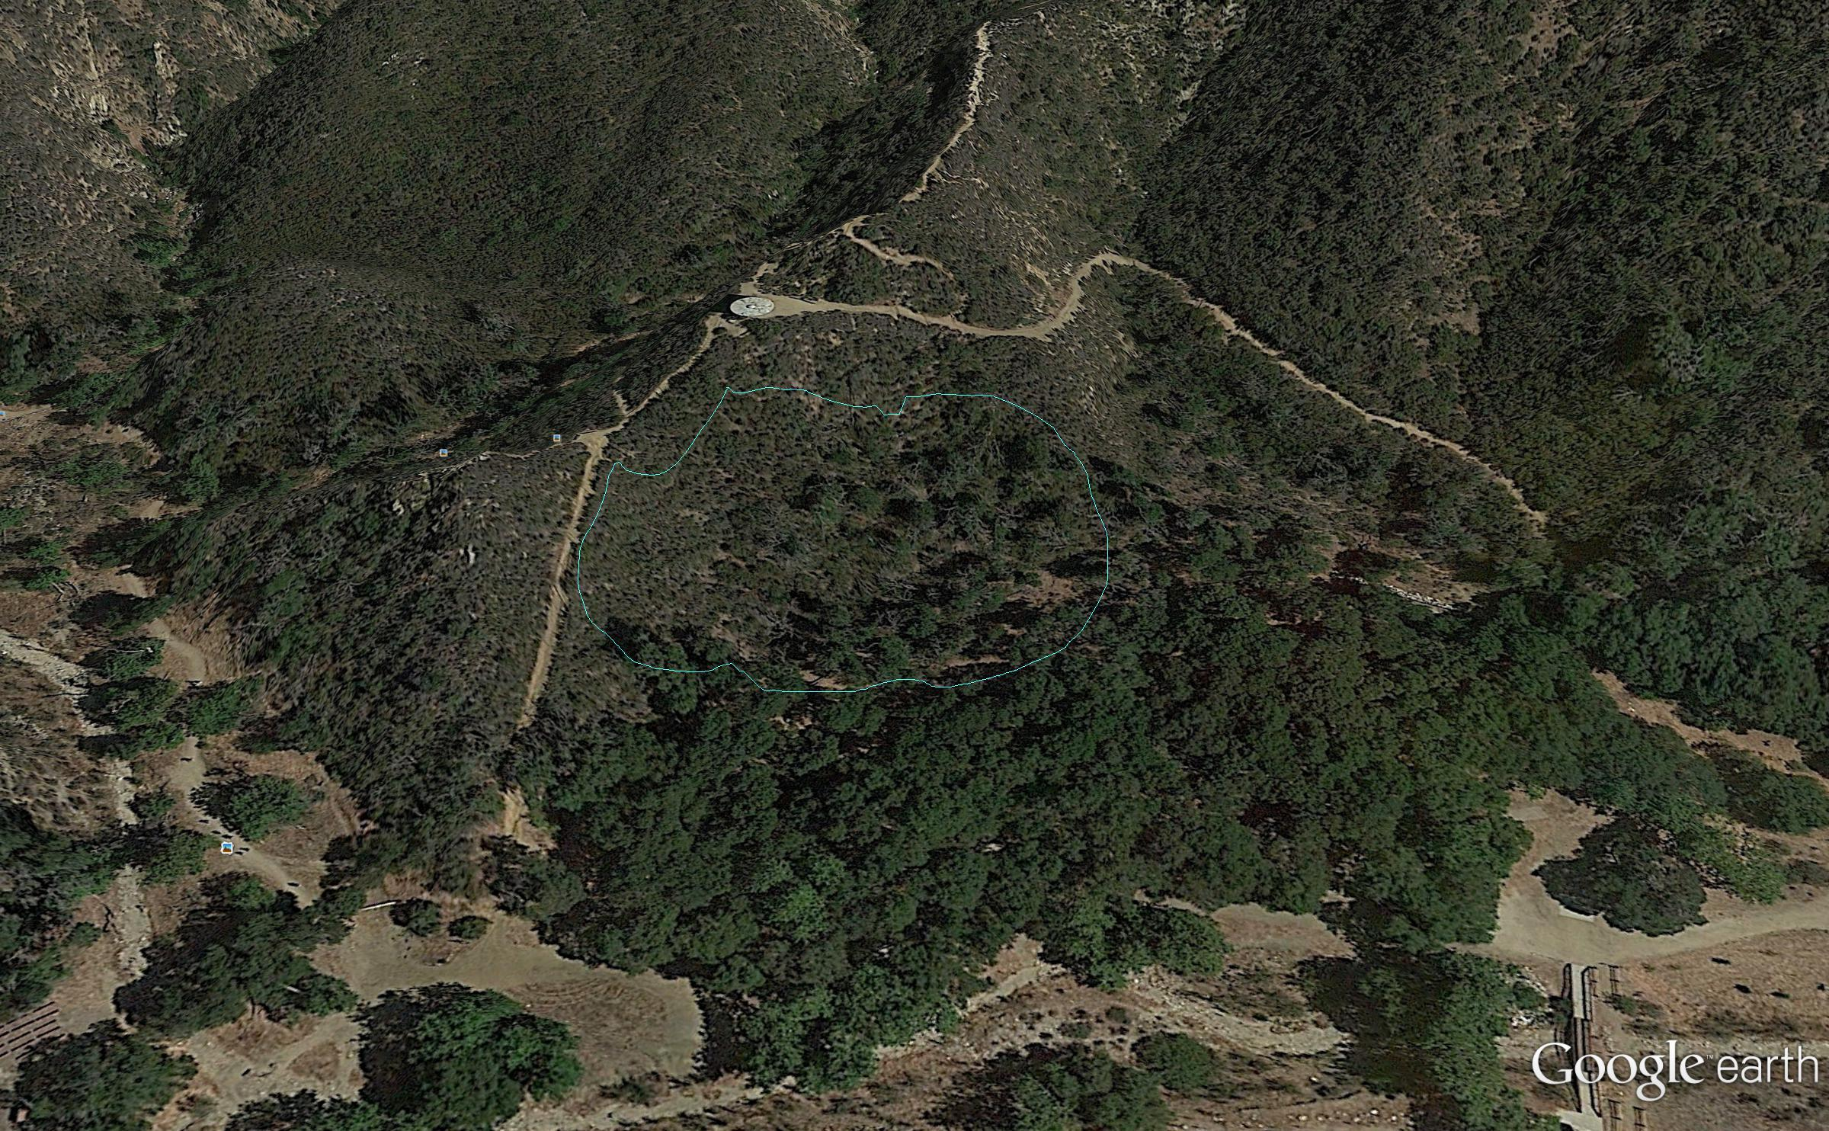
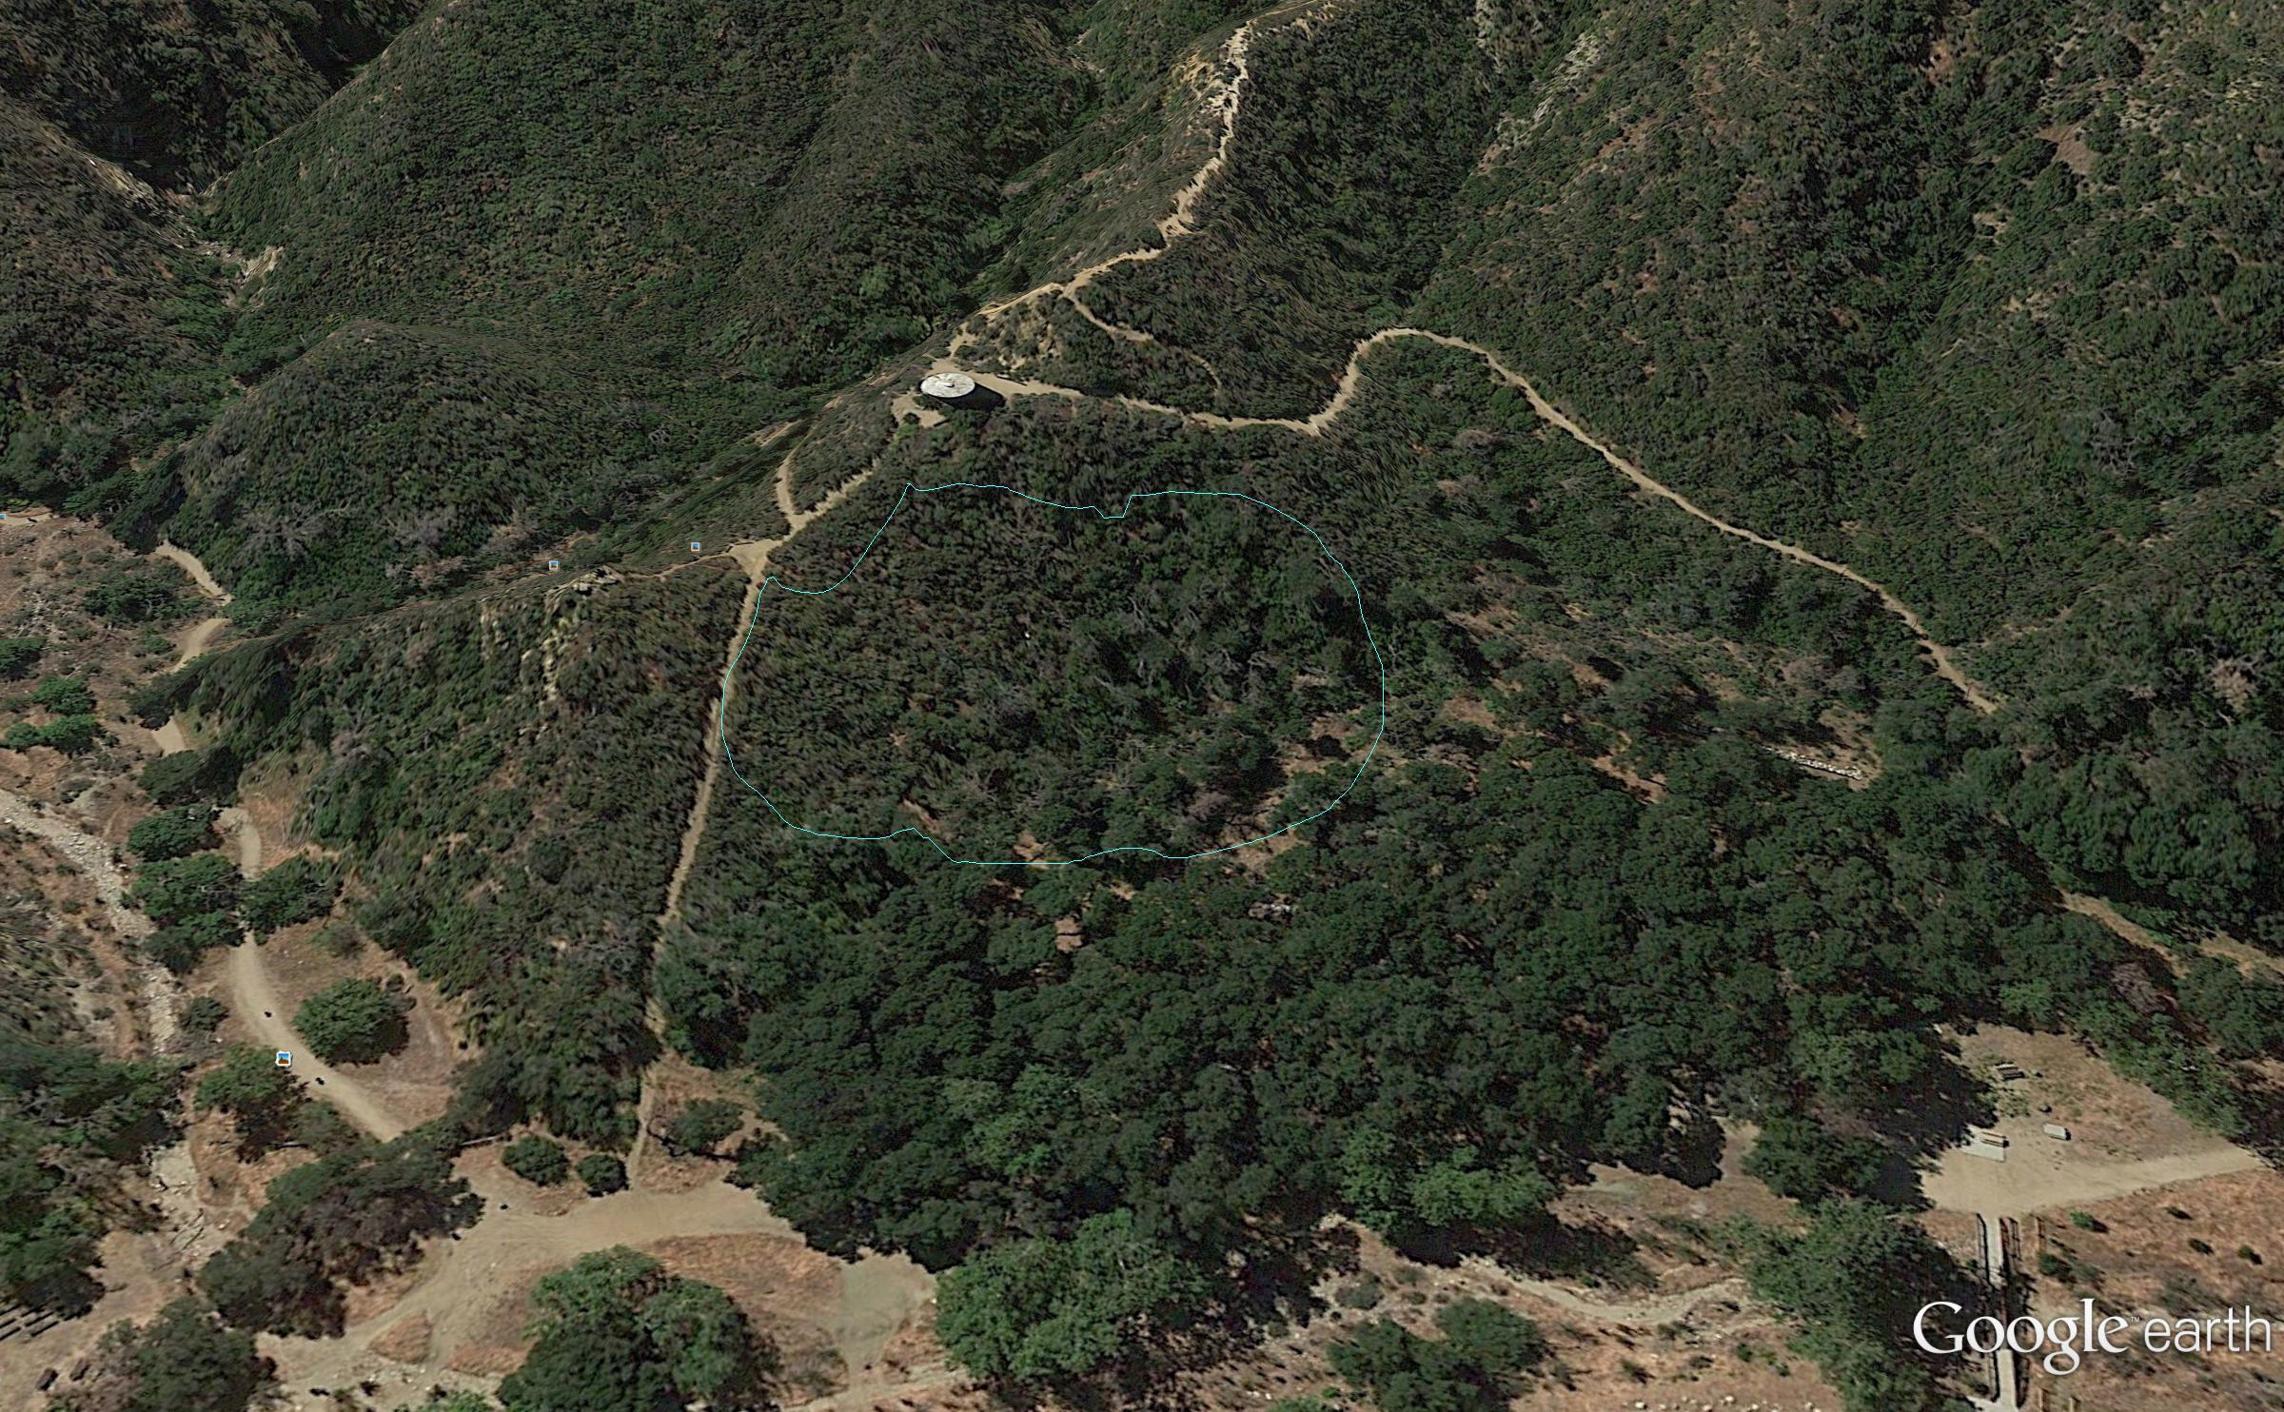
Timeline
2009
2011

Slide 9
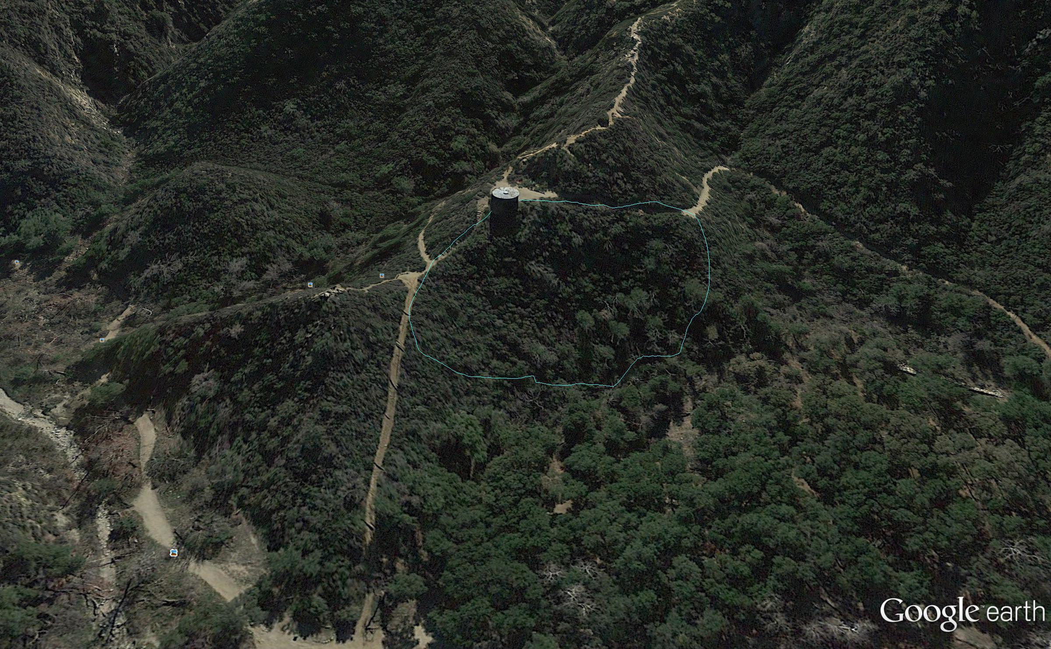
Timeline
2013
2016

Slide 10
Results
Diversity Levels
Beta
Count of all species identified in only one transect
36 species
Gamma
Count of all species identified
45 species
3 non-species selections excluded (rocks, dead shrubs, bare ground)
Alpha
Count of all species identified in each transect
Transect | 1 | 2 | 3 | 4 | 5 | 6 | 7 | 8 | 9 | 10 | Total
Alpha | 7 | 8 | 10 | 9 | 8 | 8 | 10 | 6 | 6 | 10 | 82
Excluded* | 4 | 3 | 1 | 2 | 3 | 3 | 1 | 5 | 5 | 1 | 28

Slide 11
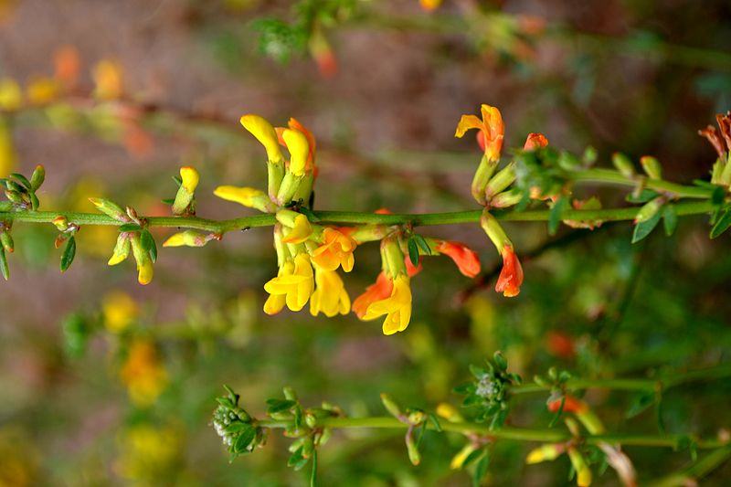
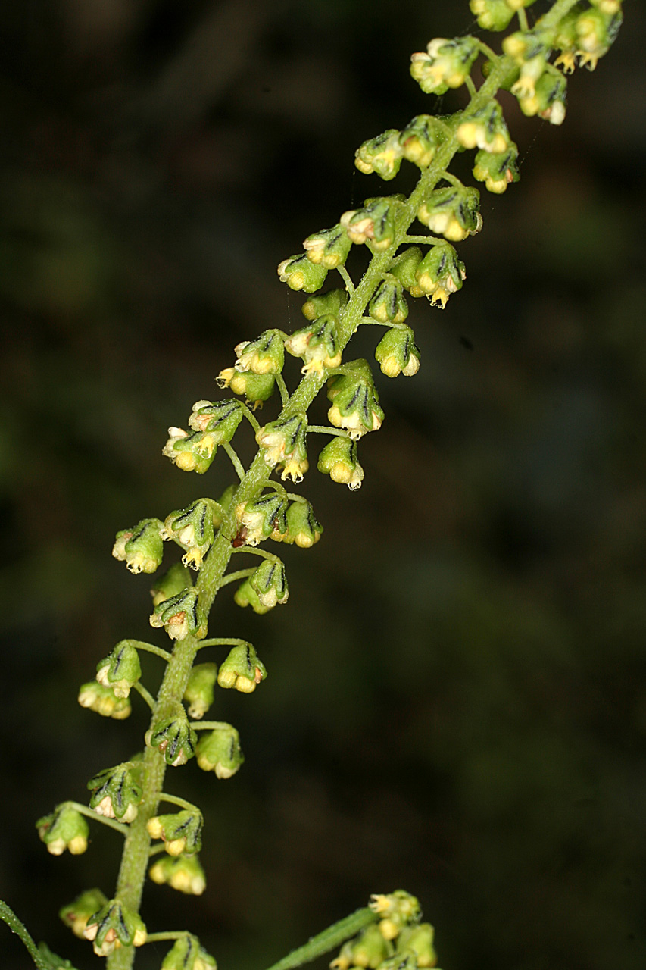
Most Common CSS found
Acmispon Glaber
Ambrosia Acanthicarpa

Slide 12
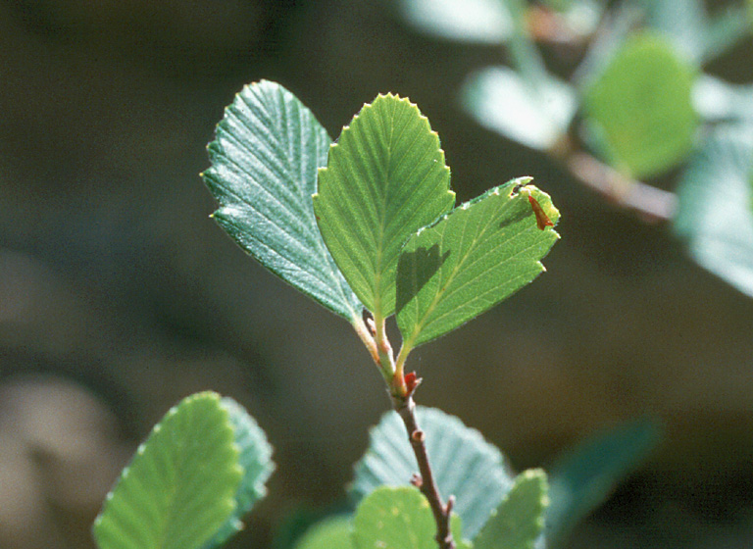
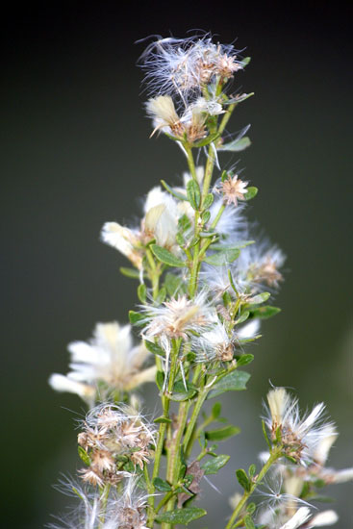
Most Common CSS found
Cercocarpus Betuloides
Baccharis Pilularis

Slide 13
Conclusion and Recommendations
From our timeline analysis, we concluded that CSS growth has been in recovering
There is evidence that CSS is recovering based on satellite imagery and GPS coordinates.
The data results from our transects indicated that there are more native plants compare to non native plants
More data samples are needed to develop a more accurate study

Slide 14
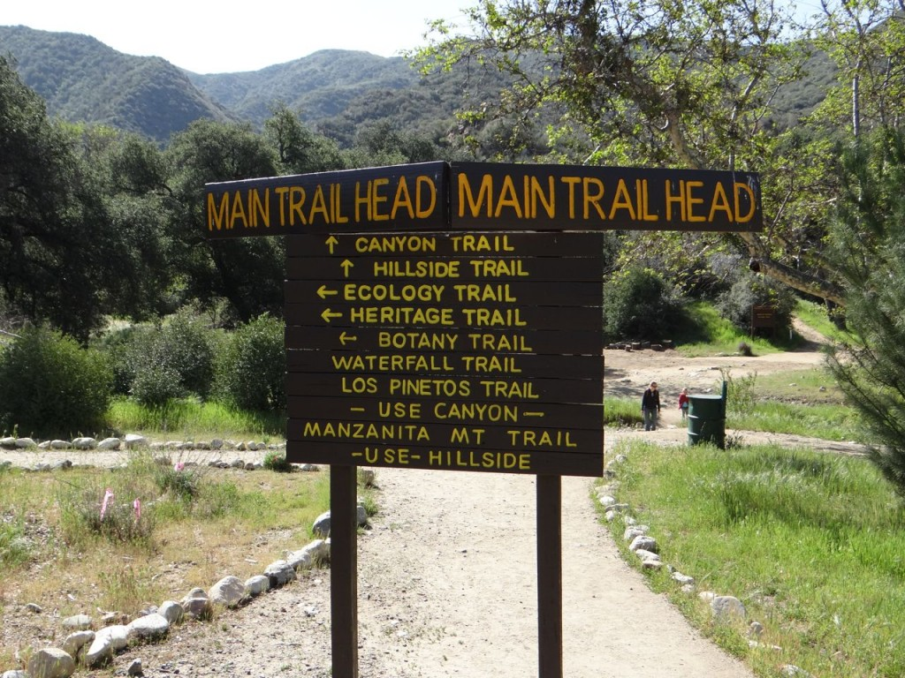
Biases
Not an accurate representation of the entire park
Transect data from previous years would have been helpful

Slide 15
Bibliography
http://www.scvhistory.com/scvhistory/placerita.htm
http://tchester.org/plants/muns/sgm/placerita_canyon.html

