Slide 1
ESP 330 Group Research Project
Chino Hills State Park
CSS and Fire Succession
Celeste Dominguez
Lissete Henderson
Shireen Dideban
Gus Orozco

Slide 2
Research: What are we studying?
We decided to do research on fire succession by studying and comparing data gathered from an area before its most recent fire with data from an area after its most recent fire.
Chino Hills State Park is the post-fire location
Sepulveda Dam is the pre-fire location
Our main research question: Are there significant differences in the quantities and species of plants when comparing a “pre-fire” to a “post-fire” location?

Slide 3
Research Questions and Hypothesis
Research Questions:
Are there differences in the frequencies of various plant species when comparing a “pre-fire” to a “post-fire” location?
Are there certain species that are more prevalent post-fire? Are these species more prevalent because they are well adapted to recovering after fires?
How can we help CSS ecosystems to recover, post-fire succession, in order to protect the threatened and endangered animal species that rely on CSS ecosystems for survival?

Slide 4
Sepulveda Dam Region
This location has similarities to Chino Hills State Park in terms of geography, topography, and the types of plants that exist there.
Transects were done in the Fall of 2014, before the most recent fire, by CSULB students in the Geography 442 class

Slide 5
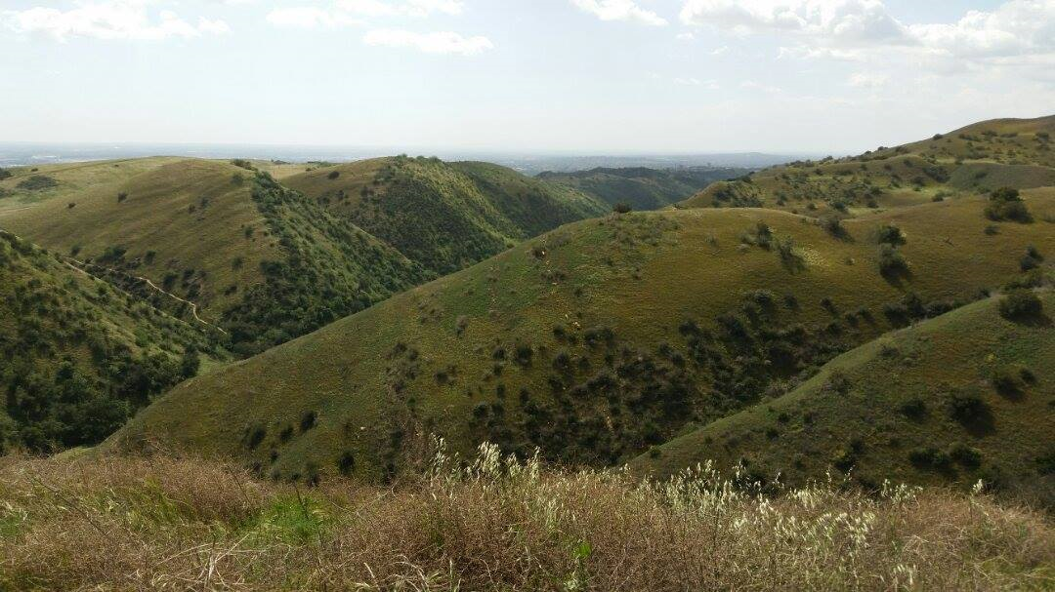
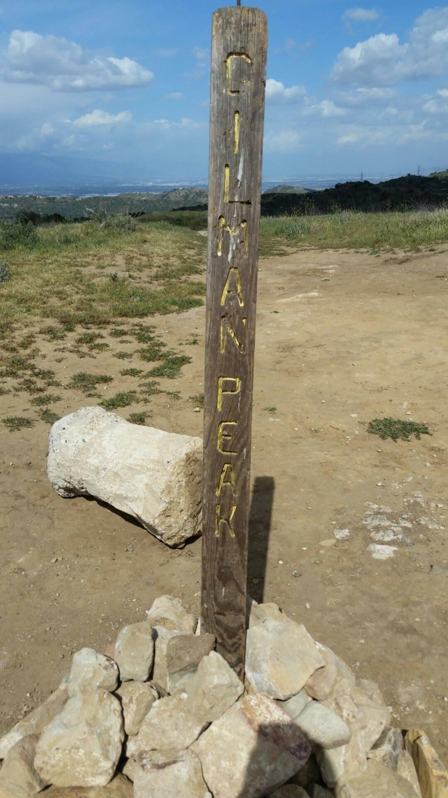
Study Site
Description:
Variety of rolling hills, mountains and canyons on its south and east sides
Elevation: ranges from 430 ft to 1781 ft (131.04m to 542.8m)
Soil type: distributed throughout were fine clay soils.
Vegetation habitats for Chino Hills include:
Riparian
Woodland
Grassland
Scrub
Chaparral
Climate:
Santa Ana mountains ranges from 20 to 30 inches in annual precipitation
Most of the precipitation falls between November and March

Slide 6
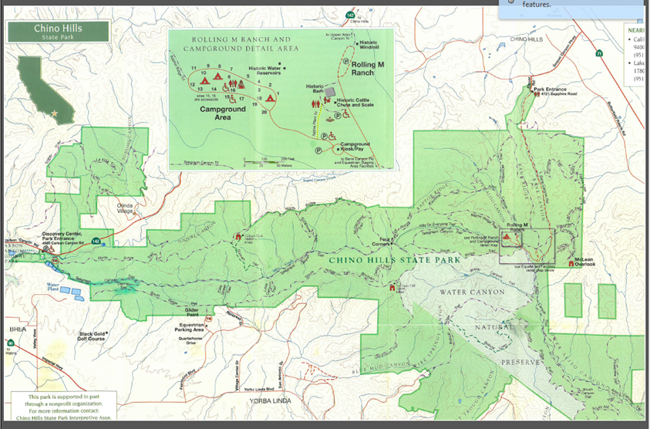

Slide 7
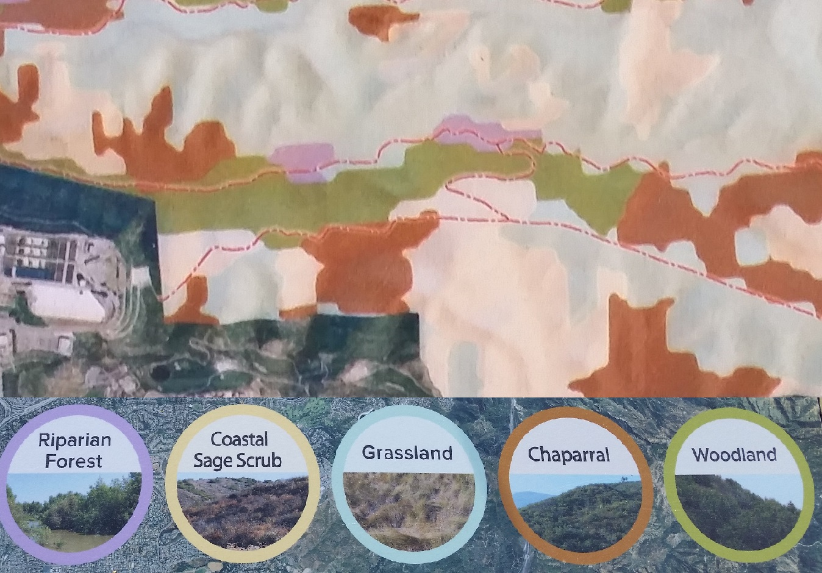
Chino Hill State Park Discovery Center
Telegraph Trail
Diemer Trail
Southridge Trial
Coastal Sage Scrub

Slide 8
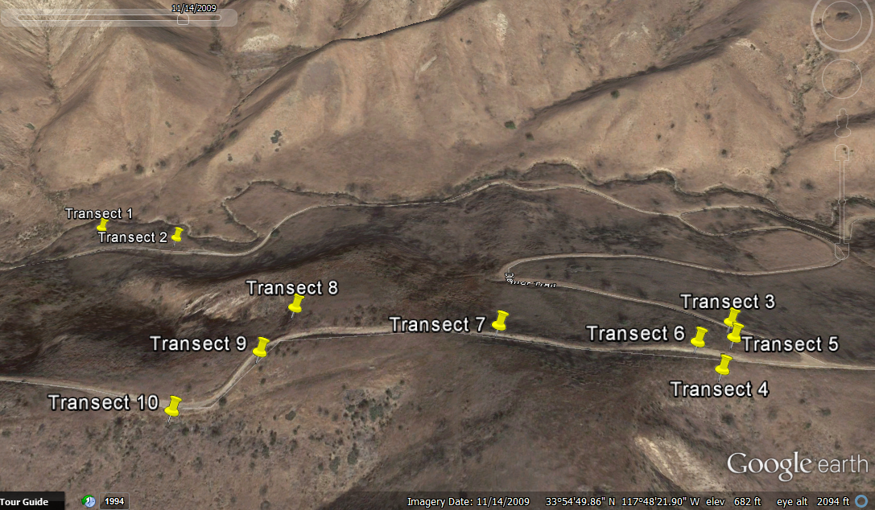
Transect Locations
Transects

Slide 9
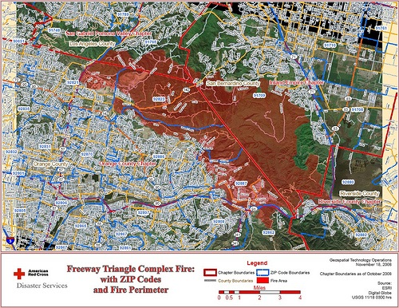
Fire of Chino Hills State Park
Freeway Triangle Complex Fire 16 Nov. 2008
Combination of two fires
Human-started fire
Burned 90% of CHSP and nearby areas.
All of the CSS in the areas that we were studying was burned during the fire.
americanredcross.org

Slide 10
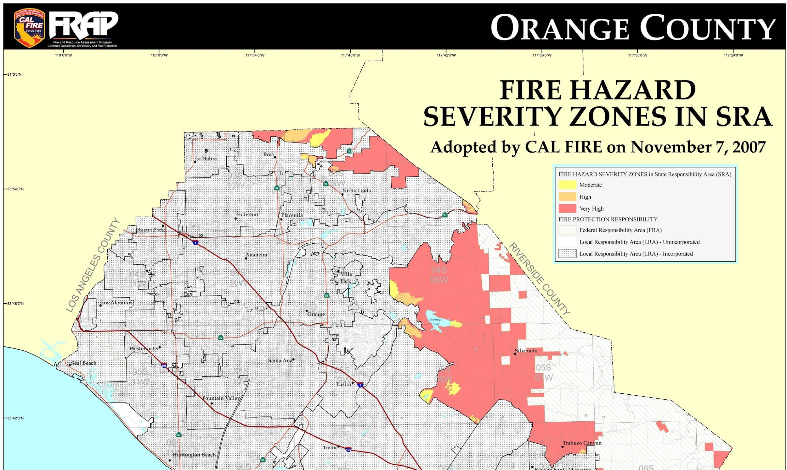
Fire Hazards in Transected Area
http://www.fire.ca.gov/fire_prevention/fhsz_maps_orange

Slide 11
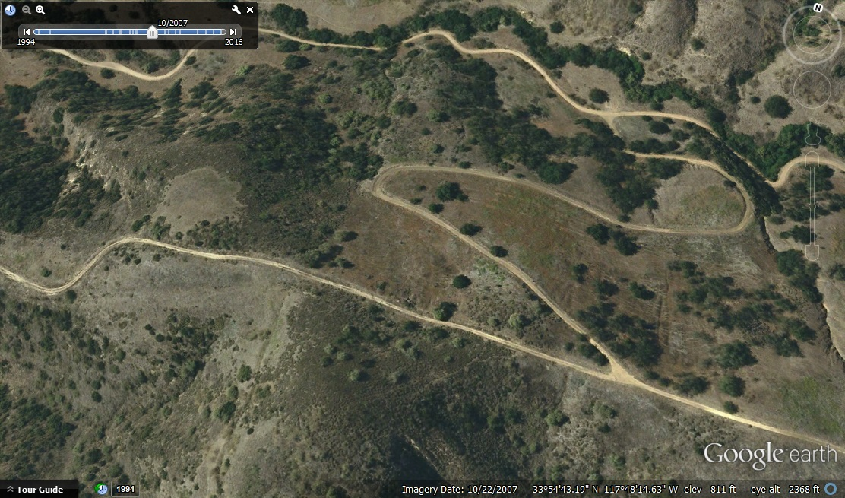
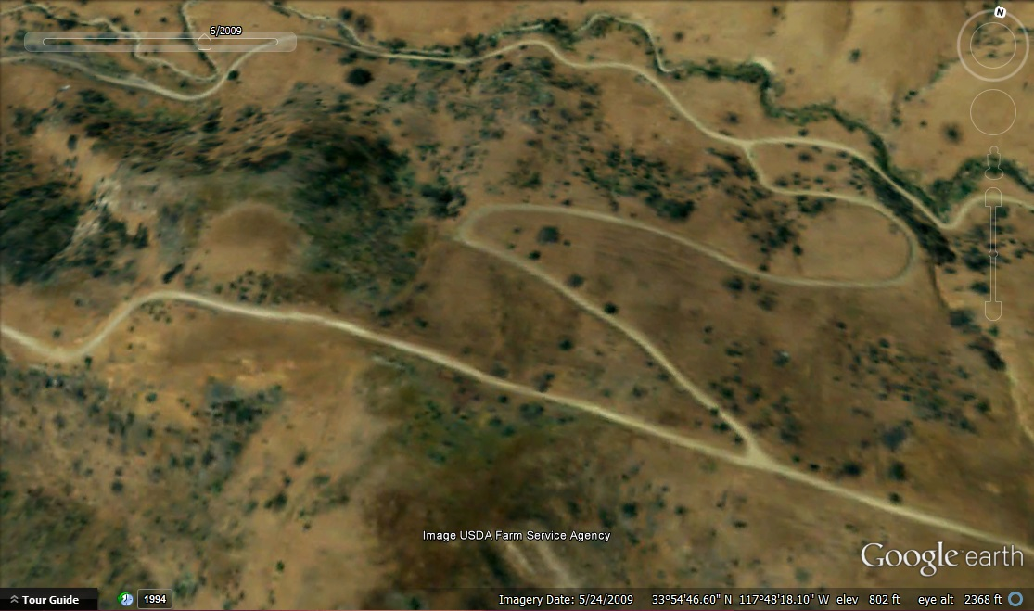
22 October 2007 vs. 24 May 2009
The image on the Left shows the transected area prior to the 2008 fire and the image to the Right is the same area 6 months after the fire.

Slide 12
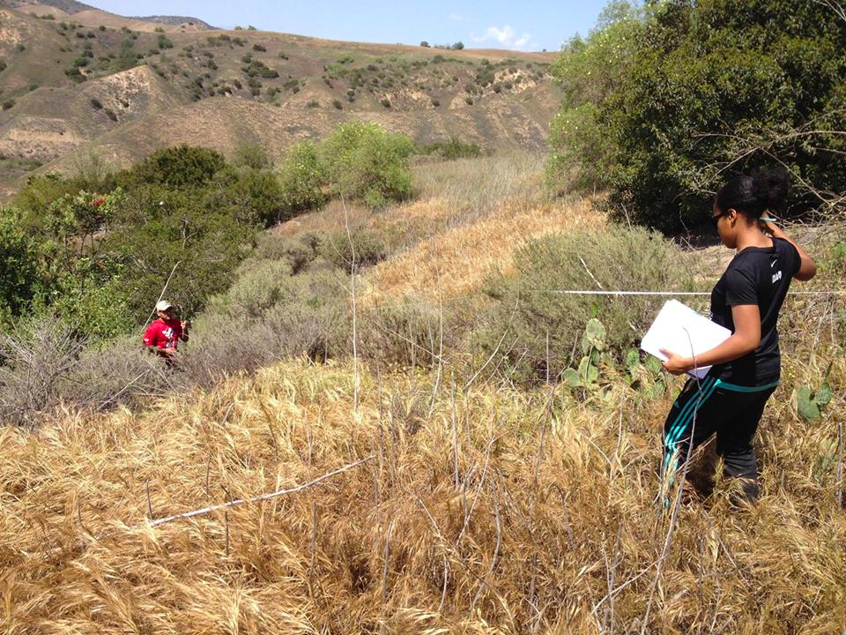
Line Transect Method

Slide 13
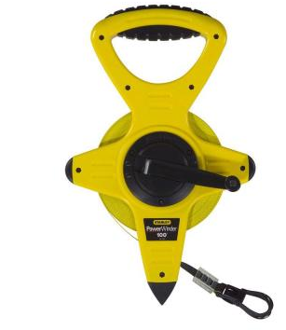


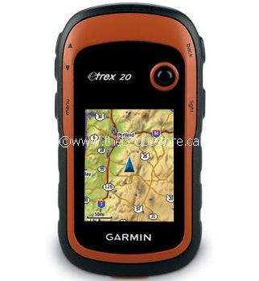
Materials
Tape measure
Note pad and pen/pencil
camera
GPS- garmin
System to identify species:
-Calflora, etc
3 to 4 people group
-roles: data recorder, holders, species identifier

Slide 14
Method
Line Transect Method
(10) 10 meter transects
Purpose
To record the frequencies of various plant species
To compare the types of CSS species from (Chino Hills Park) post-fire vs (Sepulveda Dam) pre-fire locations over the years

Slide 15
Transect | Coordinates (0m) | Coordinates (10m) | Elevation (0m) | Elevation (10m)
Transect 1 | 33.9142588°, -117.8092345° | 33.9141687°,-117.8092228° | 176m | 178m
Transect 2 | 33.9141465°, -117.8084871° | 33.9141020°, -117.8083893° | 175m | 178m
Transect 3 | 33.9126065°, -117.8040158° | 33.9126699°, -117.8039732° | 256m | 254m
Transect 4 | 33.9122536°, -117.8041964° | 33.9121995°, -117.8041959° | 256m | 259m
Transect 5 | 33.9124710°,-117.8040470° | 33.9124706°, -117.8041119° | 257m | 258m
Transect 6 | 33.9124152°, -117.8043169° | 33.9123342°, -117.8042837° | 259m | 259m
Transect 7 | 33.9125419°,-117.8056270° | 33.9125773°, -117.8057247° | 260m | 260m
Transect 8 | 33.9127580°, -117.8070569° | 33.9126772°, -117.8069912° | 250m | 251m
Transect 9 | 33.9124321°, -117.8072485° | 33.9124406°, -117.8073243° | 247m | 245m
Transect 10 | 33.9121219°,-117.8077865° | 33.9121675°, -117.8077004° | 233m | 234m

Slide 16
Data Analysis: Chi Square Contingency Analysis
Null Hypothesis: There is not a relationship between location (pre-fire location vs. post-fire location) and the types/species of plants. In other words, there is not a relationship between the two variable location and plant species.
Alternate/Working Hypothesis: There is a relationship between location (pre-fire vs. post-fire) and the types/species of plants.
The chi-square statistic is 53.66; P-value is less than 0.00001; P<alpha; chi-square statistic is greater than the critical statistic
Conclusion: We reject the null hypothesis. There is a relationship between location (pre-fire vs. post-fire) and the types/species of plants.

Slide 17
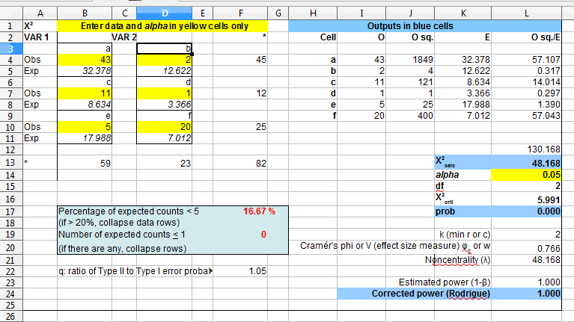

Slide 18
Data: Z-test of the difference of proportions
Null Hypothesis: There is no significant difference between the proportion of Artemisia californica in the post-fire study area (Chino Hills) compared to the proportion of Artemisia californica in the pre-fire study area (Sepulveda Dam).
Alternate/Working Hypothesis: There is a significant difference between the proportion of Artemisia californica in the post-fire study area (Chino Hills) compared to the proportion of Artemisia californica in the pre-fire study area (Sepulveda Dam).
Alpha level: 0.05; p-value=0.0000001; p<alpha
Conclusion: We reject the null hypothesis. There is a significant difference between the proportion of Artemisia in the post-fire study area compared to the pre-fire study area.

Slide 19
Data: Qualitative Observations
The species most prevalent in the Sepulveda Dam (pre-fire) transects were
Baccharis salicifolia
Baccharis pilularis
Salix gooddingii
Rhus integrifolia
Populus fremontii
Marrubium vulgare
The species most prevalent in the Chino Hills State Park transects were
Artemisia californica
Malosma laurina
Opuntia littoralis
Centaurea melitensis
Baccharis salicifolia
Encelia californica

Slide 20
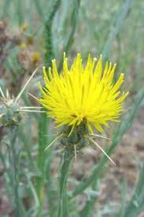
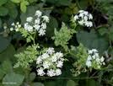
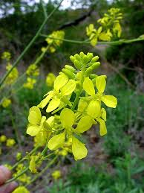
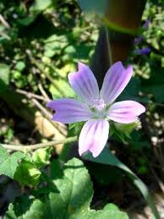
Invasive Species Present 8 yrs. After Chino Hills Fire
Brassica nigra (black mustard)
Malva parviflora (Cheeseweed mallow)
Centaurea melitensis (Tocalote)
Conium maculatum (Poison hemlock)

Slide 21
Native species Present 8 years After Chino Hills Fire
Artemisia californica (california sagebrush)
Malosma laurina (Laurel Sumac)
Opuntia littoralis (Prickly Pear)
Baccharis salicifolia (Mule fat)
Amsinckia intermedia (fiddleneck)
Hazardia squarrosa (Sawtooth goldenbush)
Silybum marianum (Milk thistle)
Encelia californica

Slide 22
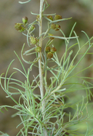
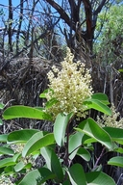
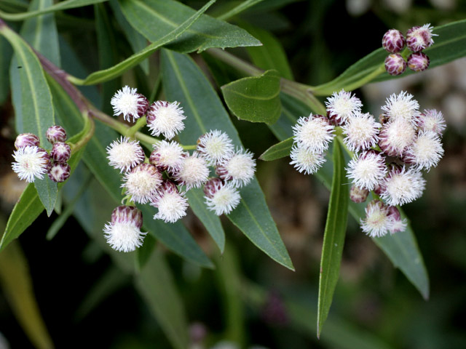
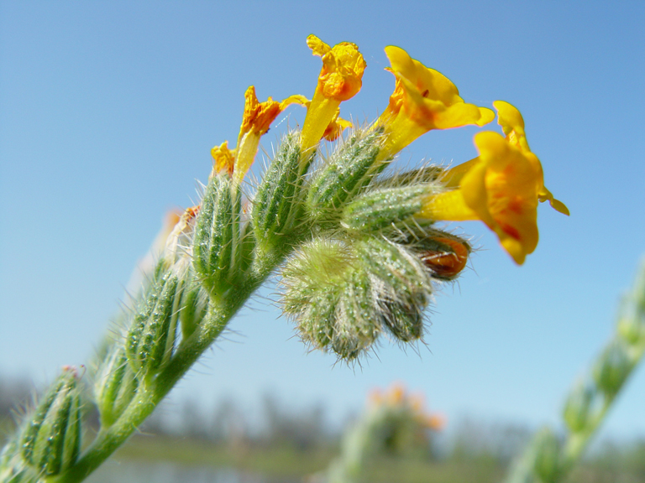
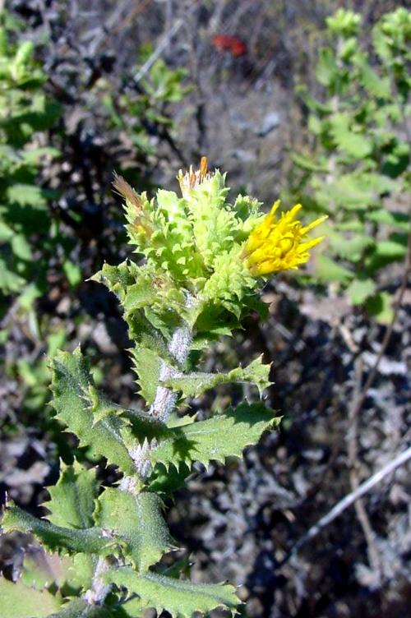
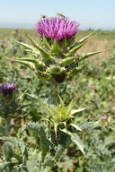
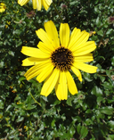
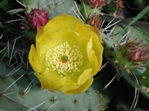
Native Species Present 8 years after Chino Hills Fire
calphotos.berkeley.edu

Slide 23
Discussion:
Plant species, such as Encelia californica and Amsinckia intermedia (fiddleneck), are known fire-followers that were observed in Chino Hills park, the post-fire location.
Artemisia also seems to be well adapted to fire recovery, considering that it was the most abundant post-fire CSS species found in Chino Hills State park.
Opuntia littoralis is another species that was able to recover after the fire in Chino Hills Park.
Malosma laurina is a species found in Chino Hills Park that is known to have the ability to recover post-fire.

Slide 24
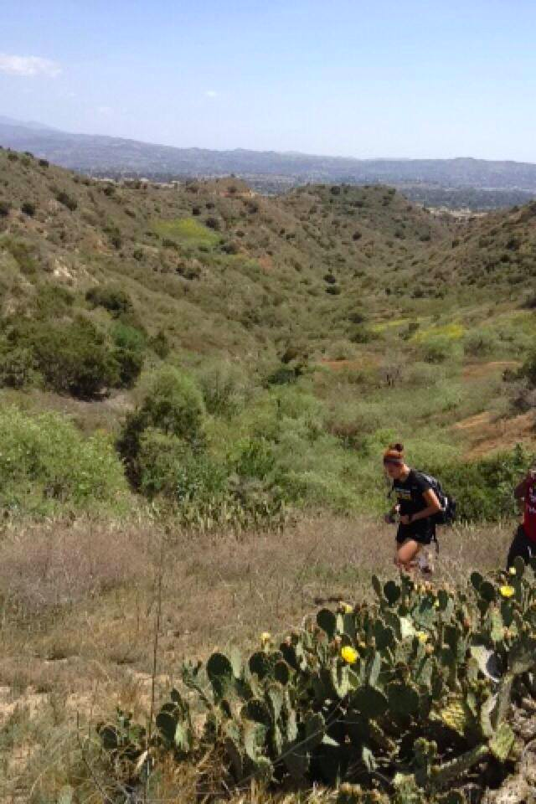
Biases
Spots chosen out of convenience
Direction of transect brought on by convenience, safety and personal preference: cactus, a high tree, CSS visibility
There were also biases in the statistical methods.
The plant species that we chose for the chi square tests were based on available sample sizes.

Slide 25
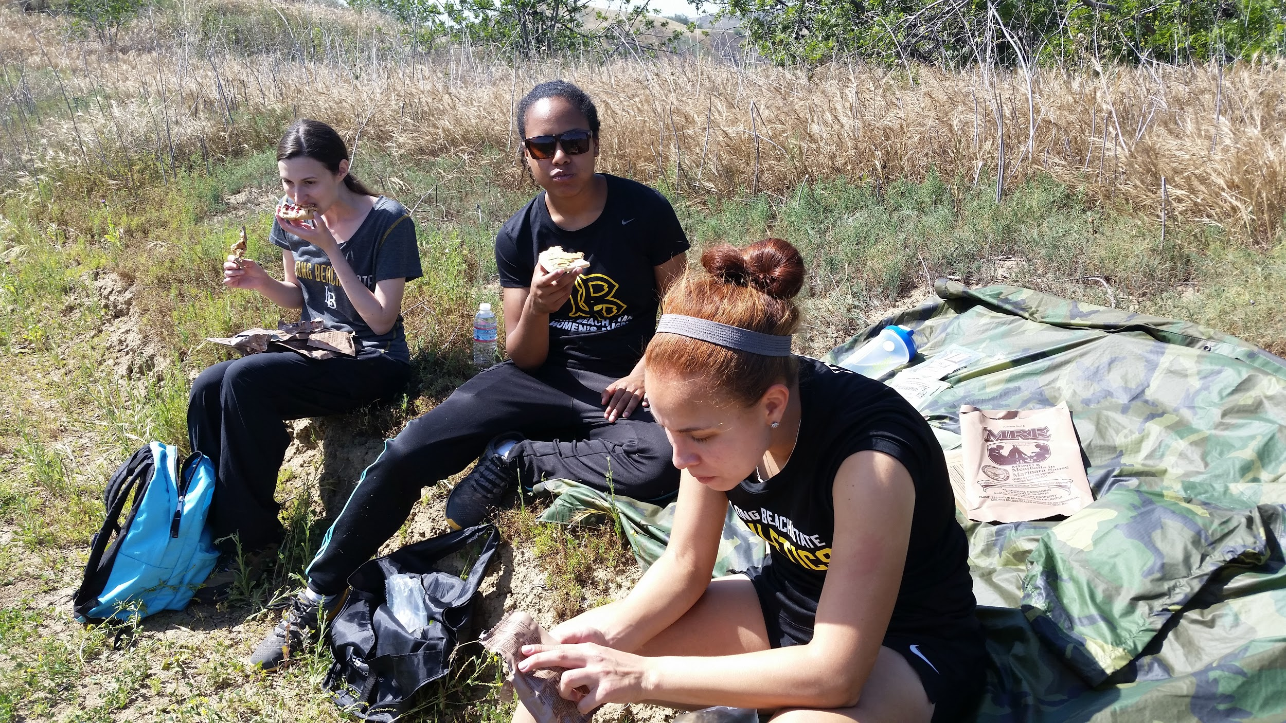
Conclusions: Recommendations
Chino Hills State Park objective:
“restoring and maintaining native plants while removing non-native, invasive species”
Need to increase ‘power’
  Sample size
  Increase number of transects
Confided in data recorded by other groups
Collected data from two separate locations
Replanting mechanisms proven successful in reintroducing native species

Slide 26
References
Chino Hills State Park Interpretive Association. 2016. Goals and Objectives. Available at: http://www.chinohillsstatepark.org/about-us/goals-and-objectives (last accessed 05/1/16). Chino Hills State Park Interpretive Association. 2009. News from Nature. Available at: http://www.chinohillsstatepark.org/pdfs/spring-09.pdf (last accessed 05/1/16).
Rodrigue, C.M. 2011. Chi-square modeling spreadsheet. Department of Geography, California State University. Available at http://www.csulb.edu/~rodrigue/geog200/ChiSquareModels.ods (last accessed 05/1/16).
Rodrigue, C.M. 2013. Differences in California sage scrub composition behind stable and recovering boundaries with annual grassland. Available at: http://web.csulb.edu/~rodrigue/apcg15/ (last accessed 04/30/16).
Rodrigue, C.M. 2013. Restoration of California sage scrub: Reclamation of ground cover from exotic grassland. Available at: http://web.csulb.edu/~rodrigue/SCAS/ (last accessed 04/30/16).
Rundel, P. and Gustafson, R. 2005. Introduction to the Plant Life of Southern California. Berkeley, CA. University of California Press.
Sepulveda Basin Wildlife. Common Native Plants. Available at:
http://www.sepulvedabasinwildlife.org/flora.html (last accessed 05/1/16).
Young-Mathews, A. 2010. Plant guide for California sagebrush. USDA-Natural Resources Conservation Service, Plant Materials Center. Available at: http://plants.usda.gov/plantguide/pdf/pg_arca11.pdf (last accessed 04/30/16)

