Slide 1
The Charmlee Chronicles
Starring Joe Kubani, Holy Heng, Joshua Pulliam, and Chris Johnson

Slide 2
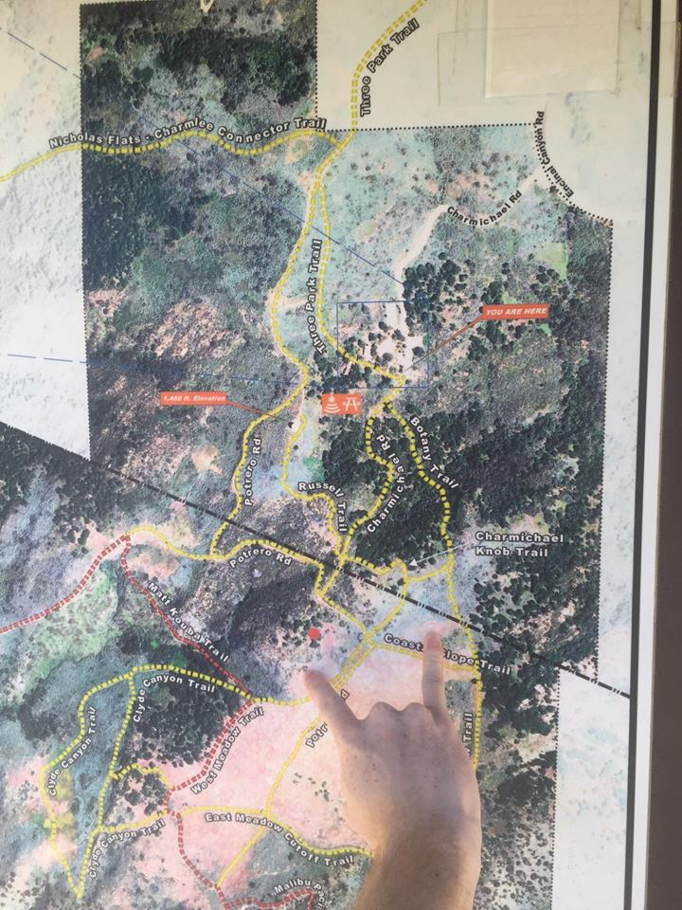
Introduction
Charmlee Wilderness Park in Malibu, California
CSS is a delicate collection of native shrubbery which thrives on California’s climate
CSS serves as a base trophic level for coastal California ecosystems
Transecting conducted on a boundary (possibly stable or recovering)
Conducted Frequency Analysis on data collected

Slide 3
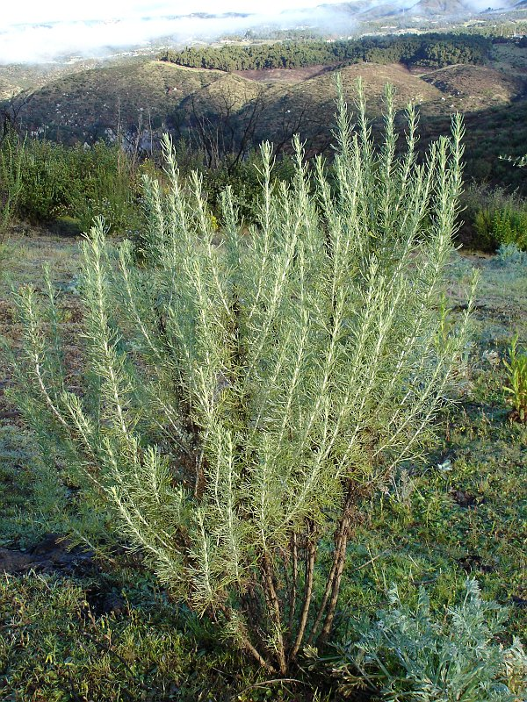
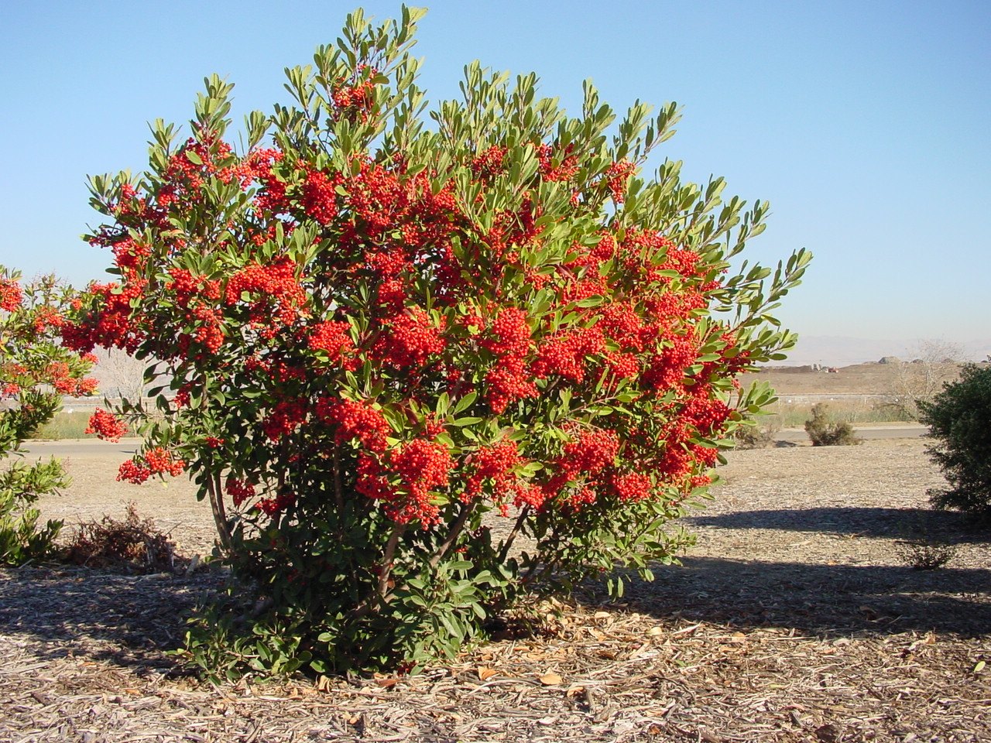
Artemisia californica and Heteromeles arbutifolia

Slide 4
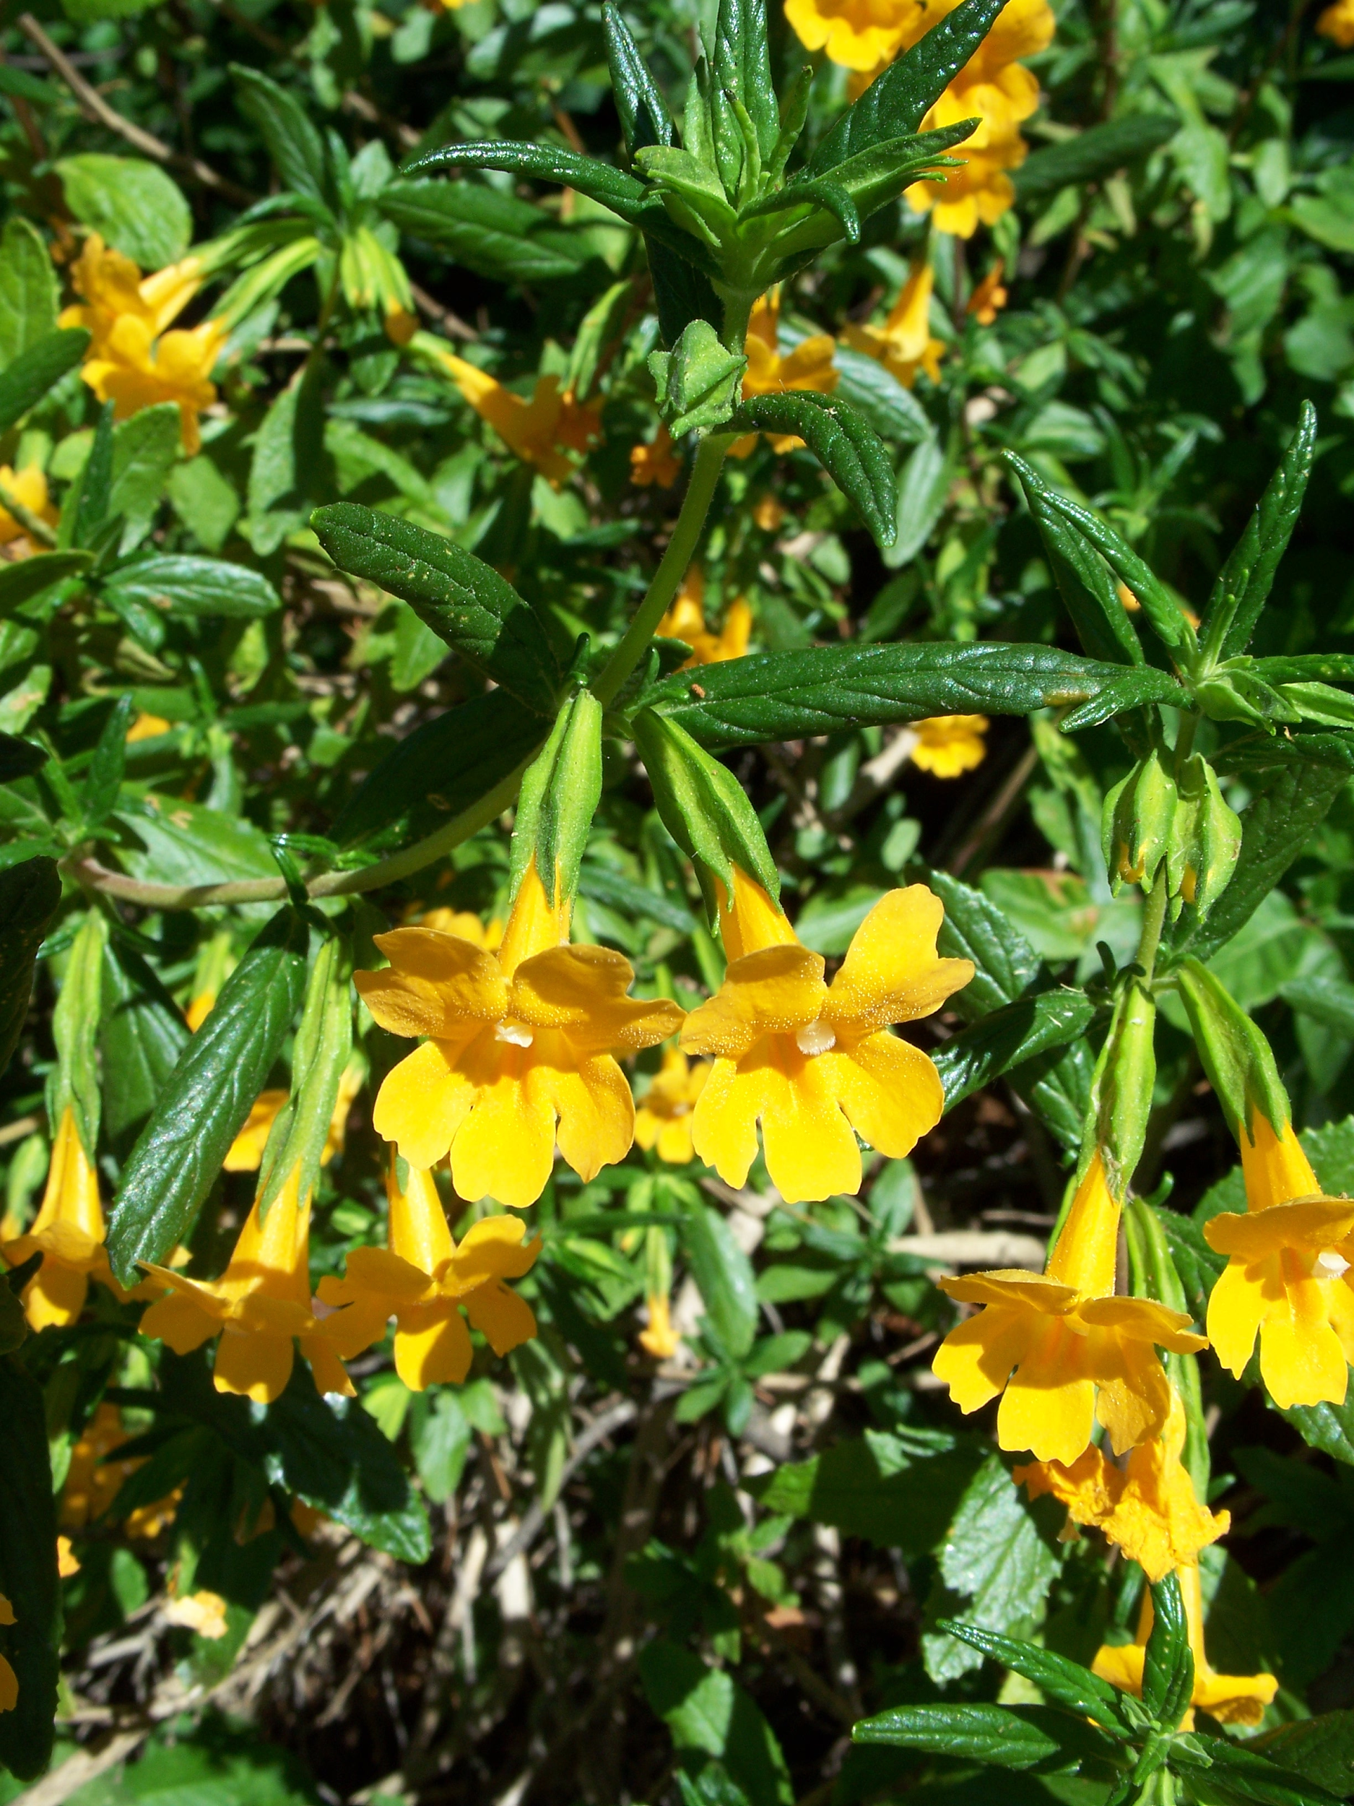
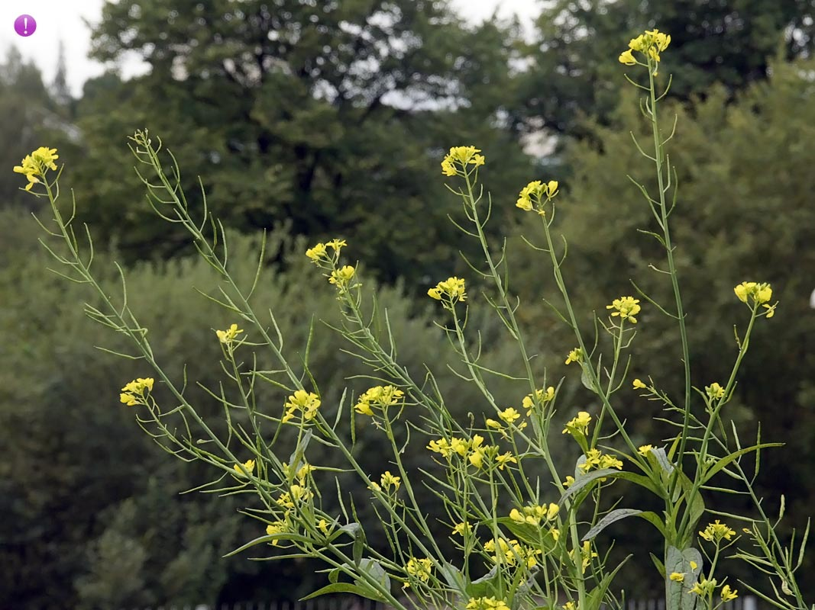
Mimulus aurantiacus and Brassica nigra

Slide 5
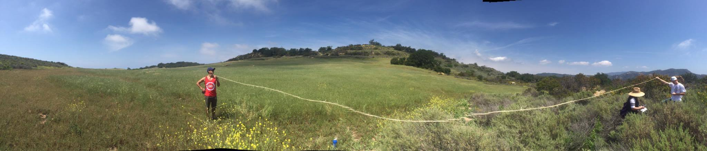
Method
Transect - a straight line or narrow section through a natural feature or across the Earth’s surface, along which observations are made or measurements taken
Observed and identified plants at each point
Break - “Rabbit Trail”
Materials Used:
Twine with every meter marked off
Cell phone - GPS Status Toolbox App
Was taut, panorama made it curve

Slide 6
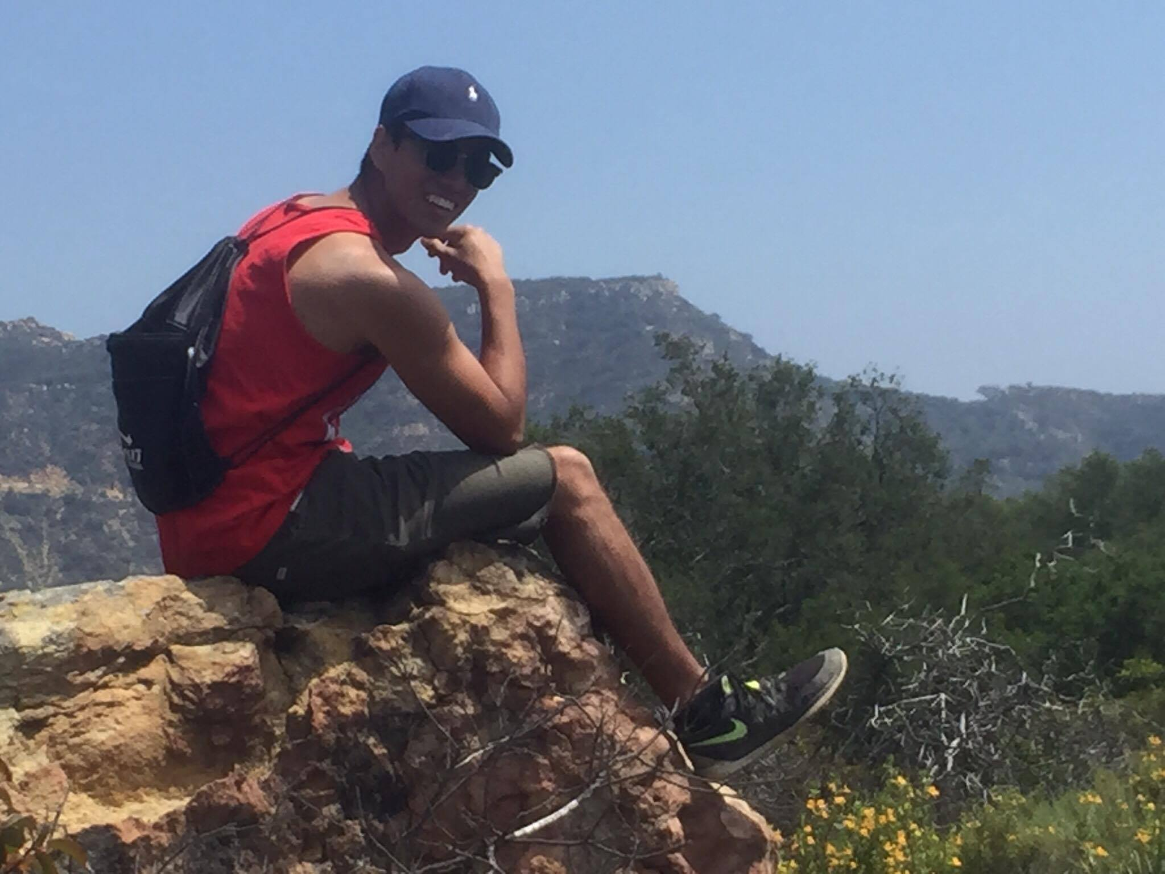
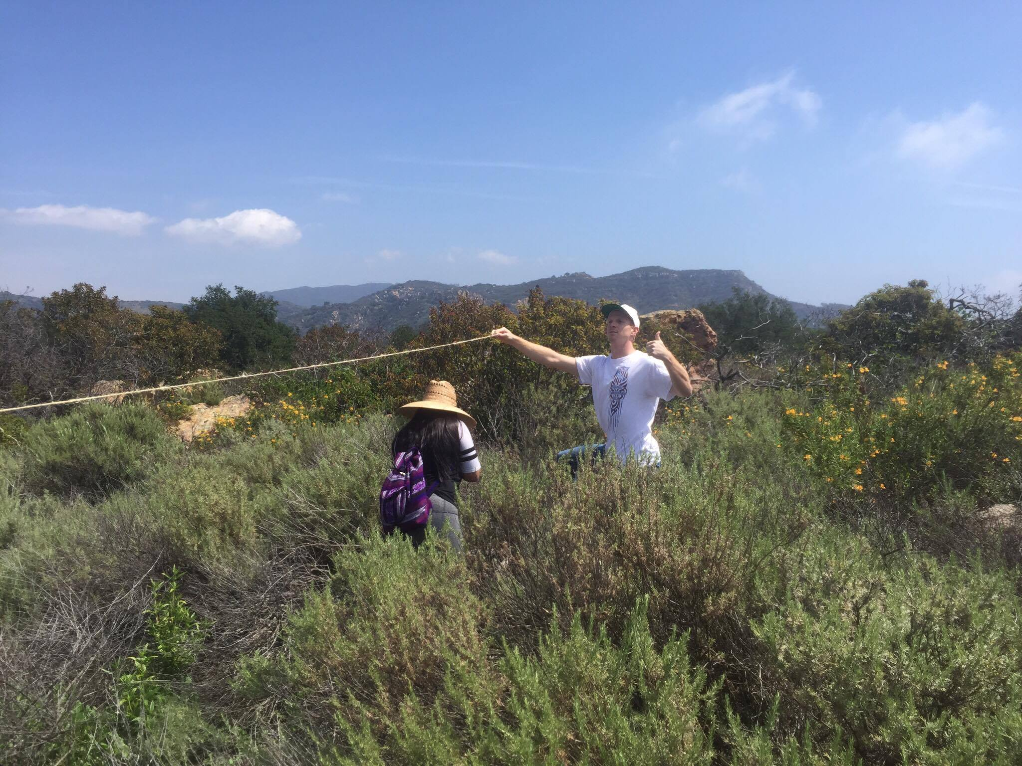
Contined
Relative frequency analysis was conducted with data collected in the field.
Lack of data in years past made comparison invalid.

Slide 7
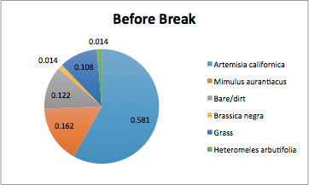
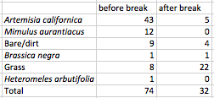
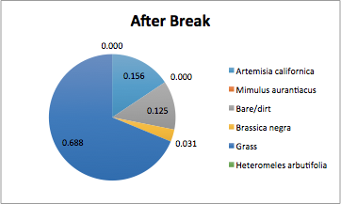
Results

Slide 8
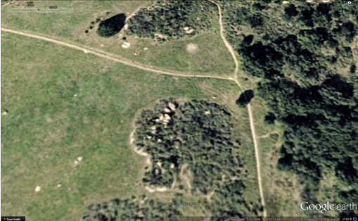
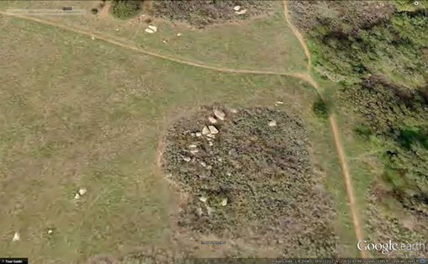
Our Recovering Boundary Over the Years
2005
2008

Slide 9
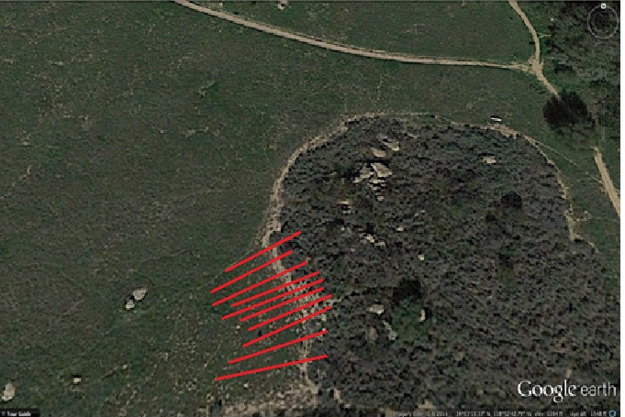
Our Recovering Boundary Over the Years
2016 with Approximate Transects

Slide 10
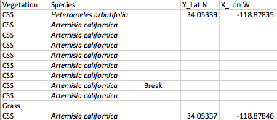
Continued
Artemisia californica is a pioneering species we had observed, Transect 9 in particular had a strong presence of it beyond the “rabbit trail”.
Brassica nigra was the only other observed plant beyond the rabbit trail (observed once).

Slide 11
Recovery
Human interference has brought about the need for recovery
With conservation efforts, the native species now have a chance to overtake non-native species.

Slide 12
Conclusion
There is evidence that the CSS is indeed growing outward and recovering based on satellite imagery and GPS coordinates gathered.
Artemesia californica is a great pioneering species, seeing as how it is at the edge of the boundary.
The CSS have been recovering well on their own, but with our help we could possibly improve the succession of their recovery.
Bias
A data set to compare the data collected to would have allowed for further statistical tests and a greater volume of data.
Transects were close together and several ends shared a GPS point, making plotting the points less useful.

Slide 13
