Slide 1
Project Pigeon Watch
Presentation by: Angel Ruiz, Jacob Rosenthal, Brendan Schultheis, Dennis Solorzano

Slide 2
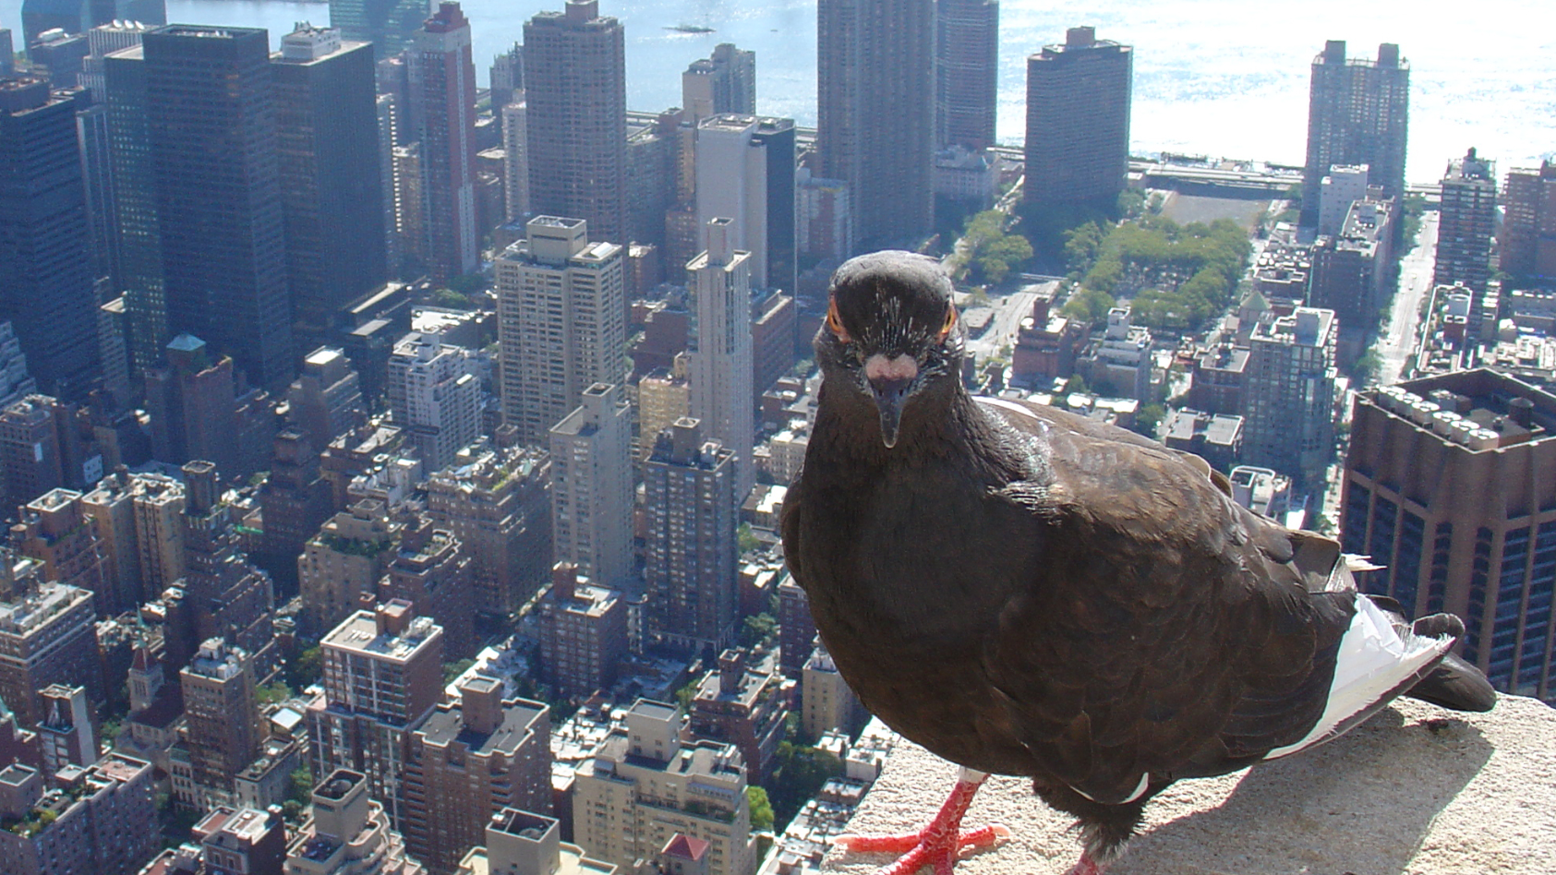
Introduction/ Context
Cornell University Project Pigeon Watch
Document the diversity of feral pigeon plumage patterns worldwide
Consisted of data acquired by volunteers from 1993-2012
What is the role of sexual selection and assortative mating in divergent selection?

Slide 3
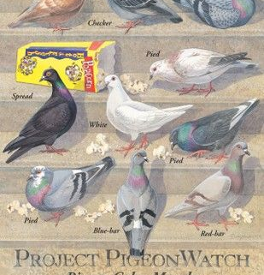
Why study Pigeons?
High adaptability in different environments
I.e. beaches, inner cities, farms, and parks
Found in North America for over 200 years, and other countries for much longer
Individuals in a population found to have different colors
Scientists explain that there are three possible reasons:
Prevents predation as they won't stick out from their environment
Different colors help attract mates
Indicates dominance in a flock

Slide 4
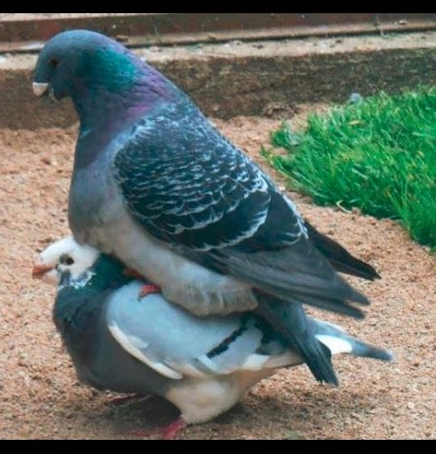
Hypothesis
Sexual selection among pigeons are directly affected by individual color morphs, where certain morphs are more sexually active when compared to other morphs.
Certain male morphs initiate more courtships compared to others, and if particular female morphs are targeted for courting more than others
Null: there is not a significant difference in the morphic diversity of the regional urban pigeon population compared to the morphic diversity of courting males, and courted females.

Slide 5
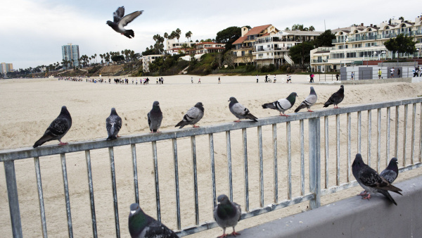
Data and Methods
We are using data collected from hundreds of CSULB students stretching across 19 years from Fall 2000 until Spring 2018.
Tallied 6,341 total pigeons
617 total courtships
Many different habitats: commercial areas, residential, beaches, and parks

Slide 6
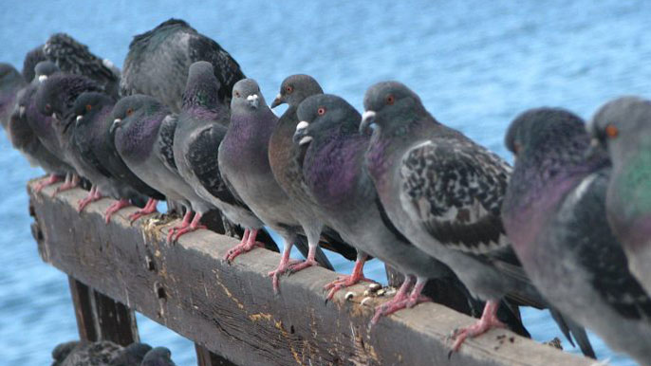
Data and Methods
Counted the total amount of pigeons in one flock
Also tallied the different color morphs in the flock
If a courtship took place, then the colors of the two birds courting were considered
Students sent all data to Dr. Rodrigue, who compiled all the data into one spreadsheet
We extracted the data from female and male pigeons and input the data into Vassar Stats

Slide 7

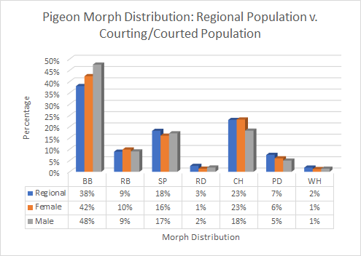
Courting distribution
Blue bar pigeon morphs appeared more frequently in areas of study
Red and white morphs being rarer to spot.

Slide 8
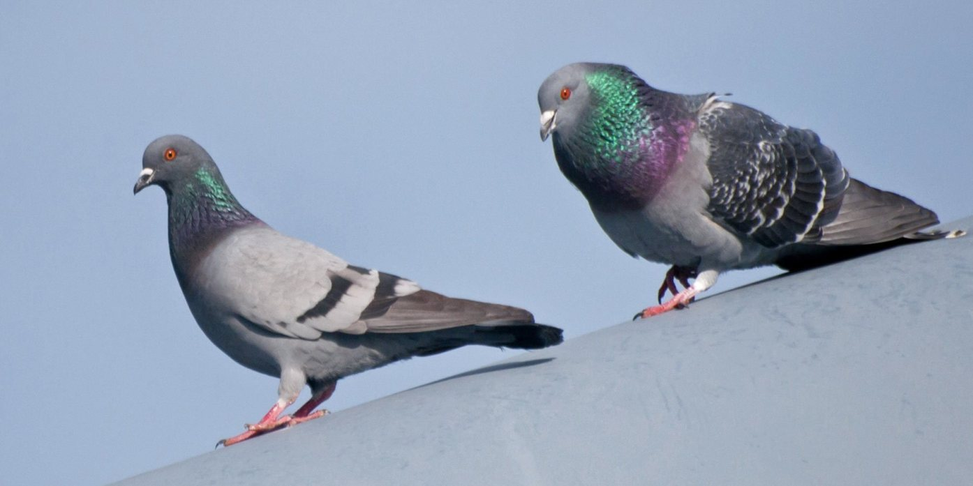
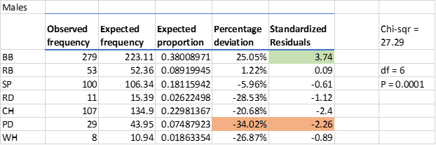

Male Pigeons
P-Value is less than .05 signifying significant results for male population
Percent deviation and standardized residuals of Blue Bar morphs is very high compared to the rest signifying higher levels of aggression to female morphs
Reject null hypothesis.

Slide 9
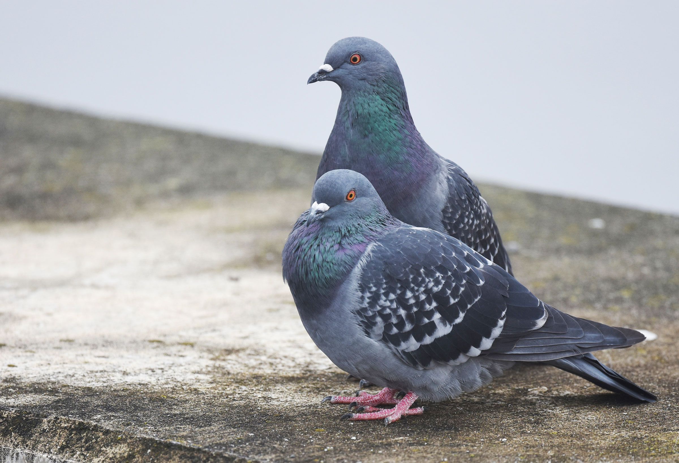
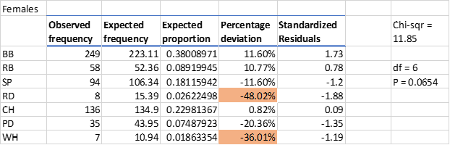
Female Pigeons
P-value is greater than .05
Based on the years of evidence considered, we must accept the null hypothesis
For both Red Bar and Blue Bar female morphs, the PD signifies a courtship prevalence above their usual courtships

Slide 10
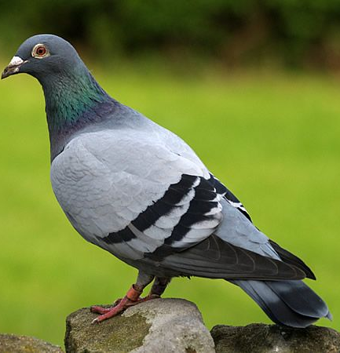
Conclusion
Males
Court with female morphs in roughly proportional numbers
Most aggressive morph: Blue Bar
Deviation: 25.05%
Residual: +3.74
Shyest morph: Pied
Deviation: -34.02%
Residual: -2.26
Females
No significant difference
Courted females are roughly proportional to the regional population

Slide 11
Works Cited
Haag-Wackernagel, D., Heeb, P., & Leiss, A. (n.d.). Phenotype-dependent selection of juvenile urban Feral Pigeons Columba livia. Retrieved December 08, 2020, from https://www.tandfonline.com/doi/abs/10.1080/00063650609461429
Jacquin, L., Lenouvel, P., Haussy, C., Ducatez, S., & Gasparini, J. (2011, February 25). Melanin‐based coloration is related to parasite intensity and cellular immune response in an urban free living bird: The feral pigeon Columba livia. Retrieved December 08, 2020, from https://onlinelibrary.wiley.com/doi/full/10.1111/j.1600-048X.2010.05120.x
Rodrigue, C. M. (n.d.). Project Pigeon Watch. Retrieved December 08, 2020, from http://web.csulb.edu/~rodrigue/geog330/PigeonWatch/PigeonHypotheses.html
Southern, H., P.. O’Donald, I., F.. Cooke, P., V.I.. Grabovskii, E., A.S.. Rautian, G., V.G.. Grin’kov, A., . . . Darwin, C. (1970, January 01). Polymorphism and phene geography of the blue rock pigeon in Europe. Retrieved December 08, 2020, from https://link.springer.com/article/10.1134/S1022795407050031

