Slide 1
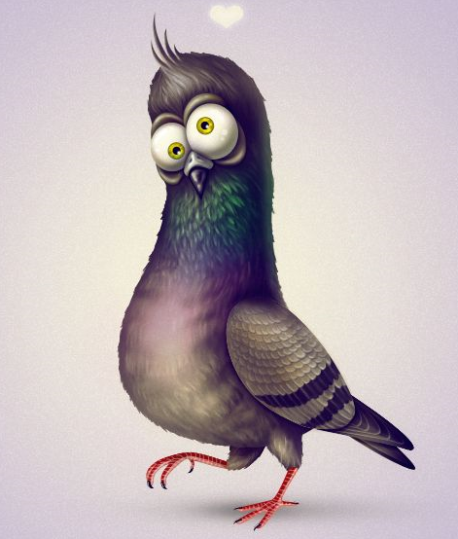
PigeonWatch Project
Fall 2020 Data
Group 3: Shaun, Saile, Chelsea, Cecilia

Slide 2
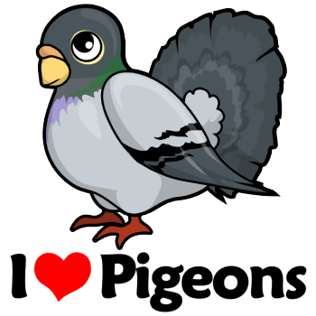
Introduction
Dr. Rodrigue fondness of pigeons
Fall 2020 data
Assortative mating
Sexual Selection

Slide 3
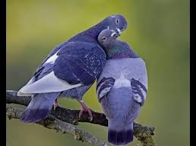
Do pigeons favor assortative mating when courting?

Slide 4
Background
Assortative mating: A form of sexual selection, preference for similar phenotypes (nonrandom)
Stabilizing selection: A form of natural selection that favors a trait that is not extremely diverse. Average/Common phenotypes are favored.
Sexual selection: A form of natural selection where certain (often extreme) characteristics of one sex is preferred by the other sex.
Divergent selection: Overtime, related species develop different characteristics due to adaptation.
Cornell’s PigeonWatch Project (1993 - 2012)
Wild pigeons of today do not exhibit Stabilizing selection as their ancestor (Columba livia Gmelin 1789) did, due to the the many differences of the original (Blue Bar) pigeon morph - Why is this?
Notes:
SEXUAL SELECTION: one sex goes to great lengths in order to copulate with another; peacock example bc theyre lives are short bc they are flashy but if they can copulate with many hens (female peacock)

Slide 5
Literature Review
Backgrounder: Why Study Pigeons ( Melinda LaBranche 1999)
Sexual Preference
Nancy Burley Experiment “Parental Investment, Mate Choice and Mate Quality (1977)”
Disassortative Mating: Females are the picky ones favoring from favored to least favored,Blue Checker, bluebar, ash red males in that ordered
Feral Pigeons Prefer Genetically Similar Mates Despite Inbreeding Depression (Jacob G 2016)
Shows a trend that when given mating choice, similar mates are always prefered. In the presence of unsimilar mate scarcity, inbreeding will occur.
Non Random Mating in Feral Pigeons (Johnson 1989)
Disassortative Mating & Size Based Preference
Notes:
NOTE: all studies cannot say for sure, are correct

Slide 6
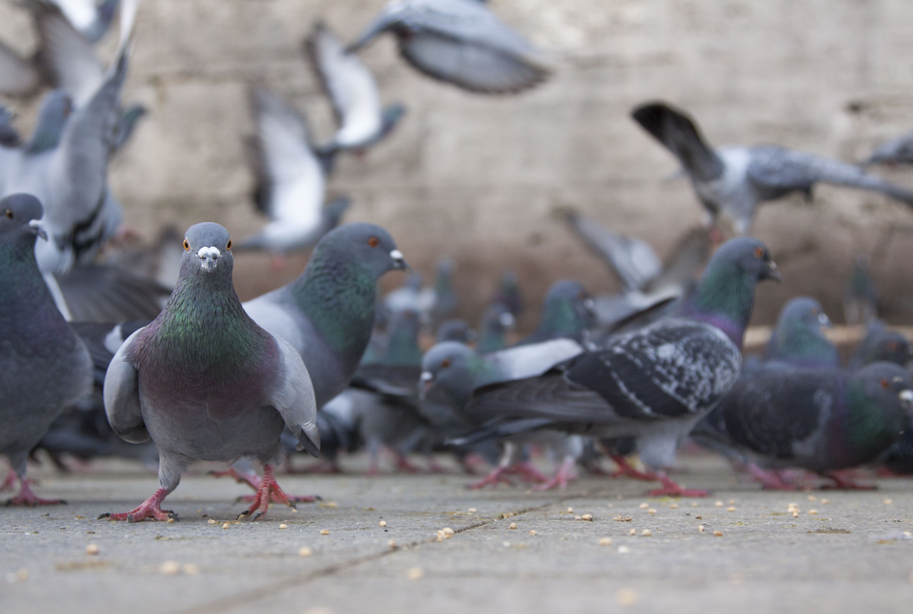
Methods
1. Fill out habitat form of the site.
2. Do 2 counts at each location.
3. Observe courtship behavior; if occurs note courter’s morph & morph of the target.
4. Take GPS coordinates with 5-6 decimal places in decimal degrees.
Notes:
!

Slide 7
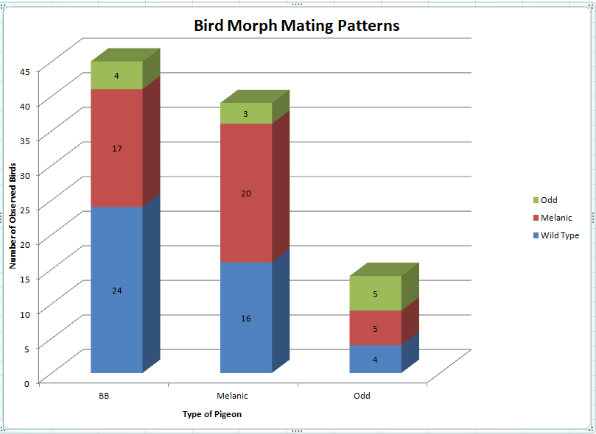
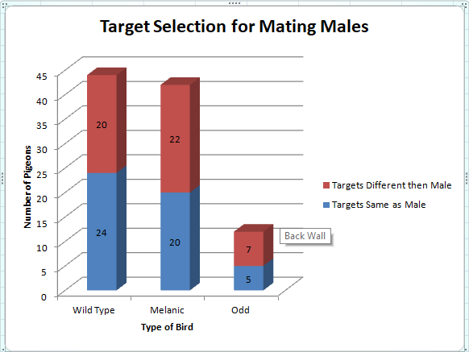
Data
8.88%
7.69%
45.45%
52.38%
37.77%
51.28%
53.33%
35.71%
54.54%
47.62%
41.02%
58.33%
35.71%
41.66%
28.57%

Slide 8
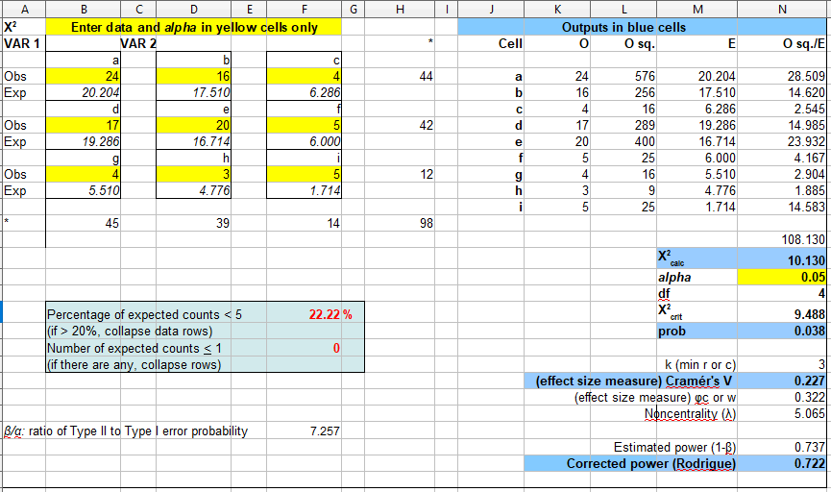
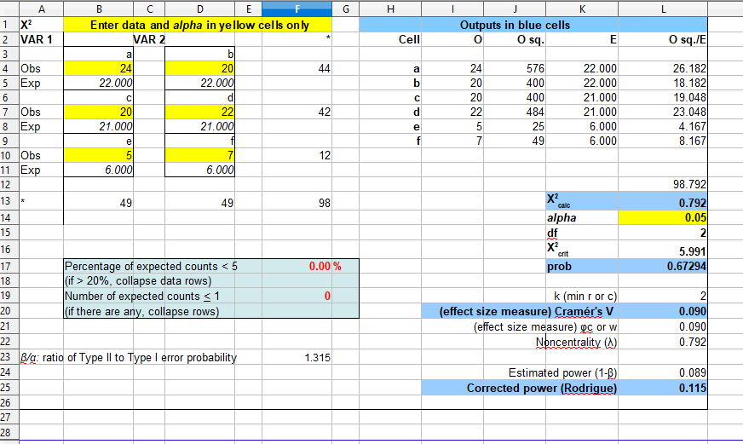
Data Continued
3x3 shows expected counts <5 are 22.22% and therefore we will condense the data into a 2x2 on the next slide
2x3 shows a X critical of 5.991 and a X calculated of 0.792
X critical is much higher than X calculated
Probability is 0.67294
Estimated Power is 0.115

Slide 9
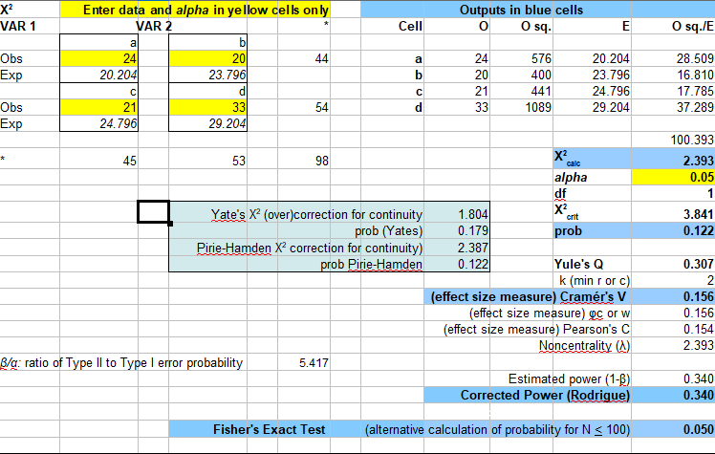
Data Continued
Went with a 2x2 test instead because of the 22.22% value on the >5 expected
X critical is greater then calculated
Power is 0.340
Probability is 0.122

Slide 10
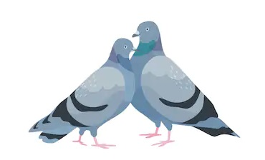
Discussion Overview
Regarding bird morph mating patterns, we reject the null hypothesis and favor alternative hypothesis
Regarding target selection of females and blue bar assortative mating, we fail to reject the null hypothesis.
Based on our observations however, we do not have enough data
Notes:
Regarding bird morph mating patterns, at a 95% significance level, the p-value is is greater than the significance level, therefore we fail to reject the null hypothesis and the result is statistically insignificant (n.s.).
Based on our observations however, we do not have enough data to conclude that this is an actual correlation with the amount of data we have because the sample size for the total population is too small.

Slide 11
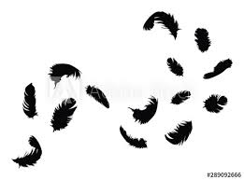
Conclusion
Findings: Assortative Matings is favored but..
Inconclusivity: Insufficient data possibly due to
  Restricted data collection methods (COVID-19)
  Lack of pigeon observations
  Food source strain from decreased human activity (COVID-19)
  Increase predation of other human dependant species
Was Cornell University’s Ornithology Lab onto something explaining the sustained morphic diversity of feral pigeon flocks? Or not? Or what?”

Slide 12
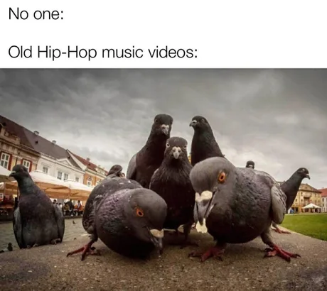

The End
Group 3: Shaun, Saile, Chelsea, Cecilia

Slide 13
Citations
1. Jacob G, Prévot A-C, Baudry E (2016) Feral Pigeons (Columba livia) Prefer Genetically Similar Mates despite Inbreeding Depression. PLoS ONE 11(9): e0162451. https://doi.org/10.1371/journal.pone.0162451
2. N Burly, Parental investment, mate choice, and mate quality. Proceedings of the National Academy of Sciences Aug 1977, 74 (8) 3476-3479; DOI: 10.1073/pnas.74.8.3476
3. LaBranche, M. S. 1999. Why Study Pigeons? Birdscope, Volume 13, Number 3: 3.
4. Johnson, Richard, Johnson Steve, (1989) Non Random Mating in Feral Pigeons. The Cooper Ornithological Society. The Condor 91;23-29

