Slide 1

Project Pigeon Watch
Nicole Angel, Yohanna Berhe, Cheryl Gatch, Brooke Goodsell

Slide 2

Goal of Project:
We sought to find if there is a significant difference in pigeon morph distributions by the three core habitats, in relation to stabilizing selection
*Stabilizing selection: penalizes morphs that diverge from a common pattern, enforcing greater uniformity in prey species, in this case diverging from what's common in a certain habitat

Slide 3
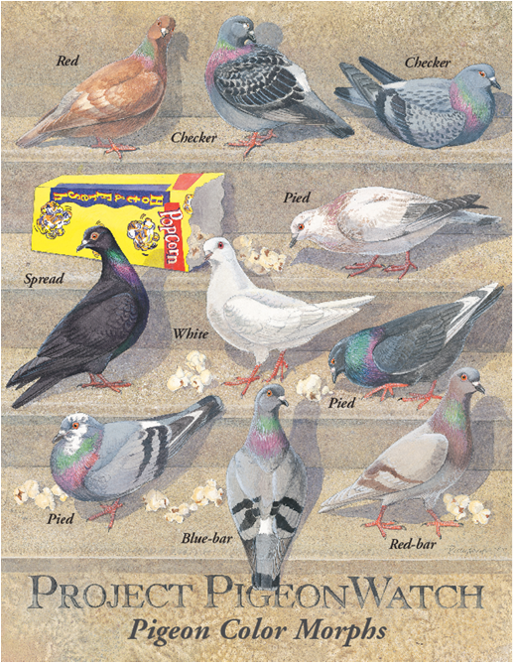
Data and Methods
Data: Archival data collected by students of ESP 330 at California State University Long Beach
Dates used: Fall 2000 until Spring 2018, from all over California
6,341 Pigeons in total
Method of Analysis: Chi-square Distribution
Alpha value = .05
12 degrees of freedom
* as chi-square is the best qualified method for analyzing counts that are divided into categories

Slide 4
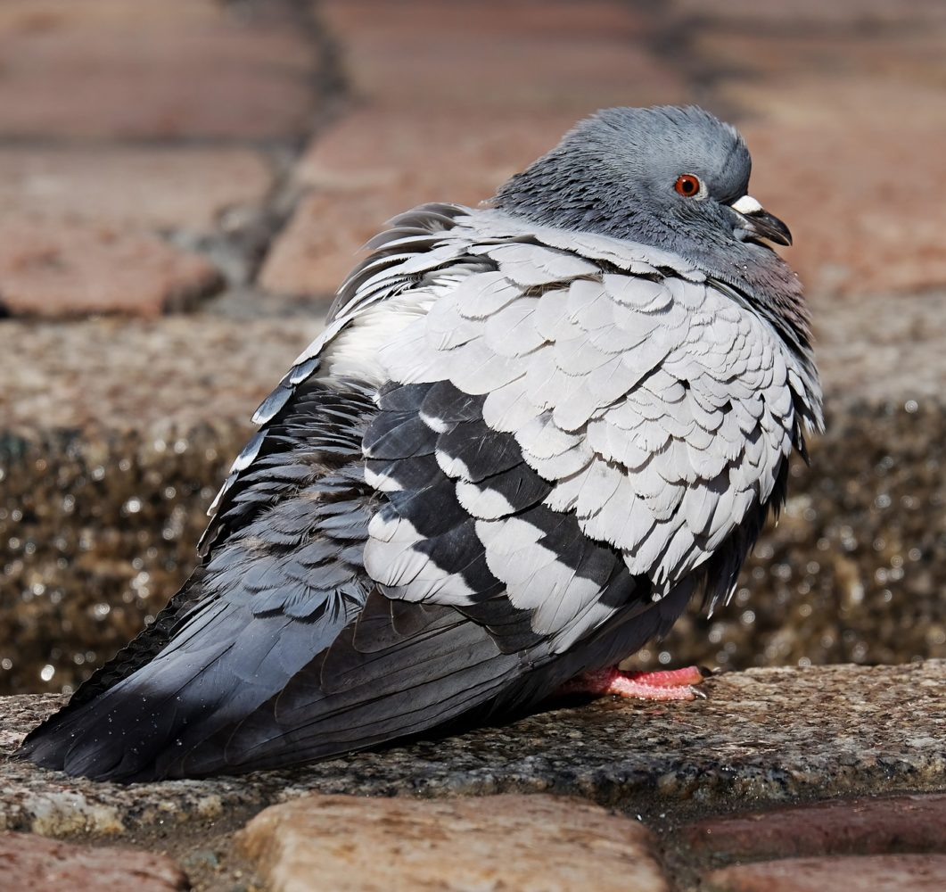
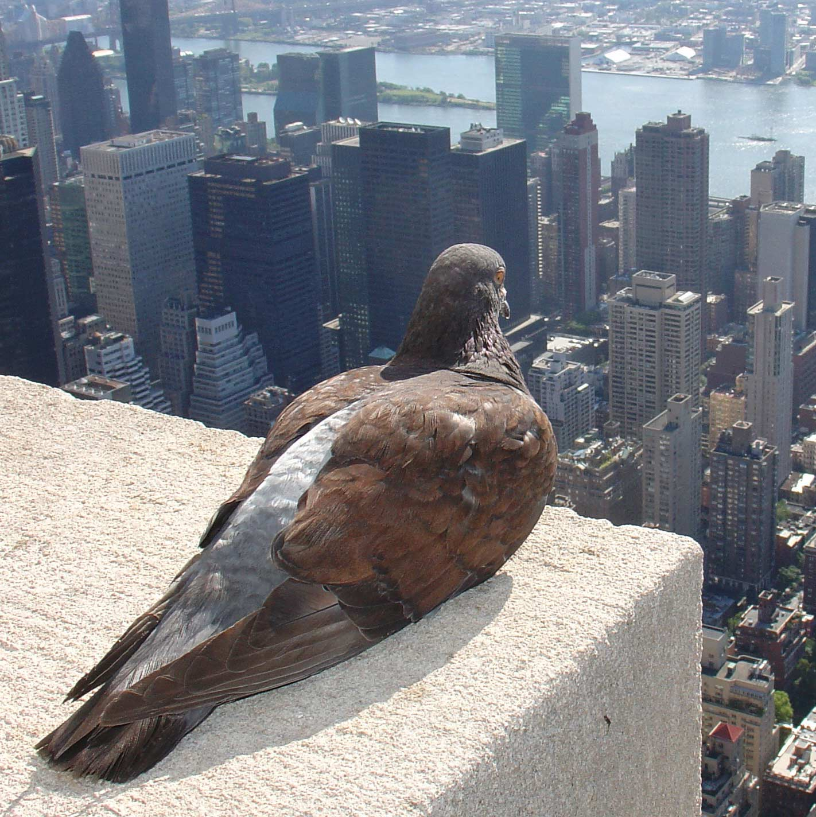
Results
Effect Size= .058
Power= .904
X-Calc= 42.5
X-Crit= 21.0
P-Value= 0.0
Alpha= 0.05,

Slide 5


What this means?
Comparing P-Value and Alpha = P-Value < Alpha
The null hypothesis: There no significant difference in the distribution of morphs by these three core habitats
→ Null rejected, there is a significant difference
The Effect Size:
.058
Was very small, this means that although significant, there is only a faint matching of pigeon morphs to habitat
Power:
.904
Power is whether we have enough power in our data to trust a finding of no significant difference, here it was very high

Slide 6
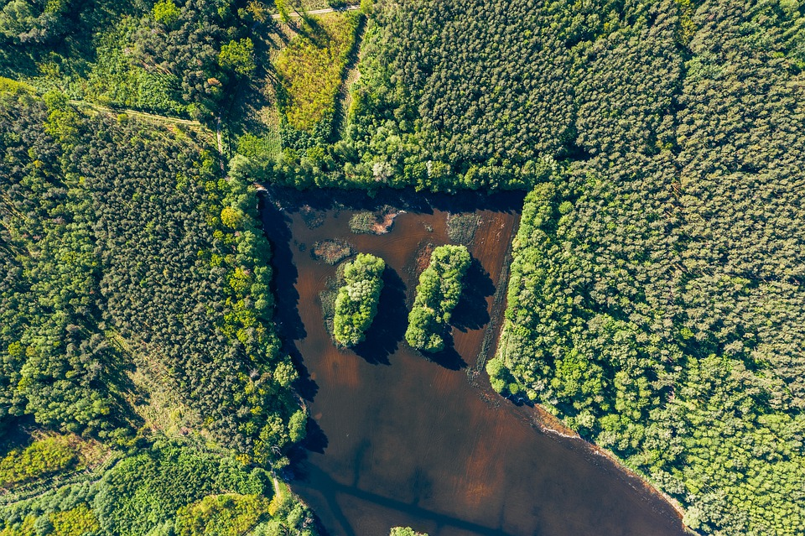
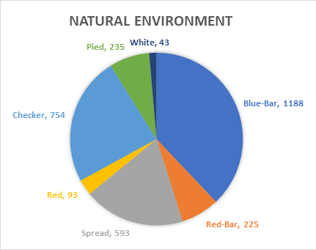
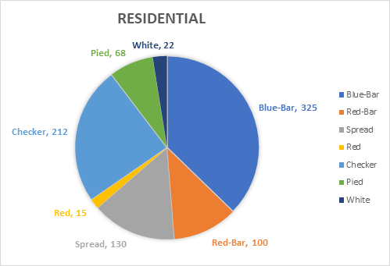

Slide 7

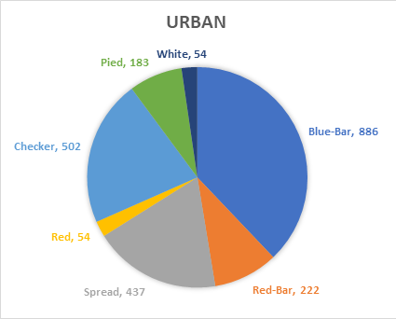

Slide 8


Slide 9
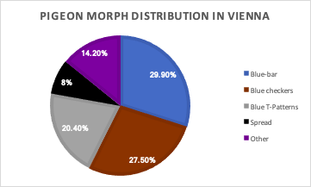
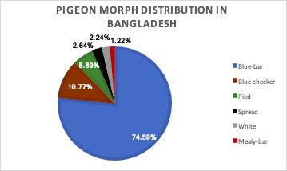
Discussion
Haag-Wackernagel, et al. (2006)
Kabir, M. A. (2016)

Slide 10
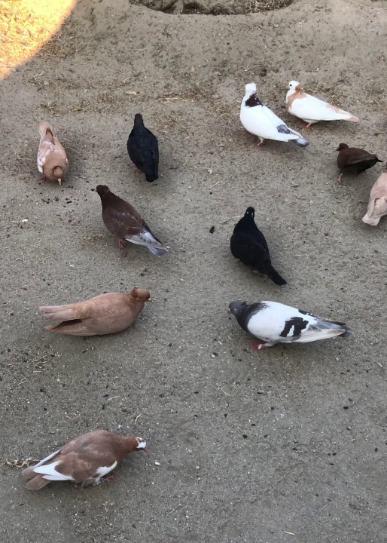
Conclusion
Pigeon morph plumage diversity was shown to vary in different environments only slightly
The rewards for lifesaving melanic stabilizing selection traits to avoid predation is generally favored
For future projects we Recommend further research to continue by separating environment grouping Parks and Beaches into separate groups; regrouping into four groups

Slide 11
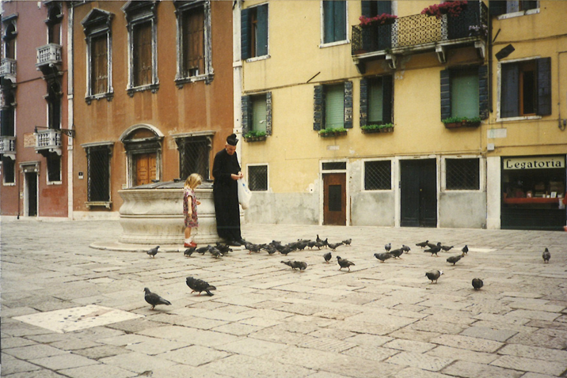

Slide 12
References
Haag-Wackernagel, D., Heeb, P., &amp; Leiss, A. (2006). Phenotype-dependent selection of juvenile urban Feral PigeonsColumba livia. Bird Study, 53(2), 163-170. doi:10.1080/00063650609461429
Kabir, M. A. (2016). Rock - Pigeons in Some Parts of Bangladesh. The Journal of Middle East and North Africa Sciences, 2(3), 45-49. doi:10.12816/0032663
LaBranche, M. S. 1999. Why Study Pigeons? Birdscope, Volume 13, Number 3: 3.
Rodrigue, C.M. 2019. Chi-square modeling spreadsheet. Department of Geography,
California State University. http://web.csulb.edu/~rodrigue/geog400500/ChiSquareModels5plus.ods

