Slide 1
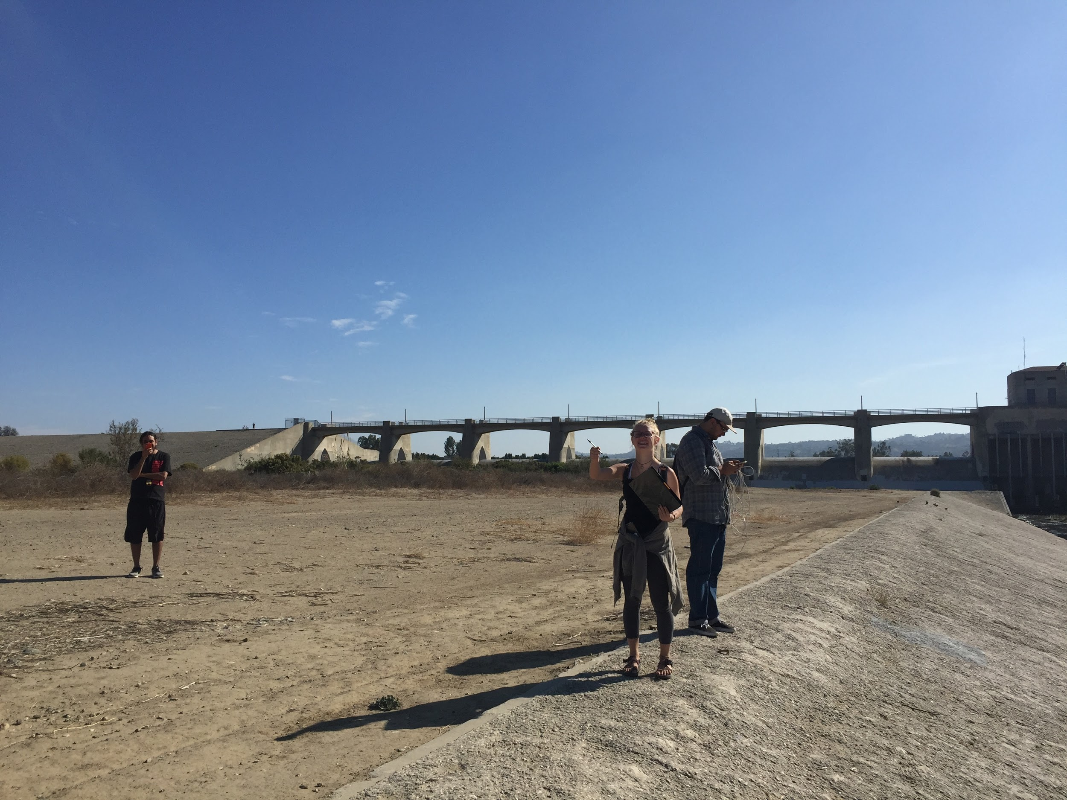
Exploratory Study: South Reserve of the Sepulveda Dam
Veronica Allen
Curran Miller
Tony Gonzalez
Zachary Hernandez

Slide 2
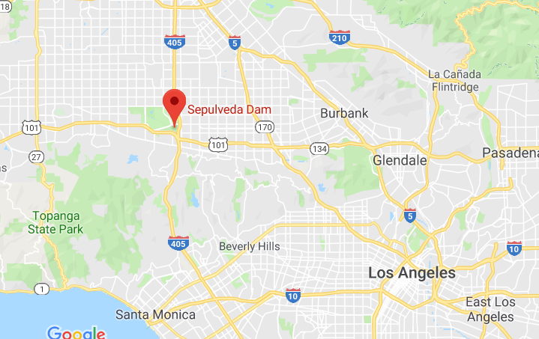
Field Site: Sepulveda Dam
Project of the Corps of Engineers in response to 1938 flood
First area of the Sepulveda Basin to be revegetated with California native plants
Original development plan of south reserve: grassland habitat, riparian woodland, coastal sage scrub, aquatic habitat

Slide 3
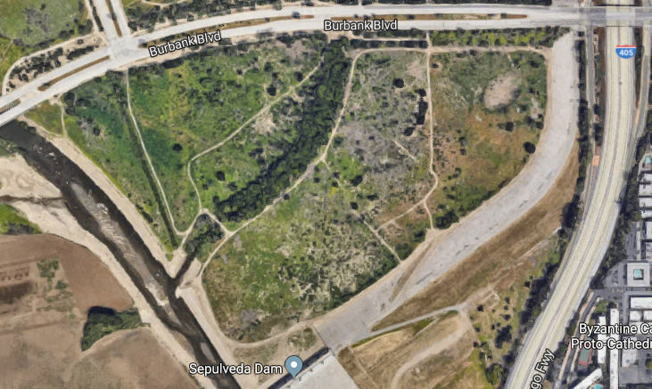

Slide 4
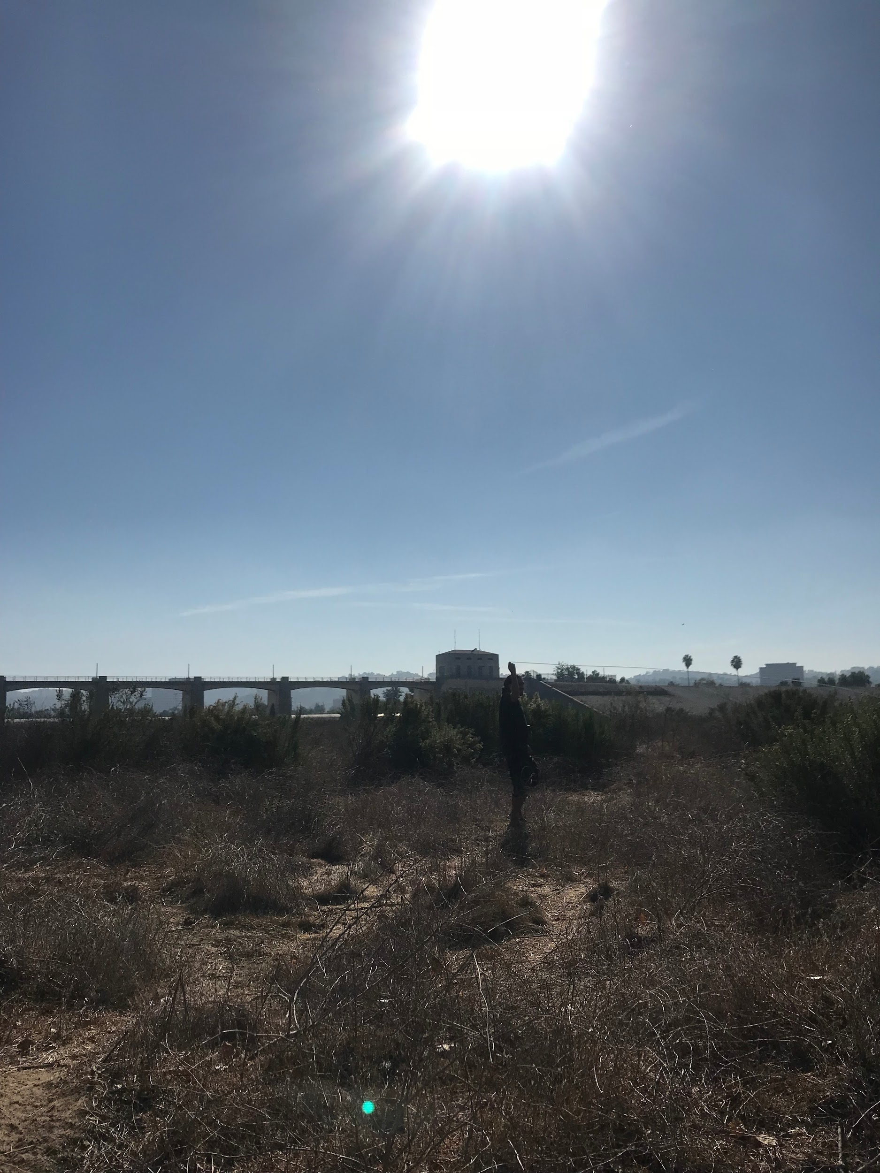
Introduction: California Sage Scrub Restoration
After construction of the dam, natural state of CSS in the area threatened due to plowing
Compare the effect this had on the landscape over time
Hypotheses: 1) There is a significant difference in mix of dominant species between our observations and previously collected data. 2) There is a significant difference in the mix of native species and exotic species for both the North and South Reserve.

Slide 5
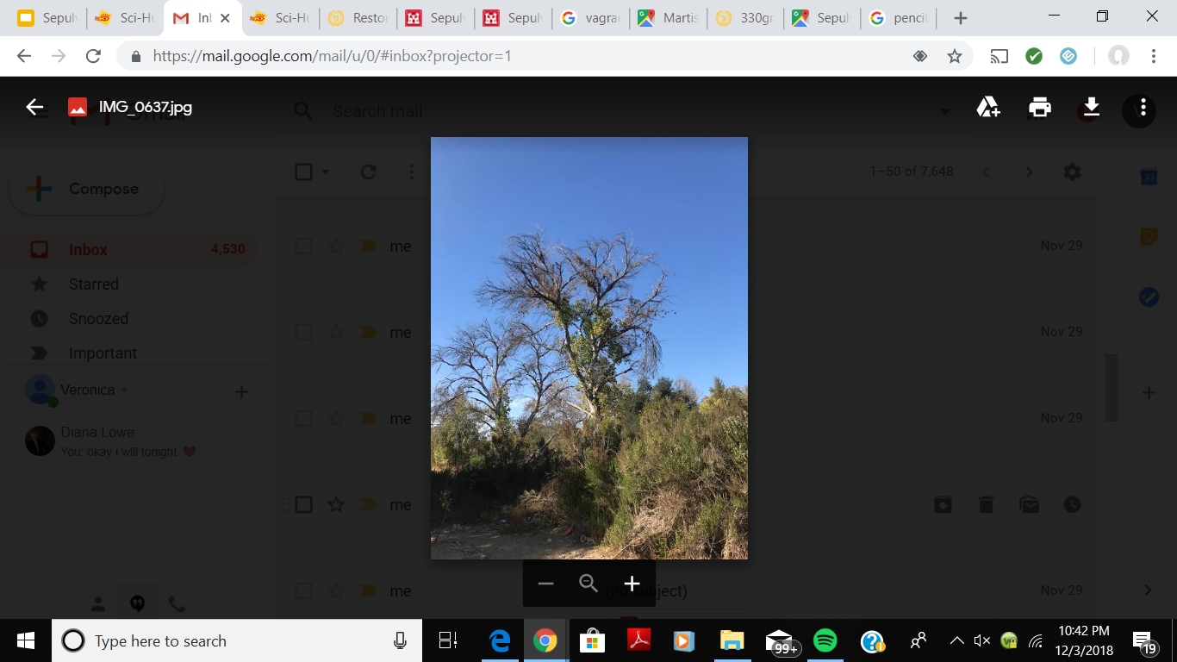
Materials & Methods
Garmin GPS and iPhone GPS via GPS Status
Clipboard & data sheet
Species reference list
Pencil
Transect line
8 transects of 10 meters each

Slide 6
Data Analysis
Employed a Chi-Square analysis to compare counts and evaluate comparison and association
Alpha standard of 0.10
Exploratory study

Slide 7
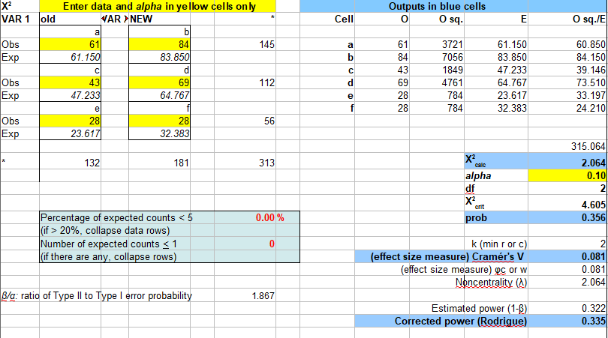
Data: North Reserve
a) Baccharis pilularis c) Bare dirt e) Baccharis salicifolia

Slide 8
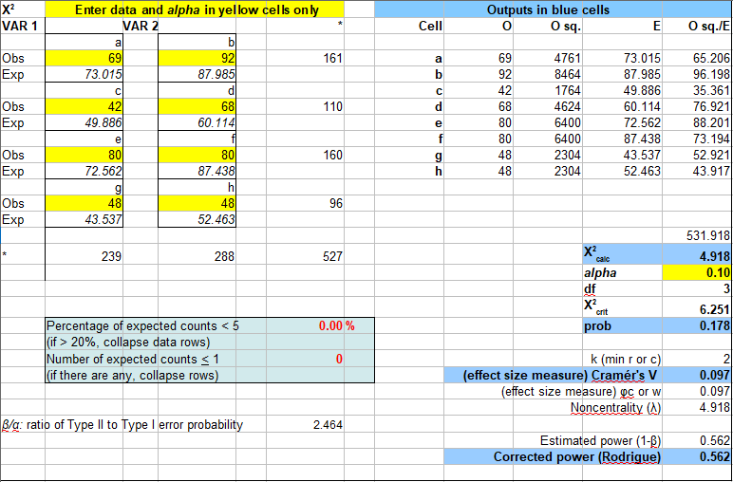
Data: South Reserve
a) Baccharis pilularis c) Bare dirt e) Brassica nigra g) Sorghum halpense

Slide 9
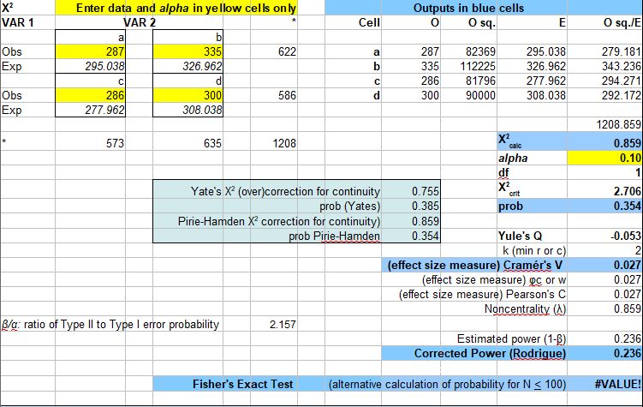
Data: Native vs Exotic Species

Slide 10
Results
For the North Reserve our X²_{calc} of 2.064 was less than our X²_{crit} of 4.605. This prompts us to keep the null hypothesis. Our alpha of 0.10 was less than our p-value of 0.356. Lastly our Cramer’s effect size at a mere 0.081 reinforced that our data is not significant enough.
For the South Reserve our X²_{calc} of 4.918 was also less than our X²_{crit} 6.251, again failing to reject the null hypothesis. Our standard alpha level of 0.10 was less than our p-value of 0.178. The Cramer’s effect size of 0.097 indicated that our data as had a less than small effect on the Chi-Square analysis.
When comparing native versus exotic species for both the North and South Reserve our X²_{calc} of 0.859 was no match for our X²_{crit} of 2.706, causing us to keep the null hypothesis for another time. Our alpha level of 0.10 fell short of our p-value of 0.354 indicating that the mix of native versus extotic species is not significant. The Cramer’s effect size resulted in 0.027.

Slide 11
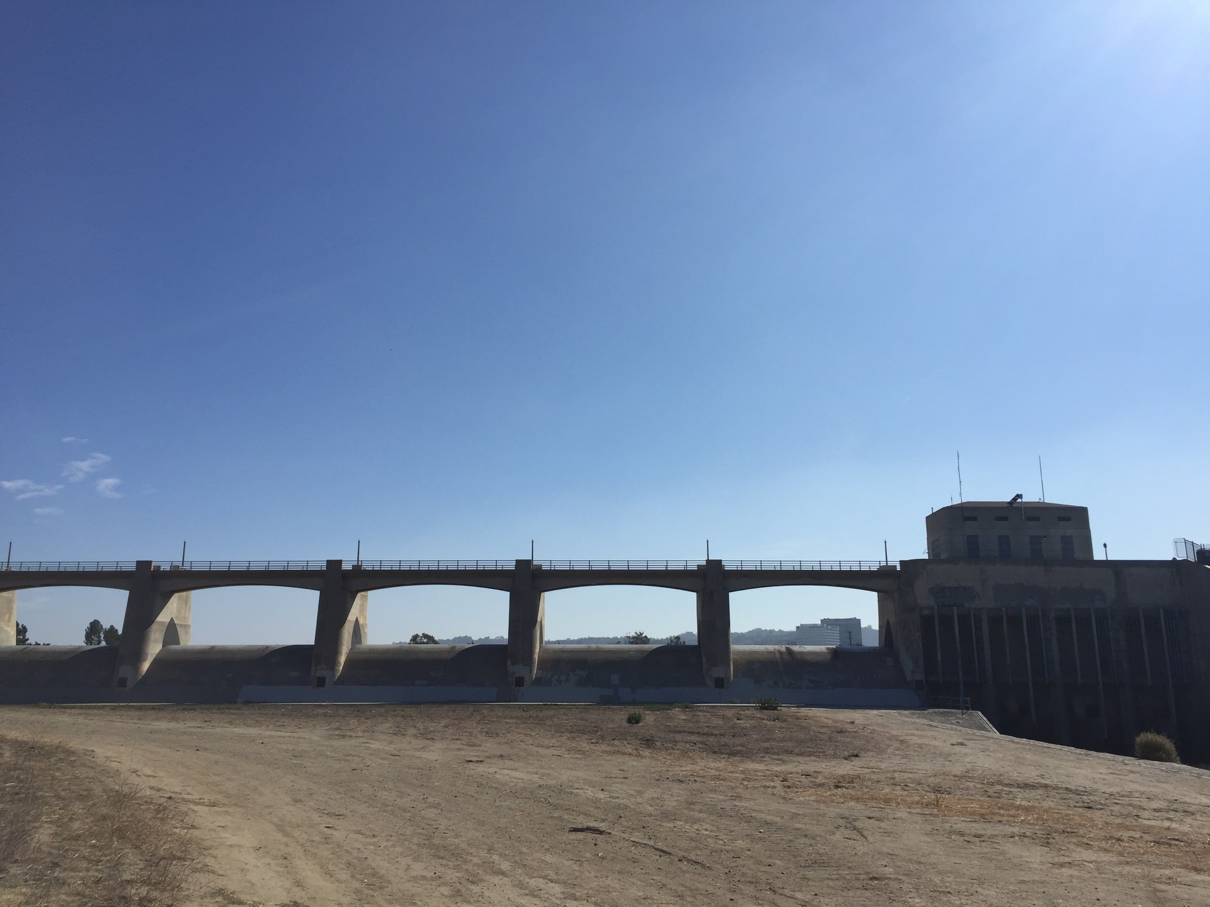
Discussion
No significant difference
CSS status in the Sepulveda Dam Basin
North Vs. South Analysis
South Vs. South Analysis
Exotic Vs. Native Analysis
48 native; 14 invasive/exotic; 26 bare ground (Our findings)
287 native; 286 invasive/exotic; 85 bare ground (Historically)
What does this mean?
Overwhelming presence of Baccharis pilularis (Coyote Brush)

Slide 12
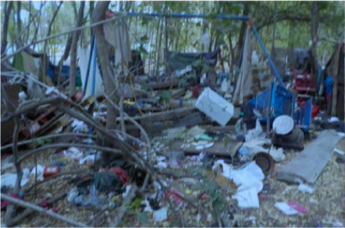
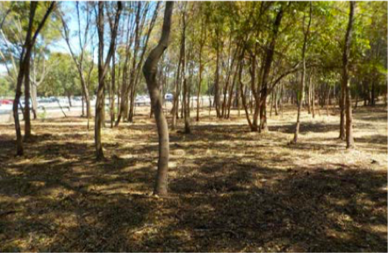
Compounding Factors
Vagrancy
Clean up initiatives & effect on environmental degradation
Notes:
https://www.spl.usace.army.mil/Portals/17/siteimages/Operations_Branch/Sepulveda%20Basin%20Homeless%20Encampment%20Clean%20Up%20Story.pdf

Slide 13
Conclusion
There is no significant data
We failed to reject the null
Majority of the exotic species that we observed while transecting were found by riparian area, specifically Silybum mariamum which is toxic cattle and sheep and is new to the data
The other new species observed was Camissoniopsis robusta
We recommend no further research

Slide 14


