Slide 1
Sepulveda Basin Reserve: Bull Creek
Angel
Arturo
Nicole
Zoi

Slide 2
Introduction
Sepulveda Basin Reserve: Bull Creek - breaking new ground
Special focus on Riparian Vegetation
Collection of new data vs data collected at Northern Reserve
Chi square testing : 1) species mix
2) native vs exotic

Slide 3
Data and Methods
Bull Creek
3 Main areas
15 parallel transect
  10 meters
10 unique species identified; 165 samples total
Common Species
  Mule fat
  Purple sage
  Bare ground
Exotic Species
  Johnson grass

Slide 4
Problems while Transecting
Homeless population
  Under bridges
  In tents
Litter
  Trash around trail
  Inside
Alternative paths
  Pathways carved from people walking through, but not the actual trail

Slide 5
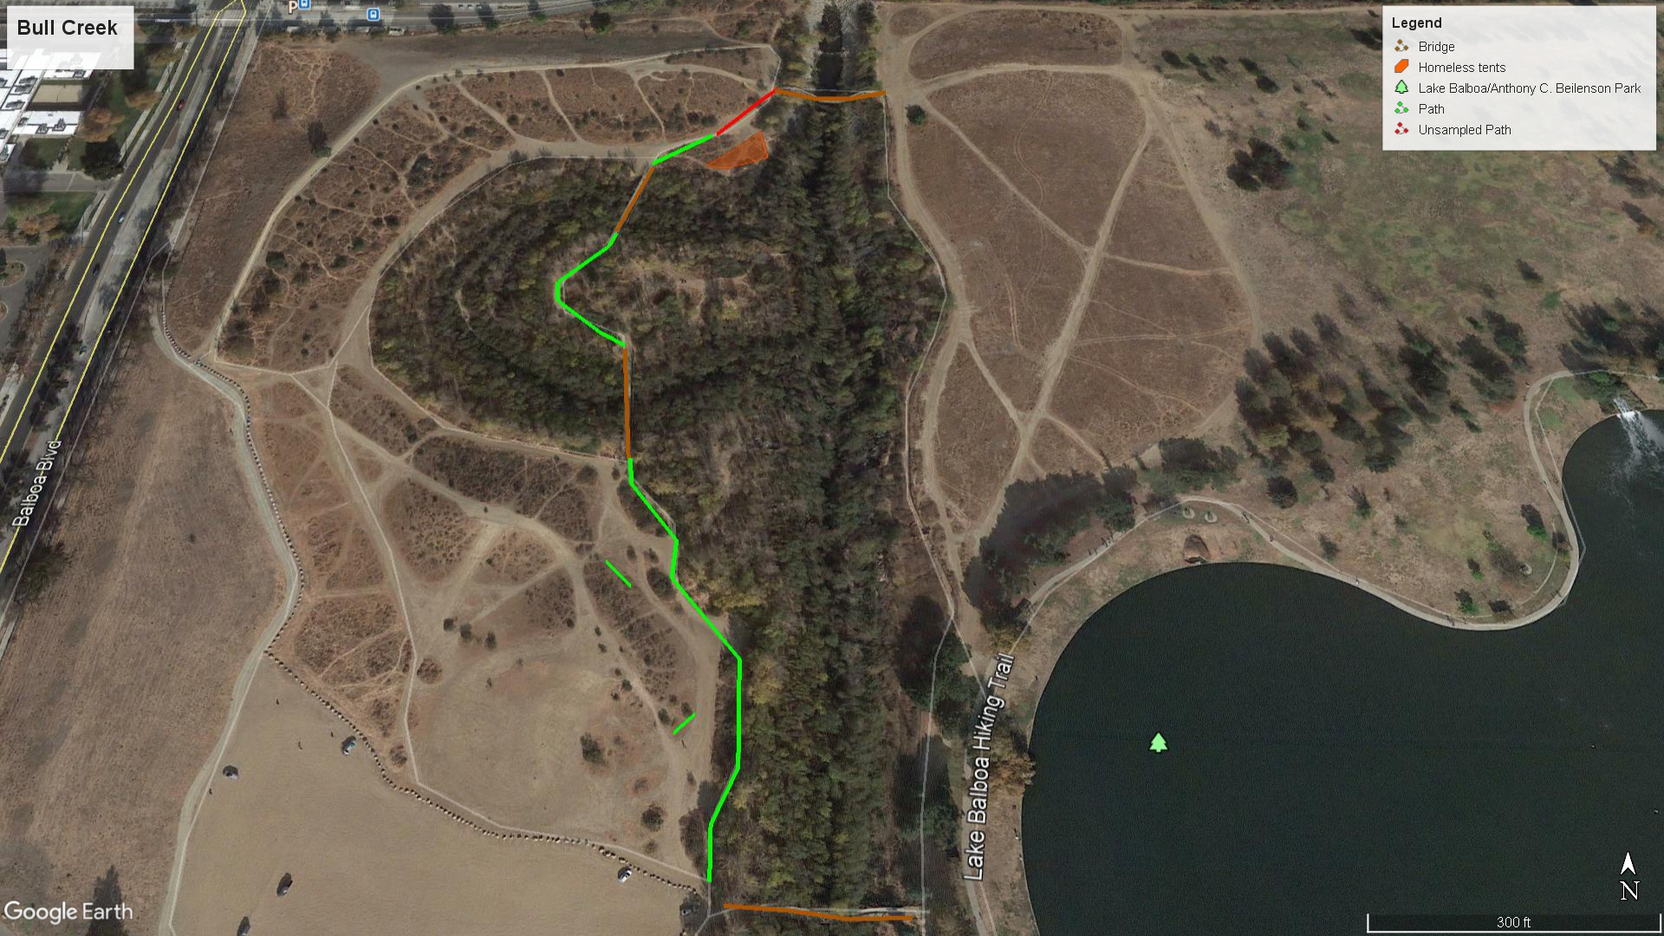

Slide 6
Results
Species mix analysis
  Alpha level = 0.10
  X2calc = 3.859
  X2crit = 4.605
  Prob-value = 0.145
  Effect size = 0.132
  Power = 0.528
  Null Hypothesis Accepted
Natives species vs. exotic species
  Alpha level = 0.10
  X2calc = 50.118
  X2crit = 2.706
  Prob-value = 0.0
  Effect size = 0.342
  Power = 1.0
  Null Hypothesis Rejected
X2calc | 3.859 | (effect size measure) Cramér's V | 0.132
alpha | 0.1 | Corrected power (Rodrigue) | 0.528
df | 2
X2crit | 4.605
prob | 0.145
X2calc | 50.118 | (effect size measure) Cramér's V | 0.342
alpha | 0.1 | Corrected Power (Rodrigue) | 1
df | 1
X2crit | 2.706
prob | 0

Slide 7
Discussion
Importance of species diversity and richness
  susceptibility to disease
  successful ecosystem
Natives > exotics
  strength and resilience of natives
Further research advised

Slide 8
Conclusion :
1st test : Null accepted
2nd test : Null rejected
Recommendations :
  Further data collection by successors
  Better maintenance, Trash problem and potential risks to plants

