Slide 1
Sepulveda Dam
Laureen Carroll, Collette Bradley, Noah Norcross, Megan Honey

Slide 2
Introduction
Purpose: To compare CSS restoration efforts between Bull Creek and the North Reserve of Sepulveda dam.
Bull Creek
Emerges from drainage channels traveling 3,000 feet before flowing into the LA river
1970s it was one of few undisturbed riparian habitats in San Fernando Valley
Channel has straightened throughout the years resulting in little support to maintain a sustainable riparian habitat
Restoration plan began in 2008 to restore native riparian and upland habitat

Slide 3
Background
The US Army Corps of Engineers conducted the restoration for the purpose of flood control after the Los Angeles flood of 1938
Plan to reduce non-native invasive plants through mowing and mulching, then using herbicide to limit their regrowth
After getting rid of invasive plants, they would restore native, “suitable sustainable habitats,” such as oak woodland grasslands and CSS

Slide 4
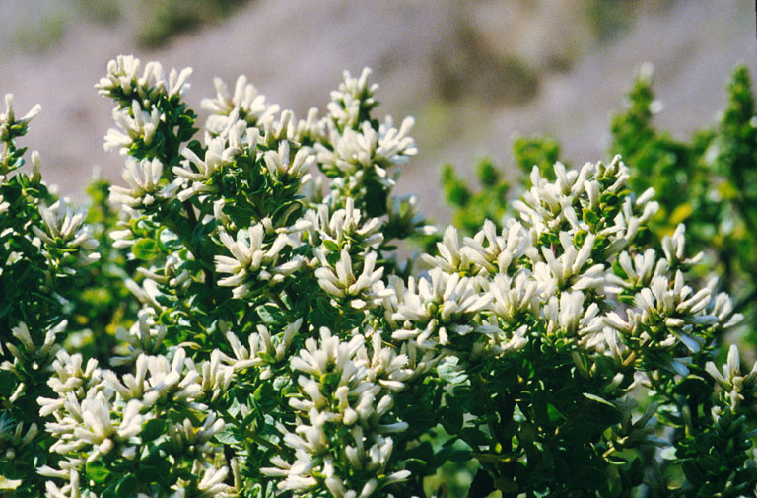
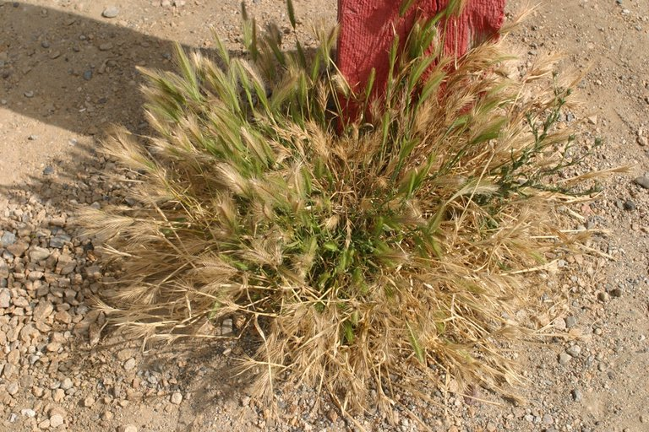
Questions
Is there a significant difference between the species mix of Bull Creek and the North Reserve?
Is there a significant difference between the presence of native and exotic species in Bull Creek and the North Reserve?

Slide 5
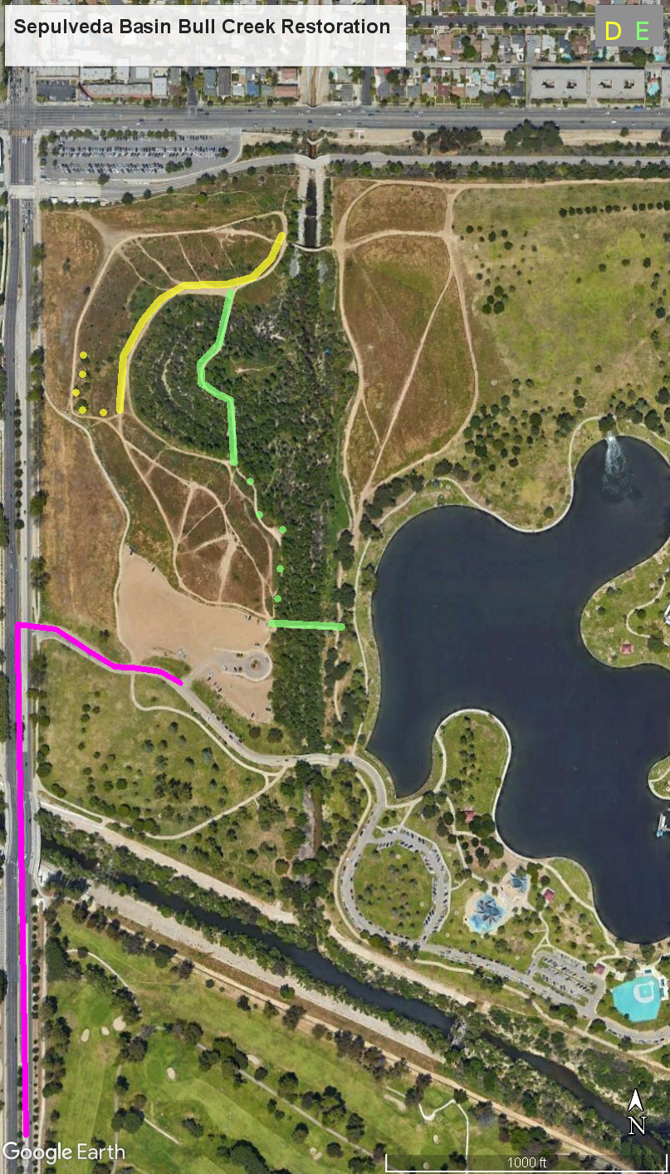
Hypothesis
Null Hypothesis:
There is no significant difference between the species mix of Bull Creek and North Reserve
There is no significant difference between the presence of native and exotic species in Bull Creek and the North Reserve

Slide 6
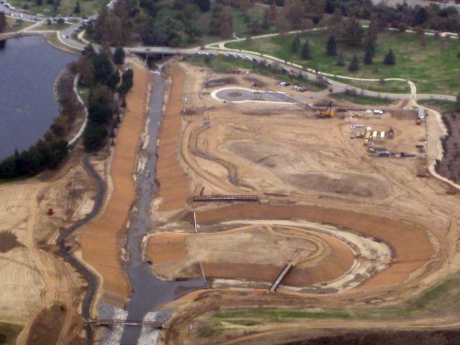
Bull Creek restoration project showing recontoured creek bed

Slide 7
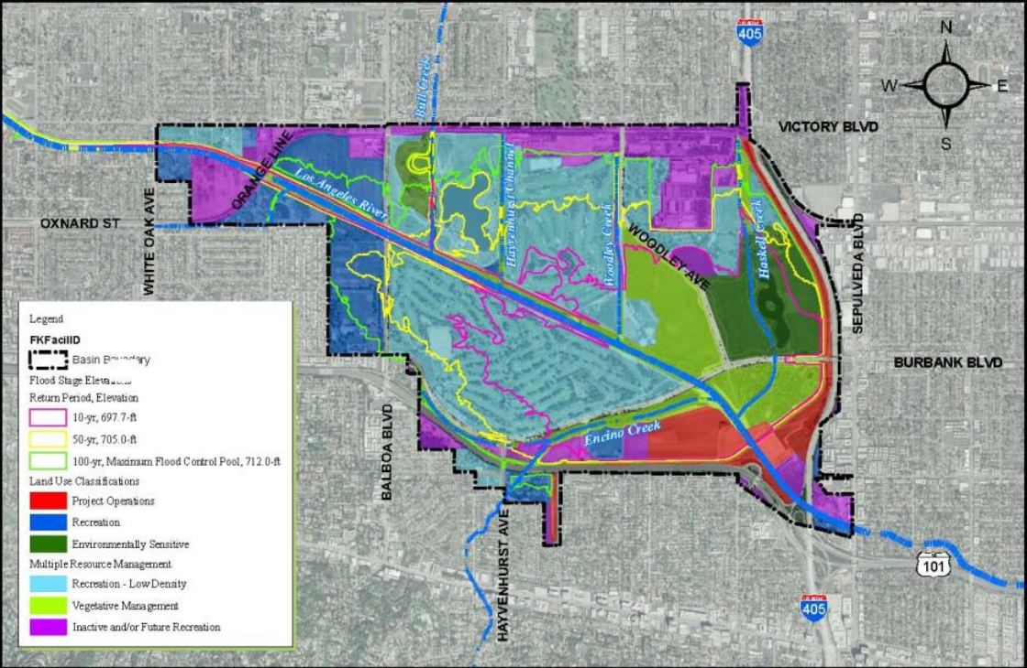
Sepulveda Basin Master Plan

Slide 8
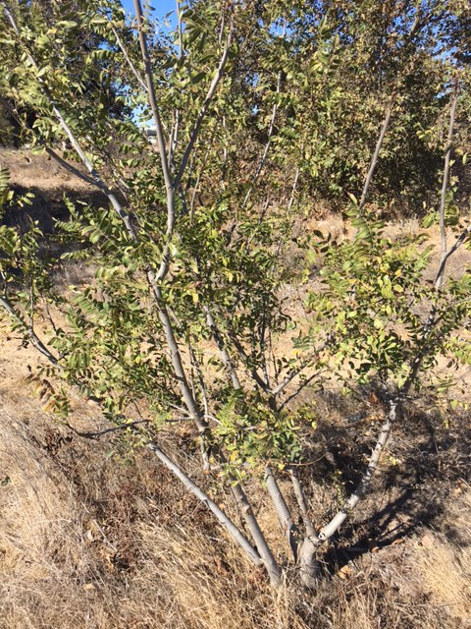
Data and Methods
Ten 10m transverse transects
We chose sample site locations based on a few parameters:
Presence of vegetation
Attempted to transect between equal distances along trail
Recorded elevation (m) and coordinates (in decimal degrees) using GPS at 0m and 10m marks
Each meter of the transect tape, we identified the species underneath
Physical samples and pictures were taken for any species that could not be identified on site

Slide 9
Data Processing Methods
Species Mix Comparison
Raw data: transferred field data into Excel
Aggregate data: Summed up number of each species
Comparison: Using predecessor’s data, we entered the North Reserve’s species frequency for each species found in Bull Creek.
Added the species frequency of North Reserve and Bull Creek and used the 4 most frequent species for a X2 analysis
Used an alpha of 0.10 for both studies
Native/Exotic Comparison
Labeled each species found in Bull Creek and North Reserve as exotic or native
Summed the total of exotic and native at each site
Inputted data into the 2X2 X2 table

Slide 10
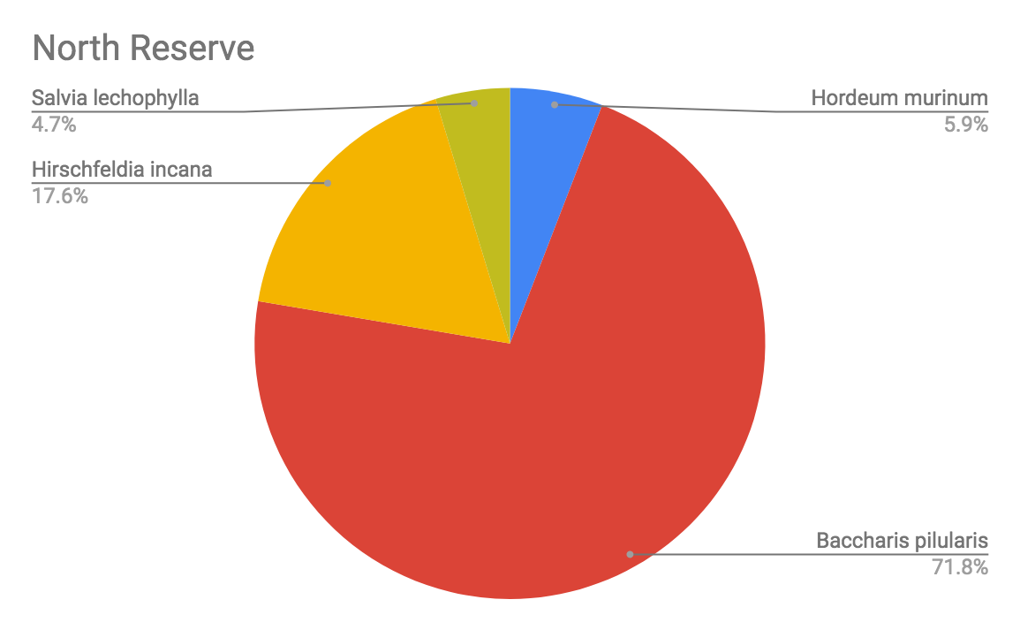
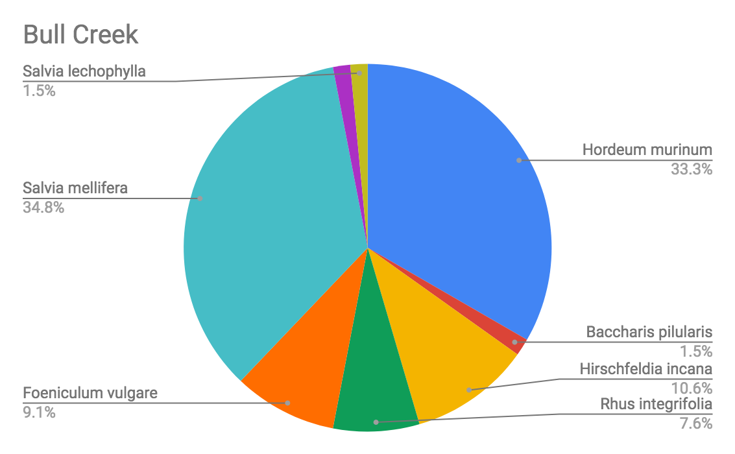
Species Mix

Slide 11
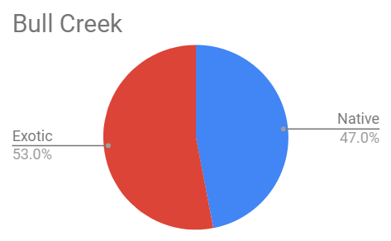
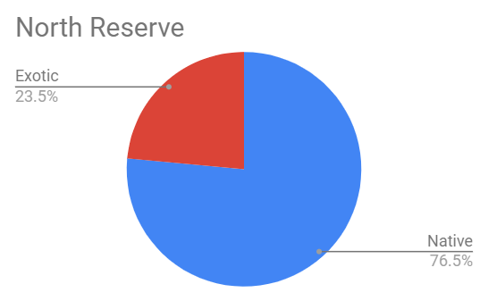
Native and Exotic Species

Slide 12
Results-Species Mix
X^2 Calculated | 92.882
X^2 Critical | 6.251
Alpha | 0.10
Degrees of freedom | 3
Probability value | 0.000
Estimated power | 1
Effect size | 0.833

Slide 13
Analyzing Results - Species Mix
Our X2 calculated value was greater than or X2 critical value, which indicates there is a significant difference between the species mix
Our prob value is less than our alpha, which indicates a significant difference
Prob value=0%: there is almost no chance the null is correct.
We calculated a strong effect size which emphasizes the size of the difference between the species mix of Bull Creek and North Reserve
The power level calculated is strong, which indicates that there is a high probability that we avoided a false negative.
With these results, we reject the null hypothesis. There is a significant difference between the species mix of Bull Creek and North Reserve

Slide 14
Results-Native/Exotic Comparison
X^2 Calculated | 13.963
X^2 Critical | 2.706
Alpha | 0.1
Degrees of Freedom | 3
Probability Value | 0.000
Estimated Power | 0.982
Effect Size | 0.304

Slide 15
Analyzing Results - Native/Exotic Species
Our X2 calculated value was greater than or X2 critical value, which indicates there is a significant difference between the presence of native and exotic species between Bull Creek and North Reserve
Our prob value is less than our alpha, indicating significant results
Prob=0%
Our effect size is moderate, which indicates an average difference between each site’s native species frequency
Similar to our species mix results, we calculated a large power between native and exotic species, which describes a high probability that we avoided a false null hypothesis
We reject the null hypothesis. There is a significant difference between the presence of native and exotic species between Bull Creek and North Reserve, with the presence of native species significantly higher in the North Reserve

Slide 16
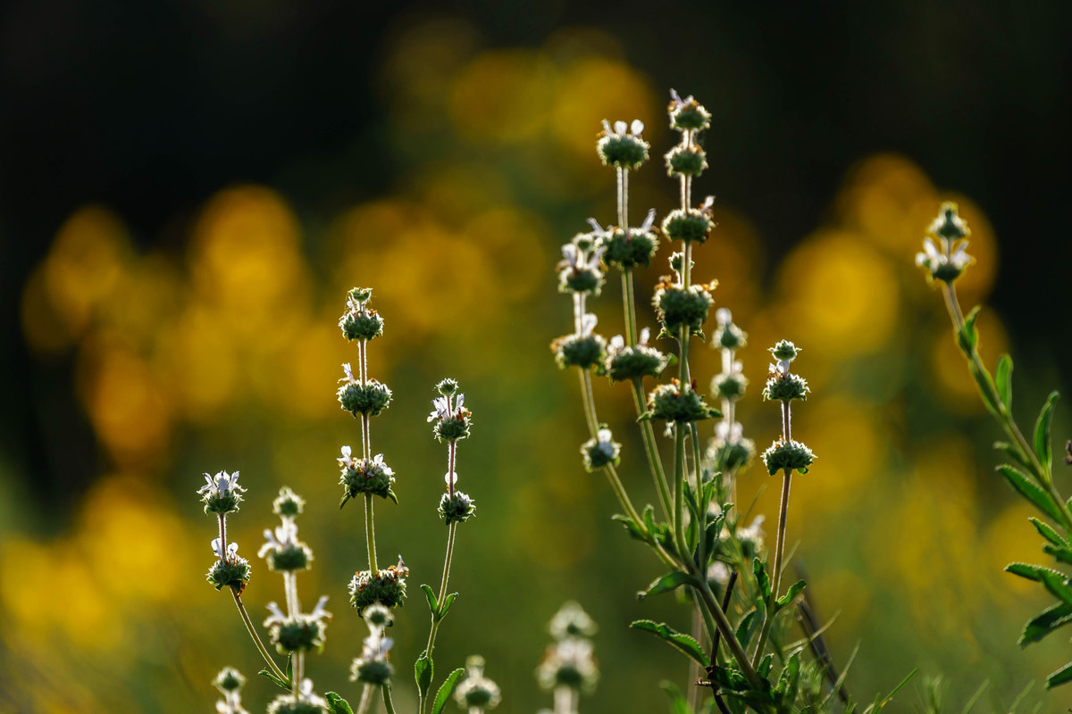
Discussion
Since there was a significant different in the species mix of the North Reserve and Bull Creek, we can conclude that the restoration efforts had varying successes in the sites
To compare which restoration site was more successful, we compared the frequency of native/exotic species in each site.
The results of our native/exotic species chi-squared comparison show that the North Reserve had significantly more native species than Bull Creek. This likely means that the restoration at the North Reserve was more successful.

Slide 17
Conclusion-Future Research
We do not need to collect more data because we already have a strong effect size and power
Collect recent data on the North Reserve
Our current study uses data collected in November of this year for Bull Creek and compares it with data from Sepulveda Dam North Reserve, which was last collected in Spring of 2017. This might not be as accurate, because the North could have gone through different stages of restoration within the gap. So, we could collect transects/data from the North Reserve and compare it with our Bull Creek data.
Conduct research during bloom period
Many of the plants sampled were not flowering or dead. This made identification much more difficult. Collecting data from both sites during bloom period (typically in winter/spring), may give us more accurate results.

Slide 18
Sources
Calflora (2018). Retrieved from https://www.calflora.org/
US Army Corps of Engineers (2012). Finding of no significant impact and environmental assessment: Sepulveda Dam Basin. US Department of Defense. Retrieved from https://www.spl.usace.army.mil/Portals/17/docs/publicnotices/sepulveda_dam_vegetation_management.pdf

