Slide 1
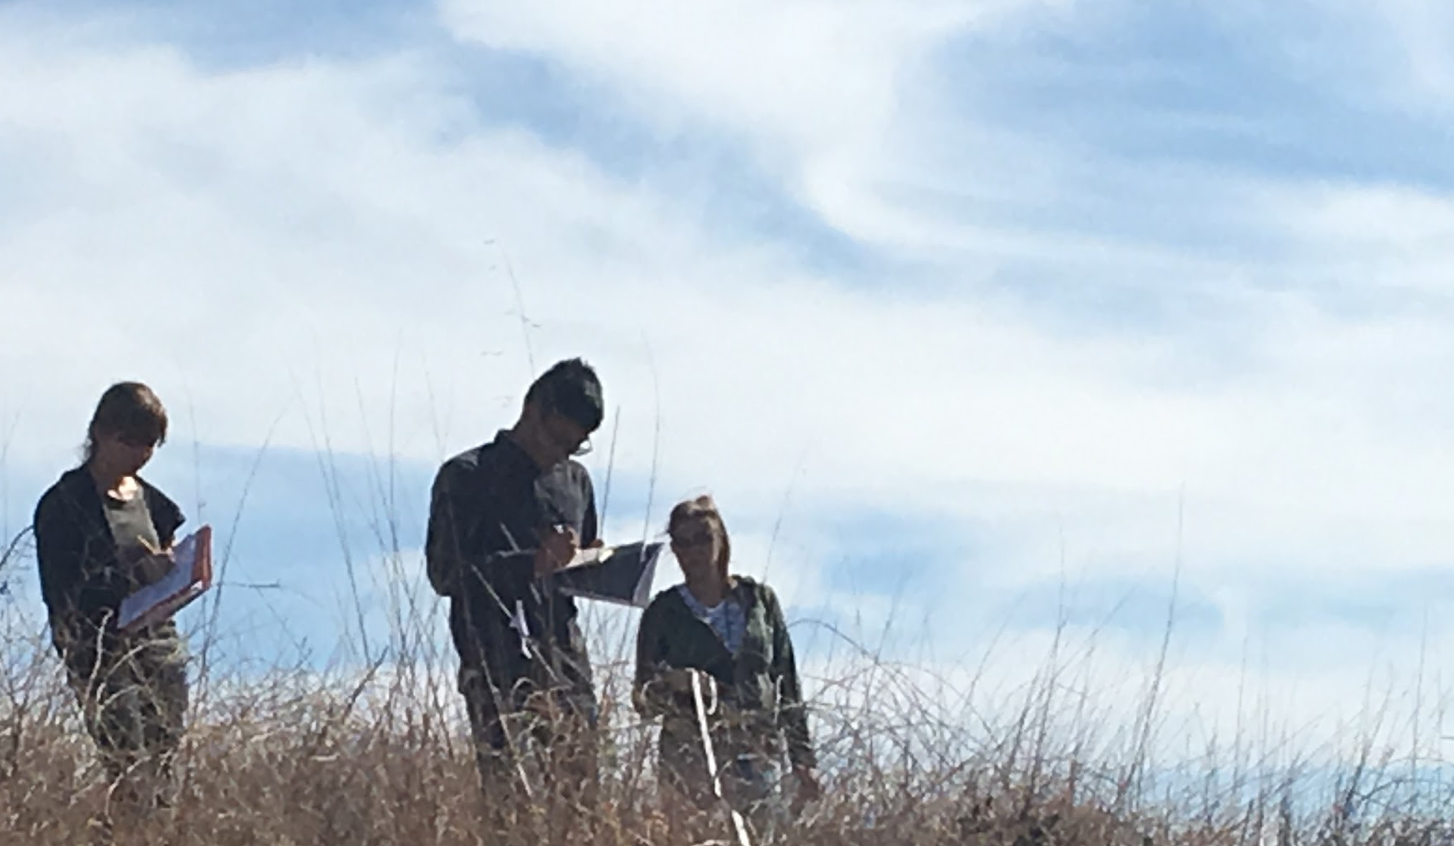
Two Branches off Charmlee Potrero Road and Ocean View
Brooke Shorey, Sydney Gumz
David Lwin, Timothy Gallagher

Slide 2
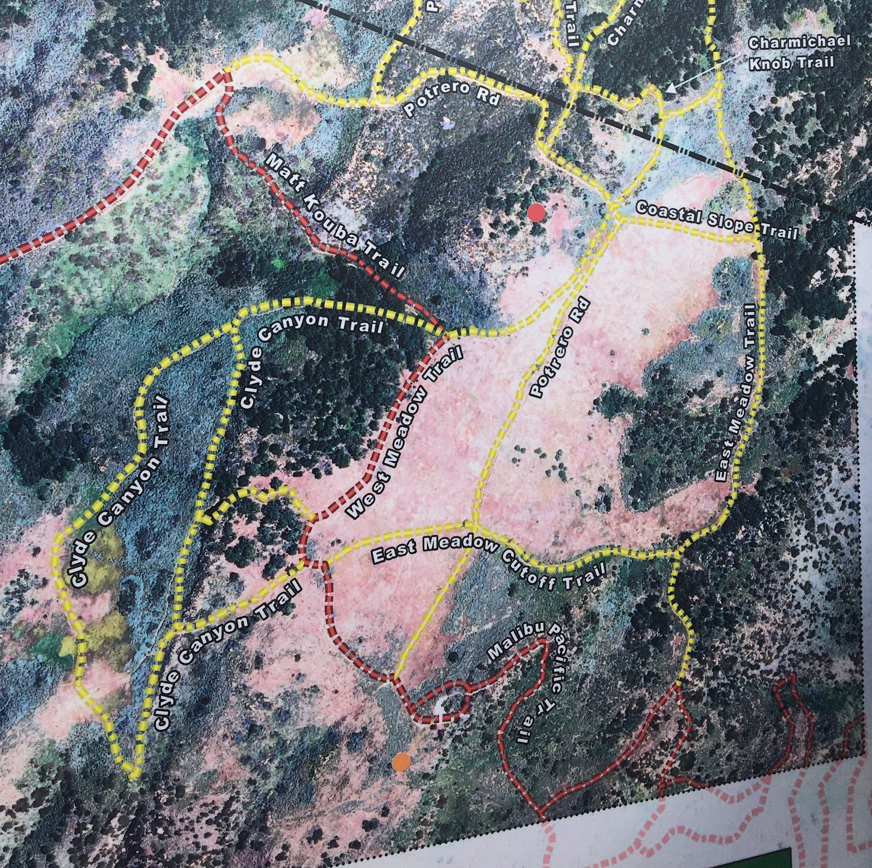
Where did we go?
Charmlee Wilderness Park
Northern end of Ocean View Trail
34.050325 -118.883400
34.050400 -118.884275
Main firebreak south of off Reservoir Trail
34.048800 -118.883050
34.048050 -118.883775

Slide 3
Why?
Analyze recovery of California Sage Scrub (CSS) after the major fire in 2003
CSS has been observed colonizing in sections of badly disturbed fire breaks
Did CSS take advantage of firebreaks to outcompete mustard
Ha:Based on previous research, firebreaks tended to facilitate CSS restoration as opposed to other forms of disruption (i.e. plowing) that prevent regrowth of CSS
Ho: Firebreaks did not differ in CSS restoration from other forms of mechanical disturbance

Slide 4
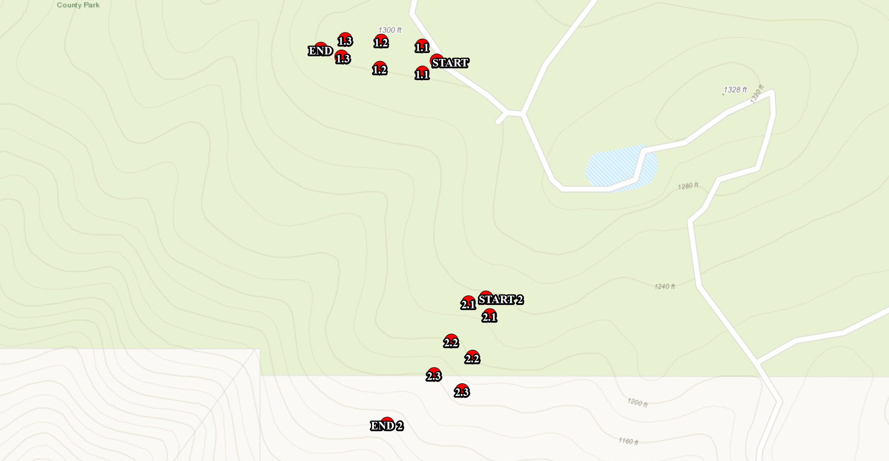

Slide 5
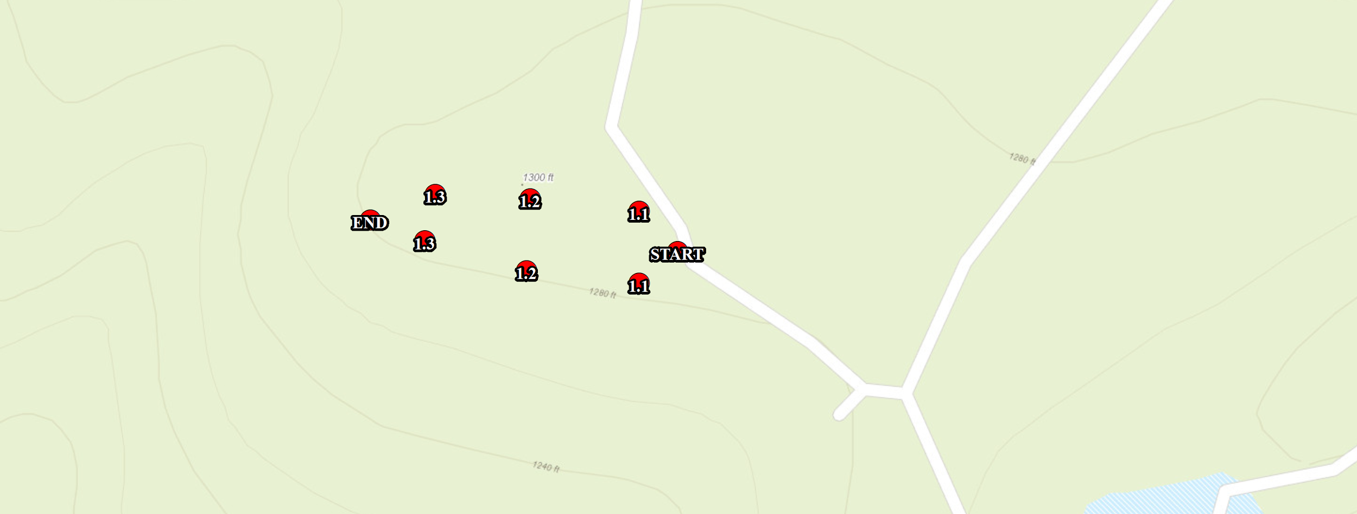

Slide 6
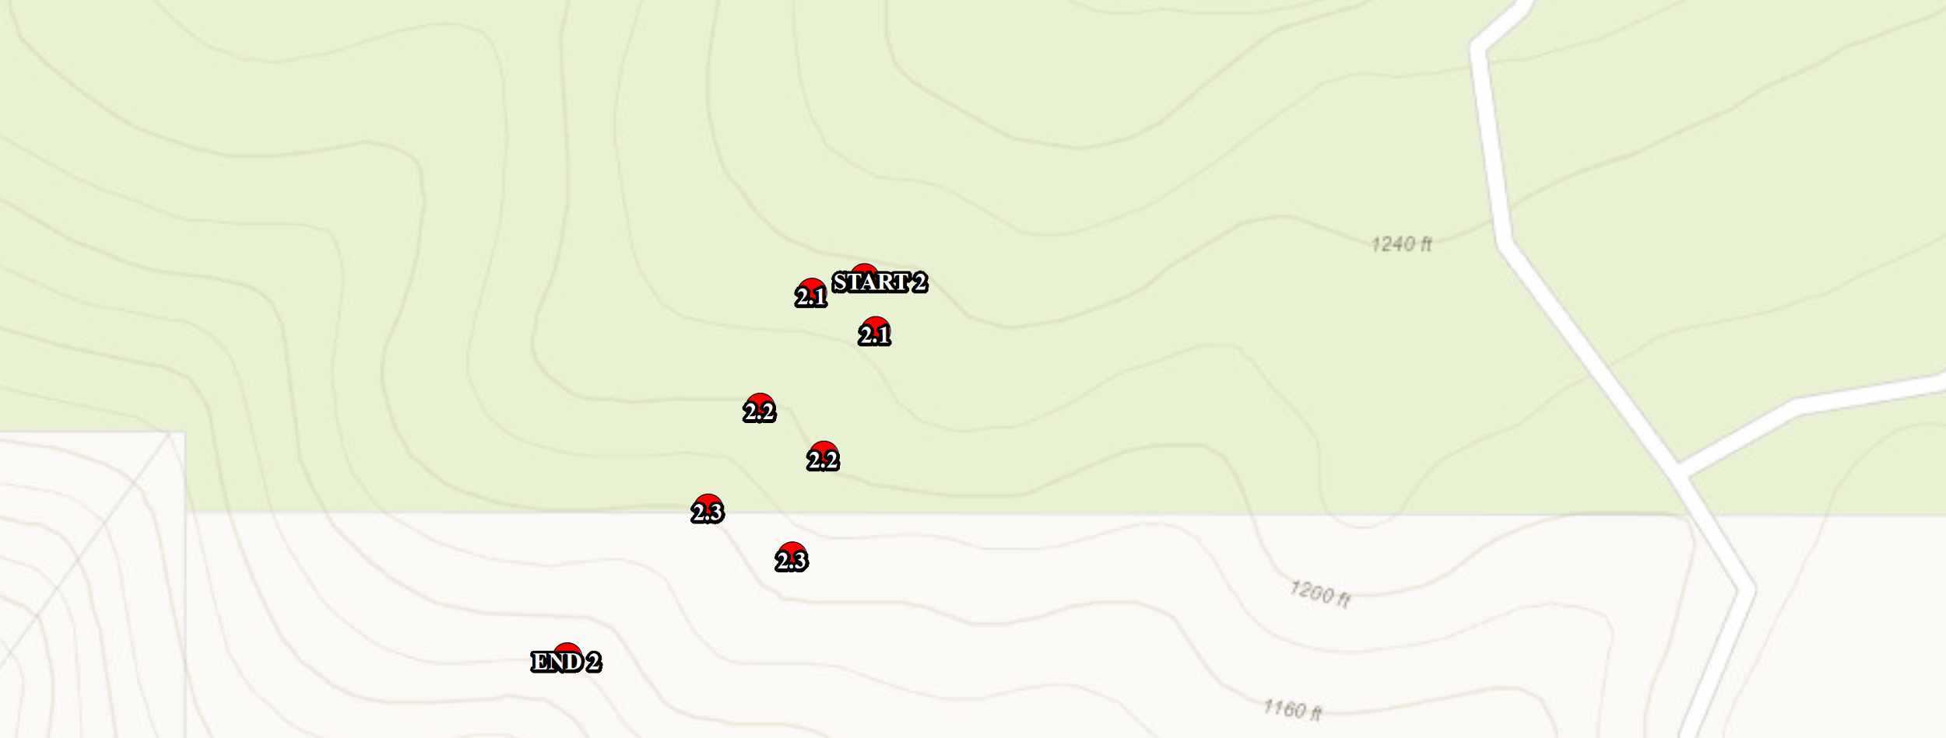

Slide 7
What did we find?
Brassica nigra (Mustard)
Dead litter
Some CSS (not as much as expected)

Slide 8


Slide 9
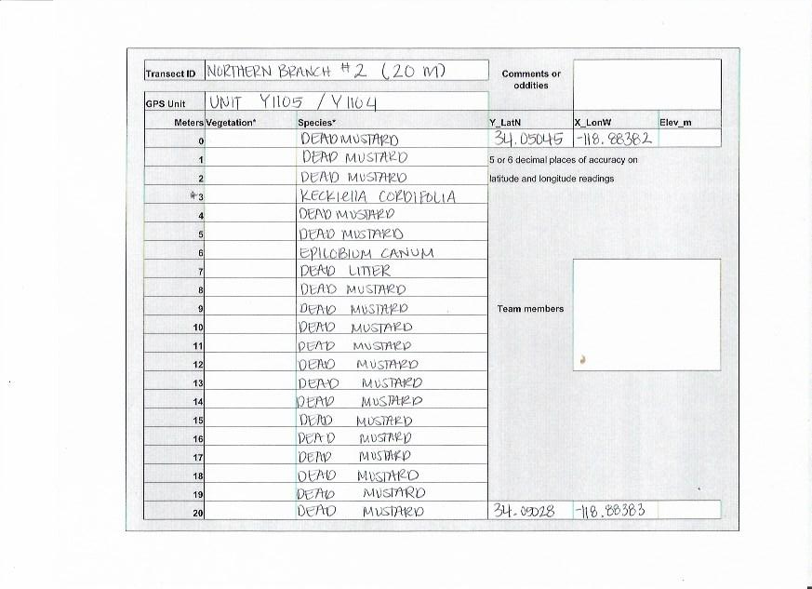

Slide 10


Slide 11
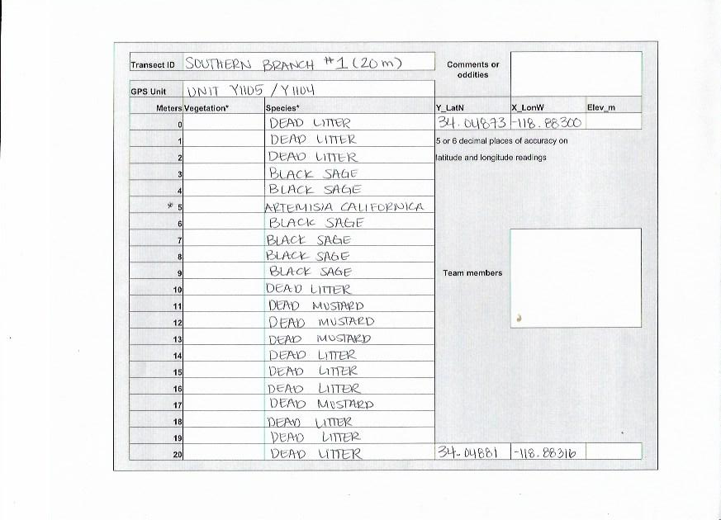

Slide 12
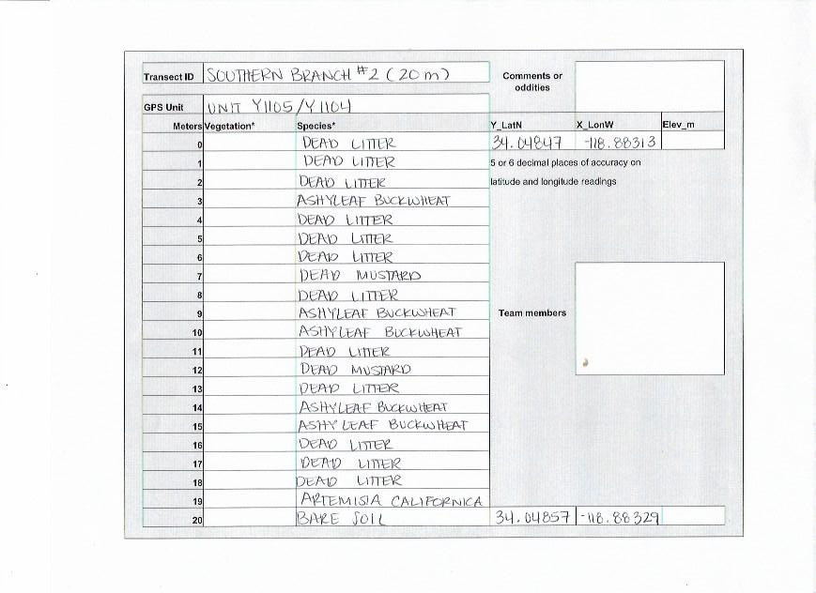

Slide 13
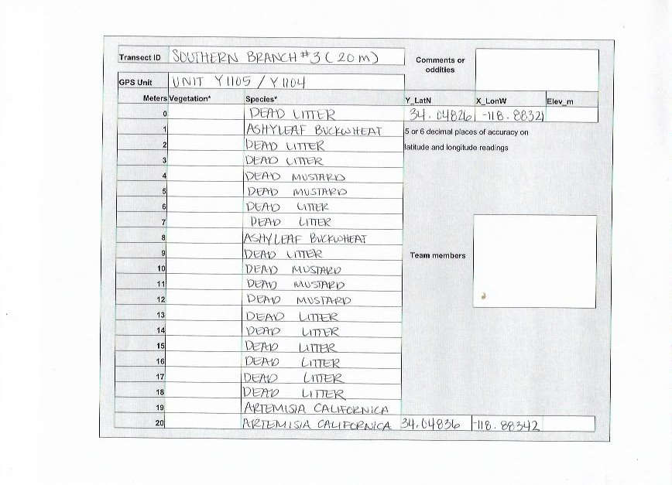

Slide 14
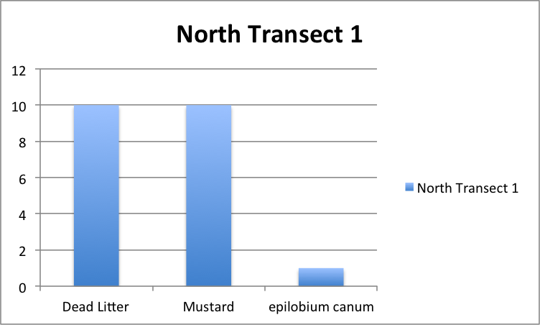

Slide 15
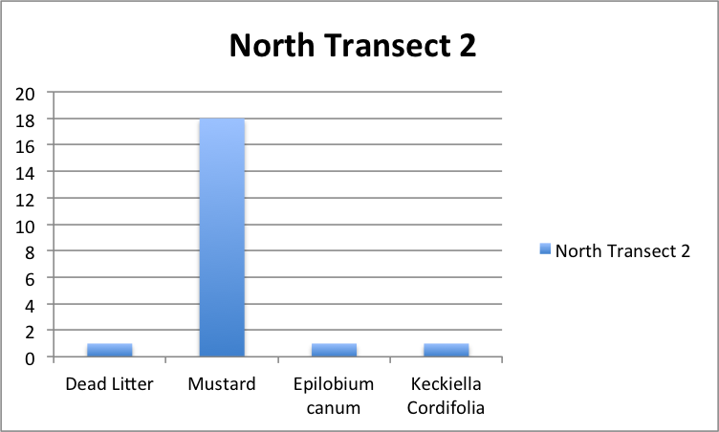

Slide 16
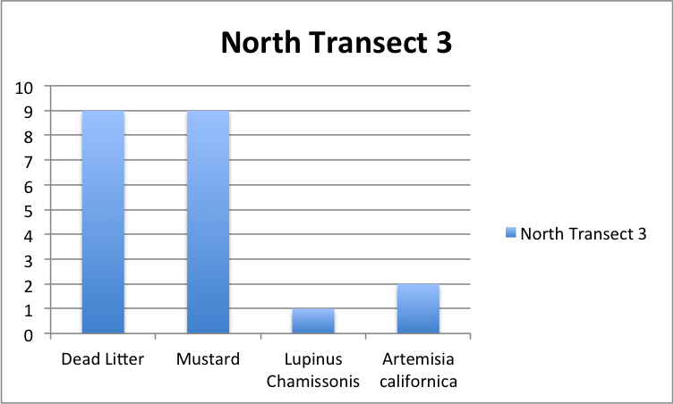

Slide 17
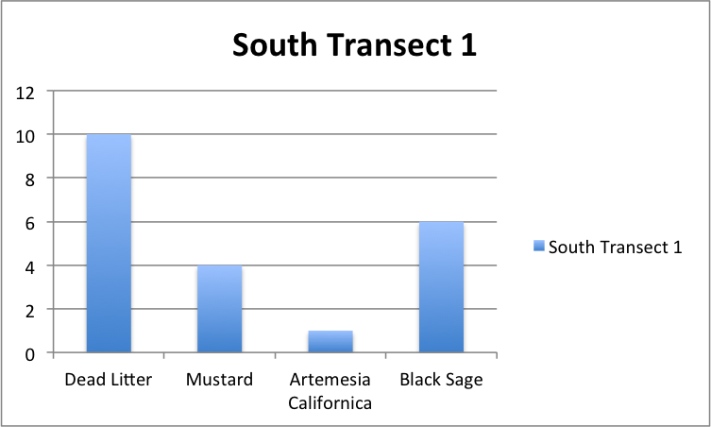

Slide 18
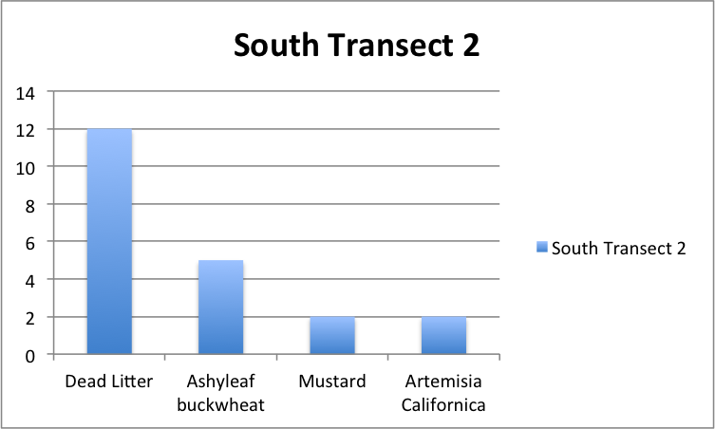

Slide 19
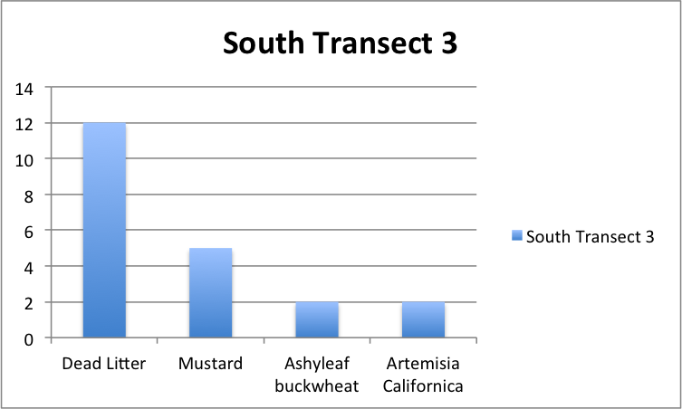

Slide 20
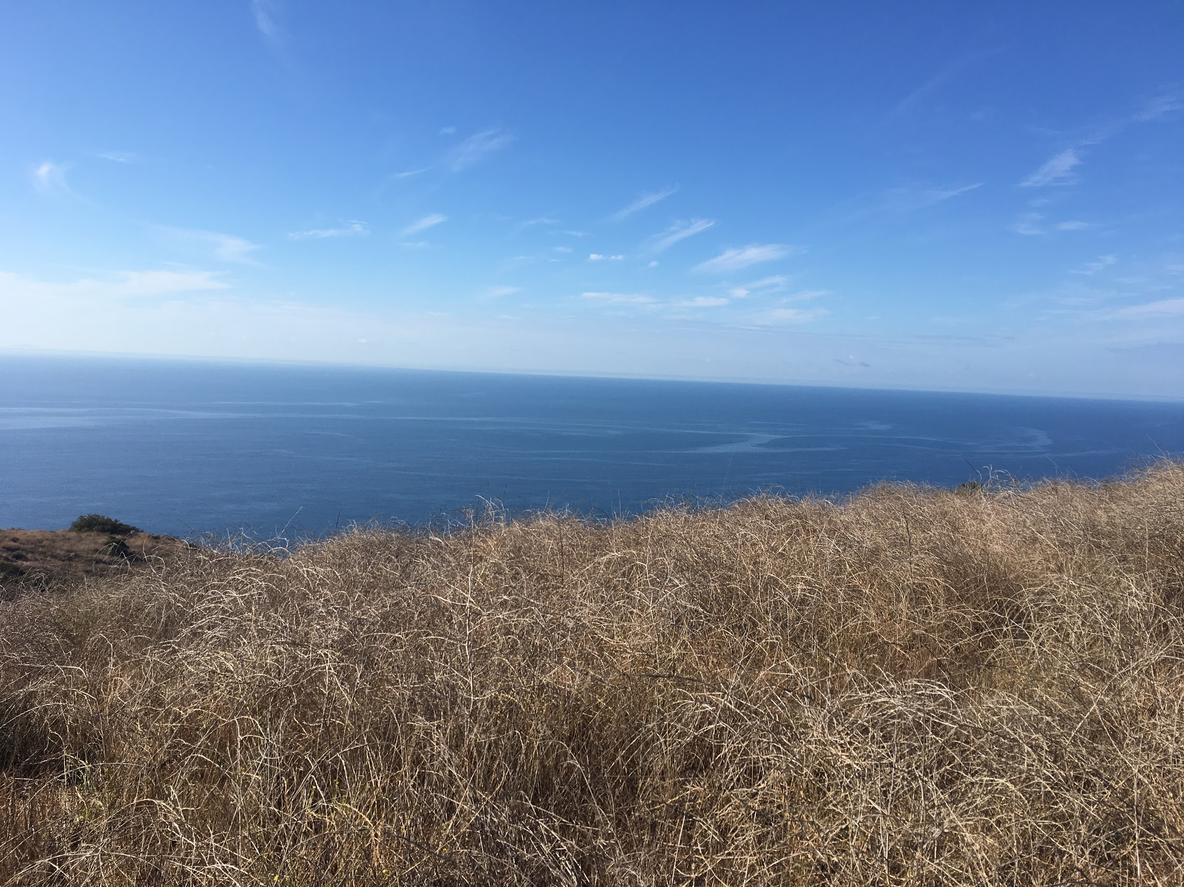
Significance
Not what we expected to find
North and South, Slightly different results

Slide 21
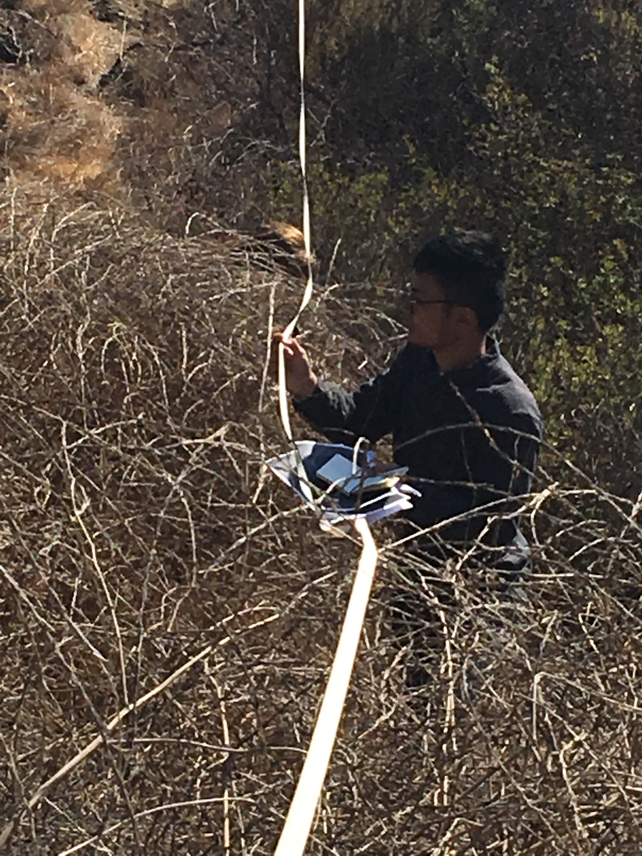
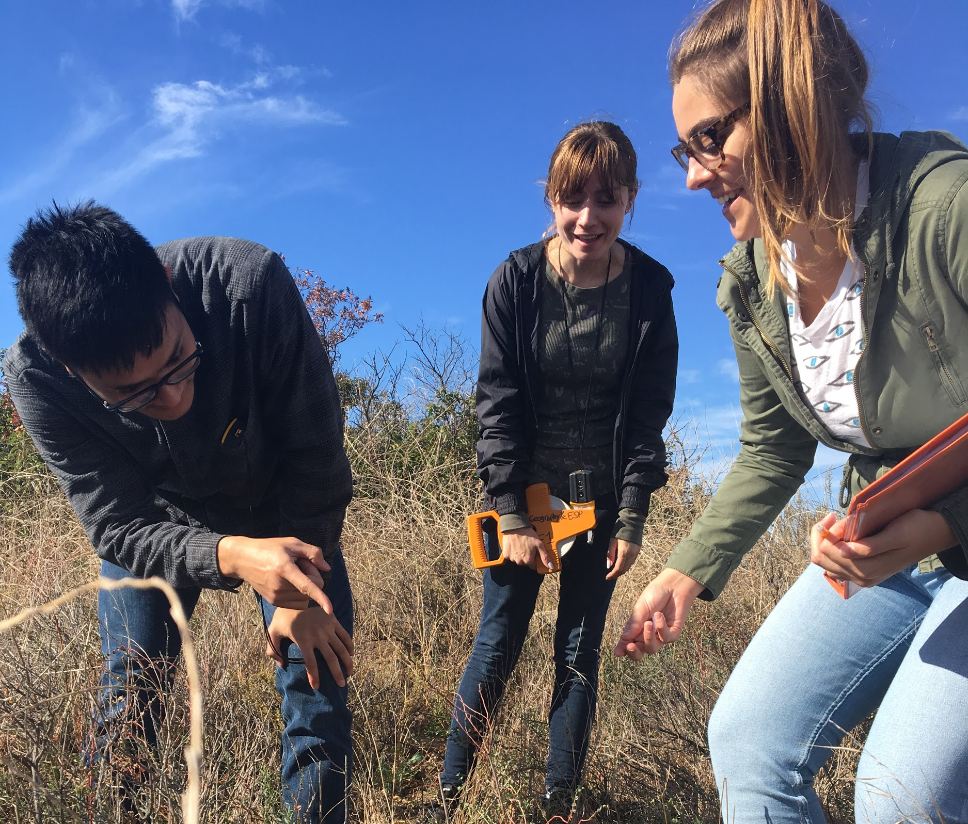
Methods
Notes:
Tim

Slide 22
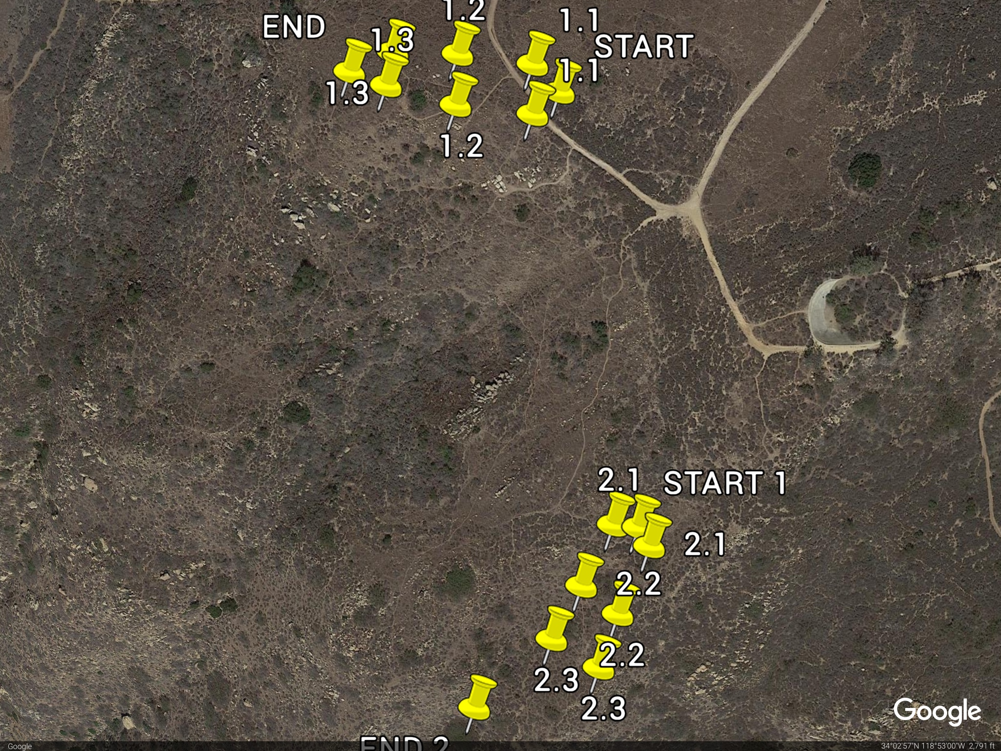

Slide 23
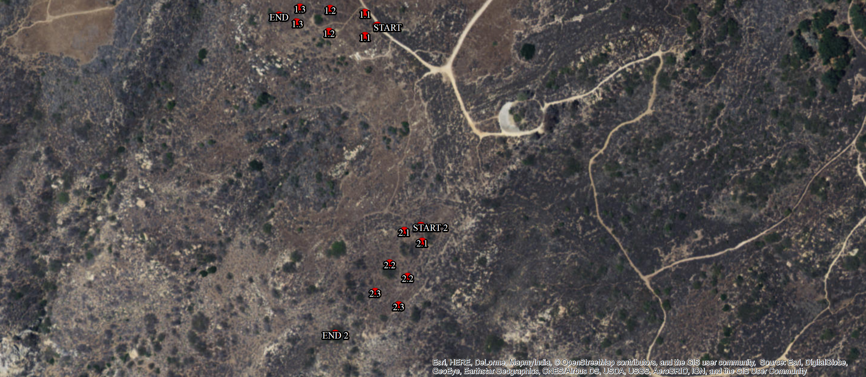

Slide 27
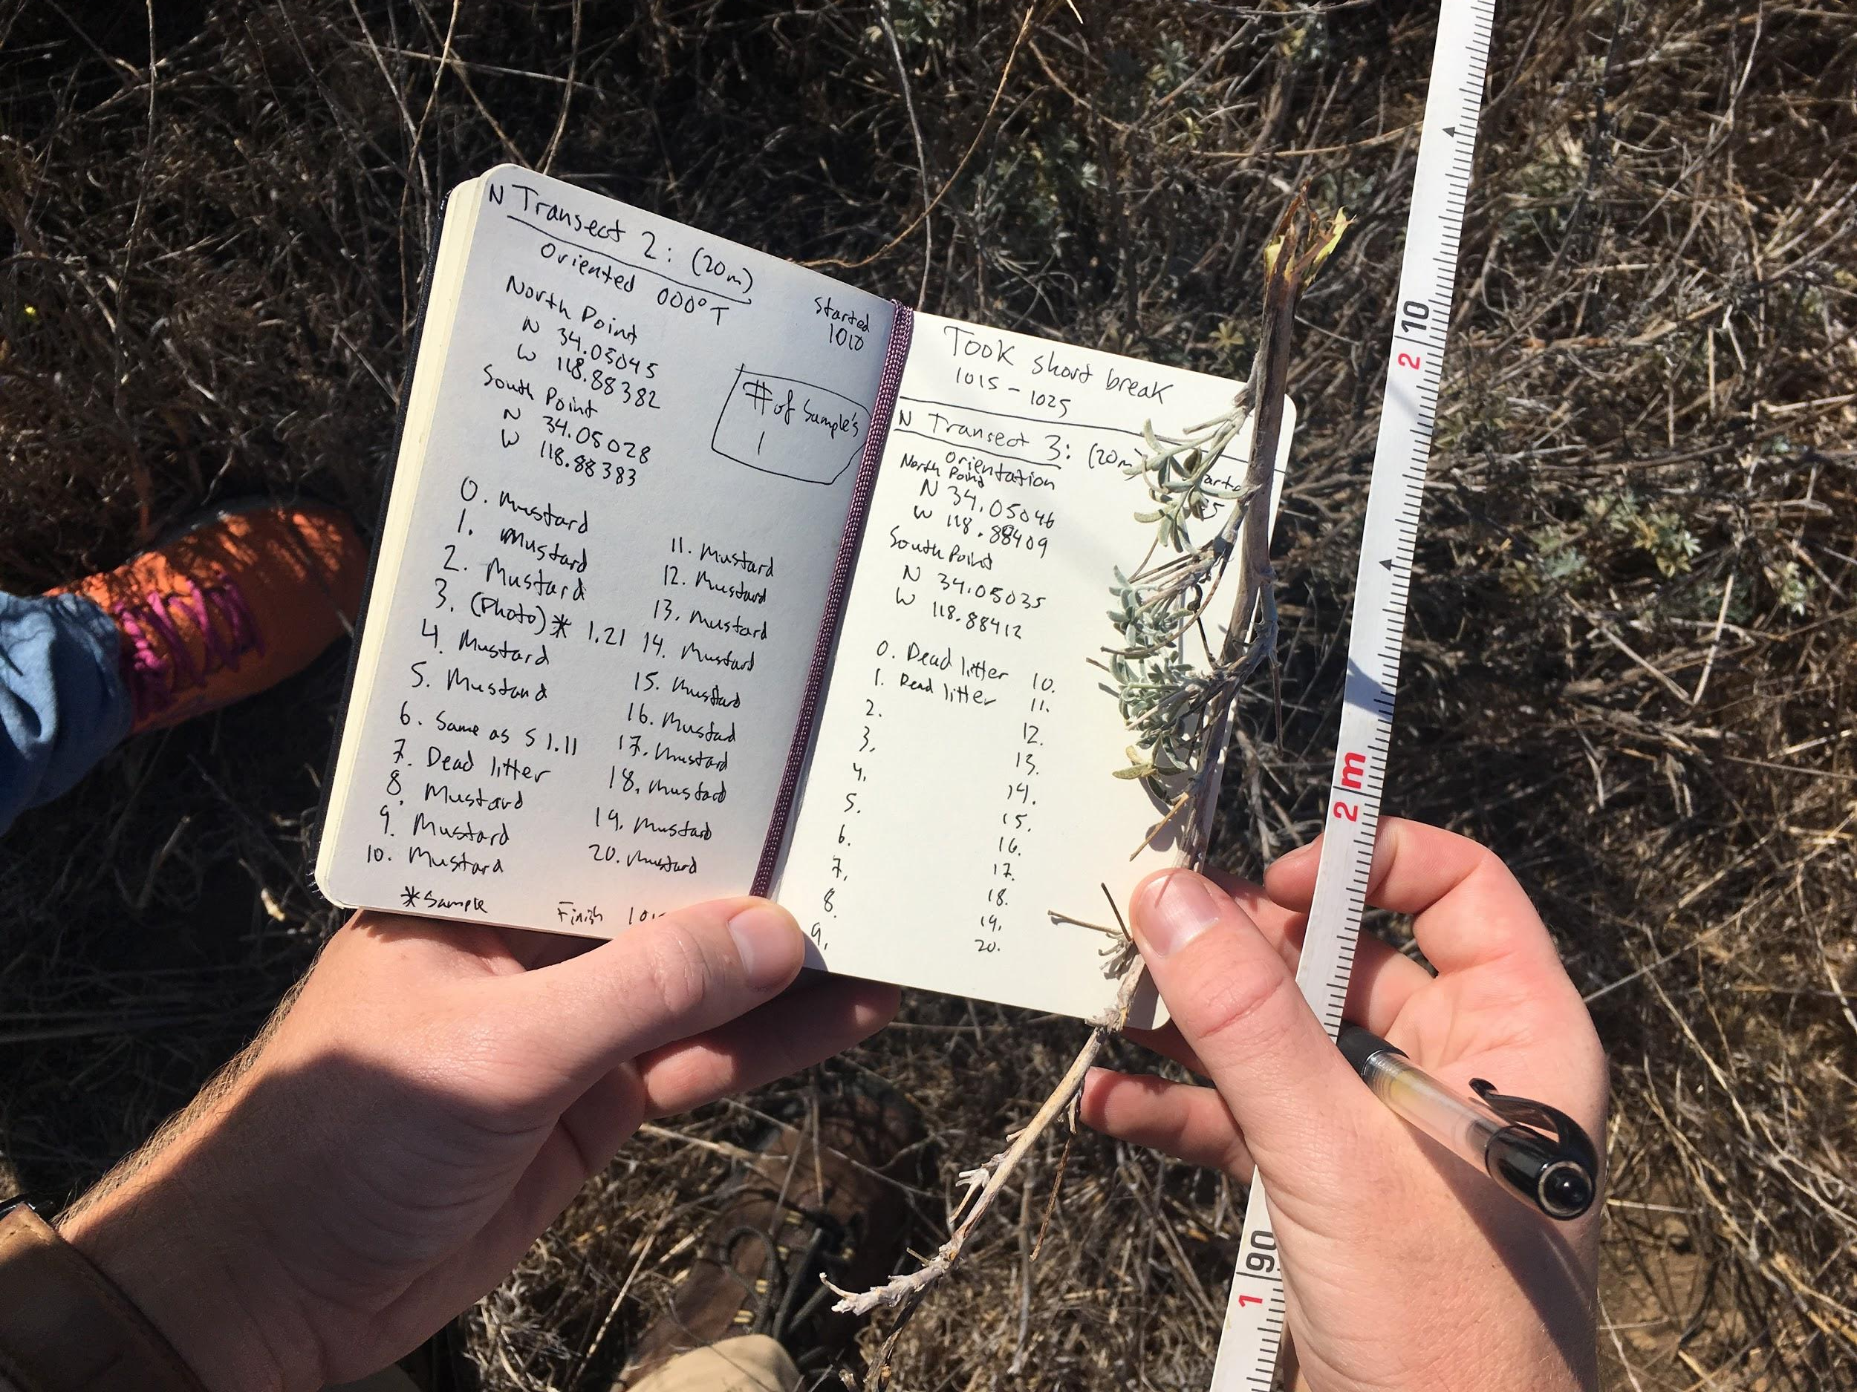

Slide 28
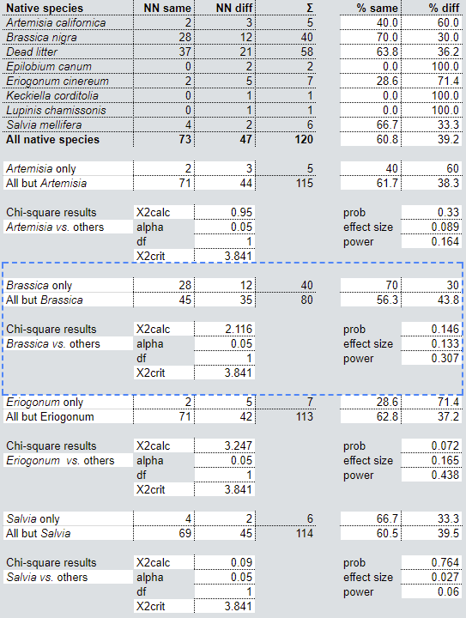
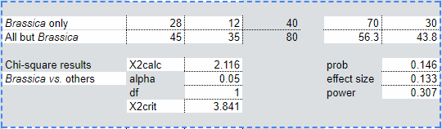
Results
X²calc < X²crit (insignificant data)
Probability > alpha (fail to reject null hypothesis)
Low effect size (more research with larger sample needed)
Low power (small magnitude)
Notes:
David

Slide 29
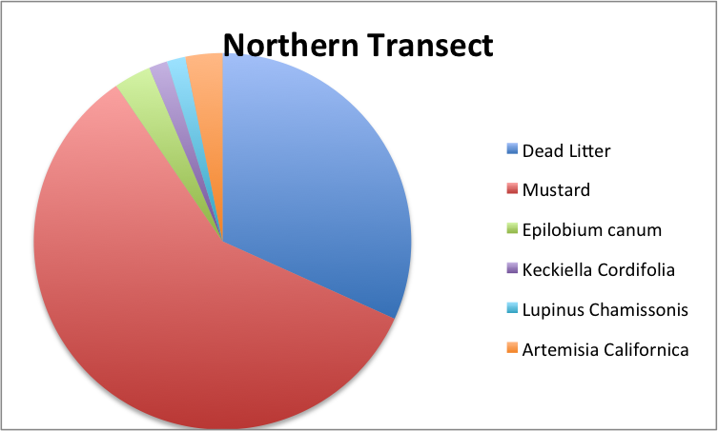
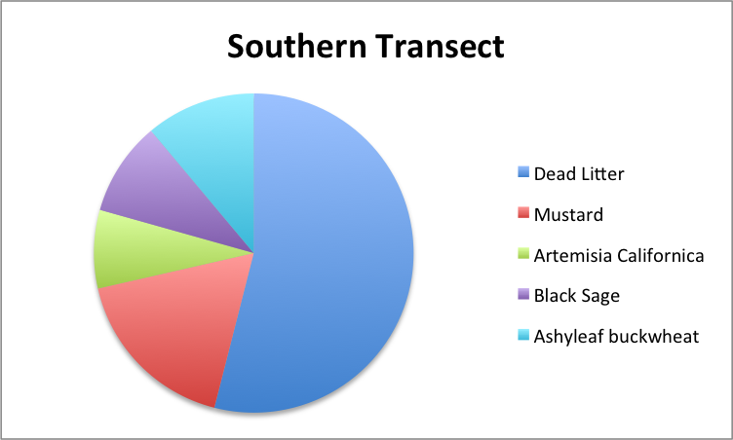

Slide 30
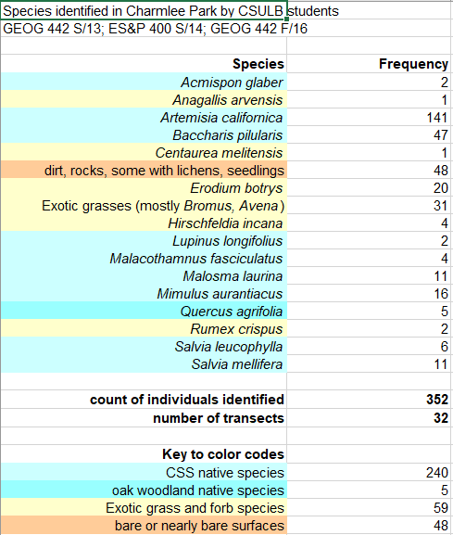
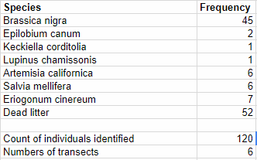
Comparism
Our Transects

Slide 31
Conclusion
Northern end of Ocean View Trail
firebreaks did not facilitate CSS restoration
Main firebreak south of the Reservoir Trail
firebreaks did kind of facilitated CSS restoration
There is a 0.05% chance of getting a false positive
More data and tests needed to eliminate errors
Notes:
David

Slide 32
