Slide 1
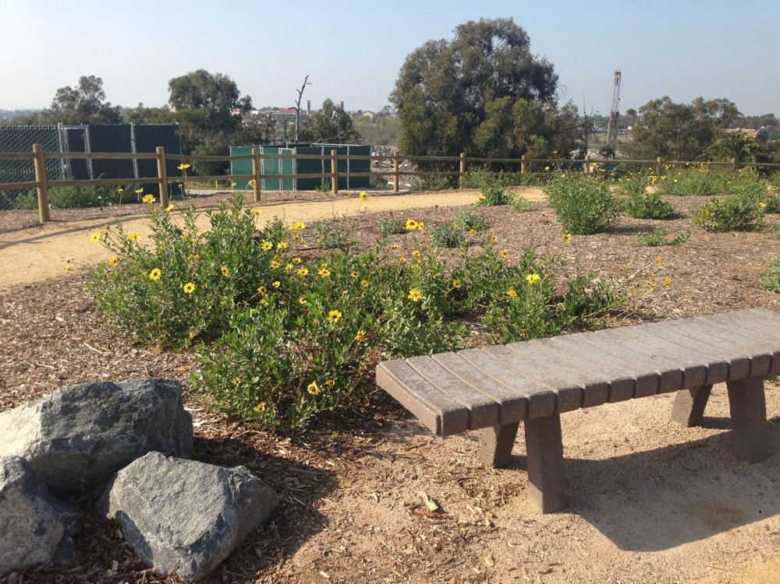
Willow Springs
Emily Critchfield
Erin Junowich
Alexis Butterworth
Allen Ly
Nick Daddow

Slide 2
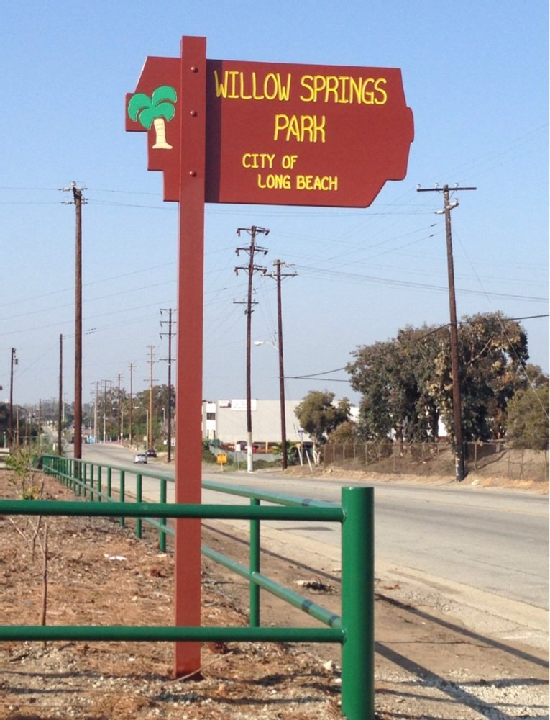
Park History
History of Artesian Flowing Springs​
​
90 Years of Oil Production​
​
Longview Point
​
Coastal Sage Scrub (CSS)​
Willow Springs Wetland Restoration Project

Slide 3
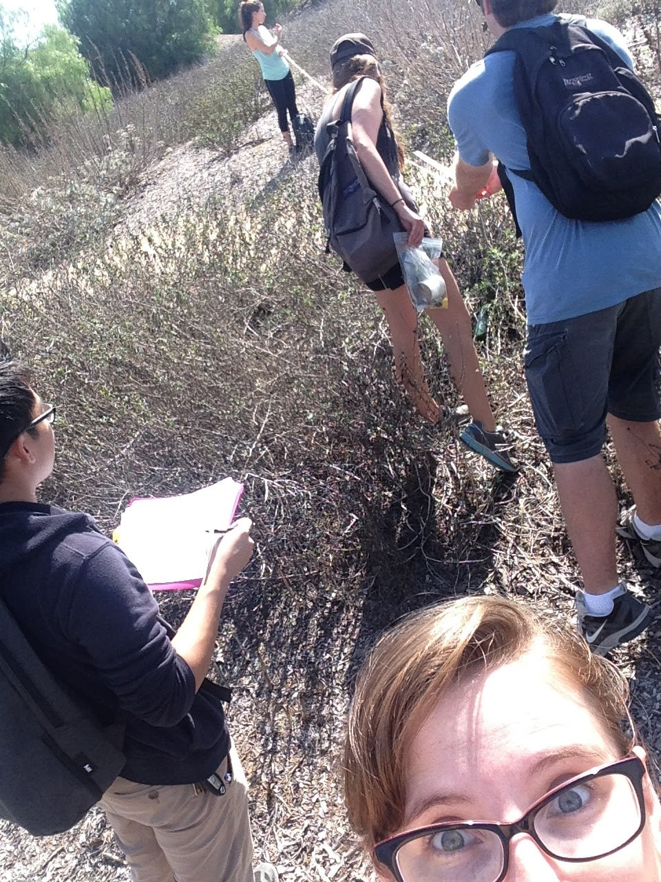
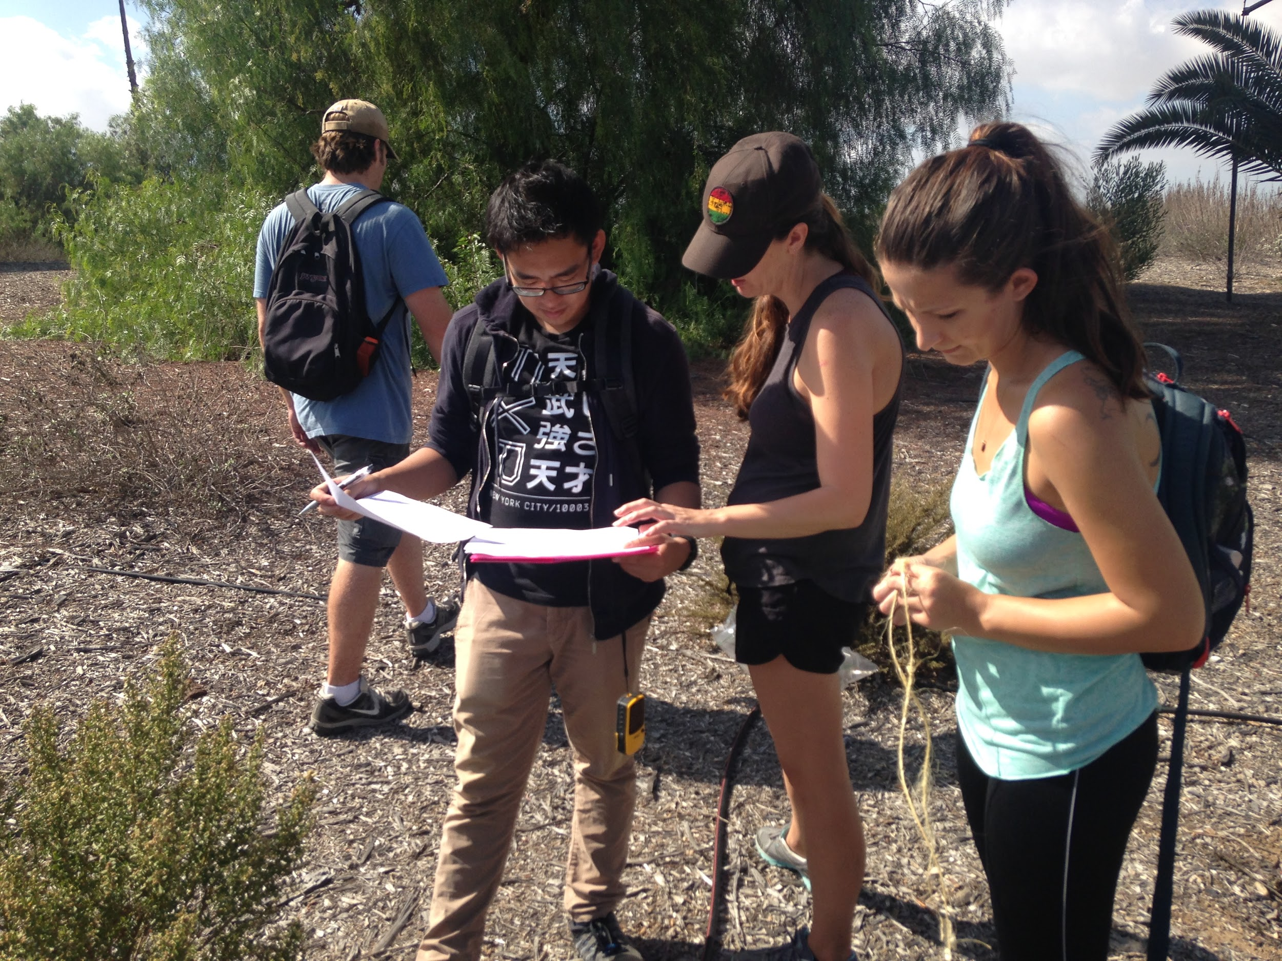
Introduction
Current Land Use: Oil extraction, concrete recycling, agriculture, stormwater detention, and recreation
Restoration: Coastal Sage Scrub
Threats: Human development and invasive species
Purpose: To determine if restoration efforts have been successful so far

Slide 4
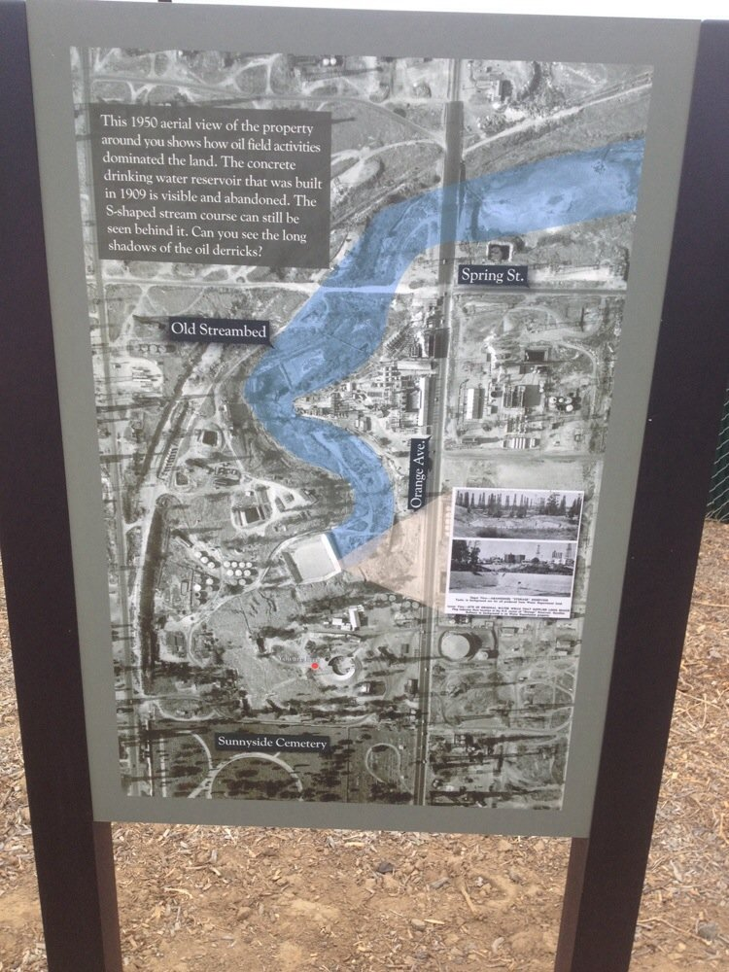
Significance
Threatened species depend upon CSS habitat
CSS is disappearing all over the CA coast
Largest Park to open since El Dorado Park
This park is also an asset to the community

Slide 5
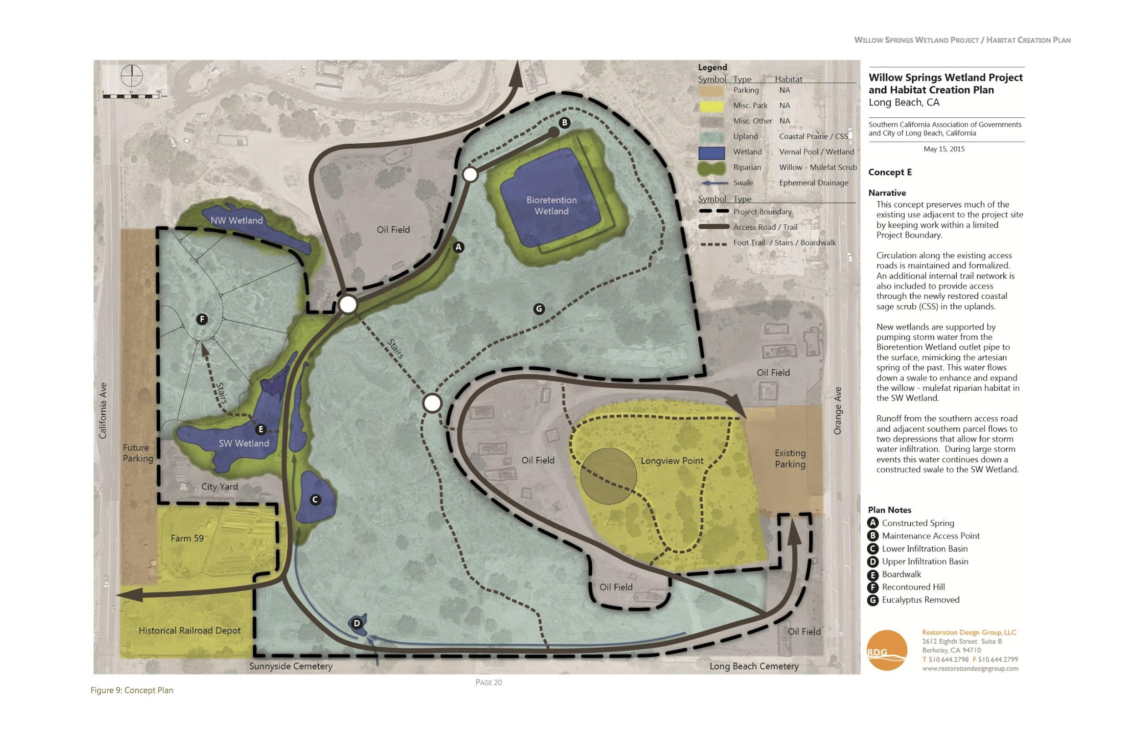
Baseline Study
Willow Springs Wetland Restoration Project
  Comprised of 12 acres, improve accessibility from east and west side of 47 acre park
  Outdoor Classroom Site
  Restore CSS and determine what CSS are effectively growing
  Create system of bioswales and ponding area
  Increase water quality
Species Present
Monitor change and compare/contrast it to future studies
Soil, water quality, vegetation, etc.

Slide 6
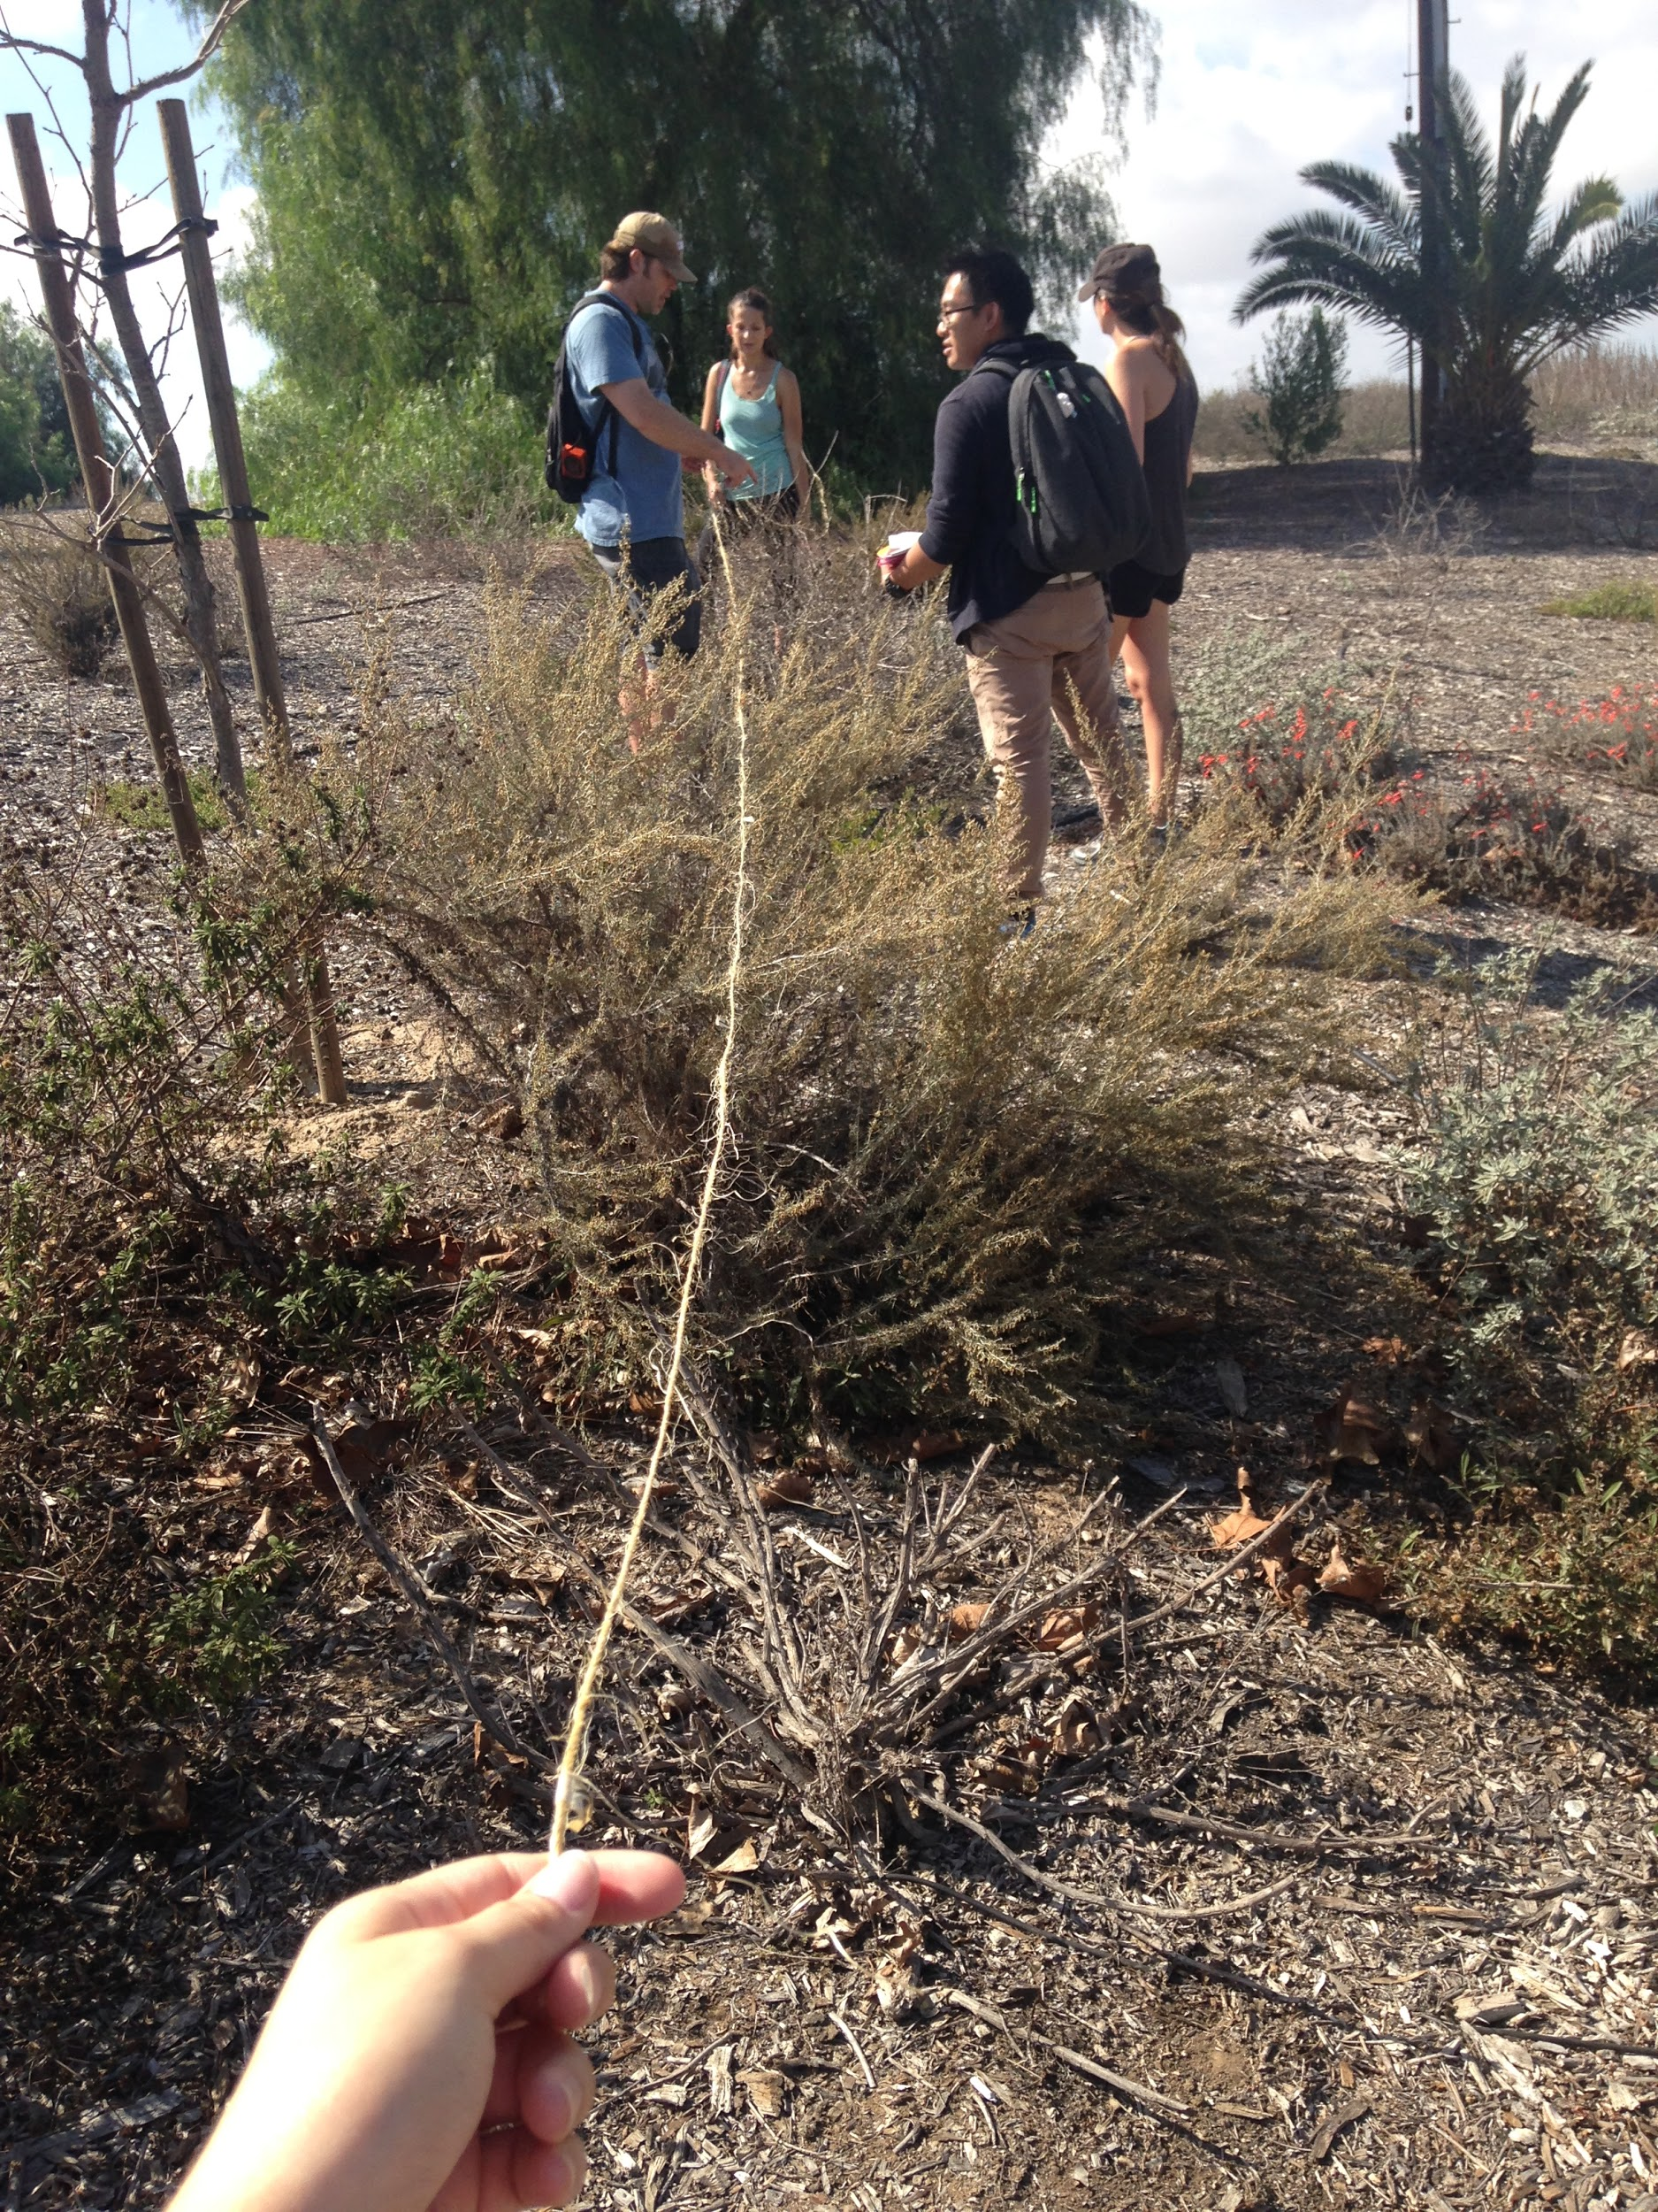
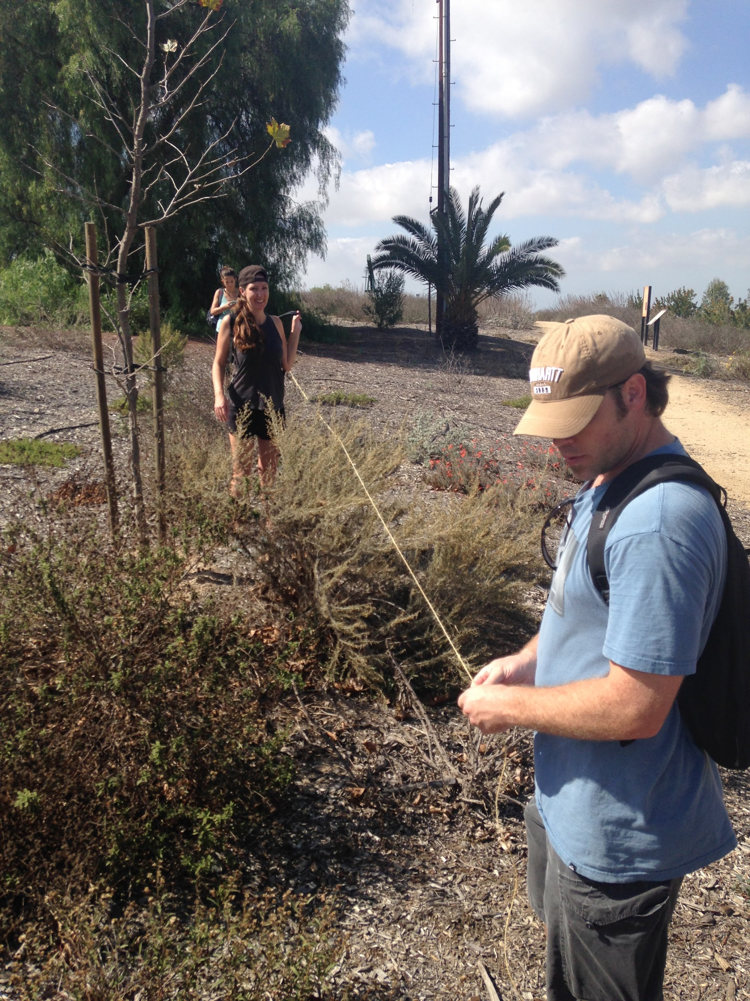
Methods
Transecting Longview Point
Field collection​
  Ten 10m Transects of CSS​
  GPS Coordinates ​
Data analysis​
  Alpha Diversity

Slide 7
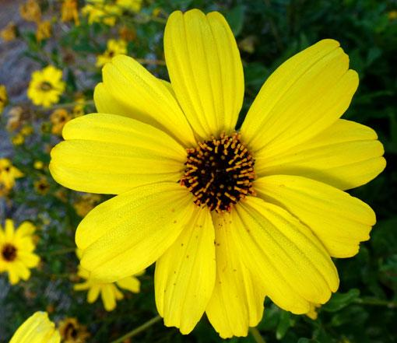
Results - Diversity
Species | Count
Asclepias fascicularis | 2
Ceanothus cuneatus | 1
Dirt | 36
Encelia californica | 18
Eriogonum fasciculatum | 12
Heteromeles arbutifolia | 12
Hirschfeldia incana | 1
Keckiella cordifolia | 1
Malosma laurina | 1
Mirabilis laevis | 1
Ribes ayreum | 1
Salix lasiolepis | 1
Salvia apiana | 2
Salvia leucophylla | 8
Sambucus nigra | 4
Schinus molle | 9
^{𝞪} | 15
Longview Point
α:15

Slide 8
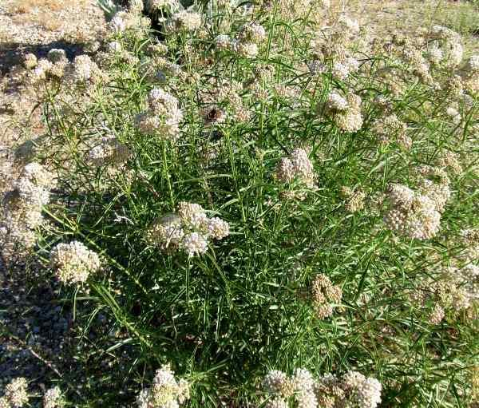
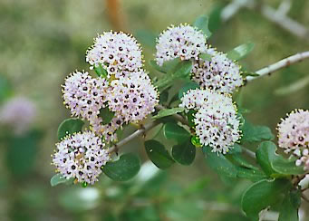
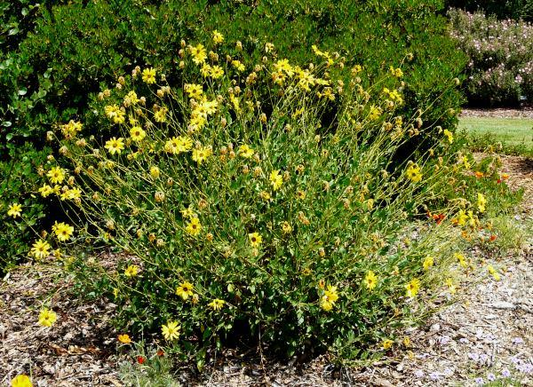
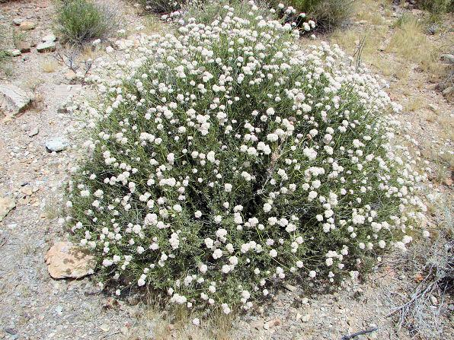
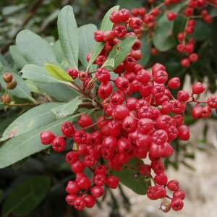
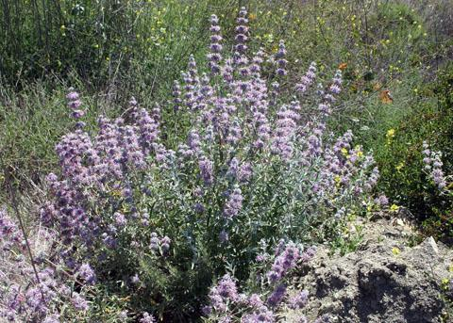
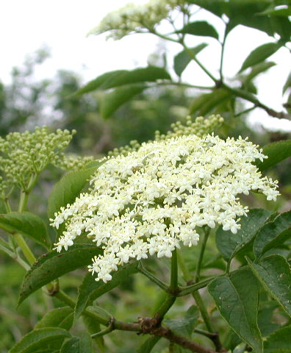
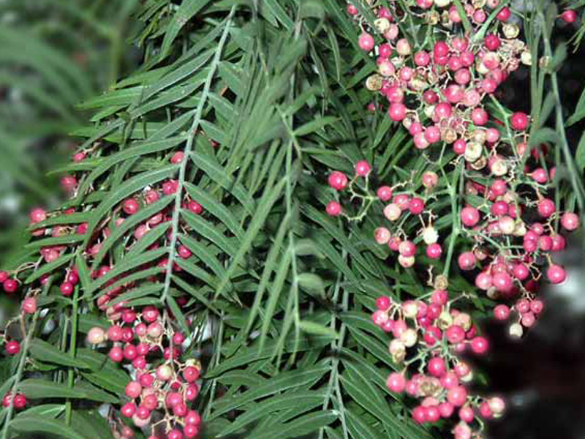
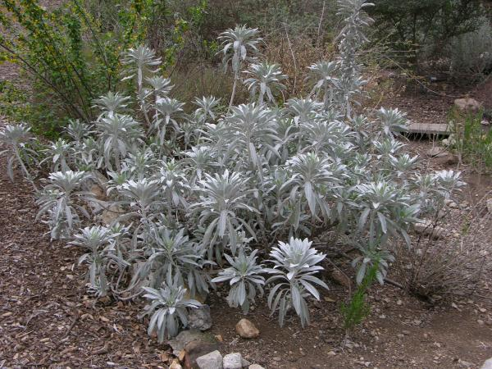
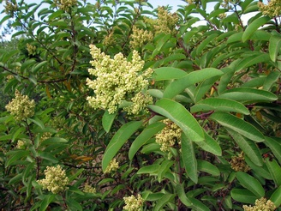
Common Species in Longview Point
Asclepias fascicularis
Ceanothus cuneatus *
Encelia californica
Eriogonum fasciculatum
Heteromeles arbutifolia
Salvia leucophylla
Sambucus nigra
Schinus molle *
Salvia apiana
Malosma laurina

Slide 9
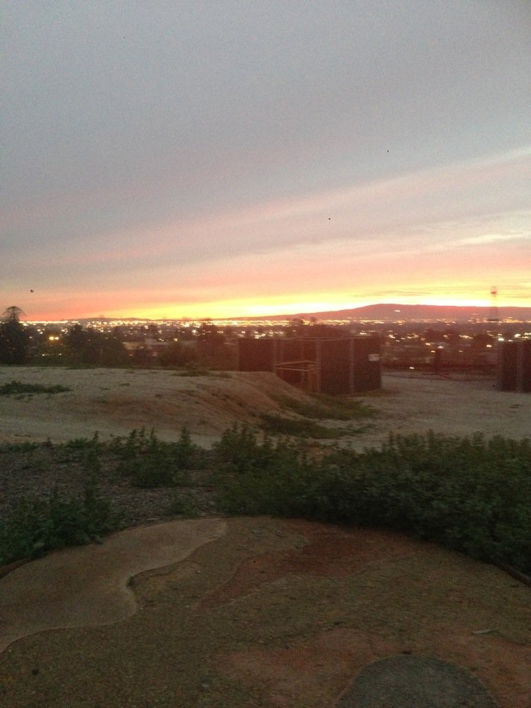
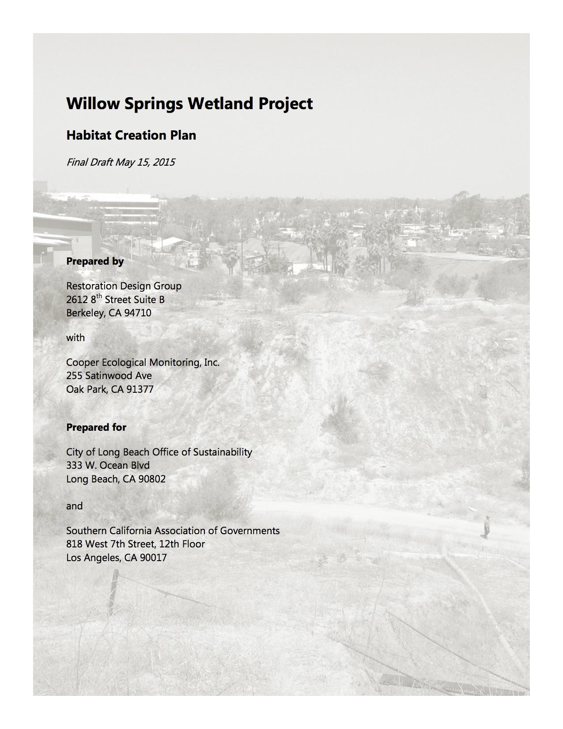
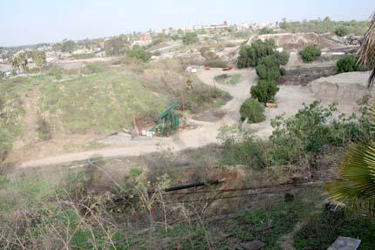
City Contribution
City was awarded a $924,000 state grant
Urban Greening for Sustainable Communities Program Grant
The city’s budget designates $350,000 in one-time revenues as matching funds
$50,000 technical assistant grant from the Southern California Association of Governments to create a Habitat Creation Plan
$15,000 grant from the Long Beach Navy Memorial Heritage Association for a signage program to interpret the history of Willow Springs Park.

Slide 10
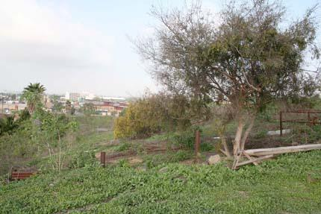
Discussion
Willow Springs is an active restoration zone that is maintained, more or less guaranteeing the success of the various CSS species.
Most vegetation species present are deliberate and systematic plantings.
The current ecosystem is dependant on rainfall for its water supply.
Removal of non-native and invasive species is being implemented, providing a changing population.
This restoration project is expanding.

Slide 11
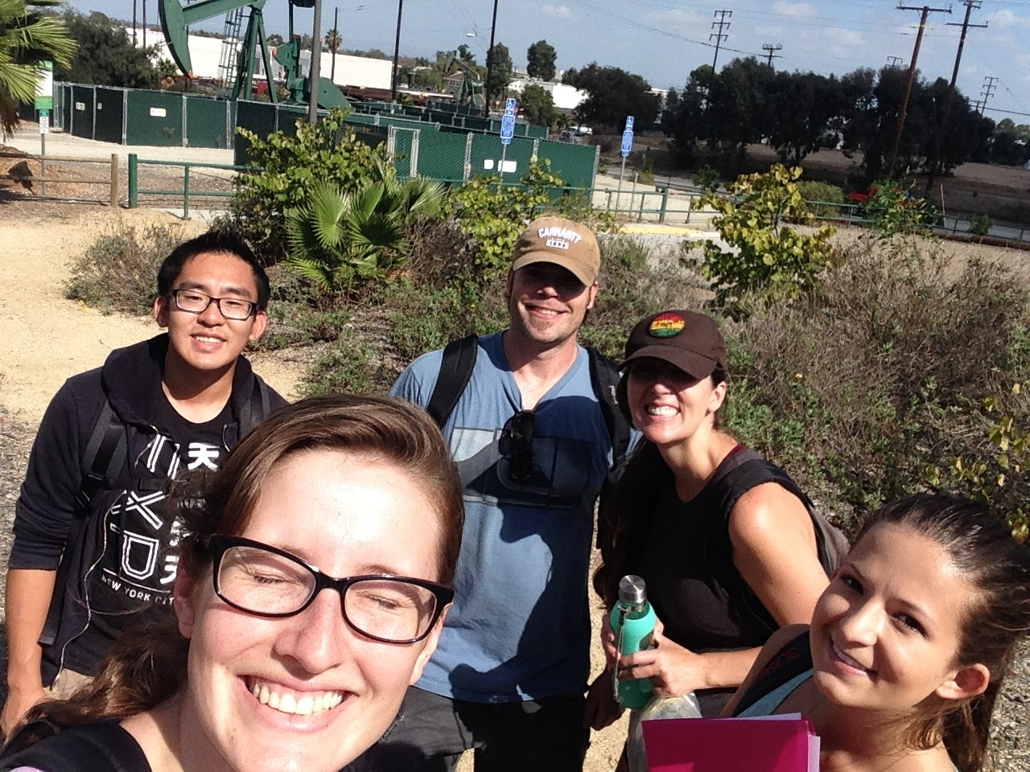
Conclusion
By performing a baseline study we are providing data that can be referenced by future geographers.
Successful restoration so far
As the restoration zone expands, additional studies need to be conducted so eventually beta and gamma tests can be done.
By documenting the progress and success of the restoration project we can hopefully spread awareness.
Need to perform multiple transects throughout the year as some species are more easily identified while their flowers are in bloom.

