Slide 1
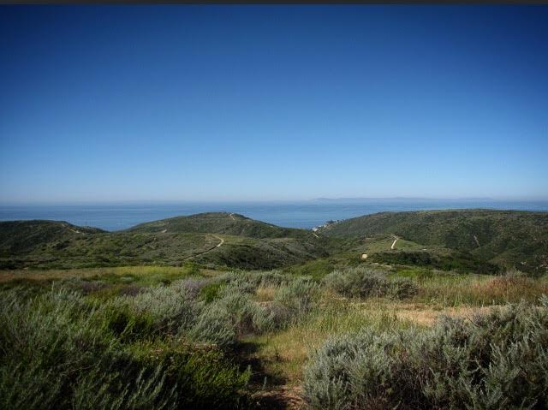
Laguna Coast Wilderness Park
By: Lorena Barahona, Christopher Castro, Sandra Gonzalez, Aubrey Stack

Slide 2
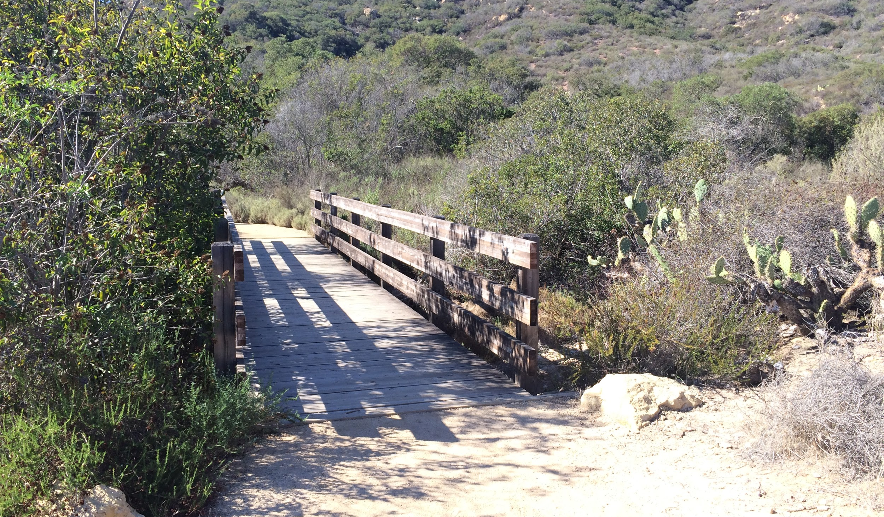
Introduction
Laguna Coast WIlderness Park
Opened in 1993, Laguna Coast Wilderness Park is made up of 7,000 acres of coastal canyons, high ridges, and endangered coastal sage scrub
Laguna Canyon Foundation -- Natural Community Conservation Planning program
Hypothesis
Null- There is no significant difference between stable and recovering CSS areas
Alternate- There is a significant difference between stable and recovering CSS areas
Overall Purpose:
identify conditions correlated with CSS self-restoration
Notes:
The park is part of the Natural Community Conservation Planning program, which is designed to protect rare and endangered species, from California Gnatcatcher to Orange-Throated Whiptail, by preserving large tracts of Orange County’s rapidly disappearing Coastal Sage Scrub community. Other species benefit from this preservation, including Mule Deer, Long-tailed Weasel, Bobcat, Red-tailed Hawk, and many more.

Slide 3
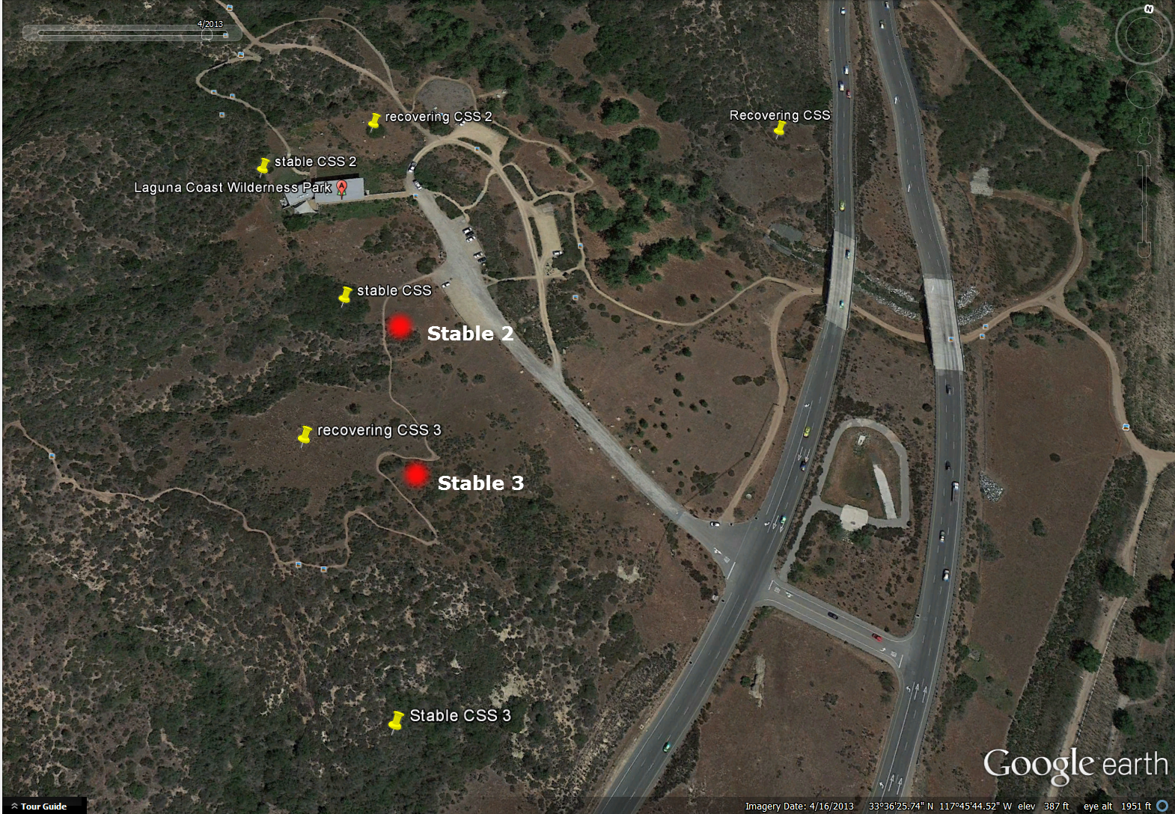
Overview of our study site

Slide 4
Methods
To pick our location, we used google maps to figure out which areas looked best to transect and dropped pin coordinate locations.
Using 10 Meter transect lines and GPS units borrowed from the geography department, we went out to our designated areas to confirm the locations of our chosen coordinates and location of species found.
Since we are not expert identifiers, there is room for error in our results but to help us with identifying species, we used a self guiding nature trail key provided at the information center which included all species we might find on the trails.
We collected samples of species we were not able to identify and took pictures of all the transects. Snapchat was very useful to include notes on our plant photos.

Slide 5
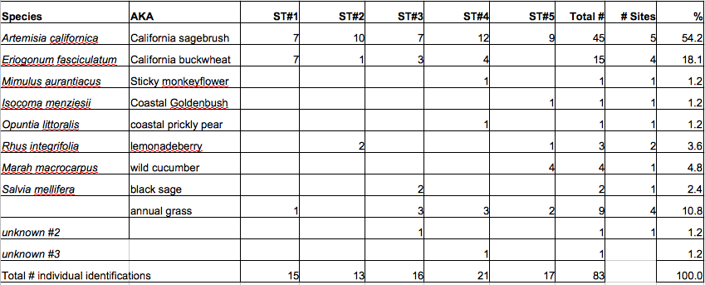
Data
Alpha, beta, gamma diversity for Laguna Coast Wilderness Park Transects (Alpha diversity: 11, beta: 7 in stable, 0 in recovering, no gamma.)

Slide 6
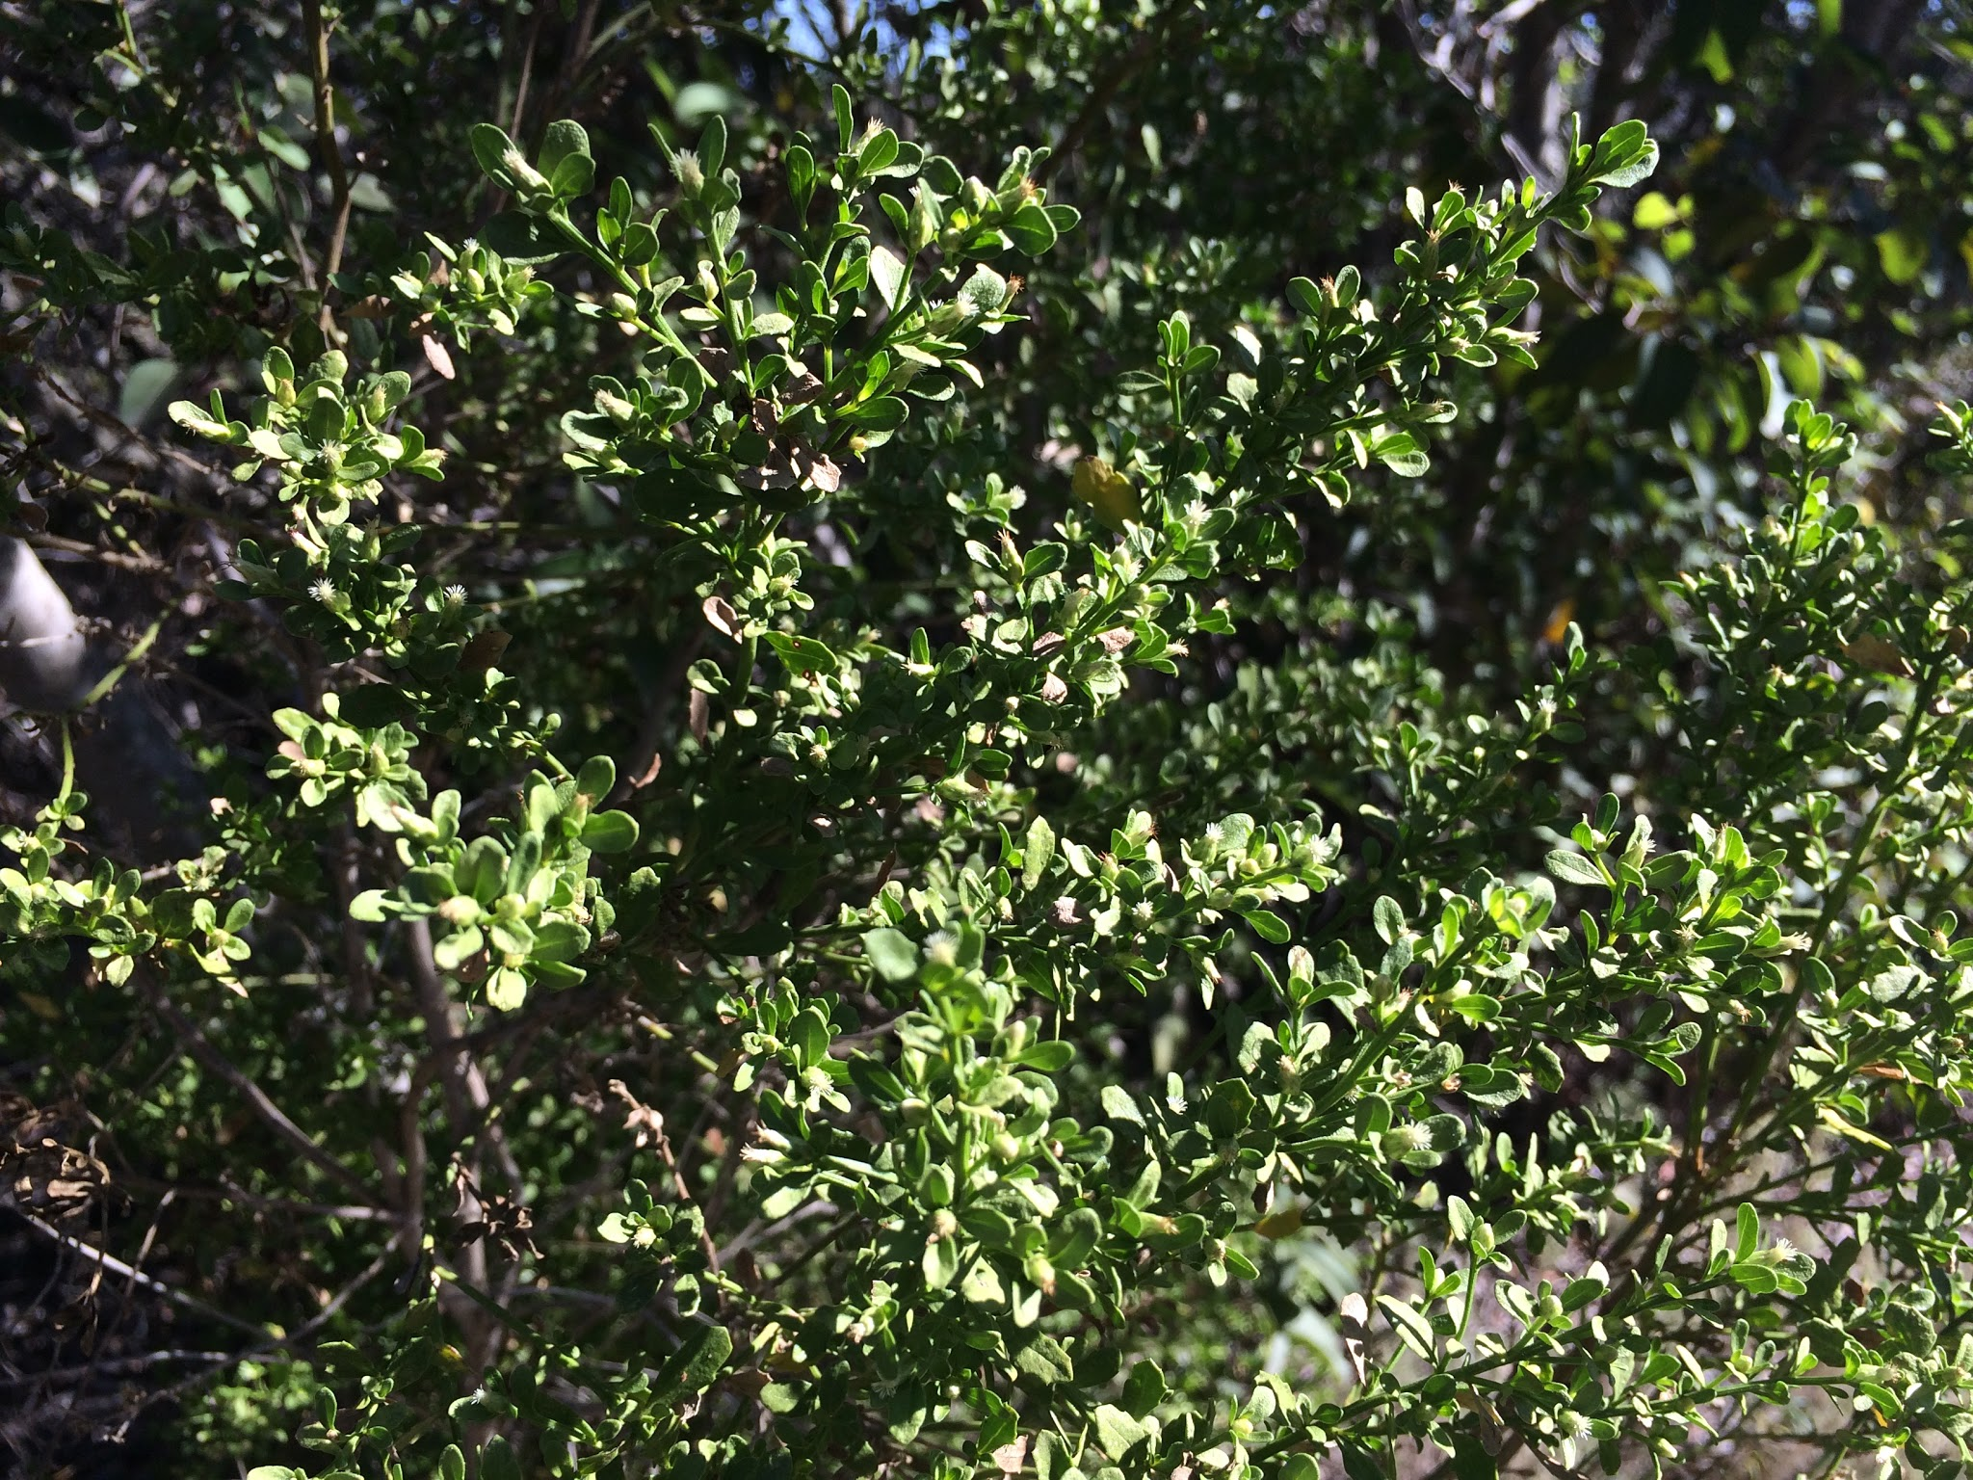
Results
California Sagebrush (Artemisia
californica )
California Buckwheat (Eriogonum
Fasciculatum)
X calc: 1.851; X crit: 3.841; Prob: .174
Significance?

Slide 7
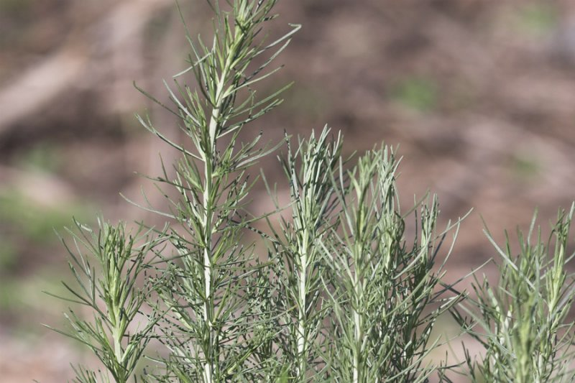
Discussion
Recovering CSS mass: 70% vs Stable CSS mass: 90%
Top Species found in both sites:
Artemisia Californica 54% (37% found in Recovering, remaining 63% found in Stable)
Eriogonum Fasciculatum 18% (about 53% Recovering and 47% in Stable)
Take into account other factors (Soil makeup in the area, slopes, history of the land, invasive species, bias in conservation efforts?)
Alpha diversity: 11, beta: 7 in stable, 0 in recovering, no gamma.

Slide 8
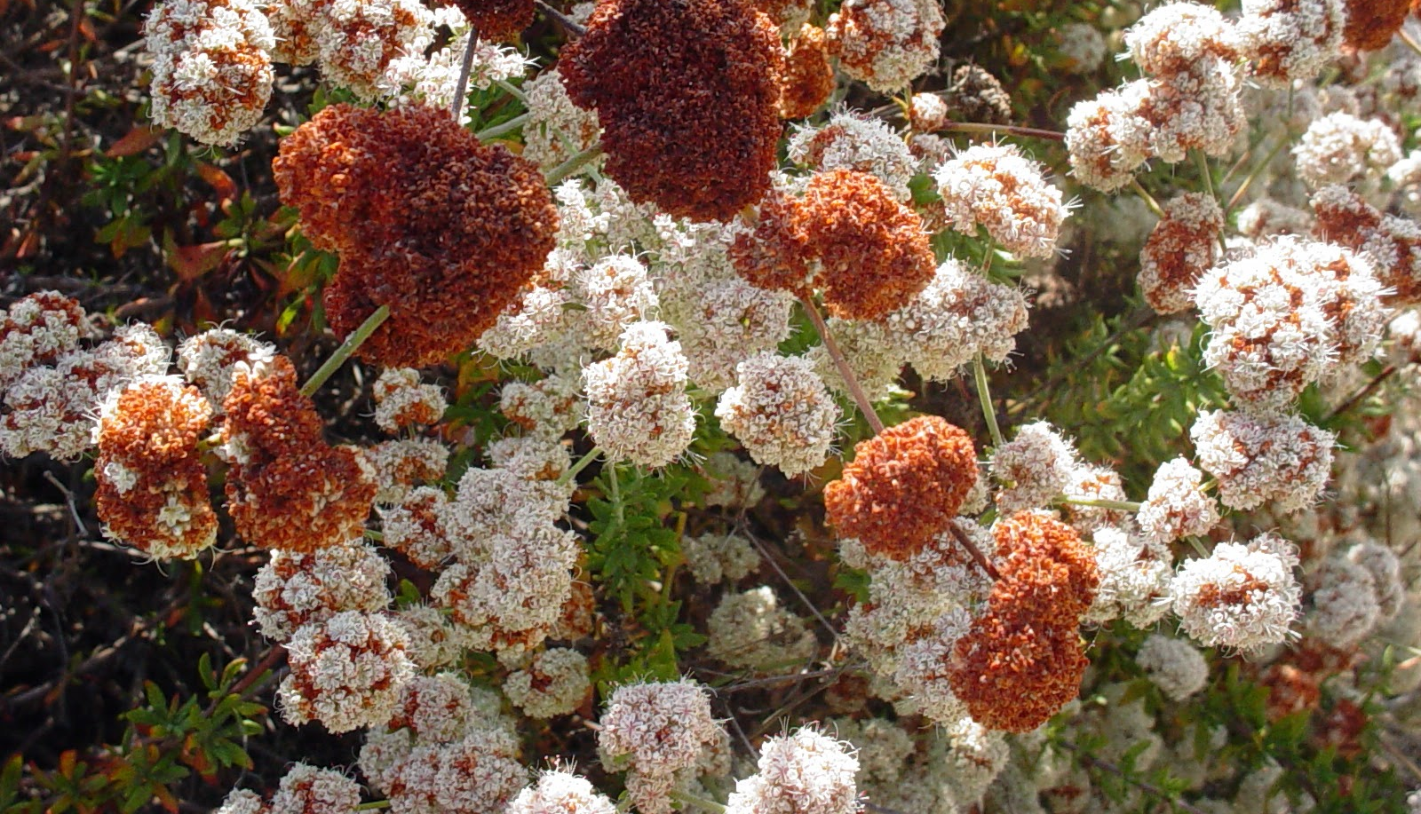
Conclusion and Recommendations
There is no significant difference found. Low power level (.174). Expecting a difference. We should find ways of getting CSS to recover more effectively BUT: We need to know more.
How long does it take for the land to recover? Can the land recover? How would we go about it? What resources are needed?
-Gather more data and perform more transects to improve accuracy
-Survey entire recovering and stable CSS sites
-Work on a site with off trail access

Slide 9
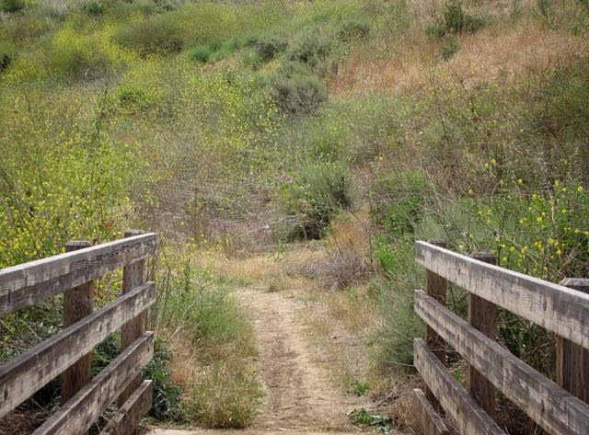
References
Rodrigue, Christine. "Differences in California Sage Scrub Composition behind Stable and Recovering Boundaries with Annual Grassland."Differences in California Sage Scrub Composition behind Stable and Recovering Boundaries with Annual Grassland. 24 Oct. 2015. Web.
Brown, Elisabeth M., Ph. D. James Dilley Greenbelt Preserve Self-Guiding Nature Trails. Comp. Allen Brown. Laguna: Laguna Greenbelt, 2014. Print.

