Slide 1
Aliso Viejo Wood Canyon Wilderness Park
Gabriella Hernandez, Sylvia Palomera, Yasmine San Pedro,
Memnon Torio, and Nick Townsend

Slide 2
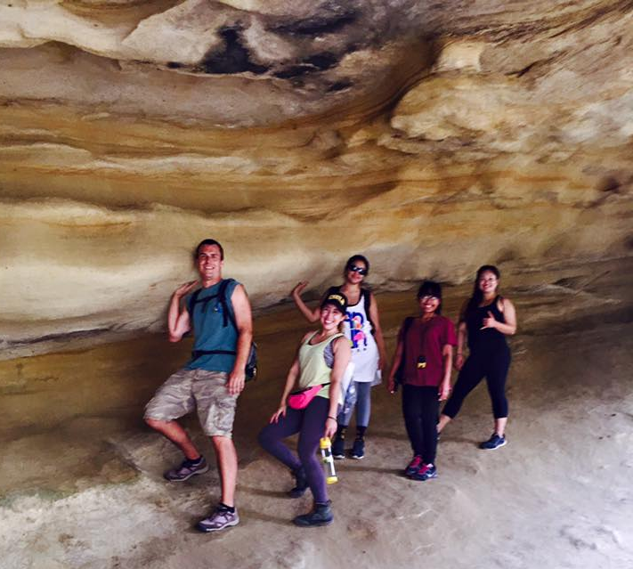
Background of Wood Canyon
Part of the 19,000 - acre Laguna Coast Greenbelt and the 38,000 acre National Nature Preserve of Orange County
Former land grant of Rancho Niguel
Contains CSS, grasslands, chaparral, woodlands. and riparian
Notes:
Aliso and wood canyons wilderness park
-Originally, part of the Juaneno or Acajchemem tribal land
-The park is designated as a wildlife sanctuary

Slide 3
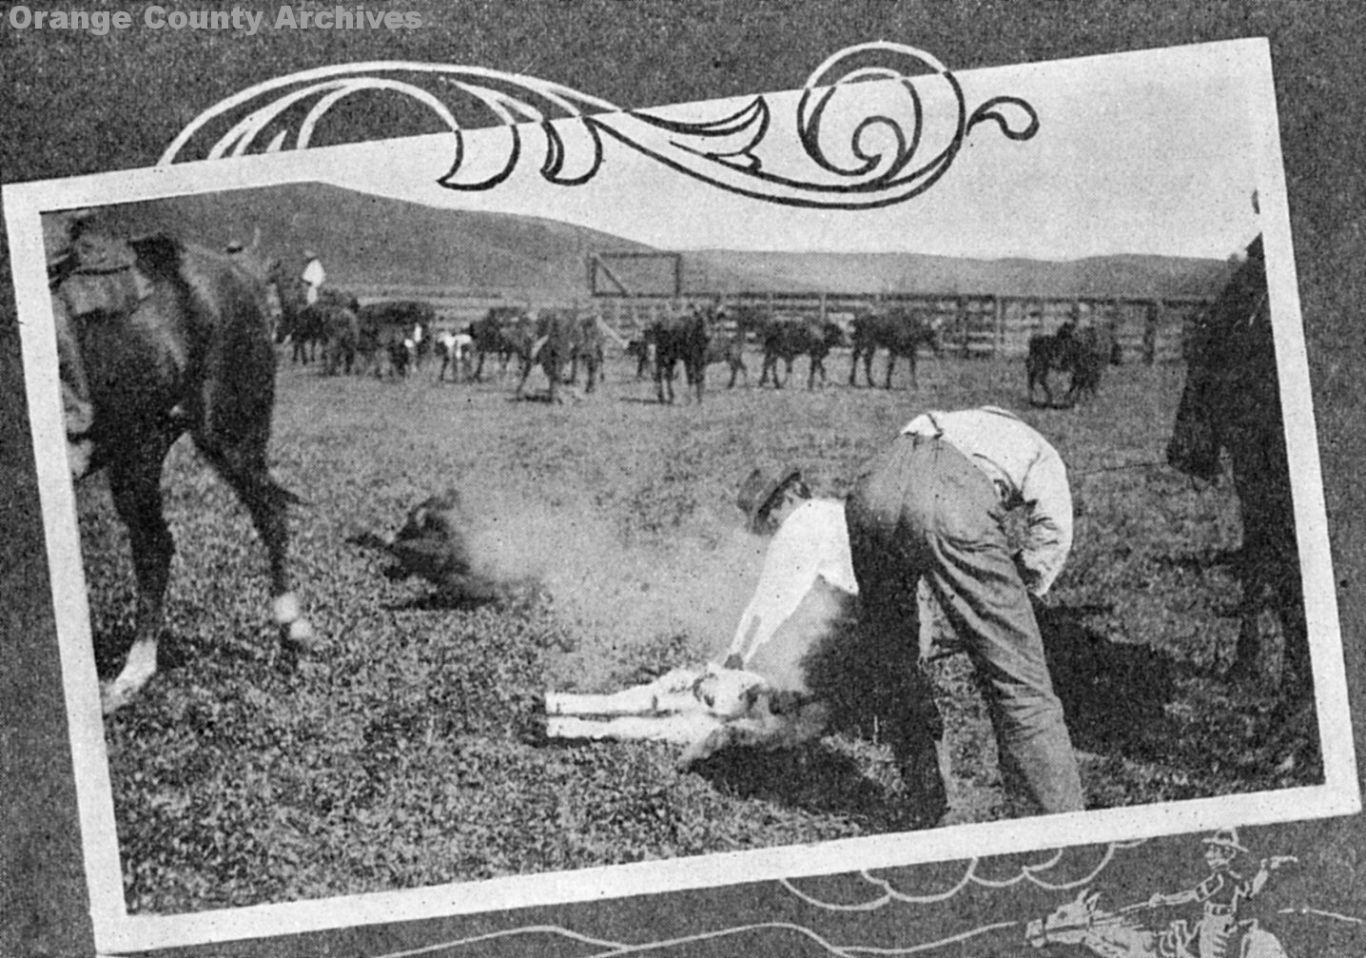
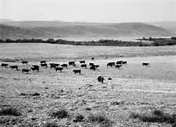
CSS type Conversion for Cattle and Sheep beginning 1850's
1913 Wood canyon
1960's

Slide 4
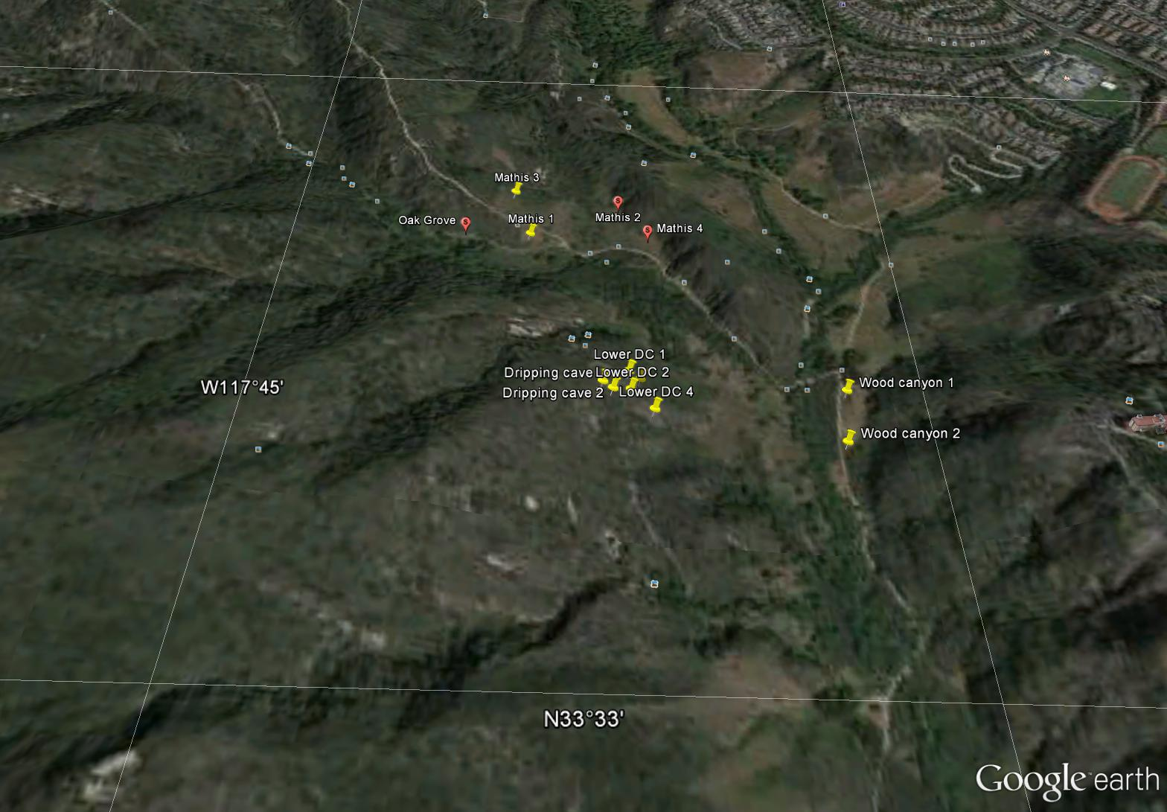
Transects Sites

Slide 5
Hypotheses
(HO): There is no significant difference between the floristic communities found within stable and recovering boundaries of CSS and Grasslands
(HA): There is a significant difference between the floristic communities found within stable and recovering boundaries of CSS and Grasslands

Slide 6
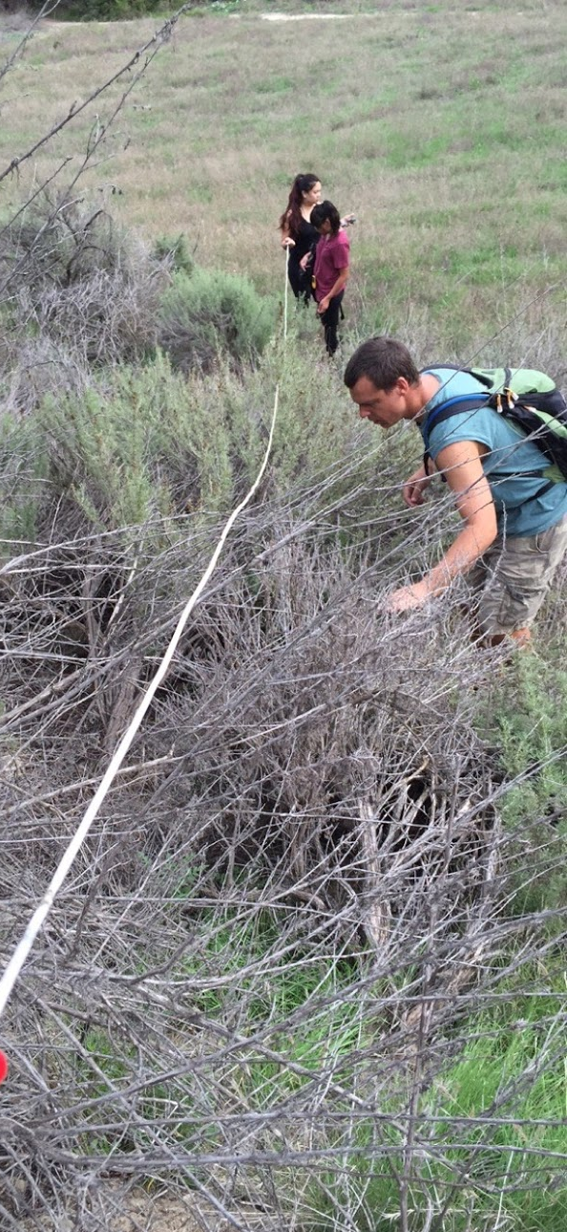
Methods
Field Collection
GPS coordinates
  Eleven 10m transects of CSS
  Vanguard Species
Data Analysis
Diversity Calculations
Chi-Square Test

Slide 7
Diversity Results
γ=11 | UDC (stable) | LDC (stable) | LDC (unstable) | Mathis (unstable) | Woodcanyon (unstable) | Vangaard
α | 5 | 4 | 3 | 4 | 5 | 4
  Alpha ranges from 3 to 5
  Vanguard: Most divergent site with fewest species shared

Slide 8
Chi – Square Results
Dominant Species | Wood Canyon Diversity
Artemisia californica | Stable | Recovering
Obs | 35 | 5
Exp | 25.882 | 14.118
Isocoma menziesii | c | d
Obs | 9 | 15
Exp | 9.706 | 5.294
Eriogonum fasciculatum | e | f
Obs | 0 | 4
Exp | 8.412 | 4.588
Xcalc | 36.717
Xcrit | 5.991
df | 2
alpha (α) | 0.05
Effect size (w) | 0.735
Prob-value | 0.000
Corrected Power | 1.000
Notes:
Dominate Species: California Sagebush, Golden bush, California buck wheat
P- Value is less than alpha
xcalc > xcrit
Null hypothesis is rejected concluding there is a significant association
Effected size at 59.7%
Corrected Power at 96%

Slide 9
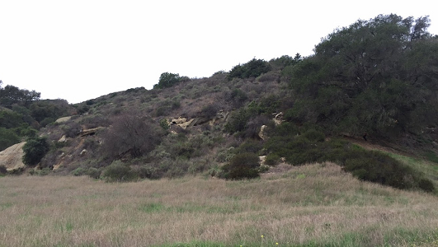
Conclusion
Vanguard Species
Increase Data Collection
Eventual Restoration Efforts

