Slide 1
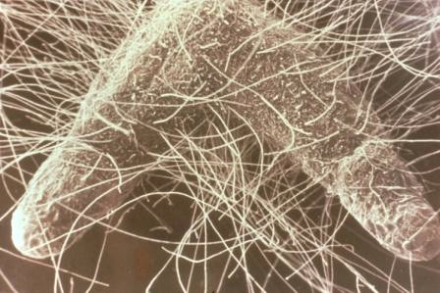
Is There Fungus Among Us? Presence and absence of mycorrhizæ fungus in California sage scrub
Mystyn Mills & Paola Ducoing Chaho
California State University Long Beach
Department of Geography

Slide 2
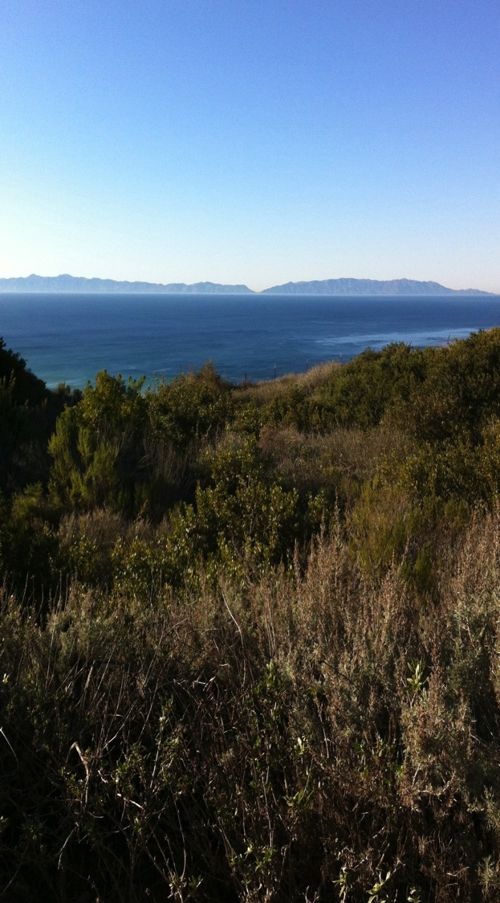
What Is Limiting CSS Re-Establishment?
Prevalence of non-natives
Anthropogenic disturbances
????
What about fungus?

Slide 3
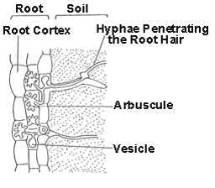
Arbuscular Mycorrhizæ Fungi (AM)
Glomeromycete fungi, inhabiting the soil and plant roots
Only 230 species described, ~85 new species in last decade
AM fungi crucial components of terrestrial ecosystems, assisting plants in uptake of water and limiting nutrients
Symbiosis structure between AM fungi and plant roots
Allen 1991; Brundett 2008; Sturmer, 2012

Slide 4
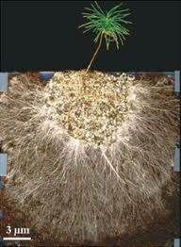
Arbuscular Mycorrhizæ Fungi (AM)
AM fungi recognize specific host plants and will not form infection structures with inappropriate hosts
May be especially critical in harsh abiotic conditions
Research on AM fungi has remained relatively sparse for a variety of reasons
Sapling with AM fungi symbiosis
Brundett 2008; Cripps and Eddington 2005; Gionannetti et al. 1994

Slide 5
Our Research Question
Is a degraded state of AM fungi multualisms with native CSS species limiting the successful re-establishment of CSS?
And
Does disturbance reduce AM presence/abundance in native species?
Do non-Natives reduce AM presence/abundance?

Slide 6
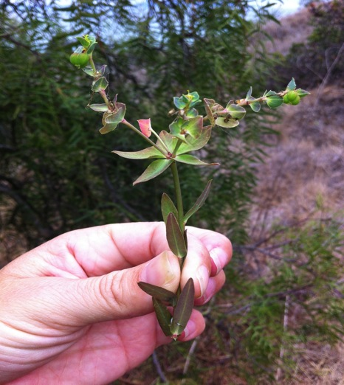
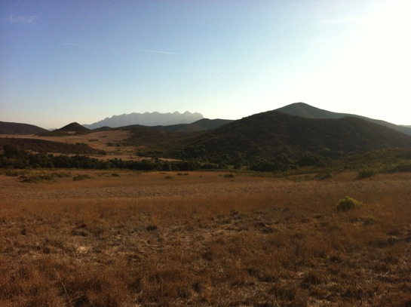
Non-Natives
Mycorrhizæ may strongly mediate competition between invasives and natives
Most non-native grasses that occur in California are not reliant on mycorrhizal mutualism
Green Spurge (Euphorbia esula)
Presence of non-natives may significantly affect soil dynamics; reduce/eliminate AM populations
Vogelsang and Bever, 2009

Slide 7
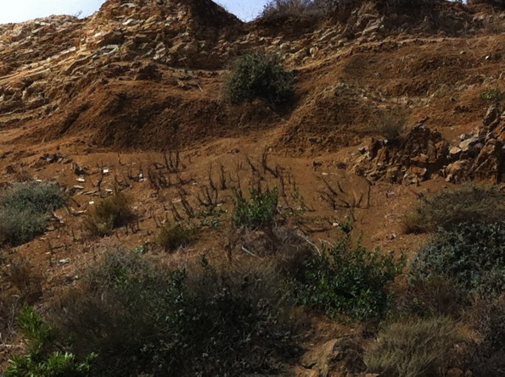
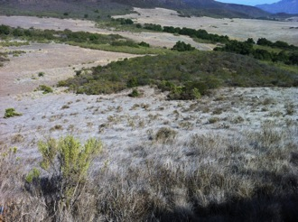
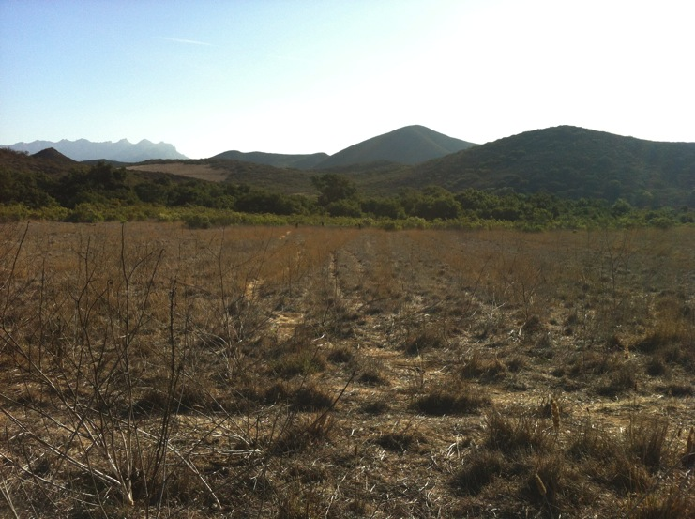
Disturbance
Anthropogenic soil disturbances may significantly affect AM populations
Break-up mycorrhizæ hyphal networks
AM affected by severe soil disturbance even after disturbance stops
Alguacil et al. 2008; Jasper et al. 1989; Alguacil et al. 2008; Stahl et al. 1988

Slide 8
Goals
Determine if there is a difference in AM fungi presence (and composition (eventually)) among non-native and native plants, and disturbed vs. undisturbed sites
Provide restoration managers with knowledge of AM fungi dynamics to help inform restoration decisions
Develop a protocol for collection and processing of samples

Slide 9
What We Did (and will continue to do)
A census of the presence and abundance of AM fungi by:
Collecting “rootballs” from native and non-native species
Collecting “rootballs” from undisturbed and disturbed sites
Keep really good notes

Slide 10
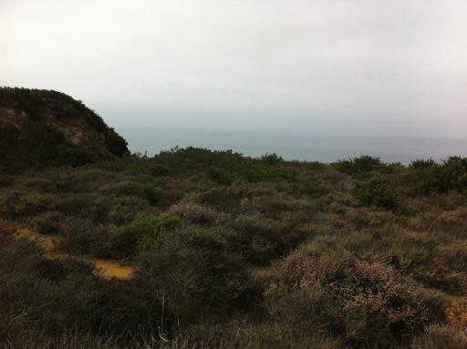
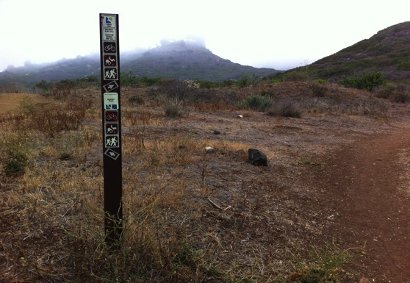
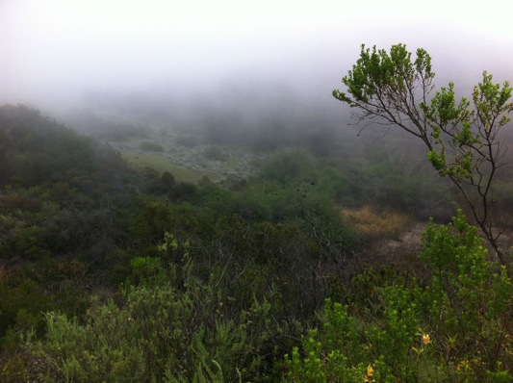
Field Collection
“Undisturbed” VS “Disturbed”

Slide 11
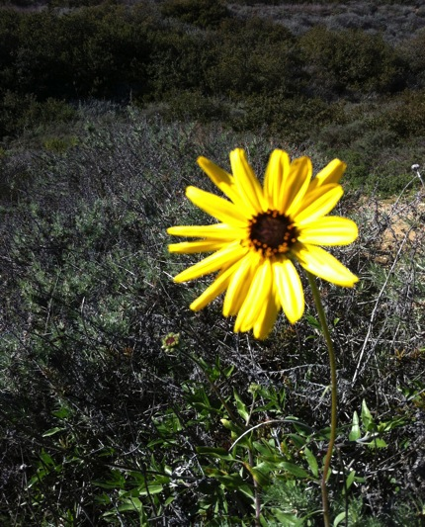
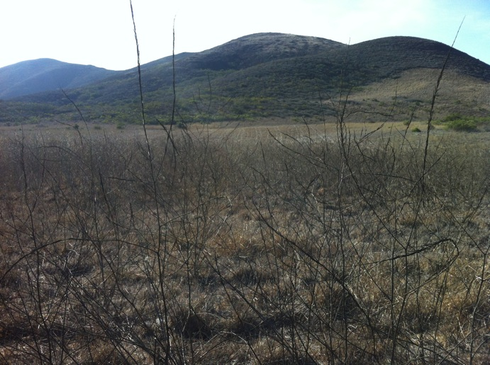
Field Collection
Native VS Non-Native
California sunflower (Encelia californica)

Slide 12
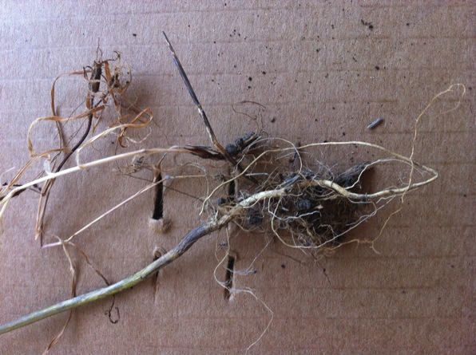
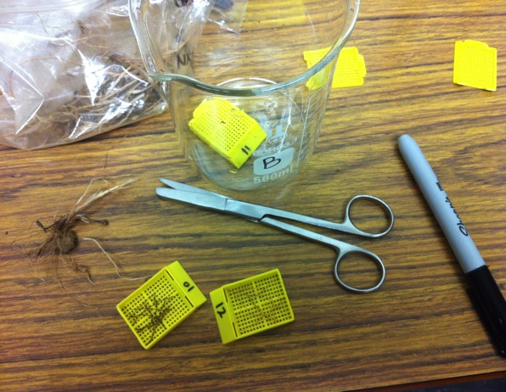
In the Laboratory
Wash root balls in water
Chop into ~2 cm long segments
Place loosely in biopsy tissue cassettes
Potassium hydroxide (KOH) 10% solution
Autoclave at 121 C for 45 minutes to clear roots (liquid cycle)
India ink and vinegar

Slide 13
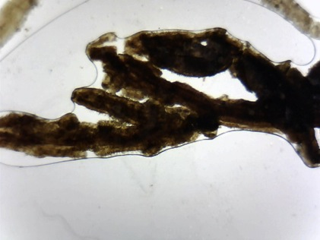
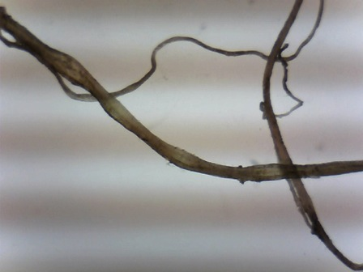
Preliminary Findings
Disturbed black sage (Salvia mellifera)
Undisturbed black sage (Salvia mellifera)
Brundett 2008

Slide 14
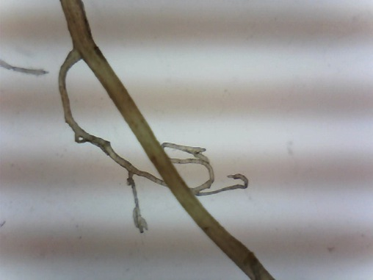
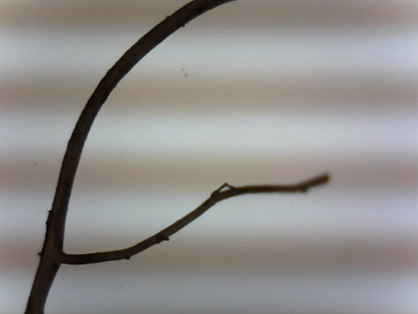
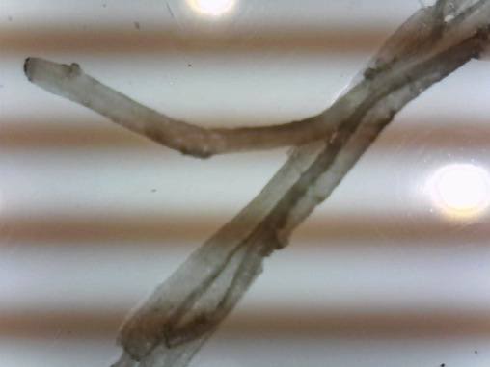
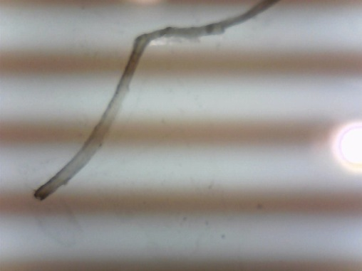
Preliminary Findings
Fennel (Foeniculum vulgare)
Black Mustard (Brassica nigra)
Fountain Grass (Pennisetum setaceum)
Dandelion (Taraxacum officinale)

Slide 15
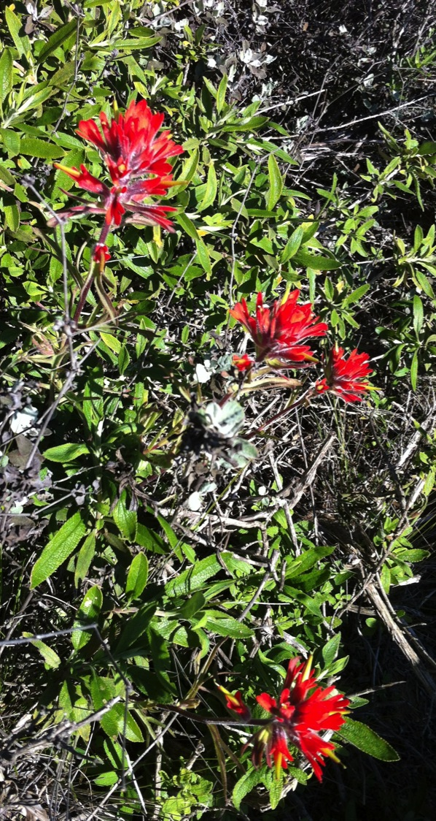
Discussion
Preliminary findings suggest that natives from disturbed sites have less AM
Also non-native species collected have little to none
Need to inoculate when restoring?
Does inoculation with non-native species work? Does it diminish already impacted native AM populations?
Continue research. . .

Slide 16
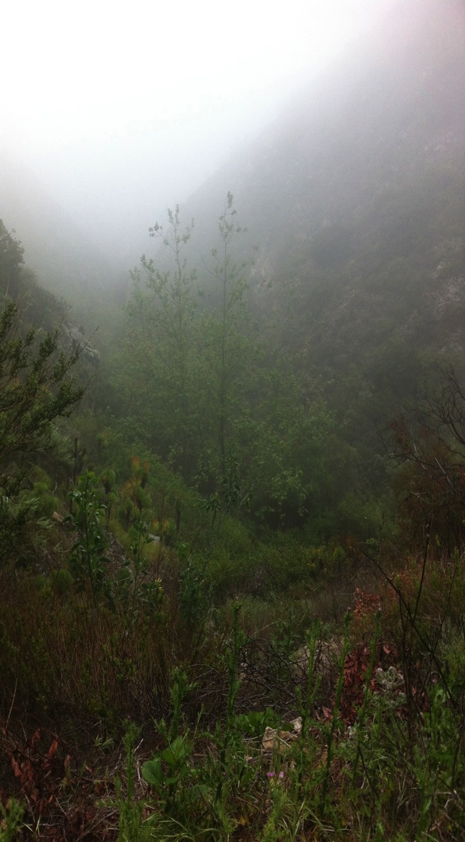
What Can Be Done
Understanding of AM fungi and plant dynamics has the potential to help improve restoration success
Information on AM fungi dynamics for restoration (and conservation) managers
Pamphlet with native AM fungi and host species for organizations such as California Native Plant Society
Development of a lab protocol

Slide 17
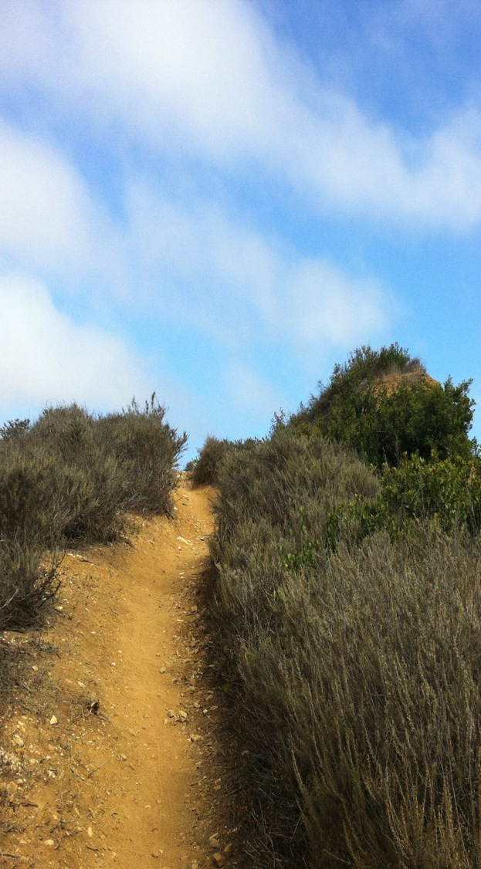
Future Research
Continue with the current project
Identify to family/species
Look at AM spores in the soil
Explore the relationship between non-native AM and native AM
Similar study conducted in different locations with CSS
Similar study conducted in California native grasslands and/or other native habitats
Etc.

Slide 18
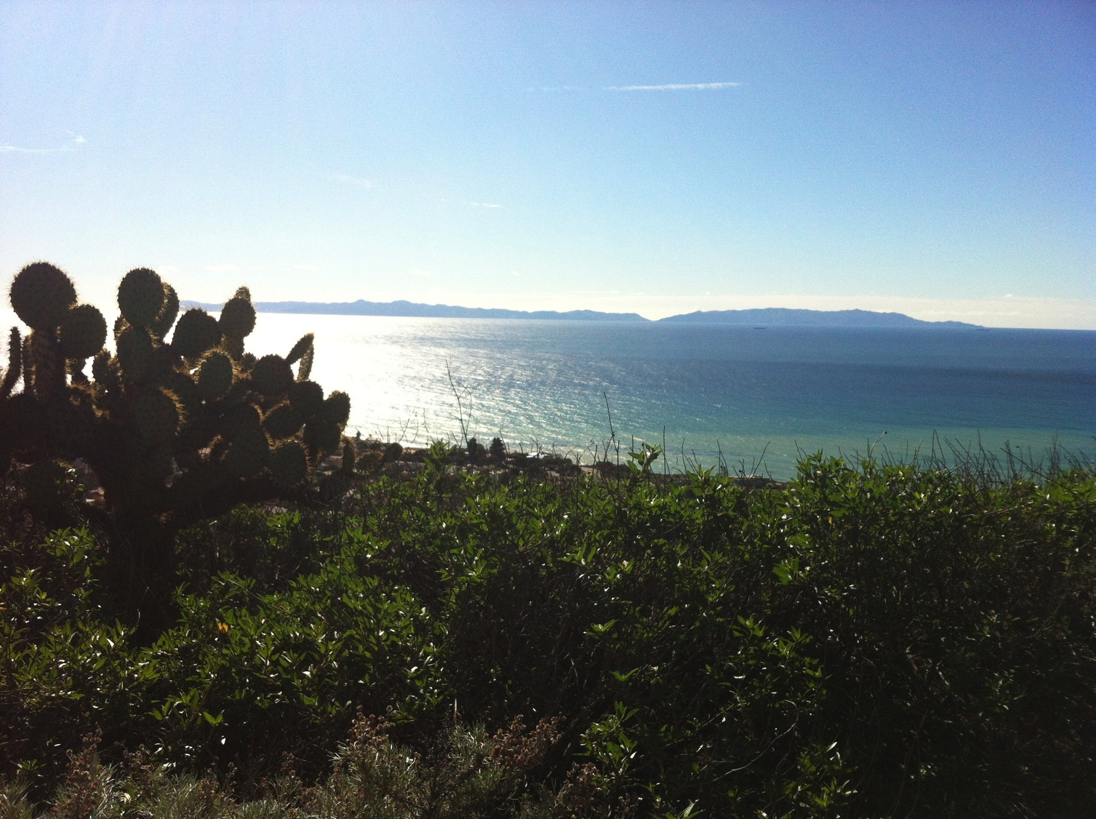
Thank You!
Special Thank You to:
Drs. Rodrigue, Whitcraft, and Laris
Maggie Munoz-Perez
The rest of the CSULB Geography Dept.
Mike Riney
Palos Verdes Peninsula Land Conservancy

Slide 19
Works Cited
Alguacil, M.M., Lumini, E., Roldan, A., Salinas-Garcia, J.R., Bonfante, P., Bianciotto, V., 2008. The impact of tillage practices on arbuscular mycorhizal fungal diversity in subtropical soils. Ecological Applications 18, 527-536.
Allen, M. F., 1991. The Ecology of Mycorrhizae. Cambridge: Cambridge University Press
Brundrett MC. 2008. Mycorrhizal Associations: The Web Resource. http://mycorrhizas.info/info.html (accessed 10 March 2013).
Cripps, Cathy L. and Eddington, Leslie H., 2005. Distribution of mycorrhizal types among alpine vascular plant families on the Beartooth Plateau, Rocky Mountains, U.S.A. Arctic, Antarctic, and Alpine Research, 37, 2: 177-188.
Giovannett, M., Sbrana, C., Logi, C. 1994. Early processes involved in host recognition by arbuscular mycorrhizal fungi. New Phytologist. 127, 4: 703-709
International Culture Collection of (Vesicular) Arbuscular Mycorrhizal Fungi.
http://invam.caf.wvu.edu/
Jasper, D.A., Abbott, L. K., Robson, A.D. 1989. Soil disturbance reduces the infectivity of external hyphae of vesicular-arbuscular mycorrhizal fungi. New Phytologist 112, 1:93-99
Stahl, P., Williams, S.E., Christensen, M. 2012. Efficacy of native vesicular-arbuscular mycorrhizal fungi after severe soil disturbance. New Phytologist. 110, 3:347-354
Sturmer, S. L., Sturmer, R., Pasqualini, D, 2013. Taxonomic diversity and community structure of arbuscular mycorrhizal fungi (Phylum Glomeromycota) in three maritime sand dunes in Santa Catarina state, south Brazil. Fungal Ecology, 6, 27-36.
Vogelsang, Keith M., and Bever, James D. 2009. Mycorrhizal densities decline in association with nonnative plants and contribute to plant invasion. Ecology 90, 2: 399-407

