Slide 1
Effects of Herbivory on Coastal Sage Scrub Recovery
in the
La Jolla Valley of Point Mugu State Park
Chelsea Vaughan, Carin Tabag, Sean Brennan
CSULB Department of Geography

Slide 2
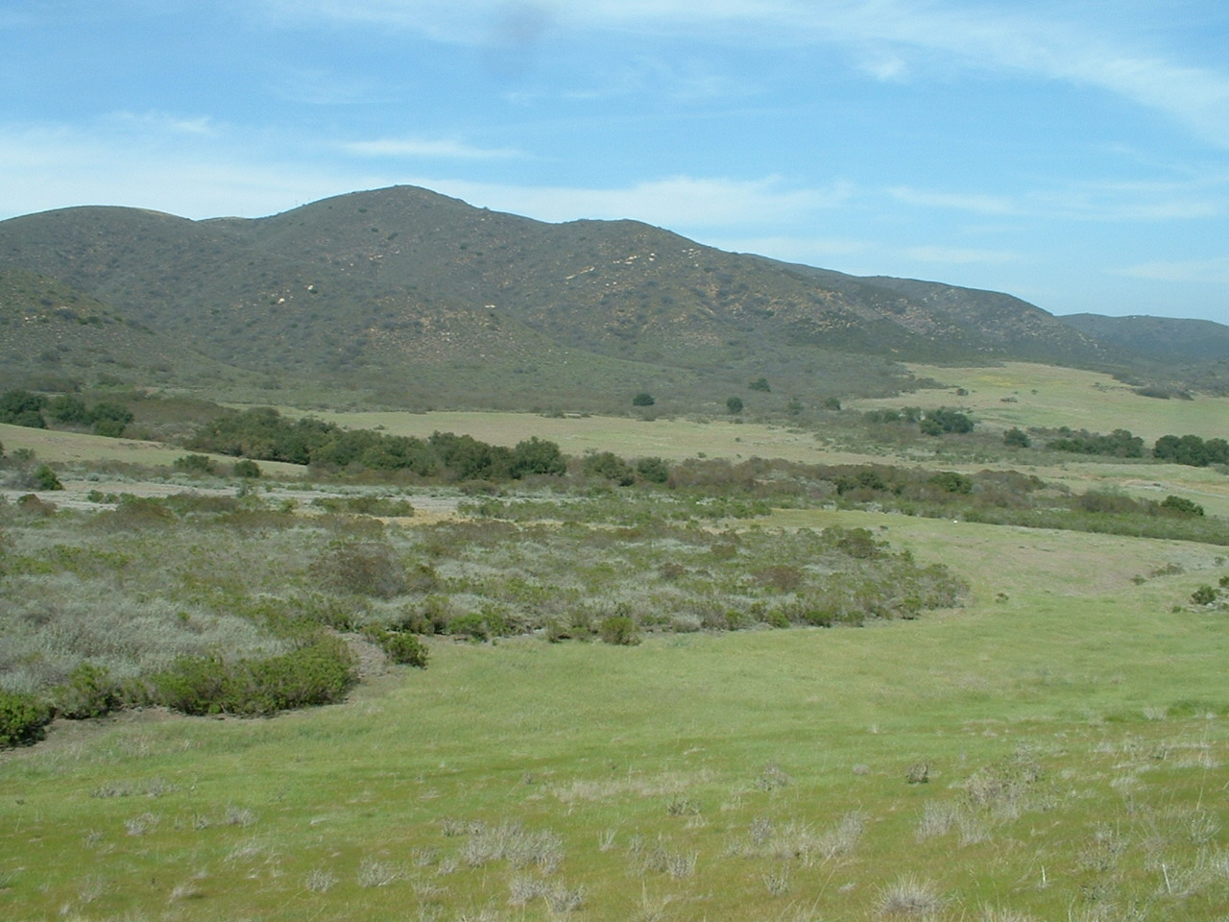
La Jolla Valley

Slide 3
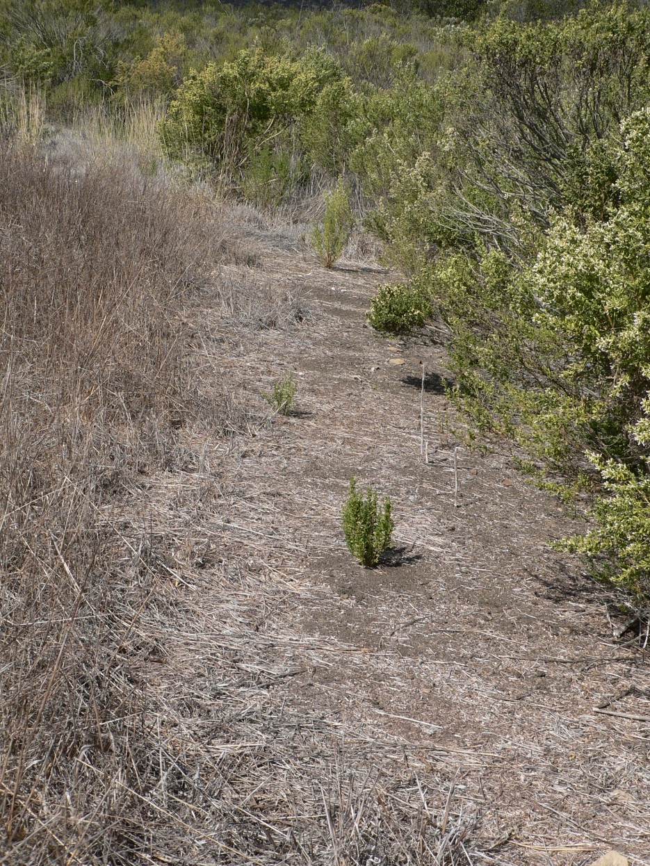
The Ecotone
Who’s invading who?

Slide 4
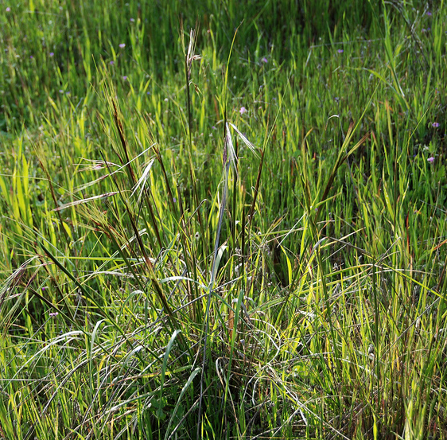
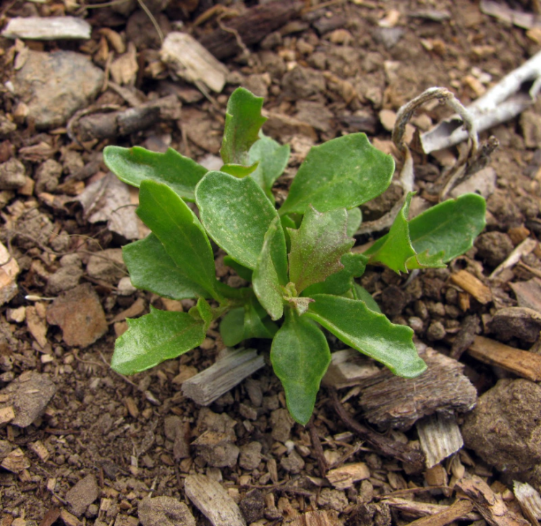
Purple Needle Grass
(Stipa pulchra)
Coyote brush
(Baccharis pilularis)
Notes:
Purple needle grass is the state grass

Slide 5
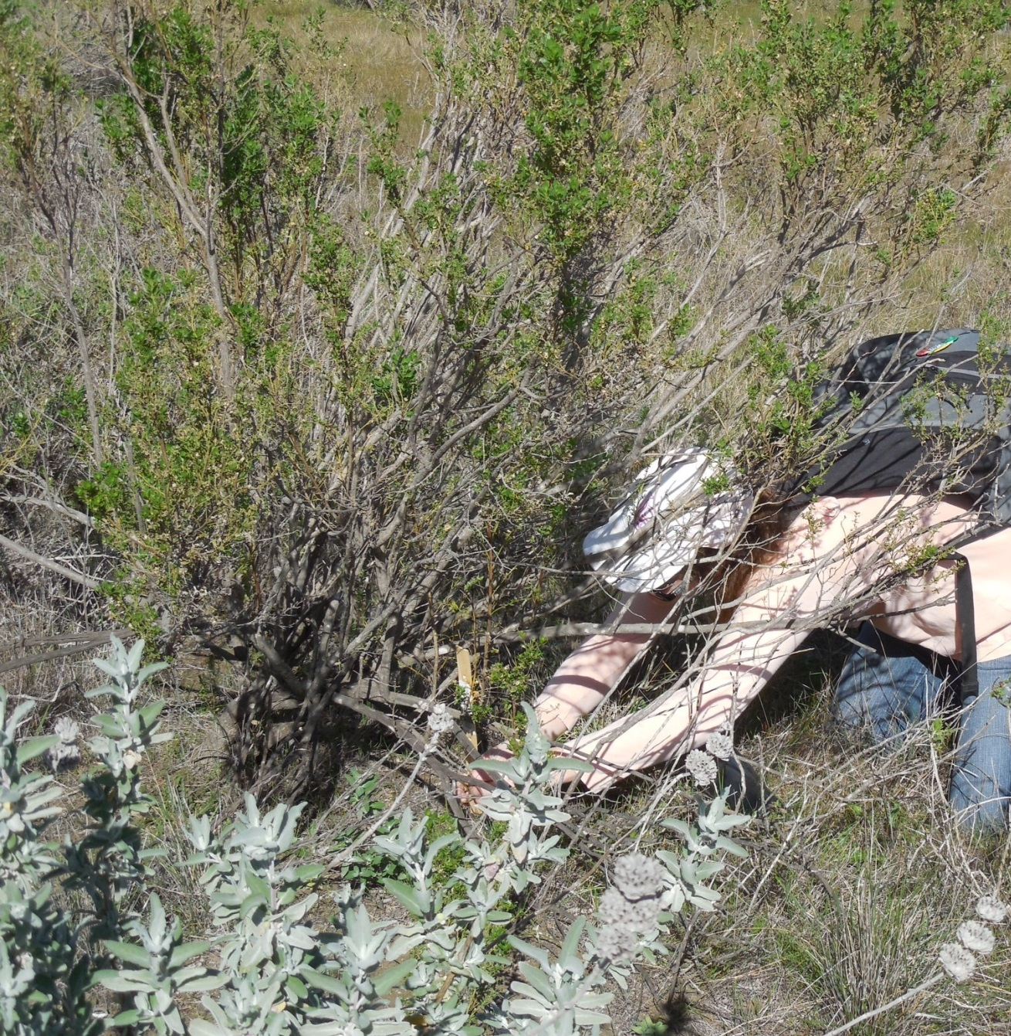

Slide 6
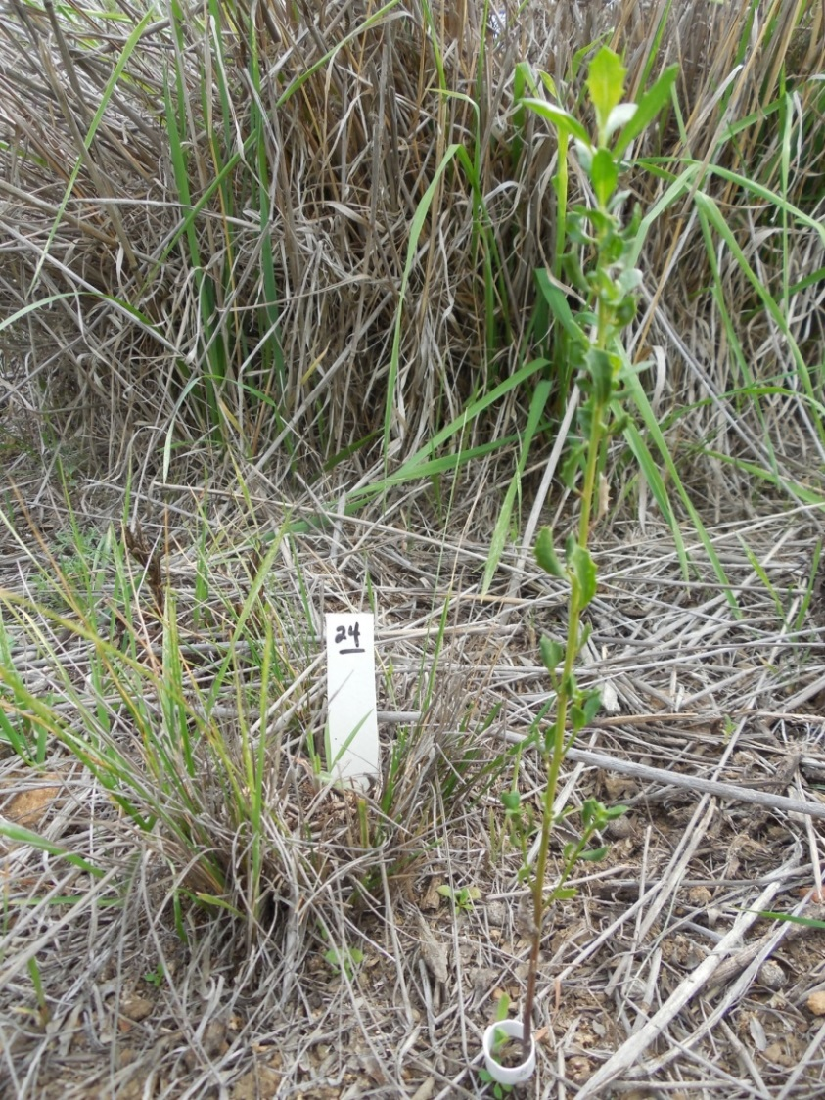
Field Methodology
30 shrub samples adjacent to 30 grass samples
Each sample was tagged and tallest growth was measured
Located approximately 30 meters apart
GPS coordinates documented
Saplings were not always prevalent
Substitutions were made for shrub saplings by measuring low, fresh growth

Slide 7
The Moose

Slide 8
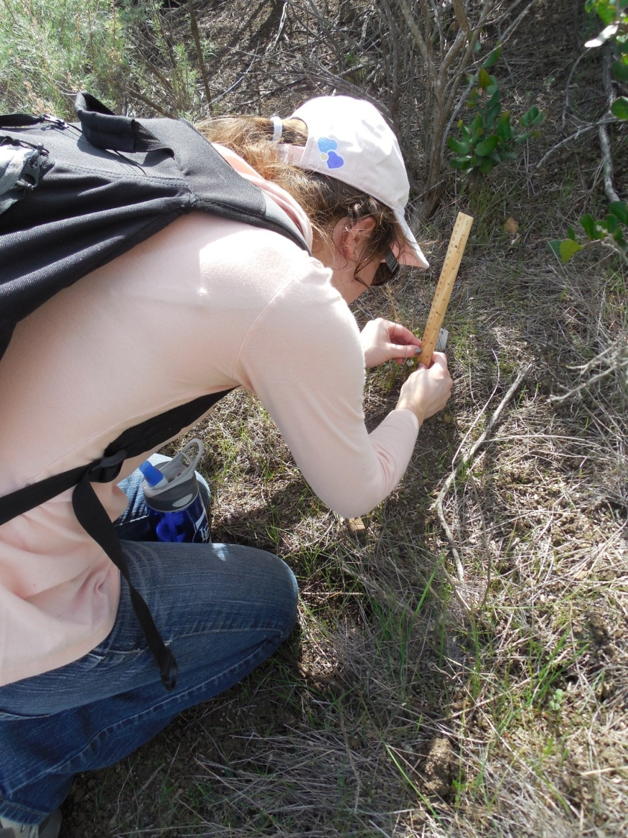
Two months Later
Measured all samples
Noted signs of predation if any
Some grasses down to the ground

Slide 9
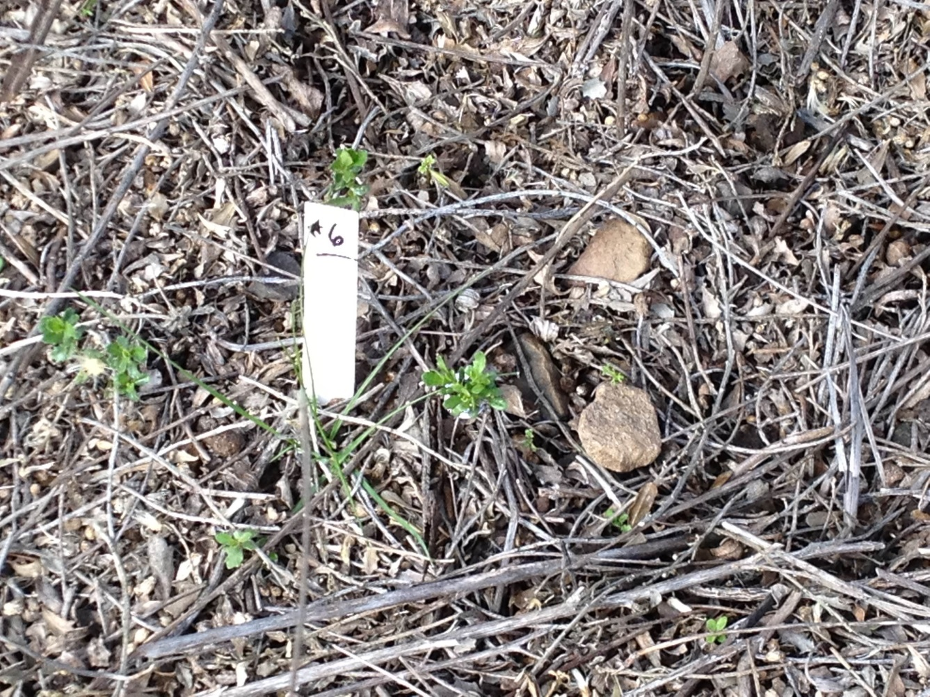
Results
11 out of 28 grasses showed signs of predation
6 out of 26 Coyotebrush saplings showed signs of predation
(Sample 6 grass lost 5cm in height while the shrub gained 0.5cm)

Slide 10
AVE Ht. 13.3, 16.4, 15.4, 19
STD 7.6, 7.5, 7.8, 11.6

Slide 12
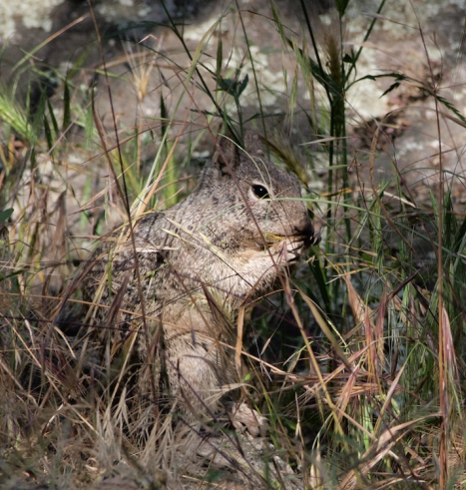
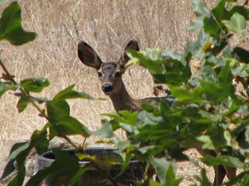
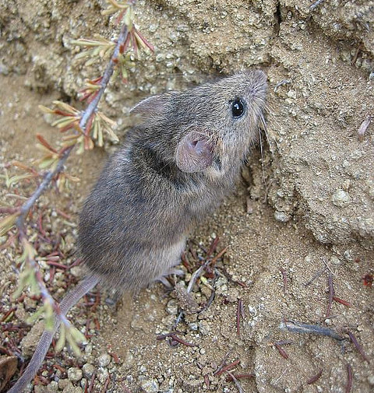
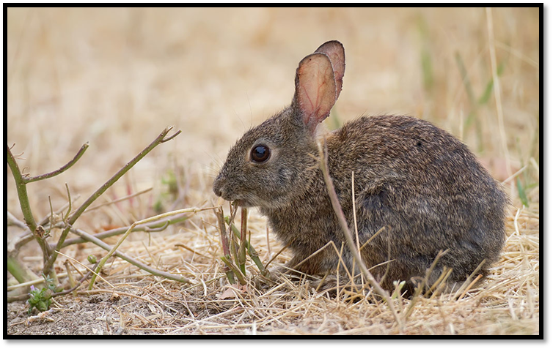
Possible Causes ?
California Ground Squirrel
Mule Deer
California Pocket Mouse
Brush Rabbit

Slide 13
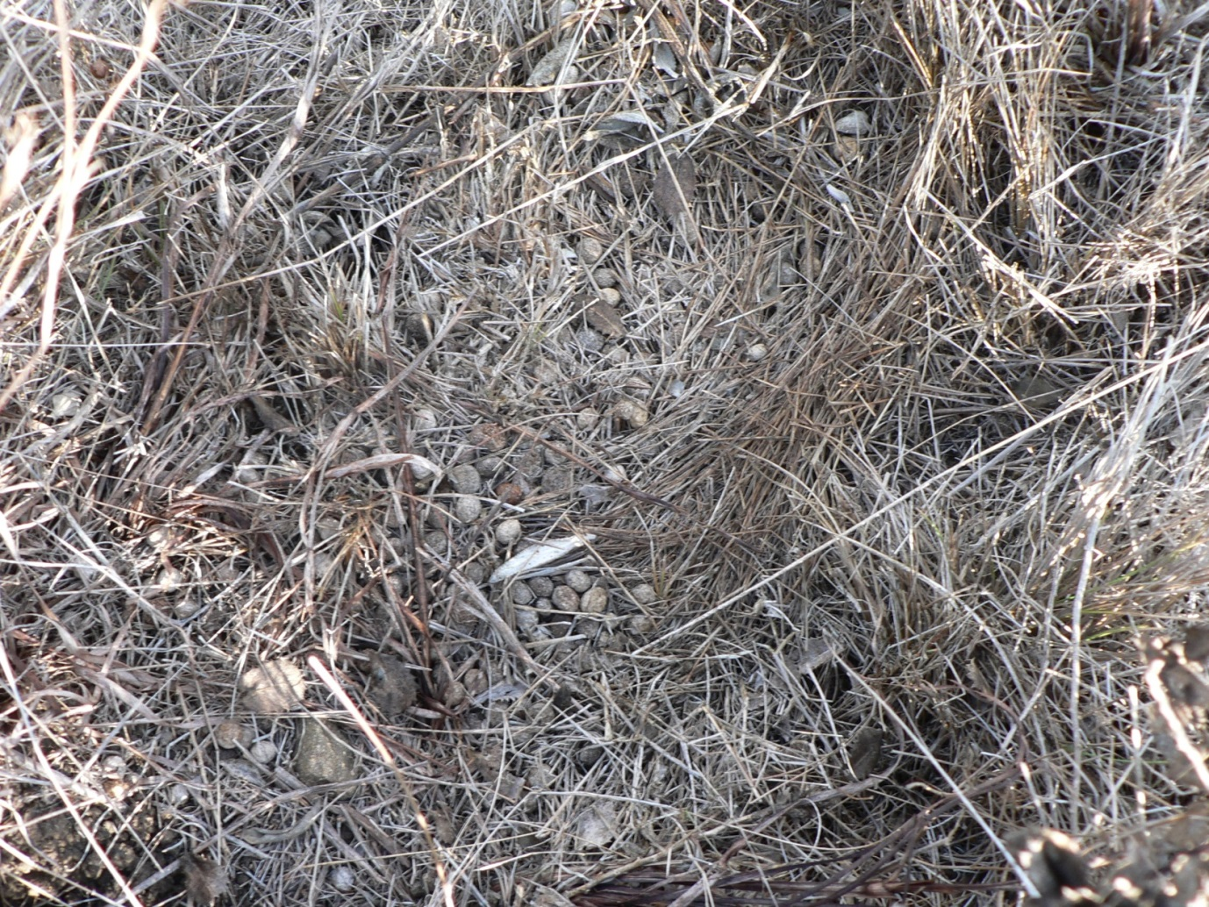

Slide 14
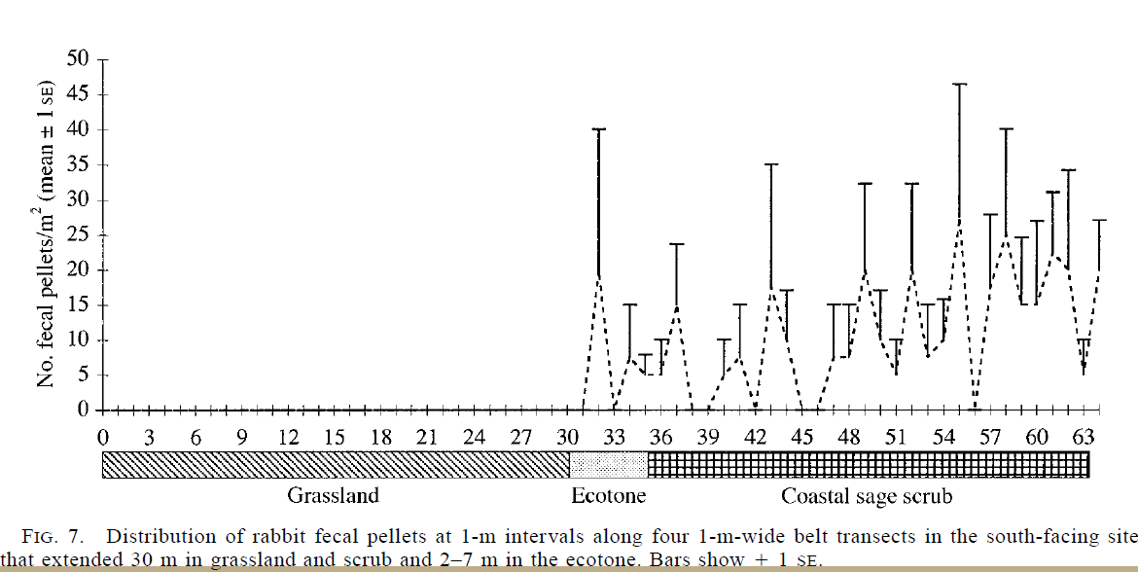
2001 study by DeSimone and Zedler, SDSU
‘predator-avoidance strategies of rodents’ (p 2030)
(others have mentioned rabbit herbivory including Westman, O’ Leary, Keeley, Orrick, and Rundel)
Notes:
Study by DeSimone and Zedler from SDSU

Slide 15
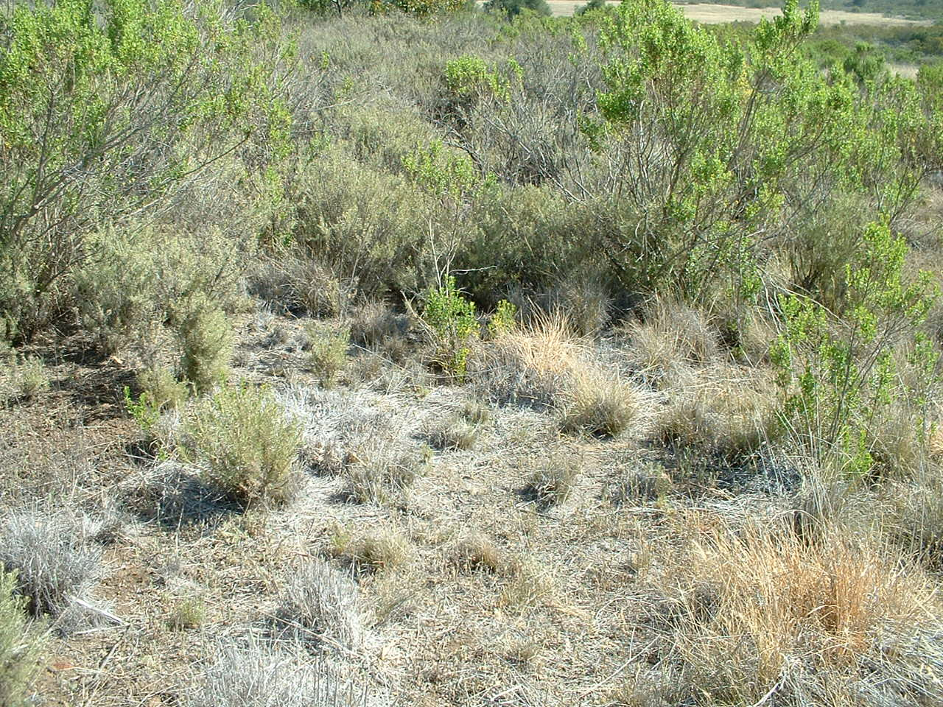

Slide 16
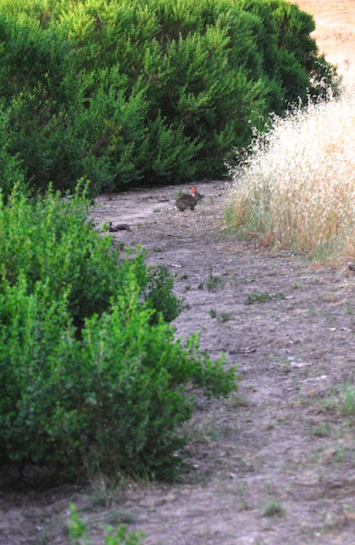
References:
DeSimone, S. A. and Zedler, P. A. 2001. Do Shrub Colonizers of Southern California Grassland Fit Generalities for Other Woody Colonizers? Ecological Applications. 11 (4):1101- 1111.
Montalvo, A. M., L. Goode, and J. L. Beyers. 2010. Plant Profile for Nassella pulchra. Native Plant Recommendations for Southern California Ecoregions. Riverside-Corona Resource Conservation District and U.S. Department of Agriculture, Forest Service, Pacific Southwest Research Station, Riverside, CA.. Online: http://www.rcrcd.com/index.php?option=com_content&view=article&id=88&Itemid=190.
J. L. Orrock, M. S. Witter. 2010. Multiple drivers of apparent competition reduce re-establishment of a native plant in invaded habitats. Oikos 119:101 108.
Rundel, P.W. 2007. Sage Scrub. Terrestrial Vegetation of California. (8):208- 228.
Santa Monica Mountains Recreation Area, Department of Interior
Verbal communication of on the ground facts.
O’leary, J. F. and Westman, W. E. 1988. Regional disturbance effects on herb succession patterns in coastal sage scrub. Journal of Biogeography. 15:775- 786.

