Slide 1



Coastal Sage Scrub
and the
Successional Influence of Coyote Brush
Sean Brennan
California State University Long Beach

Slide 2
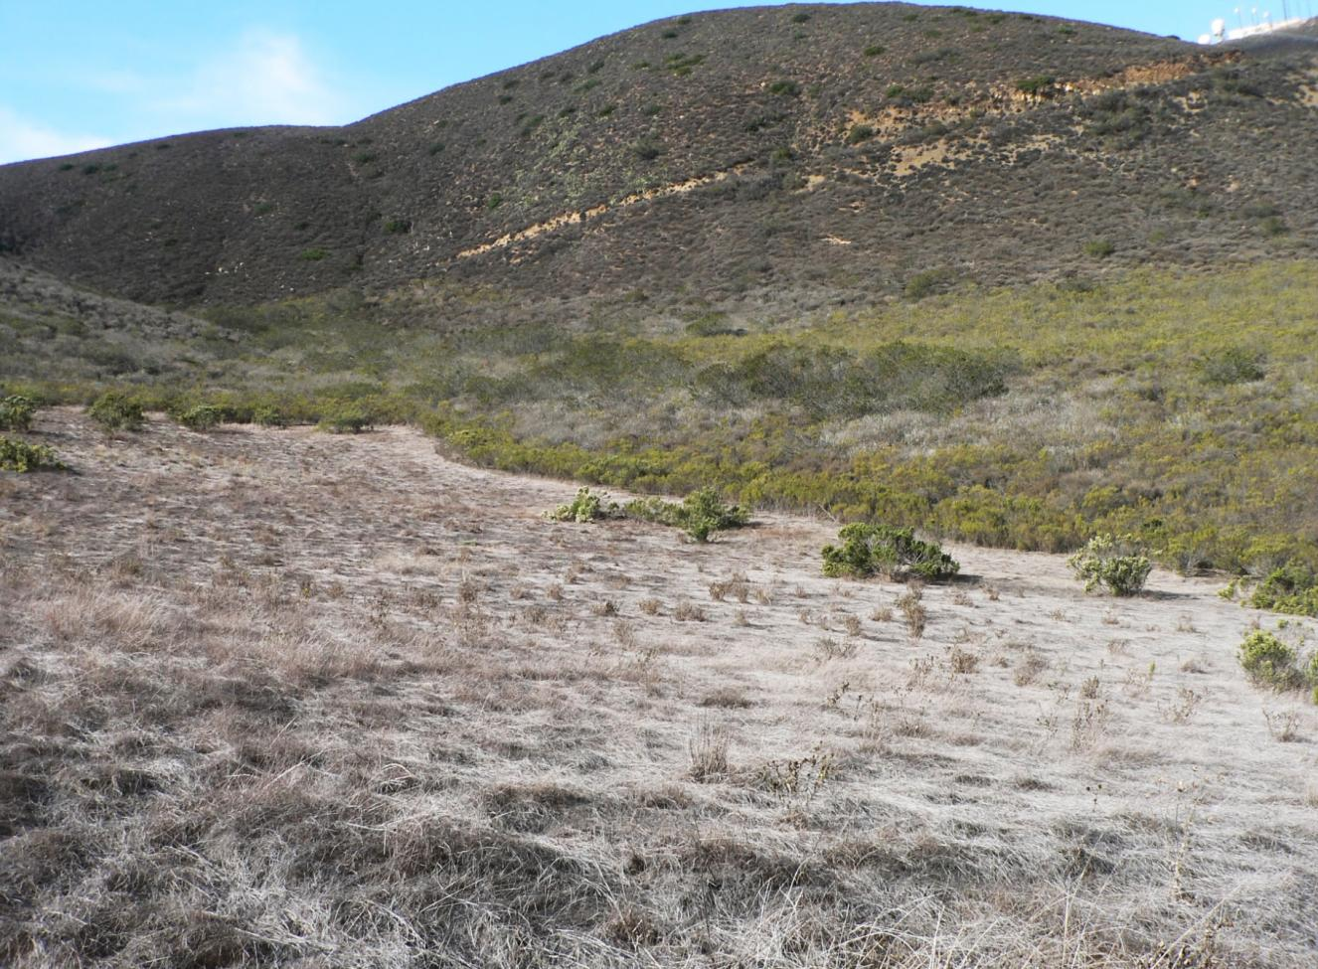
Goal of this research:
Assess the role coyote brush has on self restoration of CSS

Slide 3
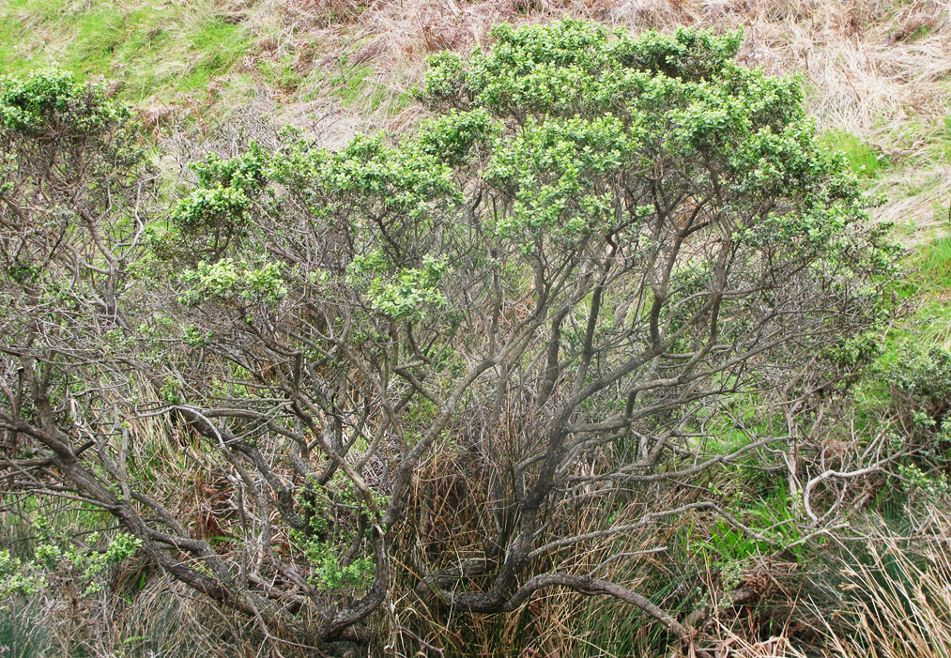
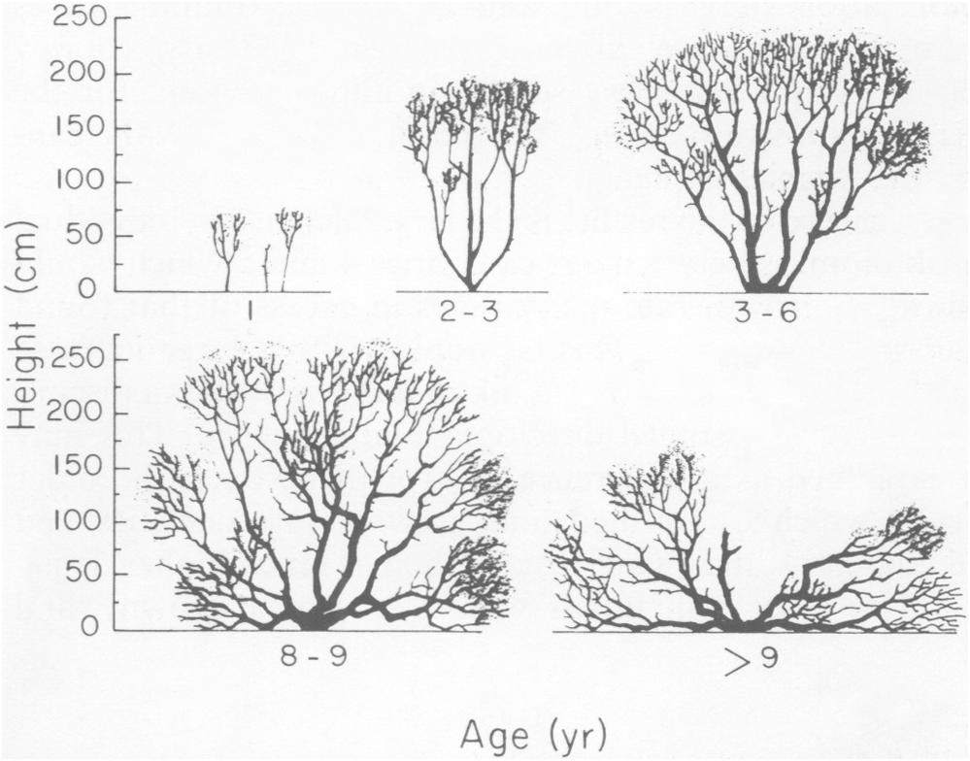
Coyote brush
“…facilitates the establishment of other CSS species.”
U.S. Department of Agriculture
Height in cm
Years of age
Notes:
Yes, grasses are unaffected by this solitary coyote brush

Slide 4
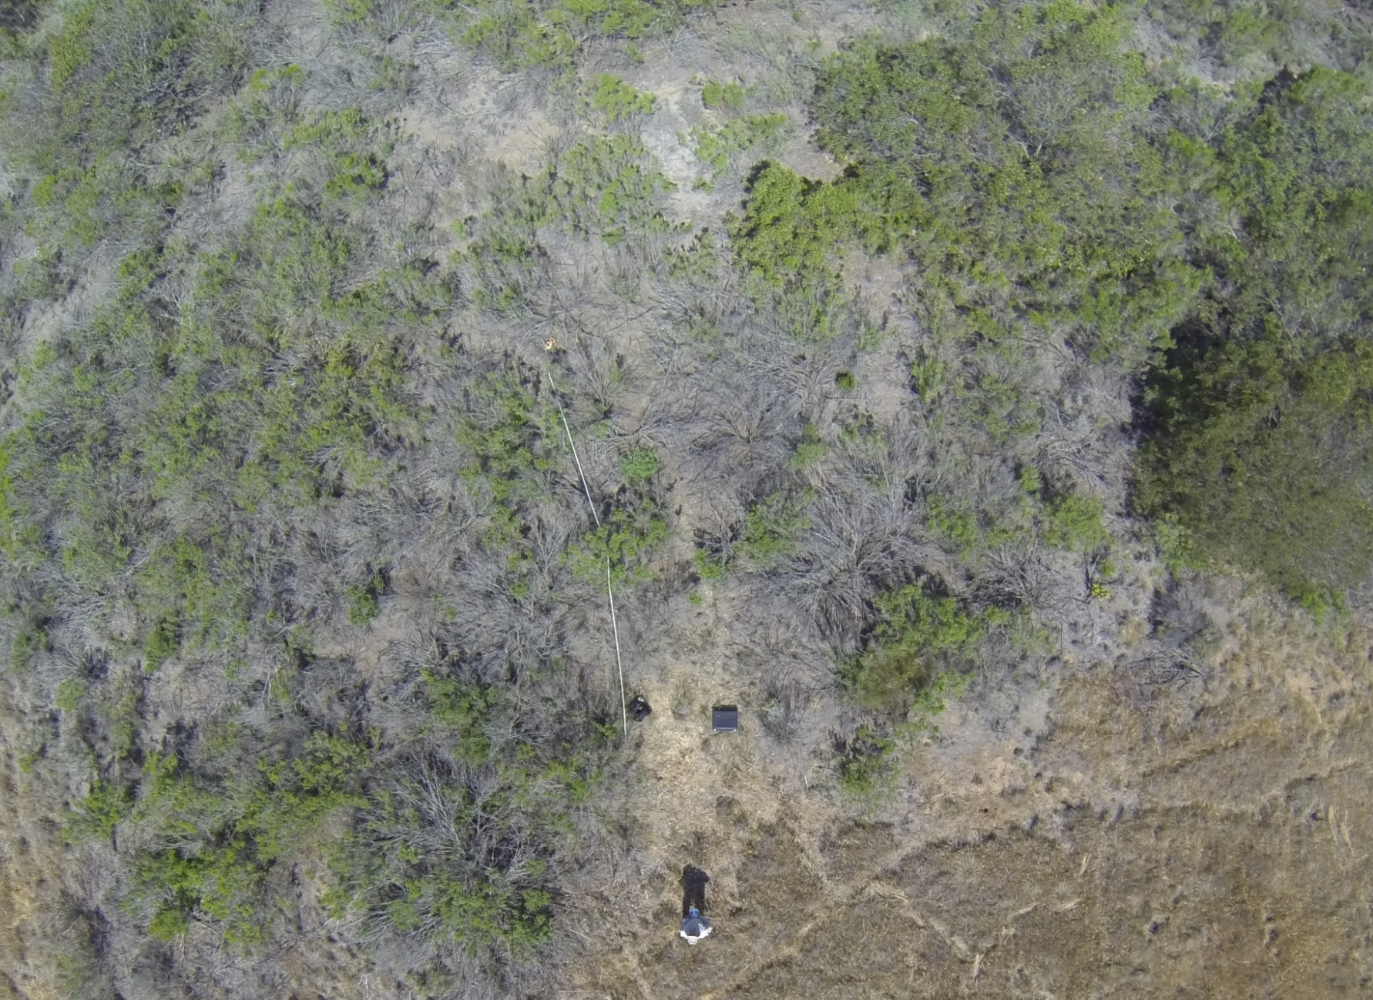
Transect going into shrub stand

Slide 5
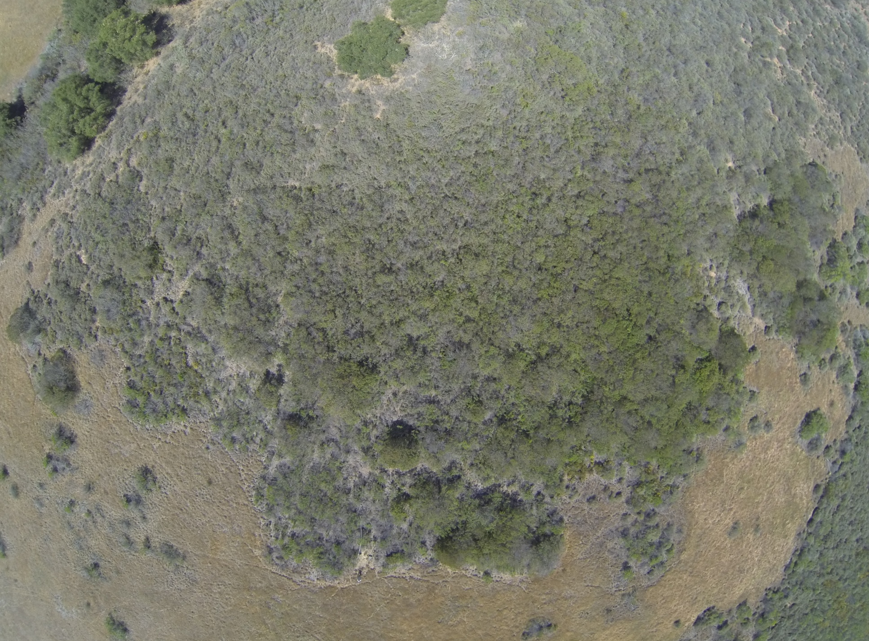

Slide 6
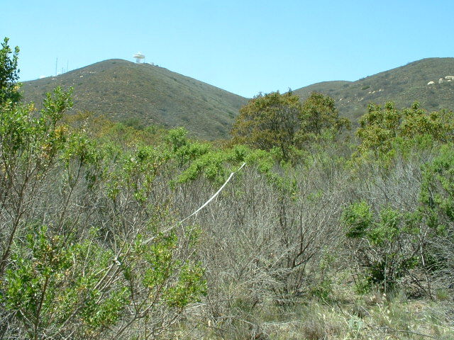

Slide 7
Where are the Coyote brush stands?

Slide 8
2007 Vegetation Map

Slide 10
1976
Coyote brush Stands
1989
2002
By combining spatial data of known shifts in CSS boundaries
with established stands of Coyote brush …

Slide 11
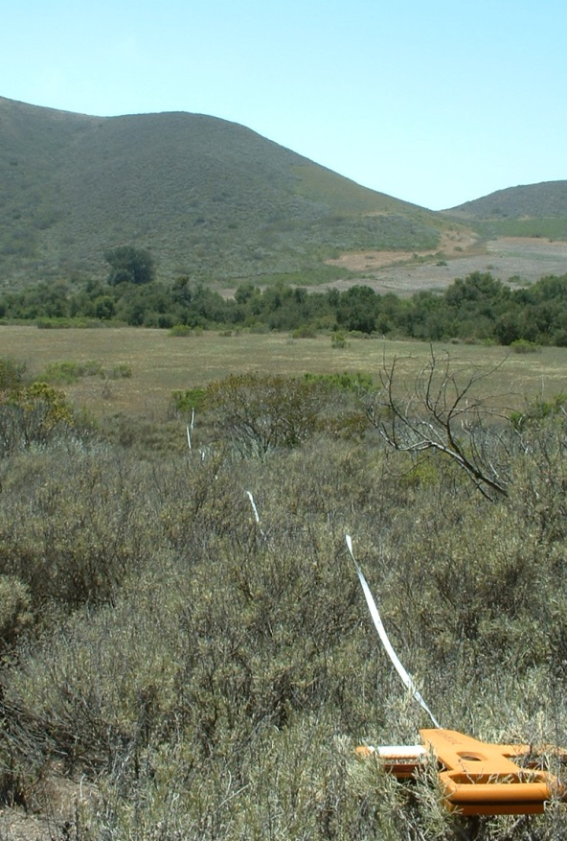
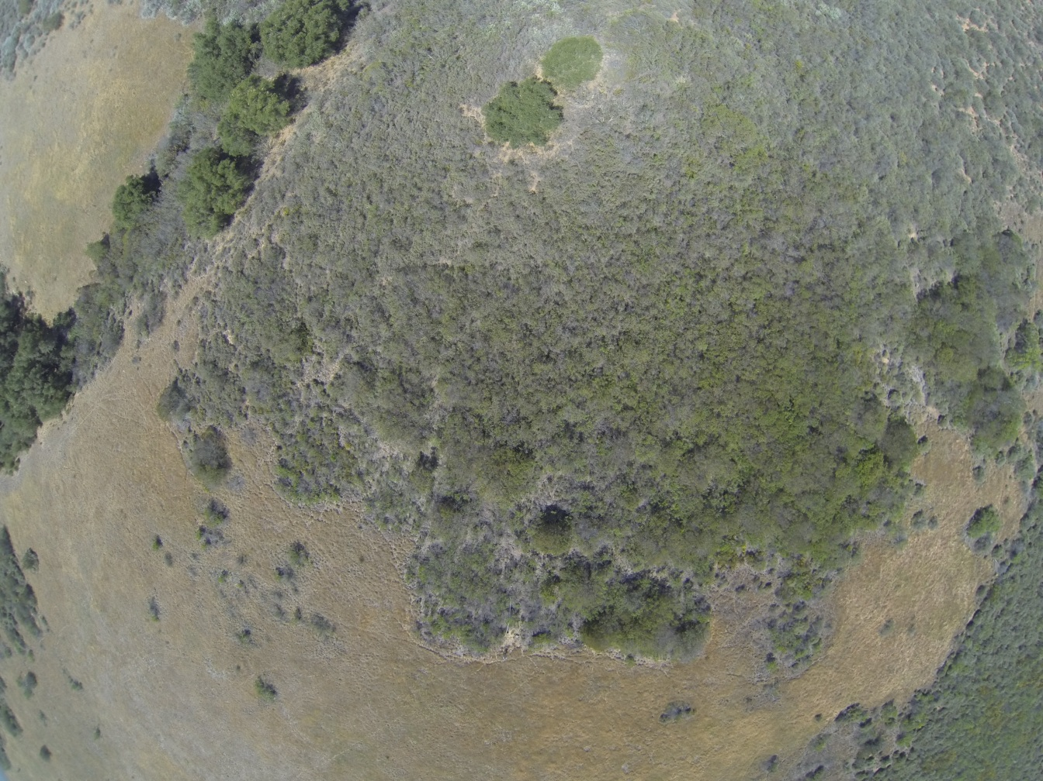
supported by species transect data into the interior of the stands,
this study will assess levels and quality of biodiversity in the wake of shifting CSS boundaries.

Slide 12
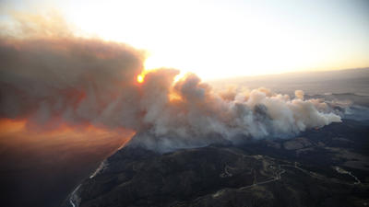
Continuing Research ?
On Hold

Slide 13
