Slide 1
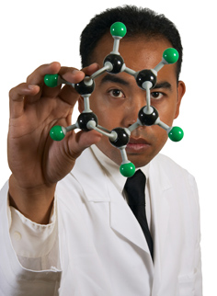
How to Write a Lab Report
What did you do?
The problem under investigation.
Why did you do it?
Principle objectives.
Who did it?
Participants.
How did you do it?
Experimental method
- materials used, test names, experimental conditions.
What did you find?
Main findings, including significance levels.
What does it mean? & What is it good for?
Conclusion and implications.
California State University, Long Beach
Electrical Engineering Department
Fall 2012 – Leeanne Bergeron

Slide 2
Components of the Lab Report
Coversheet
Abstract
Introduction or Objective
Equipment and Materials
Procedure
Results
Analysis/Discussion
Conclusions/Implications
References

Slide 3
Details of Each Component
Cover sheet:
Include school’s name, student’s name, professor’s name, class and section, title of the experiment, date of the experiment. Please avoid graphics on this page.
Abstract: 1. What was done and why?
2. What results were found?
3. What conclusions can be drawn from the results or how could the results be applied?
4. Typically answered in the passive voice.
Introduction/Objective:
Discussion of the purpose of the experiment: Your task is to explain to your readers the importance of what you are testing and to give them any theories or other background information that they will require in order to understand your results. The introductory section should state what you hoped to find out by doing the experiment.

Slide 4
Details (continued)
Equipment and Materials:
This is the part of your report where you describe how you performed your experiment. The description should be presented in sufficient detail so that another researcher would know how to repeat your experiment if he or she desired to do so.
Procedure:
Include adequate information for the experiment to be repeated precisely. Include any procedural problems encountered and tell how they were solved. Include relevant diagrams and schematics. Be sure to present all steps in logical sequence. (Note that the procedure is not a copy of the lab guide.)

Slide 5
Details (continued)
Results :
This is where you report the data and findings generated by your experiment. This section will generally feature tables, charts, graphs, and figures. Even though these tables and figures should have sufficient information to be comprehensible on their own, the text accompanying these representations should also describe the most important data and findings.
Analysis/Discussion:
Many scientists regard this as the most important part of a scientific report. It is where you interpret and explain the significance or meaning of your results to your readers. Your discussion should address questions such as: Did your experiment accomplish its purpose? Why or why not? Did you find anything unanticipated? The key to a well-written discussion is to link your interpretation back to the issues raised in your introduction.
Conclusion/Implications:
Finally, the concluding section should summarize the main finding of the experiment in relation to the purpose. This should include a brief summary of what you found and what you expected to find. Include some theoretical discussion(s) as to the specific topic.

Slide 6
Structure of the Report
The lab report should be typed, using 12 pt. Times New Roman font.
Double space the text of the report. Single space title, date, & location. Single space table & figure descriptions.
Margins must be 1.00” on all four sides.
The body of the report should be written in the third person, passive voice. (In the passive voice, the subject of the sentence is neither a do-er or a be-er, but is acted upon by some other agent or by something unnamed).
Third person pronouns: “It was found that …”
The procedure is written in the past tense.
Use the report (or its sections) as the actor: “The report shows…”
Label and number your figures, tables, equations, and graphs.
Hand calculations are not acceptable, use Microsoft Eq. Editor to write equations.
Use Matlab or Excel for plots and Interpolation.

Slide 7
“What is the passive voice?”
Example 1: Active: I put the beaker into the flame of a Bunsen burner.
Passive: A breaker was put into the flame of a Bunsen burner.
[past tense verb]
Example 2: Active: My lab partner measured the temperature of the
solution using a thermometer.
Passive: The temperature of the solution was measured
using a thermometer. [past tense verb]
Example 3: Active: We mixed three different salt solutions in a flask.
Passive: Three different salt solutions were mixed in a flask.
[past tense verb]
(The procedure is written in past tense.)
Notes:
So we constructed a worksheet and form that attempts to remedy this problem.
We explain what an abstract is and how it needs to function.
And we explained the style of an abstract, which involved a short tutorial on writing in the passive voice.

Slide 8
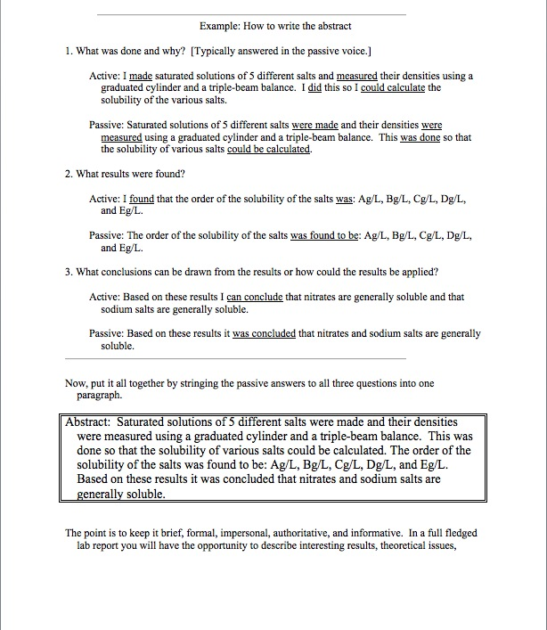
How to Write the Abstract
1. What was done and why?
2. What results were found?
3. What conclusions can be drawn from the results or how could the results be applied?
Notes:
And then we came up with 3 questions that ought to elicit responses in the passive voice that can be strung together into an abstract.

