Slide 1
SOCIAL HOMEWORK: www.edudotonline.com Using an Interaction Tool in an Online Physics Laboratory Course
Galen T. Pickett, Thomas Gredig, Zvonimir Hlousek, Chuhee Kwon, James Kisiel
CSU Long Beach

Slide 2
Outline
Motivation
Engineering a curriculum: F2F
Engineering a curriculum: Online
Teamwork: Social Homework
Online Laboratory: Authentic STEM
Conclusion

Slide 3
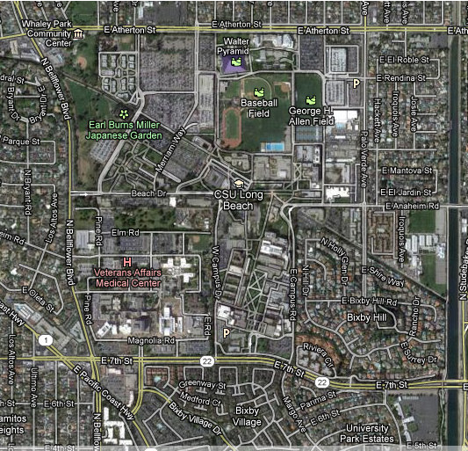
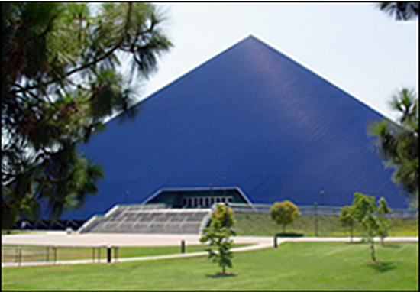
Motivation
CSU Long Beach
36,000 students, many first-generation, low-income
STEM Gateway for Long Beach
90,000 applied for 5,000 spots.

Slide 4
Motivation for Physics
Important to get it right!
Better careers for students
Special skills, better problems
Existence and justification.
Recruit physics majors from introductory physics
Double majors
If we don’t, who will?
We have a successful course F2F … export it.

Slide 5
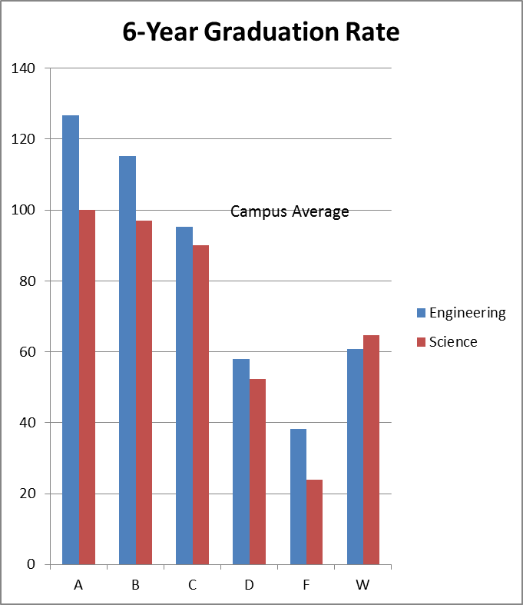
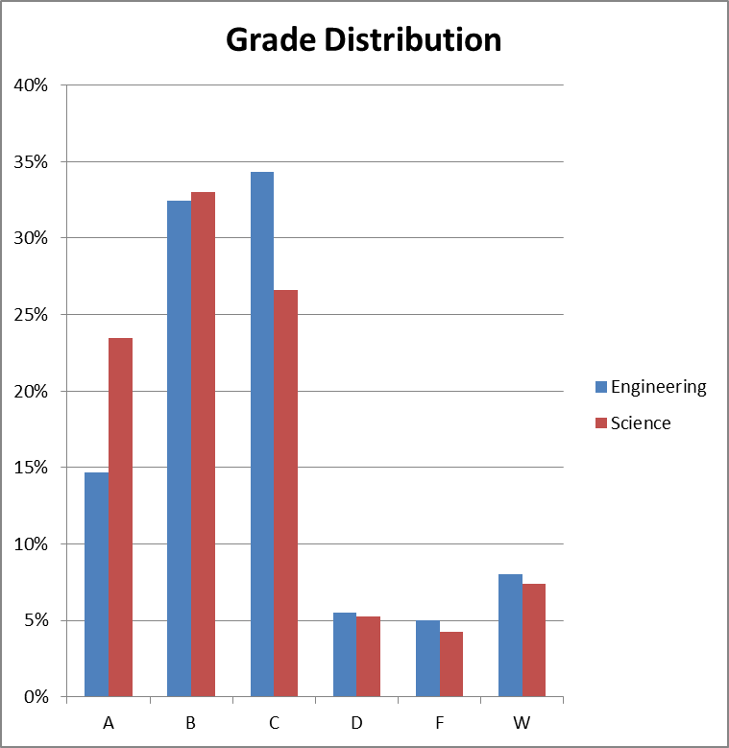
Existing Course
Physics for Scientists and Engineers (Mechanics)

Slide 6
Engineering a Pedagogy
Large lecture format: Hall of Science
I>Clicker
Cooperative
Interactive
Engaging

Slide 7
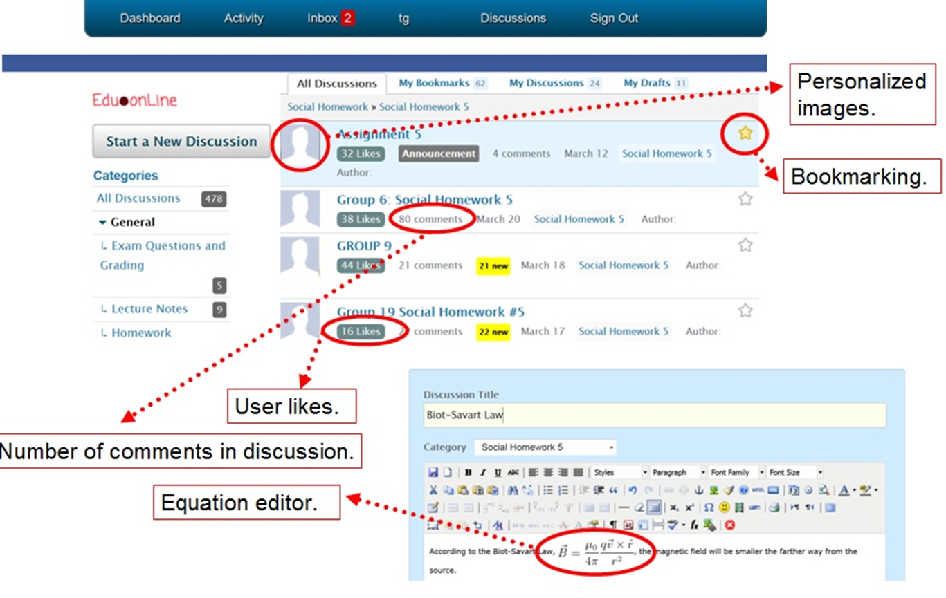
Social Homework / Edudotonline.com
Async / Groups / Roles / Rotation / Any Content
Social Media overlay / “like” “thanks”

Slide 8
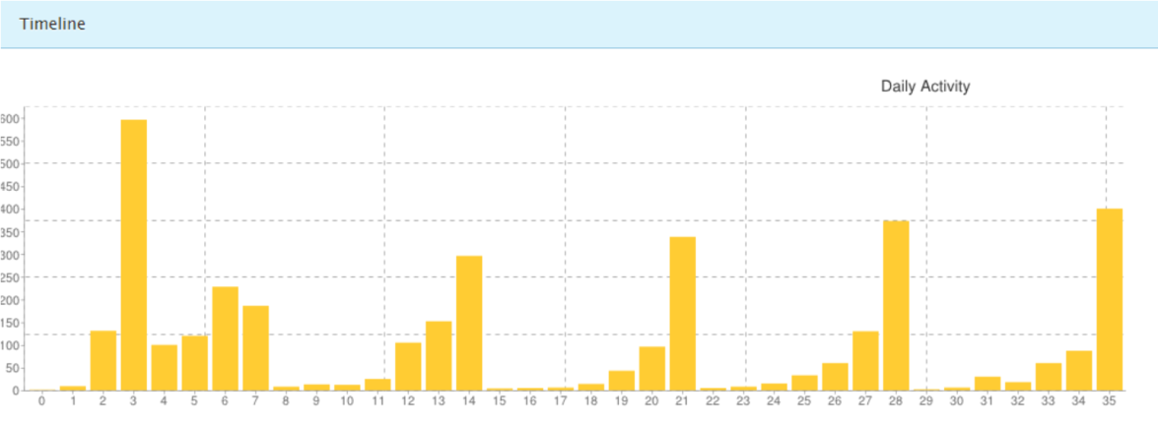
Instructor Feedback

Slide 9
Teamwork: Social Homework
Asynchronous teams: Edudotonline.com

Slide 10
Grades and SHW

Slide 11
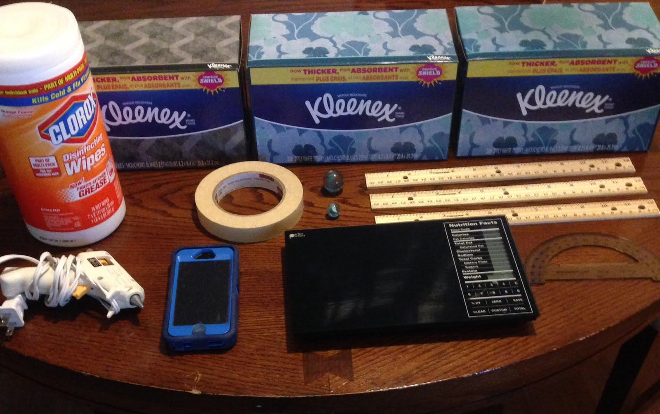
Laboratory: Authentic STEM
Social Homework Groups Design Experiments
“Tracker” used to perform measurements
Experiments independently verified / groups
Groups decide / construct their own meaning
Ph.D. – level scientist required to judge

Slide 12
Conclusion
Social Homework: MOOC Glue
Social Homework: Experiment as Social Activity
Students depend on each other
CourseCraft: positive
interdependence

Slide 13
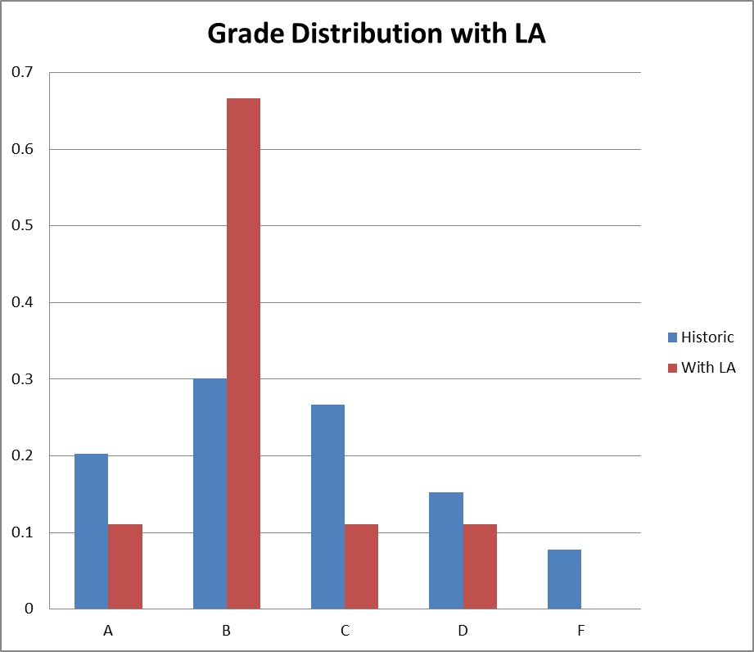
Engineering Student Support
Learning Assistants “Undergrad TA’s”
No grading
3-unit upper-division course in physics teaching

Slide 14
Honors Sections
Support high performing students
SCALE-UP classrooms, both 151 and 152
Long Beach Register, 2/5/14

Slide 15
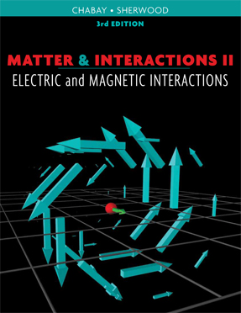
Engineering a Curriculum
Matter and Interactions
Physics the way physicists do it
Formal reasoning
Derive results, then apply
Physical Problem Solving
Momentum / Energy / L

